Slide 1

Cryptograph And it’s objectives
Encryption And Decryption
Presented by: Niraj Shrestha

Slide 2
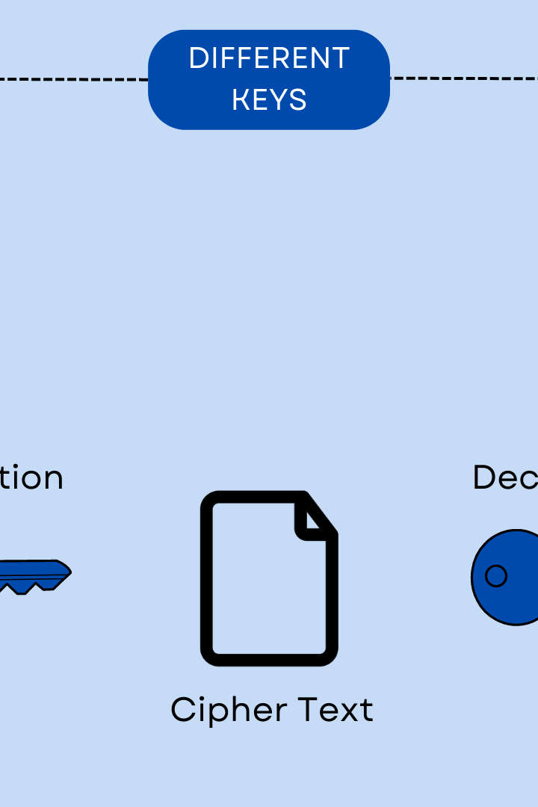
Cryptography
Cryptography is the practice and study of techniques for secure communication in the presence of third parties or adversaries. More generally, cryptography is about constructing and analyzing protocols that prevent third parties or the public from reading private messages.

Slide 3
Objective 1: Confidentiality
Definition of Confidentiality
User Case: Healthcare Records
Future Development: Quantum Cryptography
Confidentiality ensures that only authorized parties can view the information being transmitted. Encryption methods, such as the Advanced Encryption Standard (AES), allow for secure communication.
Patient health records are highly confidential and require secure communication. Encryption prevents unauthorized access to sensitive information.
Quantum cryptography promises to provide absolute confidentiality through the use of quantum key distribution, which is based on the properties of quantum mechanics.

Slide 4
Objective 2: Integrity
User Case: Financial Transactions
Financial transactions require high data integrity to prevent fraudulent activity. Hash functions protect against any modifications to the transaction data.
1
2
3
Definition of Integrity
Future Development: Homomorphic Encryption
Integrity provides assurance that the information being transmitted or stored has not been modified in any way. Hash functions, such as SHA-2, are commonly used to ensure data integrity.
Homomorphic encryption allows for data to be manipulated without the need for decryption, providing a more secure method for transmitting and processing data.

Slide 5
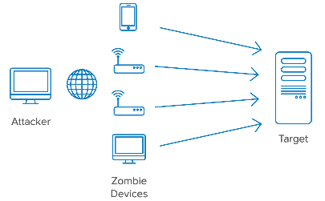


Objective 3: Availability
Definition of Availability
User Case: Cybersecurity
Future Development: Post-Quantum Cryptography
Availability ensures that the communication channels and data are always accessible and functioning properly. Network security measures, such as firewalls, protect against denial-of-service (DoS) attacks.
Cybersecurity experts ensure that networks are secure and operational, preventing hackers from disrupting or taking control of the system.
Post-quantum cryptography provides a method for securing data against quantum computing attacks, which have the potential to break traditional cryptographic algorithms.

Slide 6
Objective 3:Non-repudiation
Cryptography can be used to ensure that a sender cannot deny sending a message or that a receiver cannot deny receiving a message. This is used in legal contracts and other applications where it is important to be able to prove that a message was sent or received.

Slide 7
Objective 4: Authentication
1
Definition of Authentication
2
User Case: Online Banking
3
Future Development: Multi-Factor Authentication
Authentication ensures that the parties involved in the communication are who they claim to be. Digital certificates, such as X.509, are used to verify identities.
Online banking requires user authentication to prevent unauthorized access to sensitive information. Digital certificates are used to verify the identity of the user and ensure secure communication.
Multi-factor authentication offers an additional layer of security by requiring multiple types of identification, such as a password and a fingerprint, to verify a user's identity.

Slide 8
Encryption Process
Symmetric Key Encryption
Asymmetric Key Encryption
Symmetric key encryption, also known as shared secret encryption, uses the same secret key for both encryption and decryption. This method is relatively fast but requires secure key distribution.
Asymmetric key encryption, also known as public key encryption, uses two separate keys for encryption and decryption. This method provides secure key distribution but is slower than symmetric key encryption.

Slide 9
Decryption process
The decryption process for symmetric key encryption is straightforward, as the recipient simply uses the same secret key to decrypt the message. However, in asymmetric key encryption, the recipient must use their private key to decrypt the message, which is more secure but also more complex. Overall, encryption and decryption are crucial processes for ensuring the security and confidentiality of sensitive information.

Slide 10



Conclusion and Future Developments
Importance of Cryptography
Future Developments: AI and Cryptography
Future Developments: Blockchain Technology
Cryptography is essential for ensuring secure communication and preventing data breaches.
Artificial intelligence has the potential to enhance cryptographic methods and provide additional security measures.
Blockchain technology provides a secure and decentralized method for transmitting data, making it an area of future development for cryptography.

Slide 11
Thank you

