Slide 1
BioMedMeet
PREPARED FOR MAYO CLINIC · MAY 2026
HOSPITAL CASE-MEETING PLATFORM
Stop scheduling.
Start deciding.
A walkthrough for Mayo Clinic — how BioMedMeet turns weekly multidisciplinary case meetings into structured, audit-ready decisions without the calendaring, minute-taking and follow-up overhead.
Request your 15-minute demo
Demo deck · Prepared for Mayo Clinic · Demo@BioMedMeet.com · biomedmeet.com

Slide 2
BioMedMeet
WHAT BIOMEDMEET MEANS FOR MAYO CLINIC
The case-meeting platform built for hospital teams.
Tumor boards, MDTs, M&Ms, departmental rounds — every hospital runs them, and every hospital wastes 15+ hours per team per week around them.
BioMedMeet replaces the spreadsheets, email threads, ad-hoc Teams invites and post-meeting follow-ups with one purpose-built workflow: schedule, present cases, log decisions, generate a signed PDF summary, distribute it automatically.
Self-hosted on your own network. No PHI ever leaves the hospital. Microsoft Teams integration. Holiday-aware recurring schedules. RSVP via email or in-app. Decision-log audit trail.
18 hrs
saved per team per week
$187,200
clinician time recovered / yr
~1.6 mo
payback period vs. licence
BioMedMeet · biomedmeet.com · Demo@BioMedMeet.com
2 / 10

Slide 3
BioMedMeet
WHY HOSPITALS BUY IT
From scattered tools → one structured workflow.
BEFORE
AFTER
Today, every Monday morning…
With BioMedMeet…
✕
5 different Outlook threads scheduling one MDT
✓
Recurring MDT scheduled once, Teams link auto-attached
✕
Agenda Word doc pasted into a chat 10 minutes before
✓
Agenda pulled from the patient list, in two clicks
✕
Decisions captured in a scribe's notebook
✓
Decisions logged live, signed off by the chair
✕
Follow-ups manually dispatched to oncology, radiology, surgery
✓
PDF summary auto-mailed to attendees & EMR
✕
No audit trail when a decision is later challenged
✓
Every decision time-stamped, attributable, exportable
BioMedMeet · biomedmeet.com · Demo@BioMedMeet.com
3 / 10

Slide 4
BioMedMeet
PLATFORM CAPABILITIES
Six pillars. One platform. Zero spreadsheets.
01
02
03
Smart scheduling
Patient case rooms
Decision log
Recurring meetings (daily / weekly / monthly-on), holiday-aware for US, India and UK calendars, with Teams links generated on save.
Patient cases attached to a meeting with diagnoses, MRN, allergies, medications, files and a 5-tab case room for the discussion.
Every decision captured with the responsible doctor, priority, follow-up date and free-text rationale — searchable forever.
04
05
06
Treatment plans
PDF summaries
Inbound RSVP
A single source of truth per patient. Latest plan rolls up to the patient detail page; older plans become an audit history.
One-click PDF summary at meeting close — attendees, decisions, treatment plans, agenda items. Mailed automatically.
Participants RSVP from email links *and* by replying to the invite. An admin RSVP log surfaces every parsed reply for audit.
BioMedMeet · biomedmeet.com · Demo@BioMedMeet.com
4 / 10

Slide 5
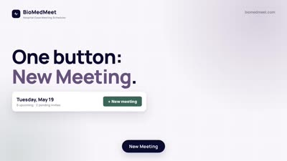
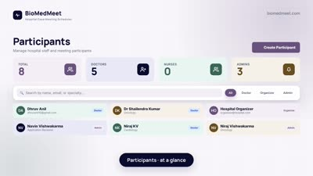
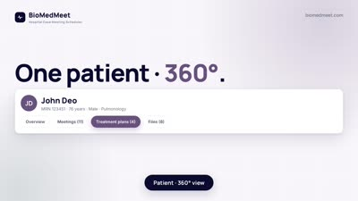
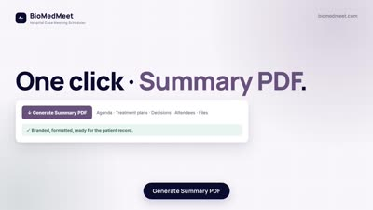
BioMedMeet
THE 4-STEP MEETING WORKFLOW
Schedule → Discuss → Decide → Distribute.
1
Schedule
2
Discuss
3
Decide
4
Distribute
Recurring meetings with Teams links auto-attached, holiday-aware date validation, and email invites with iCal.
Live 5-tab case room: Patients, Agenda, Files, Treatment Plans, Decisions. Built for an MDT panel.
Decision log captures the chair-approved outcome, owner, priority and follow-up — every entry signed.
Auto PDF + auto-email to attendees the moment the meeting is closed. Searchable history per patient.
BioMedMeet · biomedmeet.com · Demo@BioMedMeet.com
5 / 10

Slide 6
BioMedMeet
ARCHITECTURE & COMPLIANCE
Designed to satisfy your CISO before your CMO.
On-prem by default
Microsoft 365 native
Self-hosted Docker stack on your hospital network. PHI never leaves the building.
Graph API for Teams meetings, SMTP for invites, iCal for two-way calendar sync.
Audit-ready
Role-based access
Every decision timestamped, attributable, exportable. Soft-deletes preserve history.
Organizer, doctor, nurse, admin. Field-level guardrails on patient updates, agenda changes & decisions.
BioMedMeet · biomedmeet.com · Demo@BioMedMeet.com
6 / 10

Slide 7
BioMedMeet
PRICING FOR MAYO CLINIC
Own it. Don't rent it.
One-time perpetual licence. Self-hosted. No per-user fees. No monthly bill. Two-month warranty trial.
PERPETUAL LICENCE · SELF-HOSTED
WHAT YOU DON'T PAY
BioMedMeet for Mayo Clinic
Compare against the SaaS alternative.
$25,000
Per-user monthly fees
$0
Per-meeting / per-case fees
$0
Cloud storage add-ons
$0
+ applicable taxes · one-time · no recurring fees
Annual renewal markup
$0
✓
Unlimited users · unlimited meetings · unlimited patients
Data-egress charges
$0
✓
Microsoft Teams + holiday-aware recurring calendar
✓
Decision log · treatment plans · PDF summaries · audit trail
Lock-in clause
None
✓
Two-month warranty trial — full refund window
BioMedMeet · biomedmeet.com · Demo@BioMedMeet.com
7 / 10

Slide 8
BioMedMeet
RETURN ON INVESTMENT
Pays for itself before the warranty trial ends.
18 hrs / week
$187,200 / year
1.6 months
Hours reclaimed per MDT
Clinician time recovered
Payback period
Where the 18 hours go each week
Time-and-motion estimates from clinical teams running 1–2 case conferences/week.
Scheduling & calendaring
5.0 hrs
Agenda prep & case pulls
4.0 hrs
Minute-taking & decision log
3.5 hrs
RSVP chase & no-show recovery
3.0 hrs
Post-meeting follow-up emails
2.5 hrs
BioMedMeet · biomedmeet.com · Demo@BioMedMeet.com
8 / 10

Slide 9
BioMedMeet
REVENUE & THROUGHPUT BENEFITS
Beyond hours — what BioMedMeet unlocks.
Faster decisions
+1 case / MDT / week
Higher-value MDTs
30-40% capacity
Decision-to-distribution time falls from days to minutes. Patients reach treatment sooner; throughput per MDT rises.
Structured case rooms let panels handle 30–40% more cases in the same calendar slot. No time lost to scheduling friction.
Stronger billing & coding
Lower denials
Audit & accreditation
Audit-ready
Auto-generated, signed PDF summaries feed coders with structured decisions — fewer rejected claims, cleaner CPT documentation.
Joint Commission / NABH-ready decision trail. One click to export any meeting's full history for review.
BioMedMeet · biomedmeet.com · Demo@BioMedMeet.com
9 / 10

Slide 10
BioMedMeet
READY TO SEE IT LIVE?
Let's book a 15-minute walkthrough
for Mayo Clinic.
We'll bring a working sandbox so Mayo Clinic's team can click around — schedule a recurring tumor board, run a sample case, generate the PDF — all in real time.
Email Demo@BioMedMeet.com
Visit biomedmeet.com
Thank you · BioMedMeet · biomedmeet.com

