Slide 1
16 March, 2025
Student Grade Management System
Presented by
Krishna Kandel THA081BEI014
Nishanta Poudel THA081BEI025
Pranish Pokhrel THA081BEI029
Prateek Chaulagain THA081BEI030
Institute of Engineering, Thapathali Campus
Department of Electronics and Computer Engineering

Slide 2

Introduction
Manages student grades efficiently.
Stores and processes student data.
Provides an interactive console interface.
Ensures structured record-keeping.
Helps in academic performance tracking.
Reduces manual effort in sorting and ranking.

Slide 3

Student data management
Stores student name, roll number, marks.
Allows updating student records.
Enables quick retrieval of data.
Ensures efficient data organization.
Uses structured data storage.
Prevents data duplication.

Slide 4

Sorting and ranking
Shorts students alphabetically by name.
Ranks students based on GPA.
Use bubble short algorithm.
Ensures a fair ranking system.
Helps identify top-performing students.

Slide 5

GPA calculation
Uses six subjects for GPA computation.
Normalizes GPA for uniform evaluation.
Ensures fairness in grading.
Automatically updates GPA after entry.
Helps in performance assessment.

Slide 6
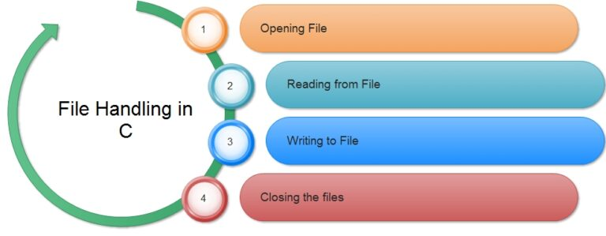
File handling
Saves student data to file.
Use text file for data storage.
Updates the file after each operation.
Enables easy data backup.
Reads and writes formatted student data.
Ensures data persistence.

Slide 7
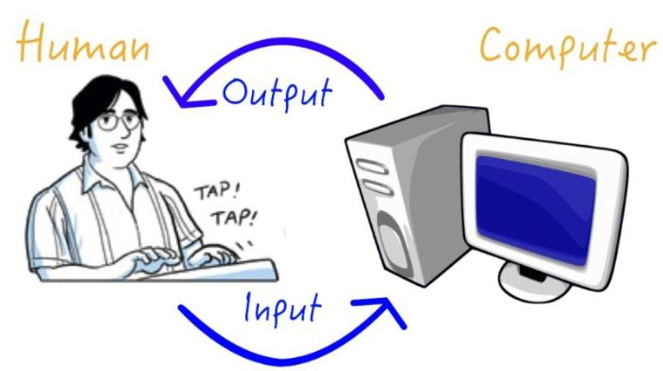
User interaction
Menu driven console interface.
Requires user inputs for operations.
Simple and easy to use design.
Supports continuous user interaction.
Ensures a smooth user experience.
Provides feedback for invalid inputs.

Slide 8

Key functions
Add display and rank students.
Sort and manage student records.
Update and save student data.
Automate data organization.
Provide real-time student organization.
Prevent duplicate student entries.

Slide 9

Conclusion
Simplifies student grade management.
Ensures organized and efficient tracking.
Reduces manual workload.
Enhances data accessibility .
Facilitates structured academic evaluation .
Supports easy data retrieval and updates.

Slide 10
Thankyou
🙏

