Slide 1
Arxiv Topic Classification and Paper Recommendation System
Nirajan Bekoju
Nirajan Thakuri
Rijan Pokhrel
Abhishek Timilsina

Slide 2
Topics of discussion
Problem Statement
About Data & Data Statistics
Expected Outcomes
Project Management
Model development and Evaluation
Demo

Slide 3
Introduction
Due to the exponential growth of digital repositories, an intelligent systems that can automate the classification process and provide targeted recommendations is needed.
Our project presents a comprehensive methodology that leverages Kaggle datasets, to tackle the task of arXiv paper topic classification.
We will use combination of text mining techniques, machine learning algorithms, and natural language processing (NLP) methodologies, to accurately classify papers based on their content,

Slide 4
Problem Statement
In today’s information-rich world, scientific publications play a pivotal role in disseminating knowledge and advancing research across various disciplines.
The exponential growth of digital repositories, such as arXiv, has made it increasingly challenging for researchers to keep up with the vast volume of available literature.
To address this challenge, we propose a novel approach that harnesses the power of Kaggle datasets for arXiv paper topic classification and builds a robust recommendation system

Slide 5
About Dataset
Data Source: https://www.kaggle.com/datasets/Cornell-University/arxiv.
The dataset contains following columns :
id, submitter, authors , title , comments , journal-ref
doi , abstract ,categories , versions

Slide 6
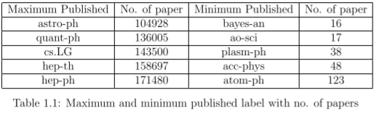
Data Statistics
There are 176 unique labels for the paper in this dataset.

Slide 7
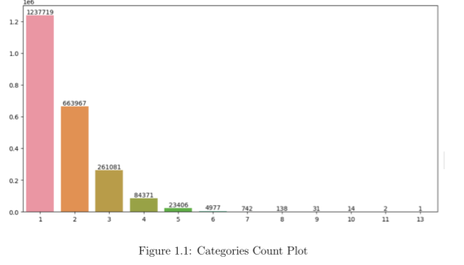

Slide 8
Deep Learning Models

Slide 9
Evaluation Metrics

Slide 10
Results

Slide 11
Discussions & Conclusions

Slide 12
Thank You

