Slide 1
नेपाली Language Processing
Team: NonLinear
Nabin Da Shrestha(076BCT037)
Nirajan Bekoju (076BCT039)
Nishant Luitel (076BCT041)
C&P Course
Notes:
Note:

Slide 2
नेपाली Language Processing
UNIT 1. Introduction
1.1. Abstract
1.2. Problem Statement
1.3. Objectives
1.4. Frontend Homepage
UNIT 2. Literature Review
UNIT 3. Word Embeddings
3.1. Methodology
3.2. Frontend Snapshots
UNIT 4. Sentimental Classification
4.1. Methodology
4.2. Frontend Snapshots
Notes:
Note:

Slide 3
नेपाली Language Processing
UNIT 5. Probabilistic Language model
4.1. Methodology
4.2. Frontend Snapshots
UNIT 6. Transformer based Language Model
5.1. Methodology
5.2. Frontend Snapshots
UNIT 7. Spelling Correction
6.1. Methodology
6.2. Frontend Snapshots
UNIT 8. Application
Notes:
Note:

Slide 4
UNIT 1. 1.1. Abstract
Abstract
Language modeling (LM) is the use of various statistical and probabilistic techniques to determine the probability of a given sequence of words occurring in a sentence.
Language models analyze bodies of text data to provide a basis for their word predictions.
They are used in natural language processing (NLP) applications, particularly ones that generate text as an output. Some of these applications include , machine translation and question answering.

Slide 5
UNIT 1. 1.2. Problem Statements
Problem Statements
Nepali Language is rich in vocabulary and it is difficult to choose the best possible vocab.
Spelling correction for nepali language available today are based on dictionary rather than contextual meaning of the sentence.
No proper development of various NLP tasks like text generation, text summarization, image captioning, text to speech, etc. due to lack of reliable nepali language model.
Notes:
Note:
Some examples of random experiments are:
+Flipping a coin.
+Rolling dices.
You will start with these simple examples and build a basis of probability.

Slide 6
UNIT 1. 1.3. Objectives
Objectives
To develop nepali language model for text generation.
Use the nepali language model to develop the spelling correction based on contextual meaning.

Slide 7
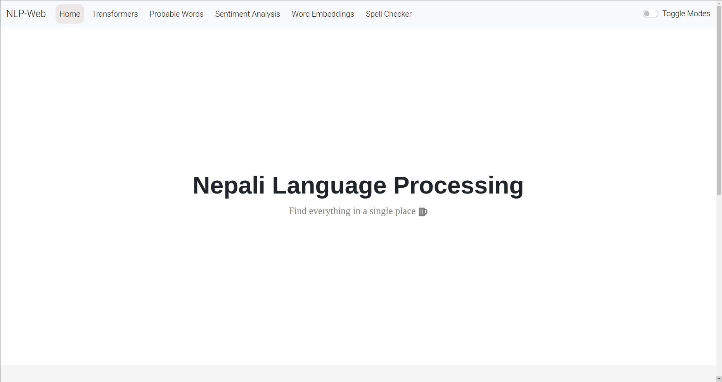
UNIT 1. 1.4. Home Page Frontend

Slide 8
UNIT 2.
Literature Review
A. Vaswani et al.'s "Attention is all you need" (2017) in Adv. Neural Inf. Process. Syst. (vol. 30).
A. Radford, J. Wu, R. Child, D. Luan, D. Amodei, I. Sutskever, et al., “Language models are unsupervised multitask learners,” OpenAI blog, vol. 1, no. 8, p. 9, 2019.
Y. Bengio, R. Ducharme, and P. Vincent, “A neural probabilistic language model,” Advances in neural information processing systems, vol. 13, 2000.
T. Mikolov, I. Sutskever, K. Chen, G. S. Corrado, and J. Dean, “Distributed representations of words and phrases and their compositionality,” Advances in neural information processing systems, vol. 26, 2013.
S. Timilsina, M. Gautam, and B. Bhattarai, “Nepberta: Nepali language model trained in a large corpus,” in Proceedings of the 2nd Conference of the Asia-Pacific Chapter of the Association for Computational Linguistics and the 12th International Joint Conference on Natural Language Processing, pp. 273–284, 2022.
Whitelaw, C., B. Hutchinson, G. Y. Chung, and G. Ellis. 2009. Using the web for language independent spellchecking and autocorrection.
Wilcox-O’Hearn, L. A. 2014. Detection is the central problem in real-word spelling correction.
Norvig, P. 2009. Natural language corpus data. In T. Segaran and J. Hammerbacher, editors, Beautiful data: the stories behind elegant data solutions. O’Reilly

Slide 9
UNIT 3. 3.1. Word Embeddings
Methodology
Use of gensim word2vec model for word embeddings of dimension 300
PCA for converting 300-dimension word embeddings vector into 2-dimensional and 3-dimensional vectors for visualization.

Slide 10
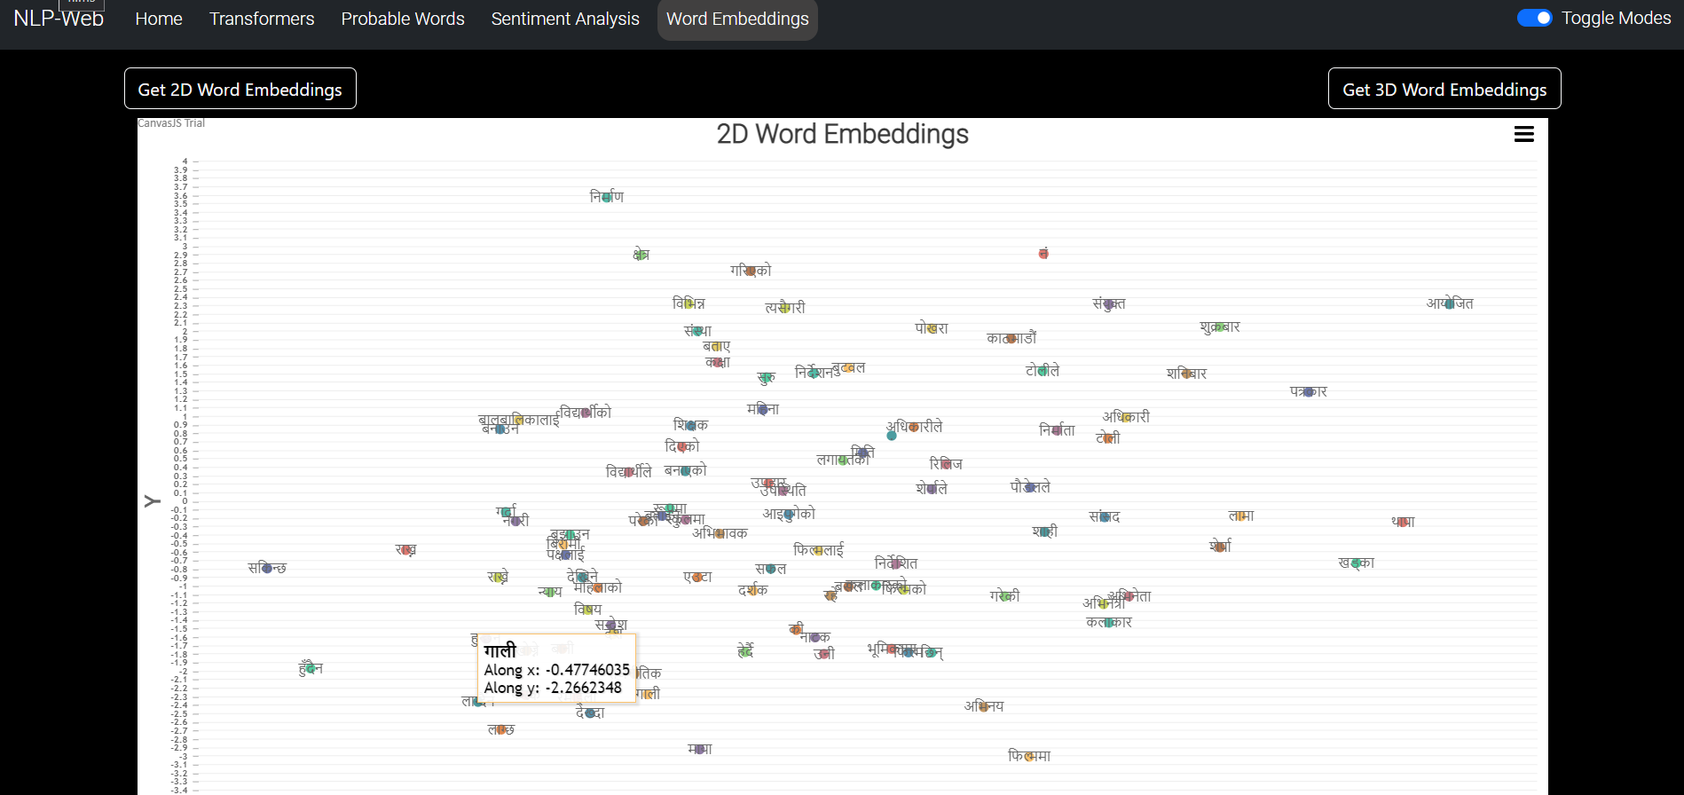
UNIT 3. 3.2. 2d Word Embeddings

Slide 11
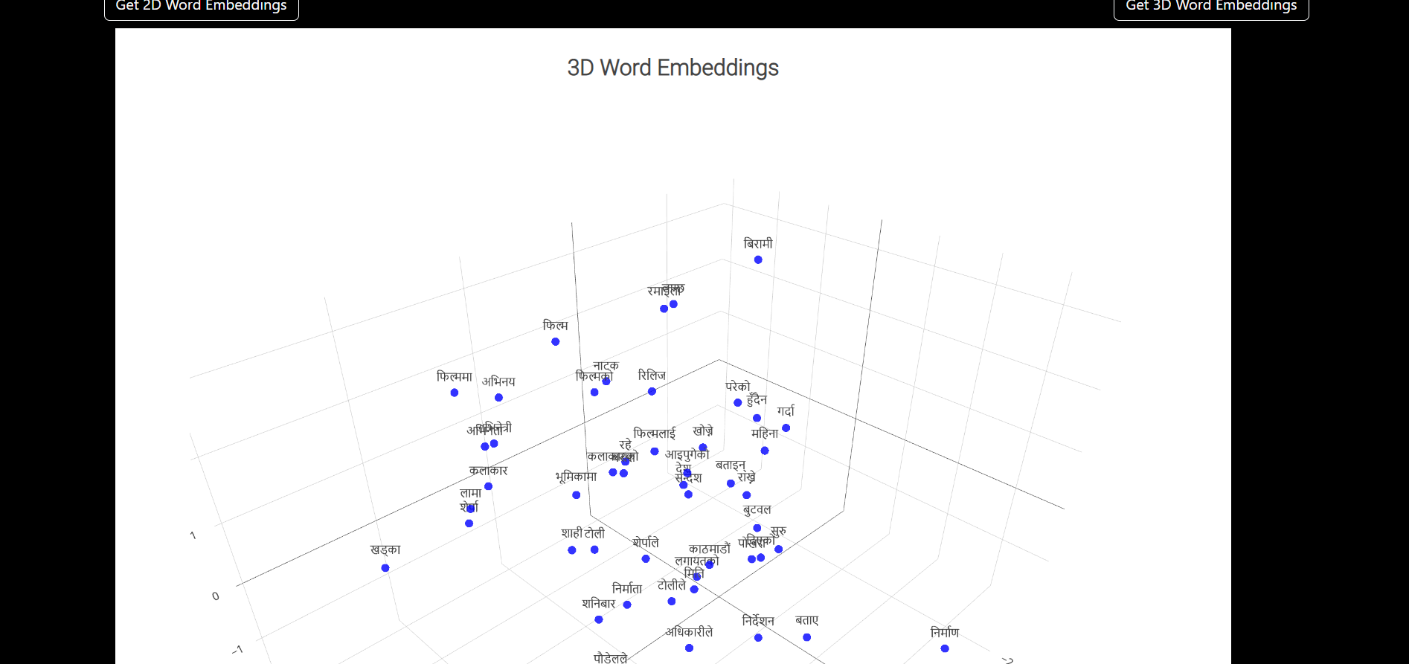
UNIT 3. 3.2. 3d Word Embeddings

Slide 12
UNIT 4. 4.1. Sentiment Analysis
Methodology
Data obtained from kaggle and hugging face
Data exploration
Data cleaning and preprocessing
Train test split
One Hot encoding and tokenization
Model Development using Embedding, LSTMs and Dense layer
Model Evaluation on Test data
Loading and Saving Model

Slide 13
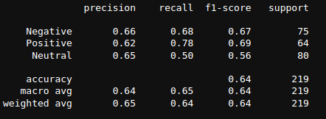
UNIT 4. 4.2. Sentiment Analysis
LSTMs Model Classification Report

Slide 14
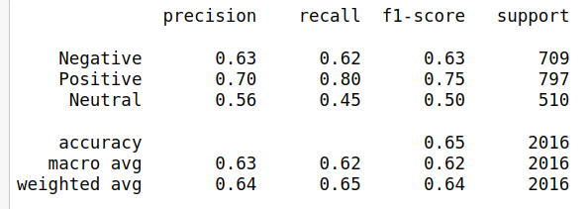
UNIT 4. 4.2. Sentiment Analysis
Bert Model Classification Report

Slide 15
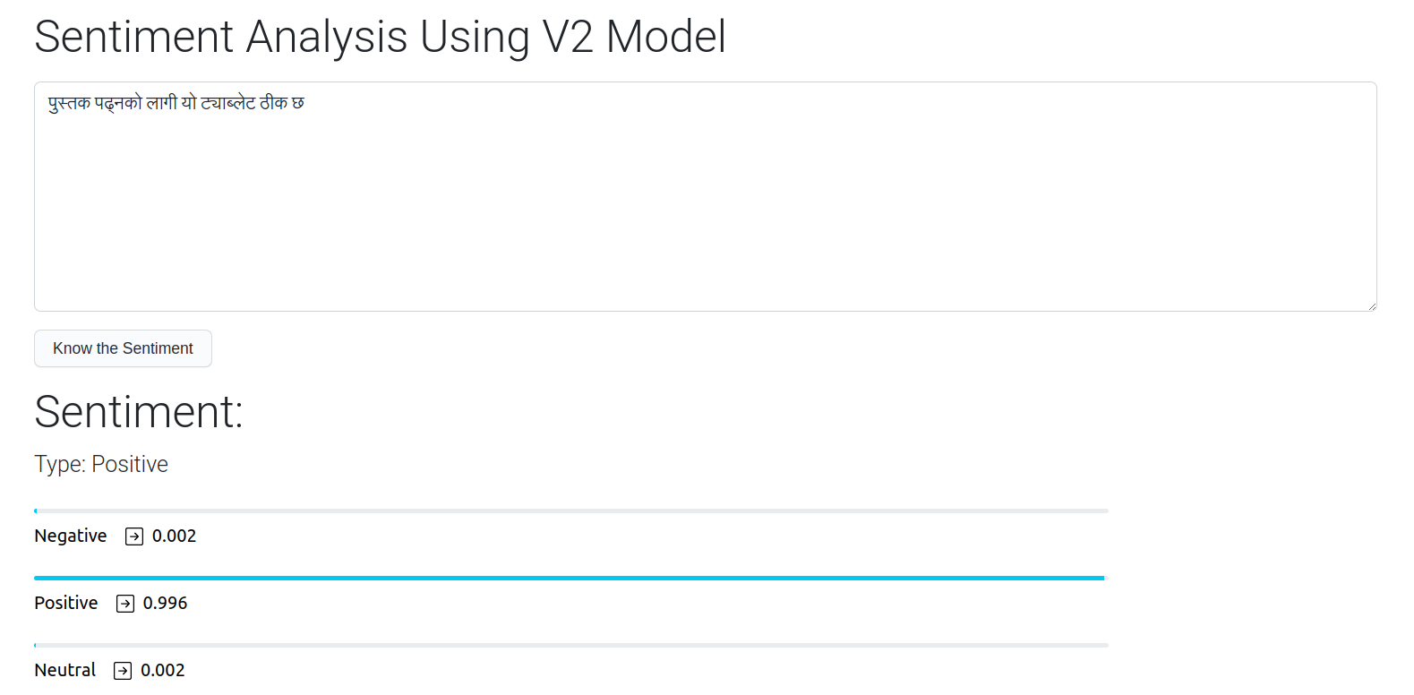
UNIT 4. 4.2. Sentiment Analysis : Positive

Slide 16
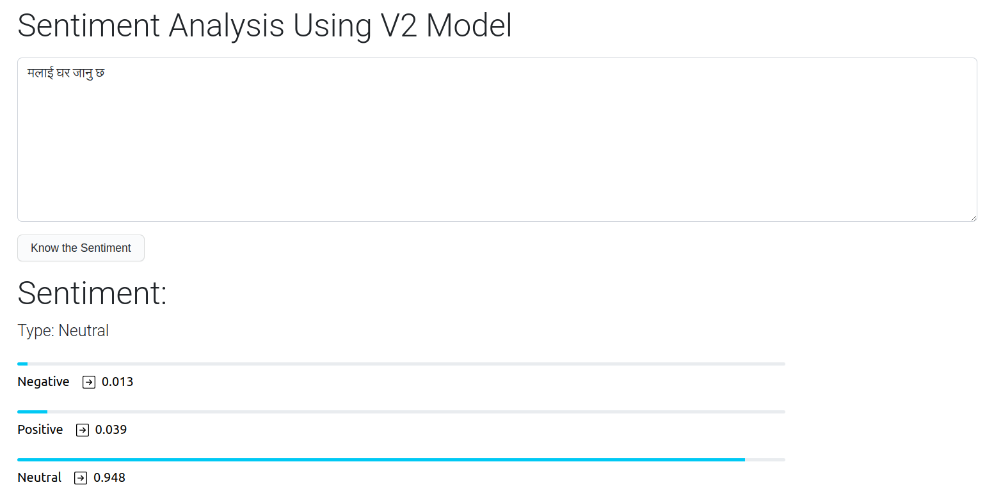
UNIT 4. 4.2. Sentiment Analysis : Neutral

Slide 17
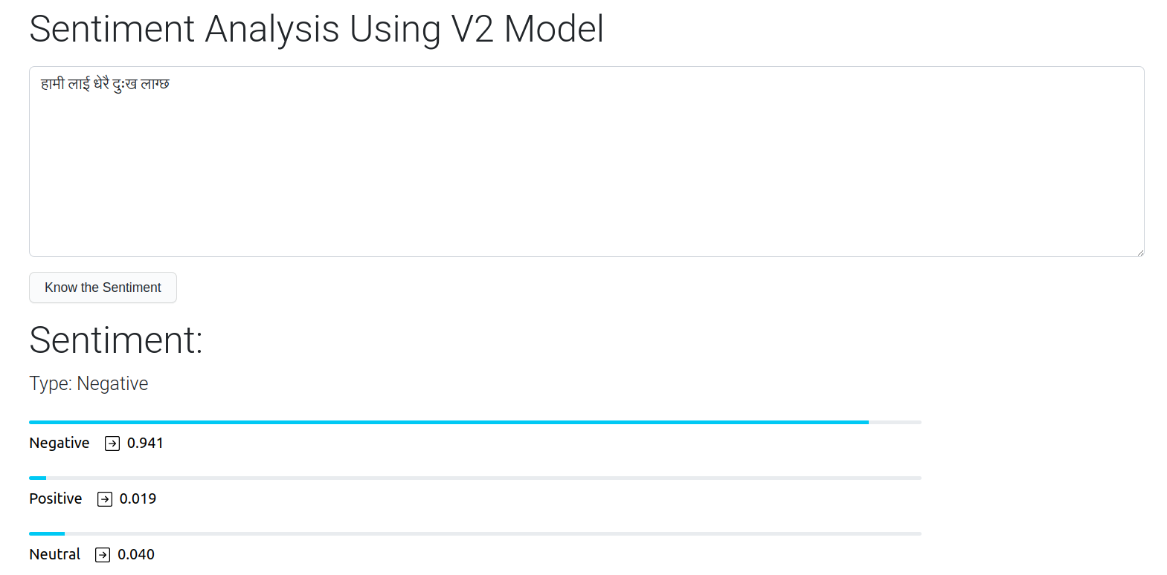
UNIT 4. 4.2. Sentiment Analysis : Negative

Slide 18
UNIT 5. 5.1. Probabilistic Language Model
Methodology
Generate a vocabulary from the training data set
split text into list of sentences
remove all non-devanagari letters
remove numbers from the corpus
create word tokenization
create vocabulary from the tokenized word using minimum frequency constraints
create <UNK> token for Out Of Vocabulary words with the help of minimum frequency
Generate n_gram_counts_list from the training data set
count n-gram with the help of tokenized word sequences
estimate probability with the help of word given, n and (n+1) gram counts list and vocabulary

Slide 19
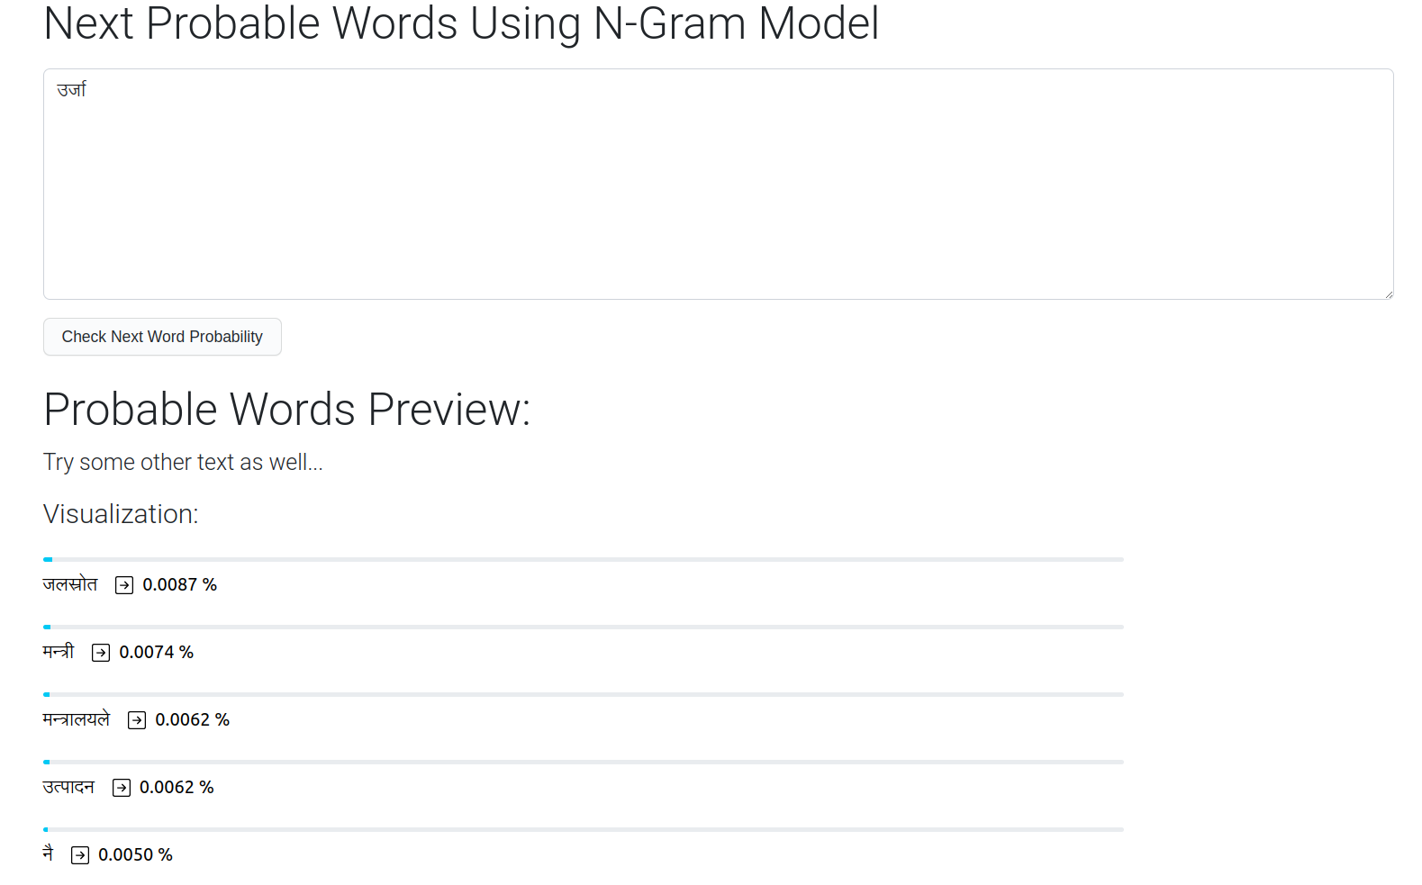
UNIT 5. 5.2. Probabilistic Language Model

Slide 20
UNIT 6. 6.1. Transformer Language Model
Methodology
Generate a vocabulary from the training data set
split text into list of sentences
remove all non-devanagari letters
remove numbers from the corpus
create word tokenization
create vocabulary from the tokenized word using minimum frequency constraints
create <UNK> token for Out Of Vocabulary words with the help of minimum frequency
Define Transformer Architecture and Train based on corpus of data.
Estimate probability through inference and choose one from top-k choices using categorical distribution.

Slide 21
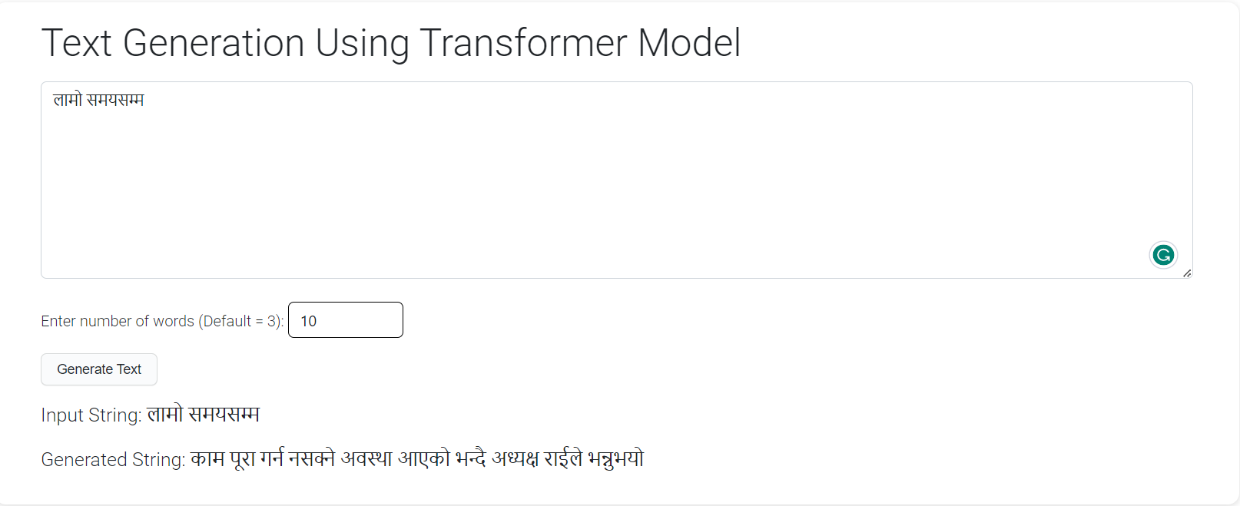
UNIT 6. 6.2. Transformer based language model

Slide 22
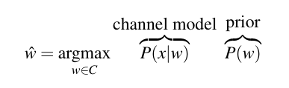
UNIT 7. 7.1. Spelling Correction
Methodology
Used Noisy Channel Model for spelling correction.
Train Channel model based on Brill and Moore model using unsupervised data from corpus.
Use Probabilistic and transformer language model to determine prior distribution
Find candidate sentences using edit distance and based on above equation.
Choose the word that maximizes channel model and prior.

Slide 23
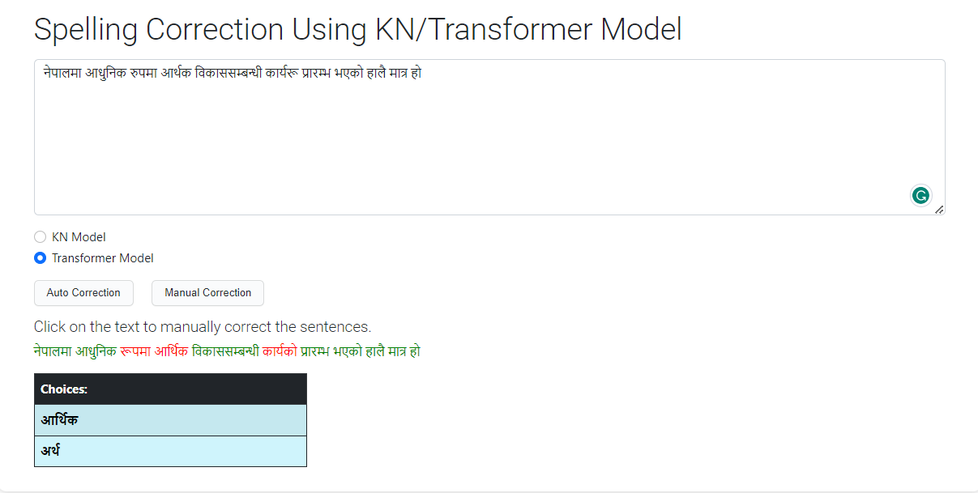
UNIT 7. 7.2. Manual Spelling Correction using Transformer Model

Slide 24
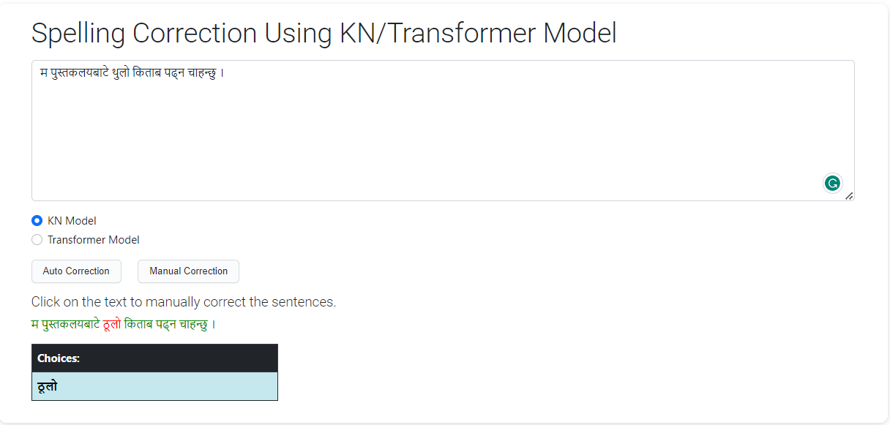
UNIT 7. 7.2. Manual spelling correction using KN Model

Slide 25
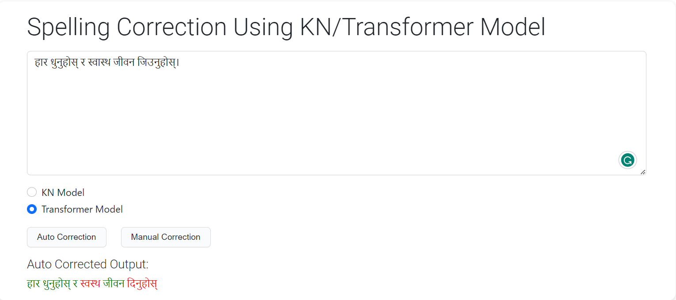
UNIT 7. 7.2. Auto spelling correction using Transformer Model

Slide 26
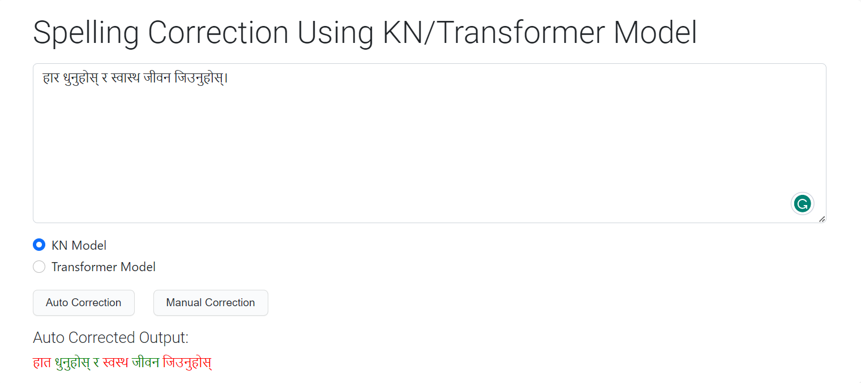
UNIT 7. 7.2. Auto Spelling correction KN Model

Slide 27
UNIT 7.
Application
Further NLP Tasks : text summarization, speech to text model
Drafting emails and report
Language Learning : text generation and spelling correction for improving writing skills and word embeddings visualization to understand the antonyms and synonyms of words

