Slide 1
Wine Quality Classification
Nirajan Bekoju
Bishal Adhikari
Rijan Pokhrel
Manoj Khatri

Slide 2
Topics of discussion
Problem Statement
Feature Engineering and EDA
Model development and Evaluation
Demo

Slide 3
Problem Statement
The dataset describes the amount of various chemicals present in wine and their effect on it’s quality.
The datasets can be viewed as classification or regression tasks.
The classes are ordered and not balanced (e.g. there are much more normal wines than excellent or poor ones)
The complexity arises due to the fact that the dataset has fewer samples, & is highly imbalanced

Slide 4
Feature Engineering and EDA

Slide 5
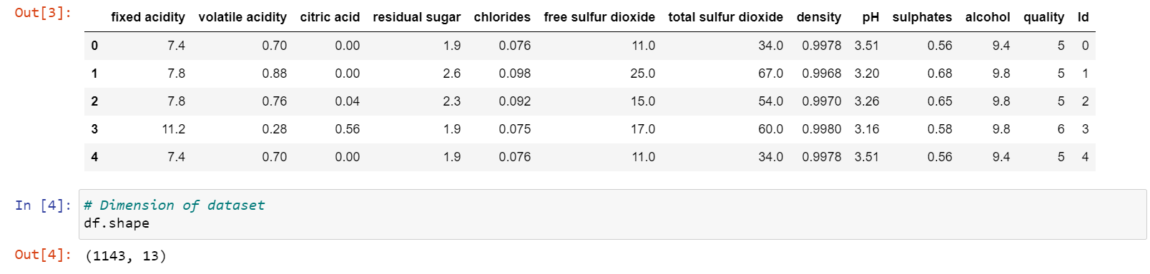
Dataset

Slide 6
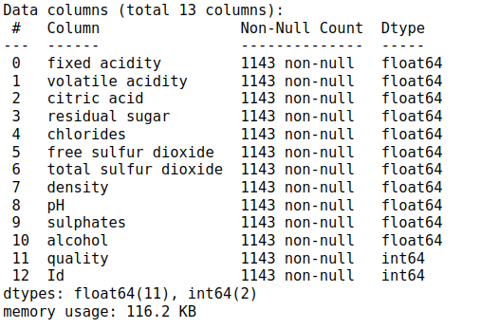

Slide 7
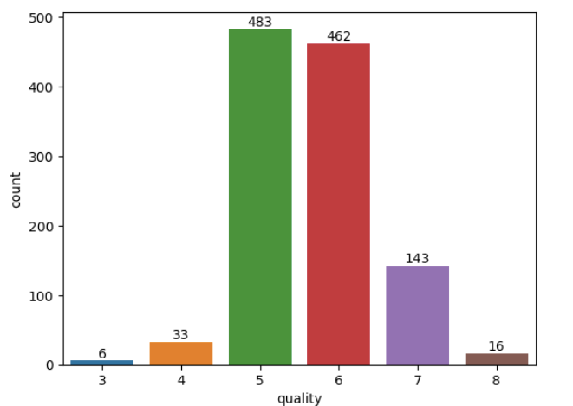
The count plot of the whole dataset on the basis of the quality of wine is shown aside.

Slide 8
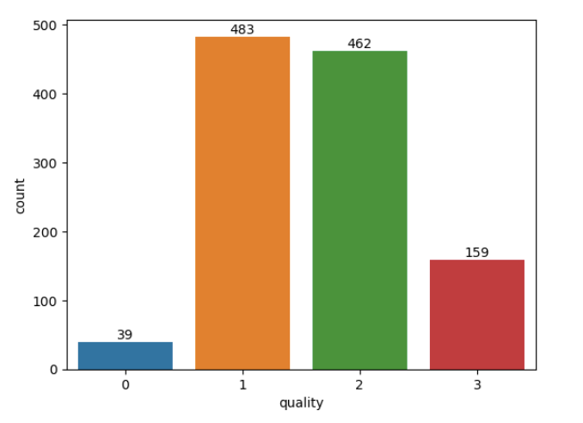
label 3 and label 4 => label 0
label 5 => label 1
label 6 => label 2
label 7 and label 8 => label 3

Slide 9
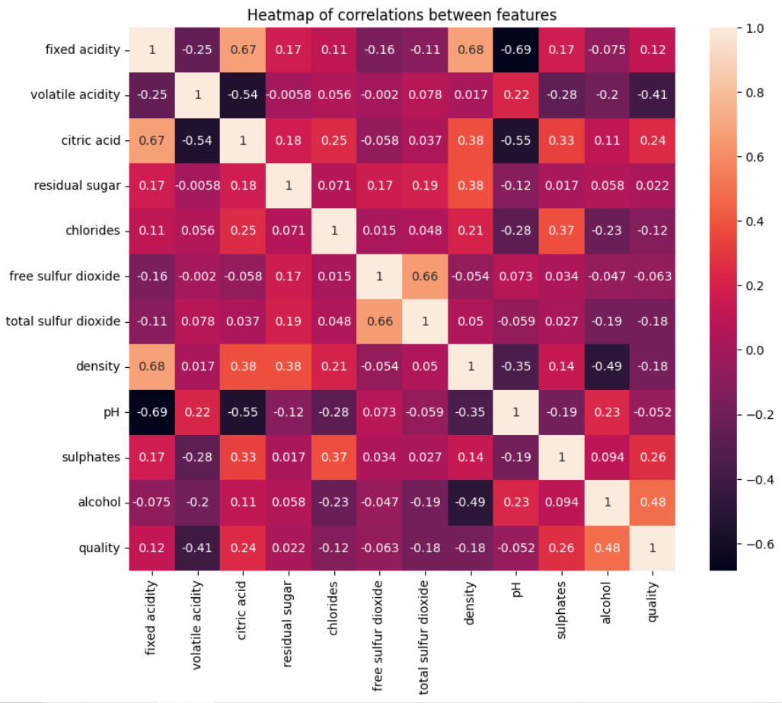

Slide 10
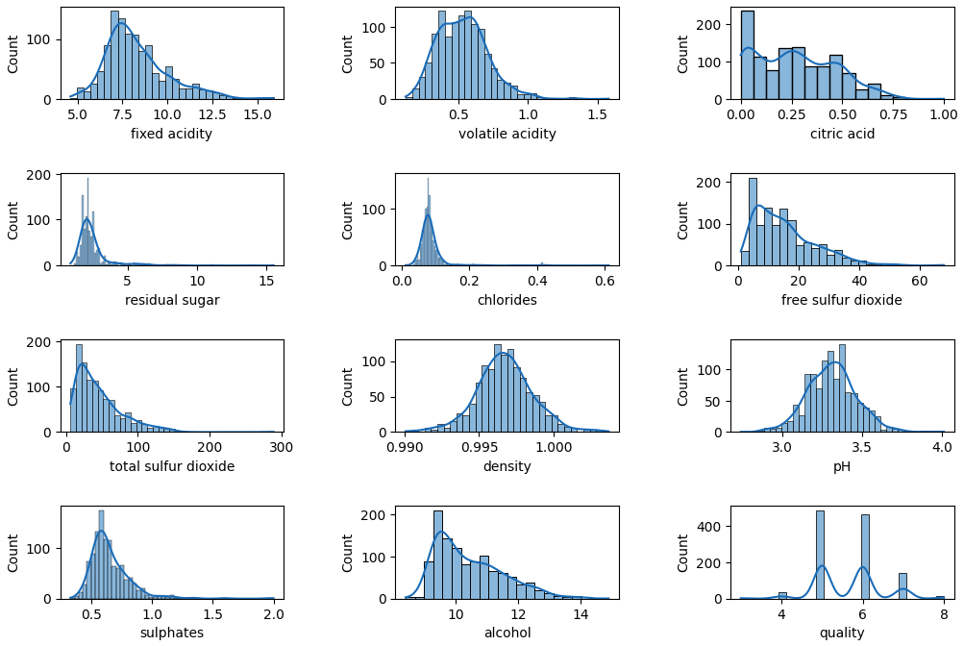
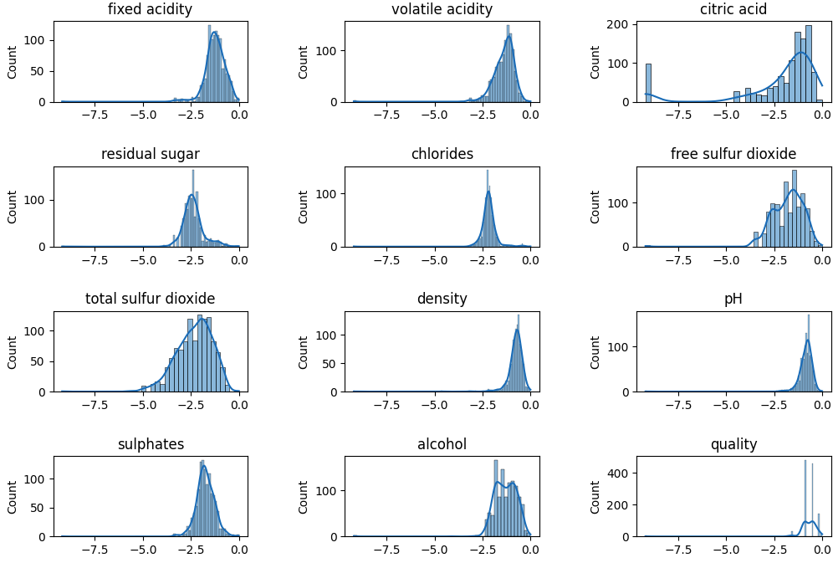
Data Distribution
Data Distribution after min max scaling and log transformation

Slide 11
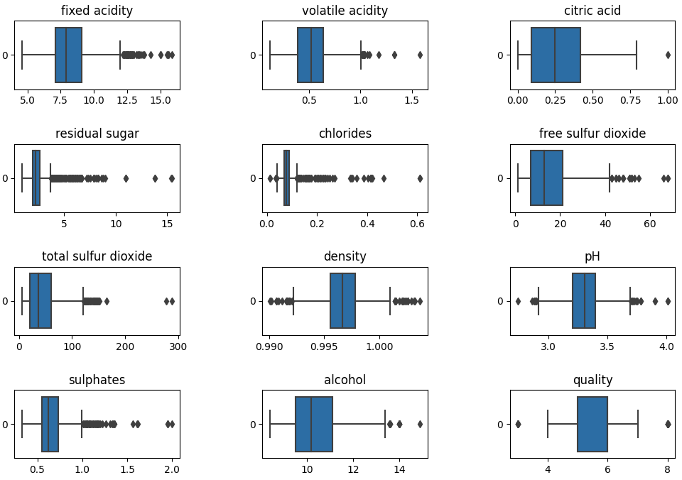
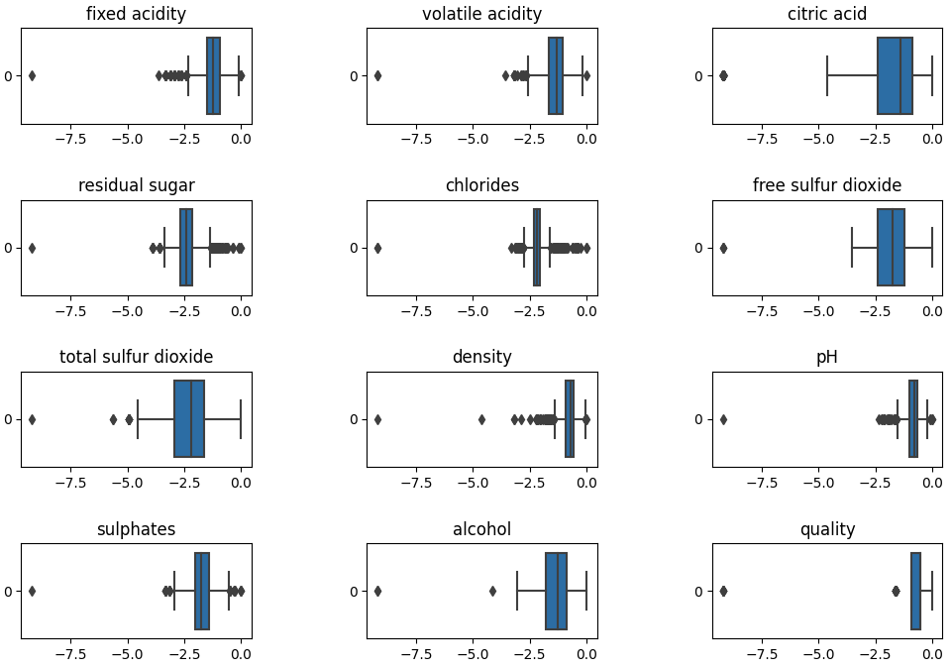
Box plot of features
Box plot after min max scaling and log transformation

Slide 12
Model Development and Evaluation

Slide 13
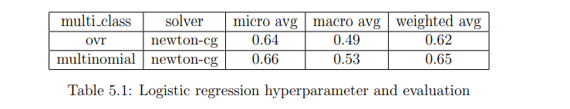
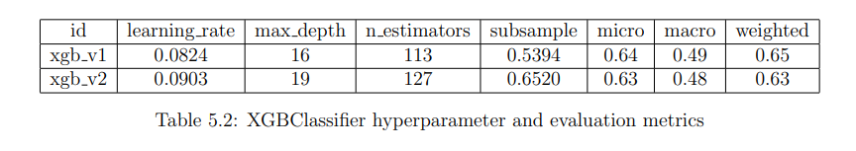

Slide 14
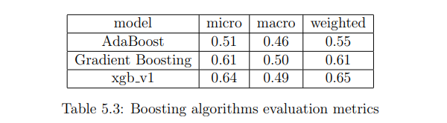
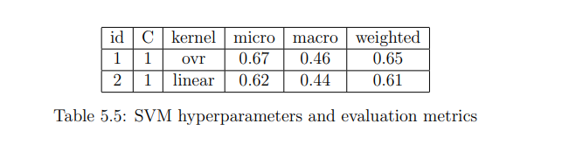

Slide 15
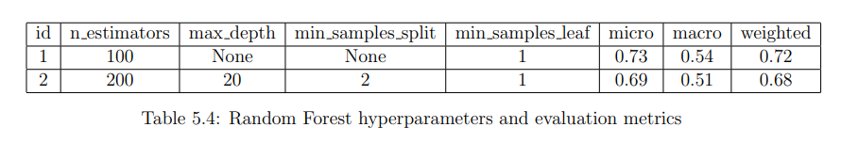

Slide 16
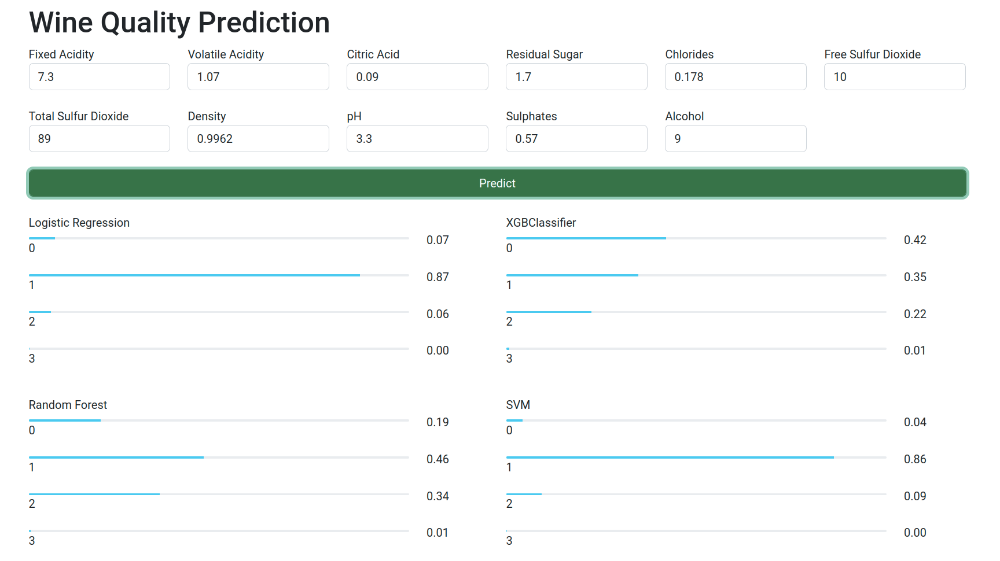

Slide 17
Thank You

