Slide 1
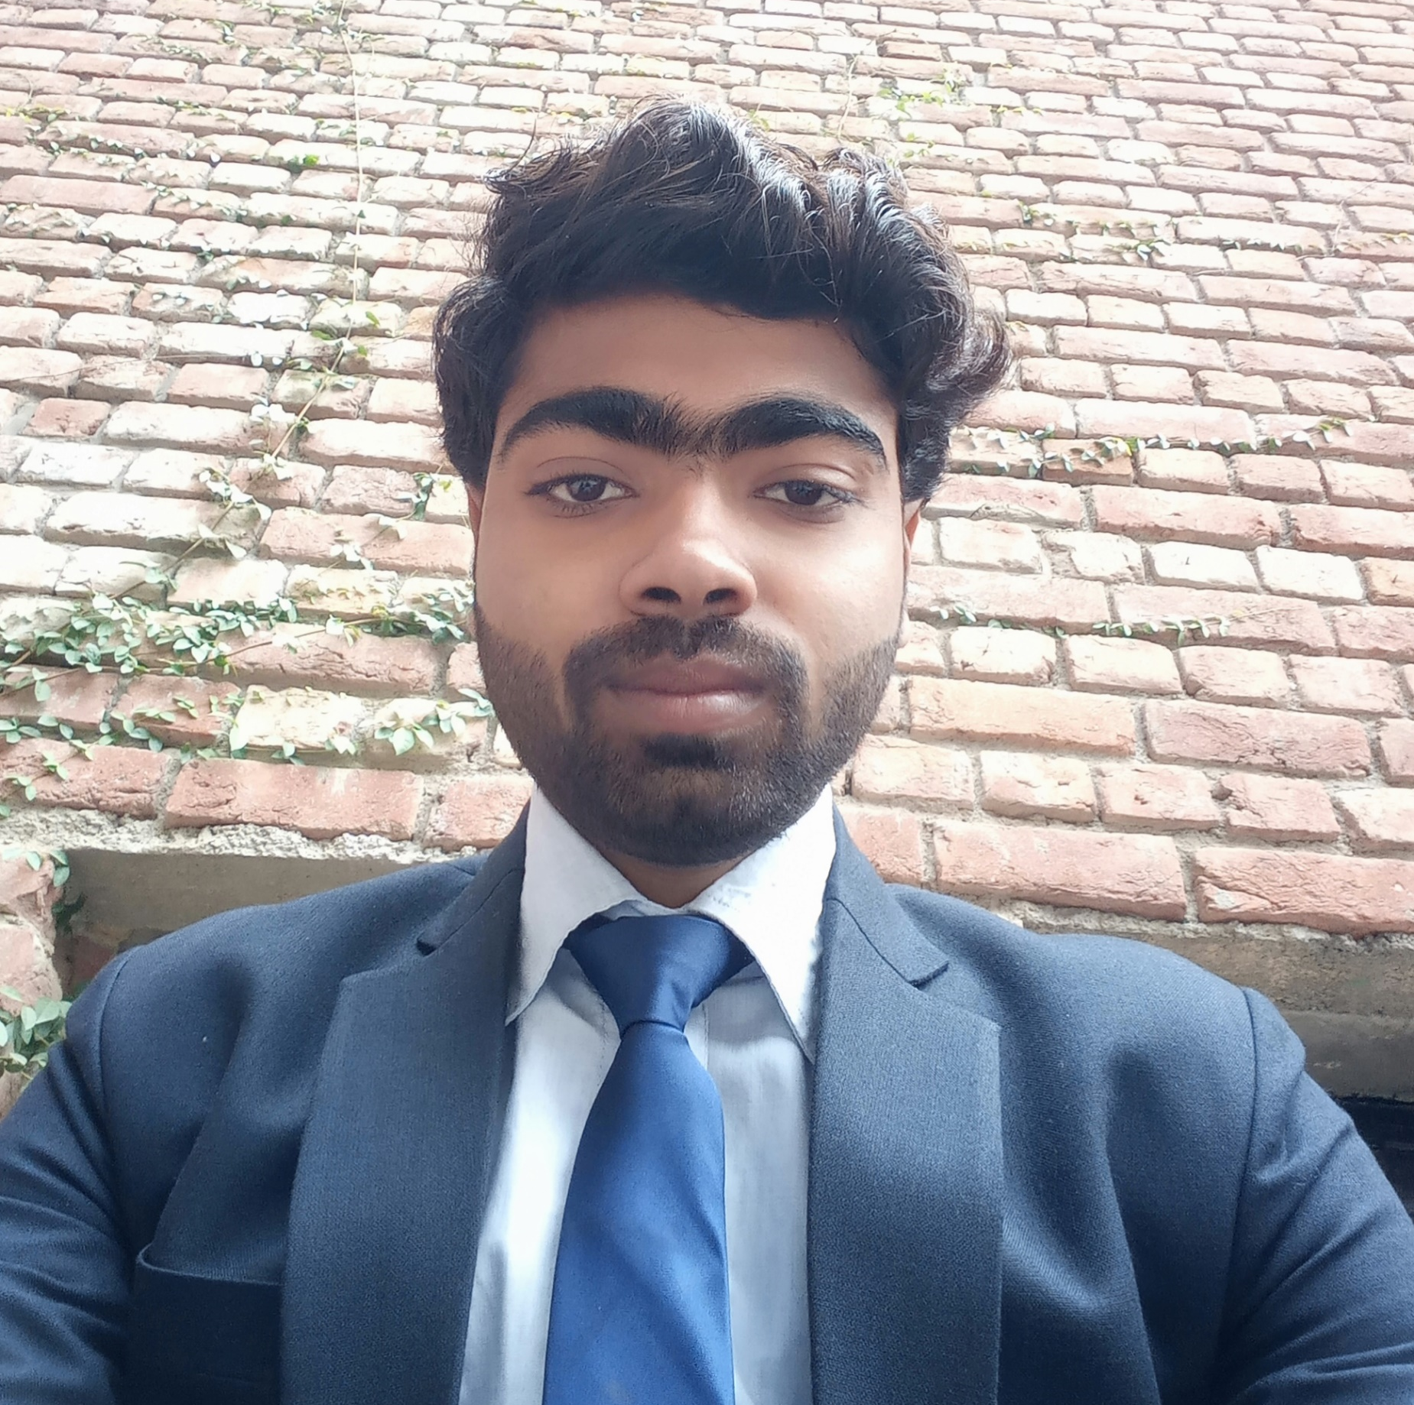



NIRAJ KUMAR
Analyst/Software Engineer
Bachelor of Engineering
Computer Science : 2018 - 2022
Skills
Java 8 /J2EE | Java Basics, OOPS, Generics, Collections, Arrays, Loops, Lambda Exp, Stream API Junit, Mockito, Servlets
Spring core | IOC & Dependency Injection, Autowire
Spring REST | REST controllers, Implementation of GET, POST, PUT & DELETE, Bean Validation & Exception Handling, Testing Services, Controller & Repository layer
Spring Data JPA | Implement DAO layer using spring Data repositories, Transaction Management
Spring Boot Microservices | Spring Boot Starters, annotations, Messaging Service, Sync/Async comms, Swagger API documents
Spring Cloud | Eureka, Netflix Ribbon, Feign Client, Netflix Hystrix, Netflix Zuul & Config Server
React | Components, Hooks, Event handling, Redux, Reducers, Testing using Jasmin & Karma
Database | MongoDB No Sql Basics My SQL RDS Basics
UI Tech | HTML 5 & CSS 3,JavaScript, ES6 & TypeScript Reusable templates, Optimized UI Designed
Tools | Git, Postman, Maven, IDE
Devops | CI/CD, Jenkins configuration, Build Pipelines, notifications, quality gate understanding
Add On skills | Communications, Team management. Peer learning
Bangalore
NIRAJ.I.KUMAR@CAPGEMINI.COM
+91 8102025636
A4
/nirajkumar1999
Full Stack Developer
Hands on experience in creating microservices with Spring boot, Spring Security, Spring Cloud API Gateway, Eureka server, load balancing.
Proficient in creating Single page Web Application in React.
In Depth understanding of OOPs Concepts (core java)
Experience in creating spring boot application with testing using Junit, Mockito & Swagger.
Hands on experience in creating webpages using React, HTML, CSS & Bootstrap, JS & ES6 with good understanding of Document Object Model & DOM()
ON-DEMAND Car Wash Application
Completed end to end case study of ON-DEMAND Car Wash Application along with Swagger and payment testing using Razor pay, responsive UI with CSS & Bootstrap and React used for user interface.
Distance Converter Project based on HTML, CSS and JS.
Analysis of Sales using Excel
Completed Geeks For Geeks DSA Self Paced Certification.
Completed Geeks For Geeks Complete Interview Preparation certification (C++, Data Structure & Algorithms)
Completed Java Script Certification from Coursera.
AWS Cloud Practioner Certified
https://github.com/Nirajkumar-1999/Case-Study

