Slide 1





India Election
ELECTION DATA ANALYSIS
Insights from Constituency, Party, and State-Level Results

Slide 2


Introduction
This project focuses on analyzing Indian parliamentary election data to uncover insights related to party performance, voter behavior, and constituency-level trends. By using structured SQL queries on a relational database, we explore key aspects such as winning margins, voter turnout, party-wise results, and candidate statistics. The goal is to support data-driven decision-making for political strategy, public awareness, and election transparency.

Slide 3
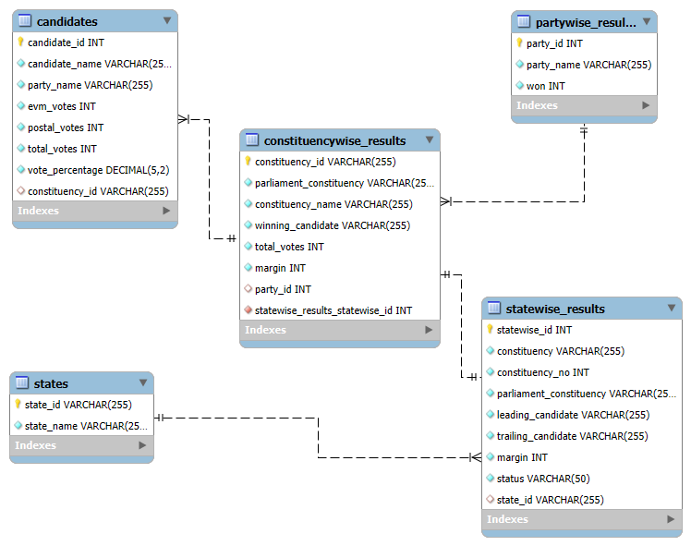

ER DIAGRAM

Slide 4
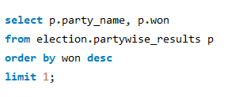
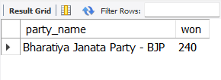
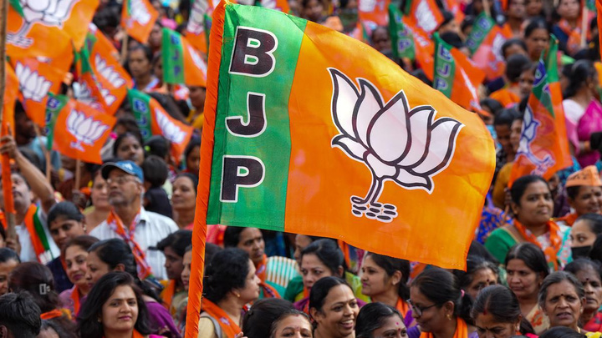
1.Find the party with the highest
number of seats won.
Explain more about some facts related to the melting of arctic ice here

Slide 5
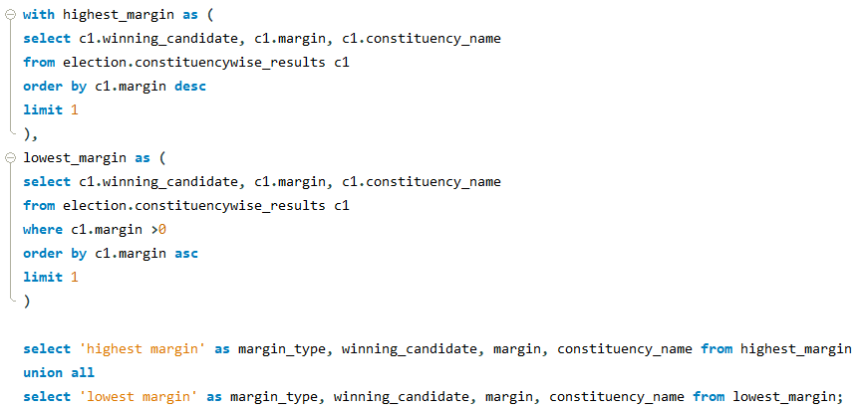
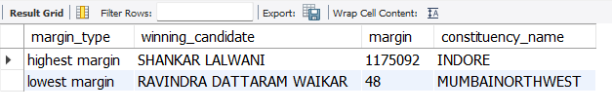
2. Identify the candidate with the highest
and lowest winning margin.

Slide 6
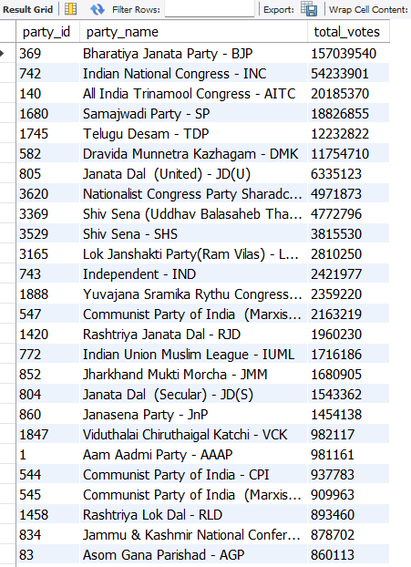
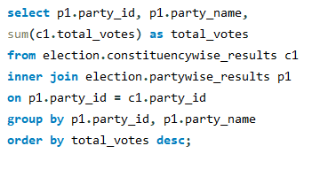

3. Calculate the total votes received by each
party across all constituencies.

Slide 7
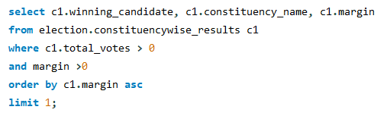
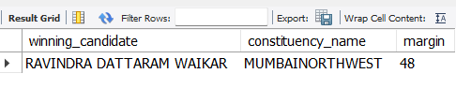

4. Find the constituency with the smallest
winning margin.

Slide 8
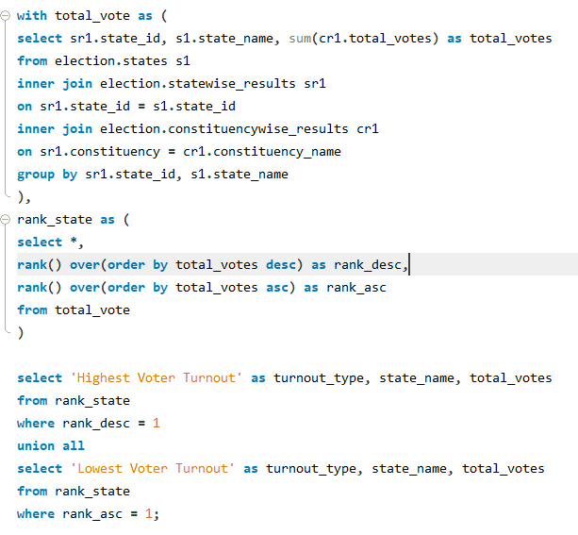
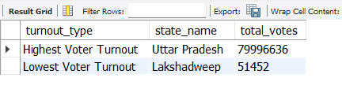
5. Determine the state with the highest
and lowest voter turnout.

Slide 9
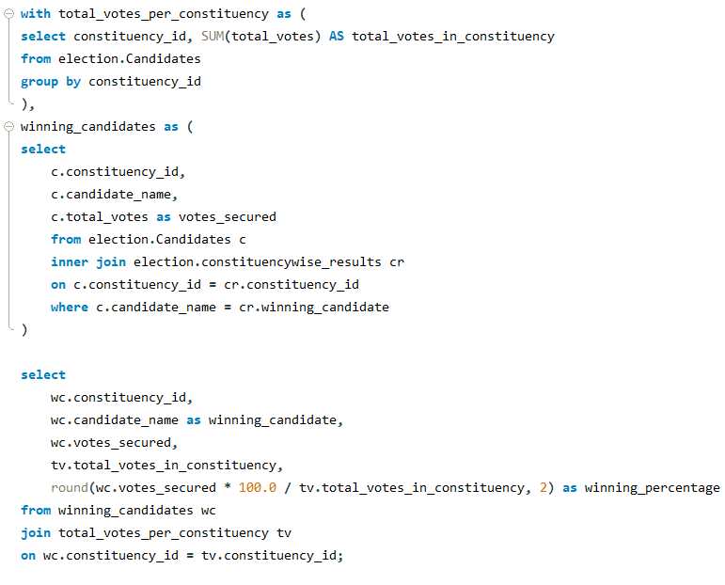
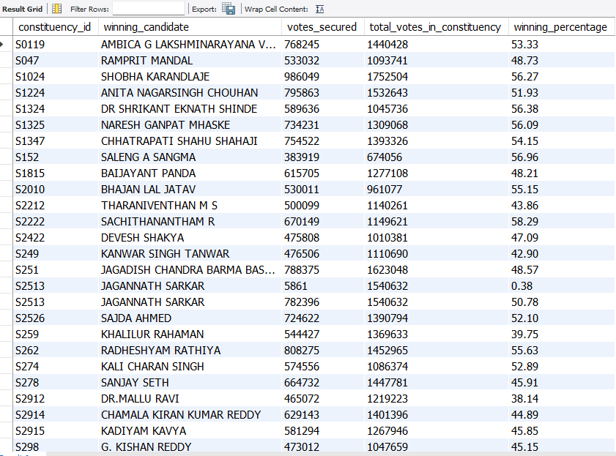
6. Calculate the percentage of votes secured by the winning candidate in each constituency.

Slide 10
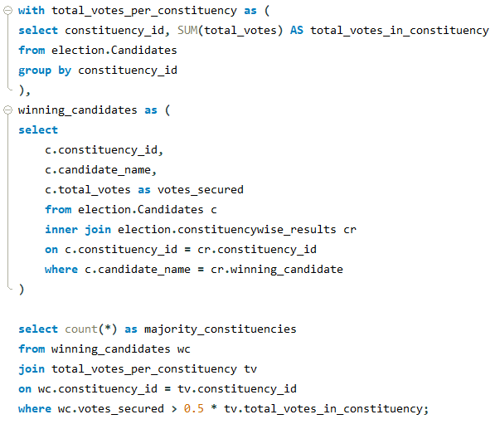

7. Find the number of constituencies where the winning candidate received more than 50% of total votes.

Slide 11
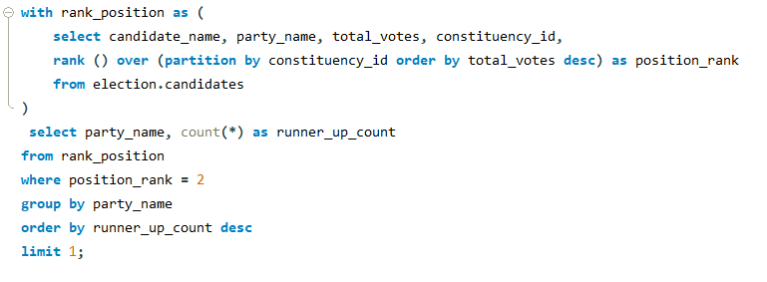


8. Identify the party that secured the
most runner-up positions.

Slide 12

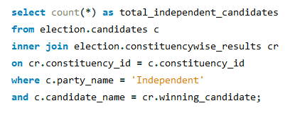
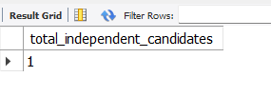
9. Find the number of independent candidates who won and their constituencies.

Slide 13
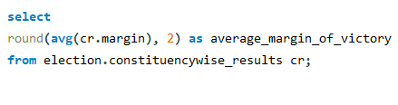
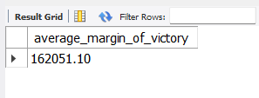
10. Calculate the average margin of
victory across all constituencies

Slide 14


THANK YOU!
iNDIAN ELECTION

