Slide 1


Global Life Expectancy
HEALTHCARE Analytics

Slide 2
INTRODUCTION
  We've explored life expectancy records across countries and years, utilizing a dataset containing 1649 rows and 22 columns.
  Our dataset spans from 2000 to 2015 Years, and we're using predictive analytics to extend predictions beyond this timeframe.
  We got this dataset from one of the government site in US.
  Leveraging predictive modeling on a healthcare platform, we've forecasted life expectancy, population trends, and additional health data.
  This predictive capability empowers us to project future health outcomes, guiding proactive interventions and policy decisions.

Slide 3
Overview of dataset
  Dataset containing 1649 rows and 22 columns.
  Our dataset spans from 2000 to 2015 Years,
  Columns name : Country, Year, Status("Developed" or "Developing),Life expectancy(our star), Schooling(avg school year) ,GDP, Population , infant deaths, Hepatitis B,Measles , BMI, Diphtheria , HIV/AIDS, under-five deaths, Polio, Total expenditure, Income composition of resources,
  Adult Mortality - Adult mortality is the chance that a person will die between the ages of 15 and 60.
  Alcohol - average alcohol consumption in liters per capita
  percentage expenditure-how much money a country spends on healthcare relative to its total economic output
  thinness 1-19 years & thinness 5-9 years – underweight children and teenagers

Slide 4




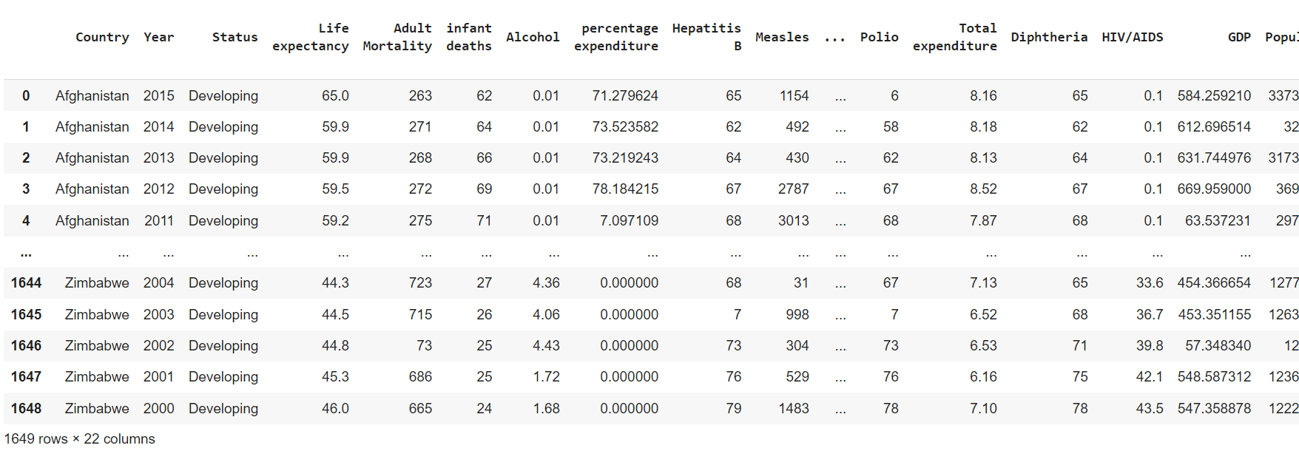

Data Overview
2021
2022
2023
2024
2025

Slide 5



What is Life Expectancy in healthcare term??
In healthcare, life expectancy refers to the average number of years that a person is expected to live, typically based on statistical data and demographic factors such as age, sex, and other relevant characteristics. It represents an estimate of how long an individual is likely to live, on average, given current mortality rates and other relevant factors.
Life expectancy is an essential indicator of a population's overall health and well-being. It is influenced by various factors, including access to healthcare, prevalence of diseases and chronic conditions, lifestyle choices, environmental factors, socioeconomic status, and advancements in medical technology and public health interventions

Slide 6
Why Life Expectancy are important?
  Life expectancy is a key indicator of the overall health of a population.
  Life expectancy is often used as a measure of a country's level of development and quality of life.
  Life expectancy influences economic planning, especially in terms of pensions, retirement planning, and long-term care.
  On a personal level, knowing about life expectancy can inform individual decisions about health, lifestyle choices, and financial planning
  Alcohol - average alcohol consumption in liters per capita
  On a global scale, life expectancy helps international organizations identify areas of need and prioritize health initiatives, such as disease prevention.

Slide 7


Process
  Data Cleaning
  Univariate and Bivariate Analysis
  Descriptive Analysis
  Feature Importance
  Correlation between Numerical Columns
  Conversion of Categorical Columns to Numerical Columns
  Model Selection using Lazy Predict
  Model Deployment for Life Expectancy's prediction

Slide 8
Overview of eda
  During the analysis, we found that the dataset has outliers for each columns, we remove multiple outlier for columns to get more accurate views.
  We handled the outliers appropriately by either imputing or removing the missing values.
  To focus on the relevant parameters for predicting life expectancy, we selected important features and dropped unnecessary columns.
  We removed any non-contributing factors and features that were not dependent on life expectancy.
  Additionally, we performed bivariate ,univariate analysis on data to get better views
2021
2022
2023
2024
2025

Slide 9
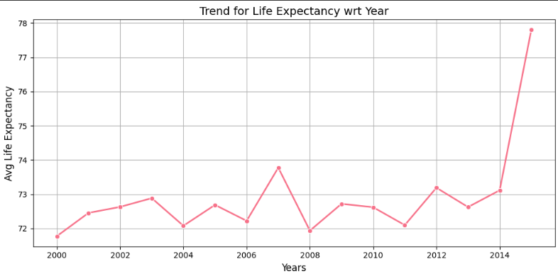
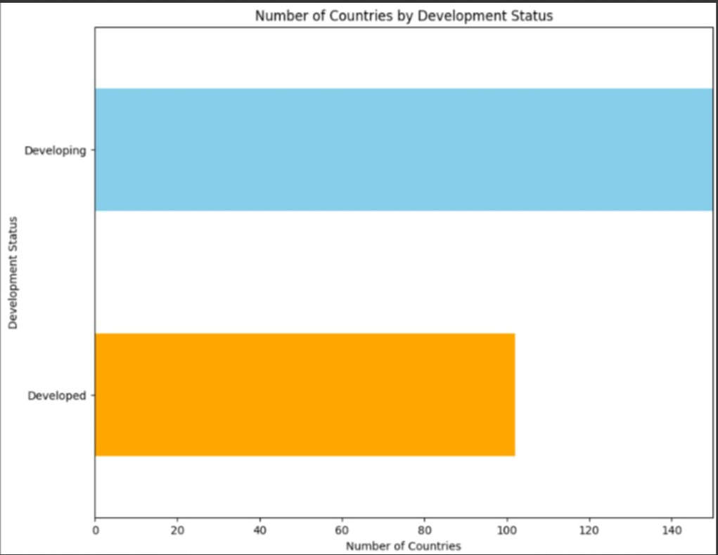
Highlights of EDA
Bivariate Analysis for Numeric-Numeric Relationships:
Bivariate Analysis for categorical-categorical Relationships:
2021
2022
2023
2024
2025

Slide 10
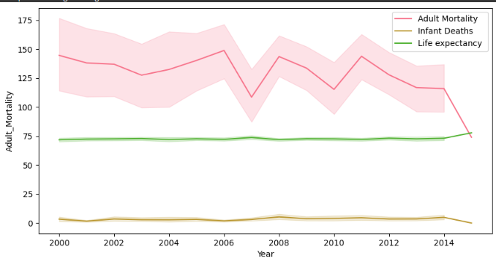
Highlights of EDA
Multivariant analysis:
2021
2022
2023
2024
2025

Slide 11
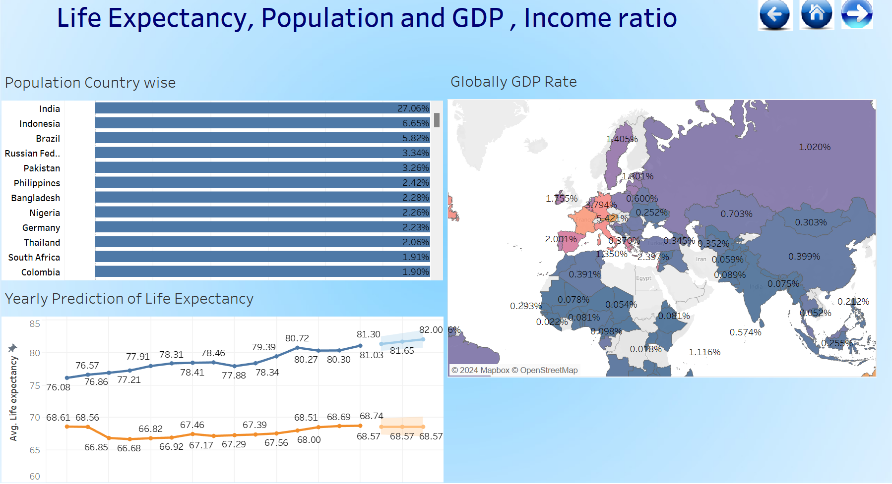
Dashboard - 1
2021
2022
2023
2024
2025

Slide 12
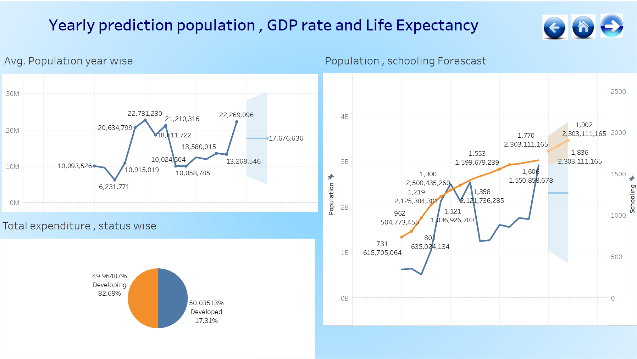
Dashboard -2
2021
2022
2023
2024
2025

Slide 13
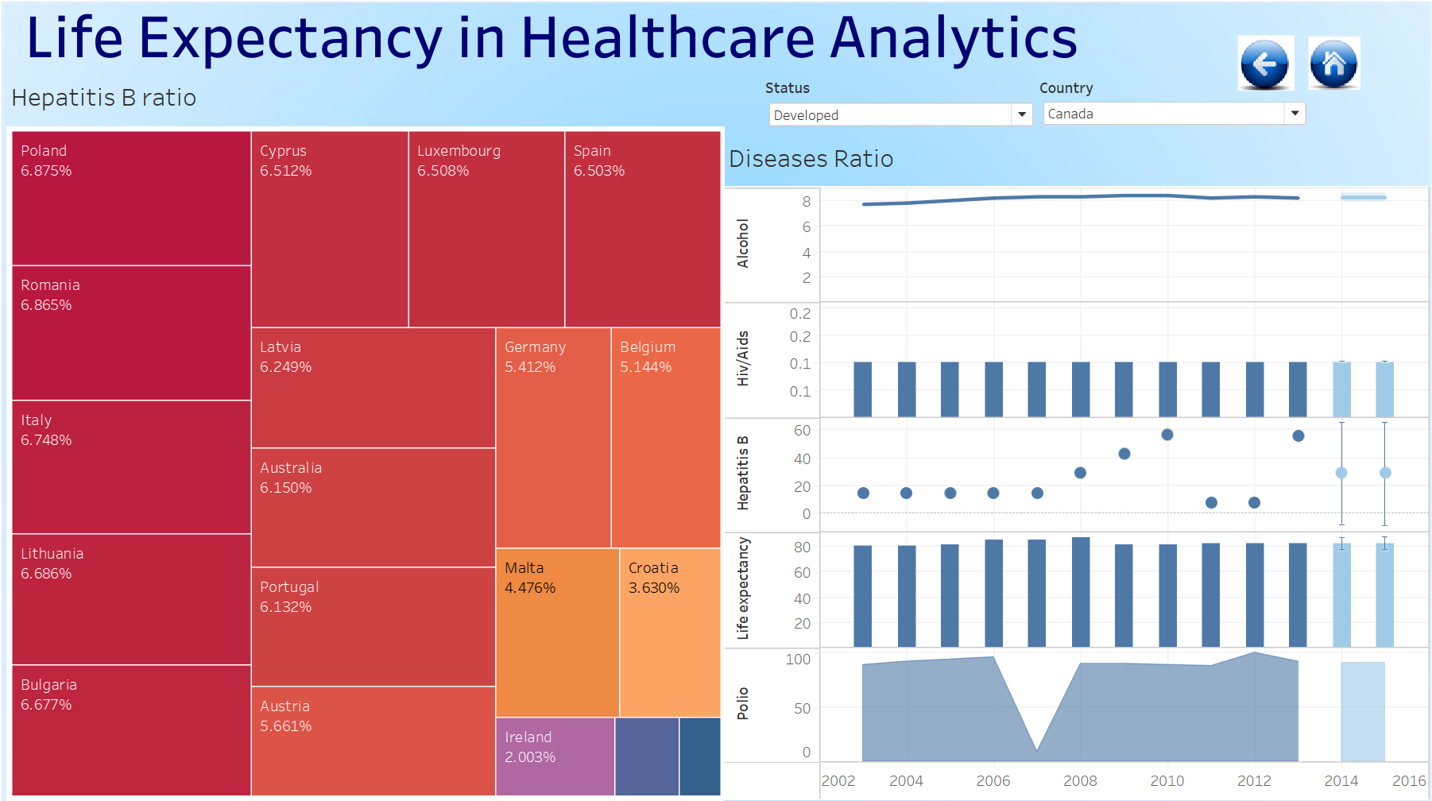
Dashboard -3
2021
2022
2023
2024
2025

Slide 14
How we implement the ML model?
  After dashboard, we know our data well and it is better to interpret the complex information quickly.
  We decided to move on something more with machine learning model to better understand the life expectancy.
  Before the model implementation, we check our data is ready for the model or not , we found out that some categorical column should have to convert into numerical because some model works best on numerical columns
  We convert status (Developing ,developed),country into the numerical columns. After that we first choose the features that are corelated with life expectancy according to correlation matrix.
  We got better result from Extra tree regressor model and we predict the life expectancy.
2021
2022
2023
2024
2025

Slide 15
Model deployment
  Once the data is prepared, it is fed into the loaded Extra tree regression model. The model applies the learned coefficients to the input features and calculates the predicted life expectancy.
  The predicted life expectancy is obtained from the model and can be displayed to the user. This can be done by updating the web page with the predicted value or by presenting it in a user-friendly format.
  Flask application was developed to provide a user interface for predicting life expectancy based on the given features.
  The Flask framework was used to handle the backend logic and routing, while HTML and CSS were used to design and structure the frontend interface.
  The Flask app allowed users to input the relevant feature values through a form or user interface.
2021
2022
2023
2024
2025

Slide 16
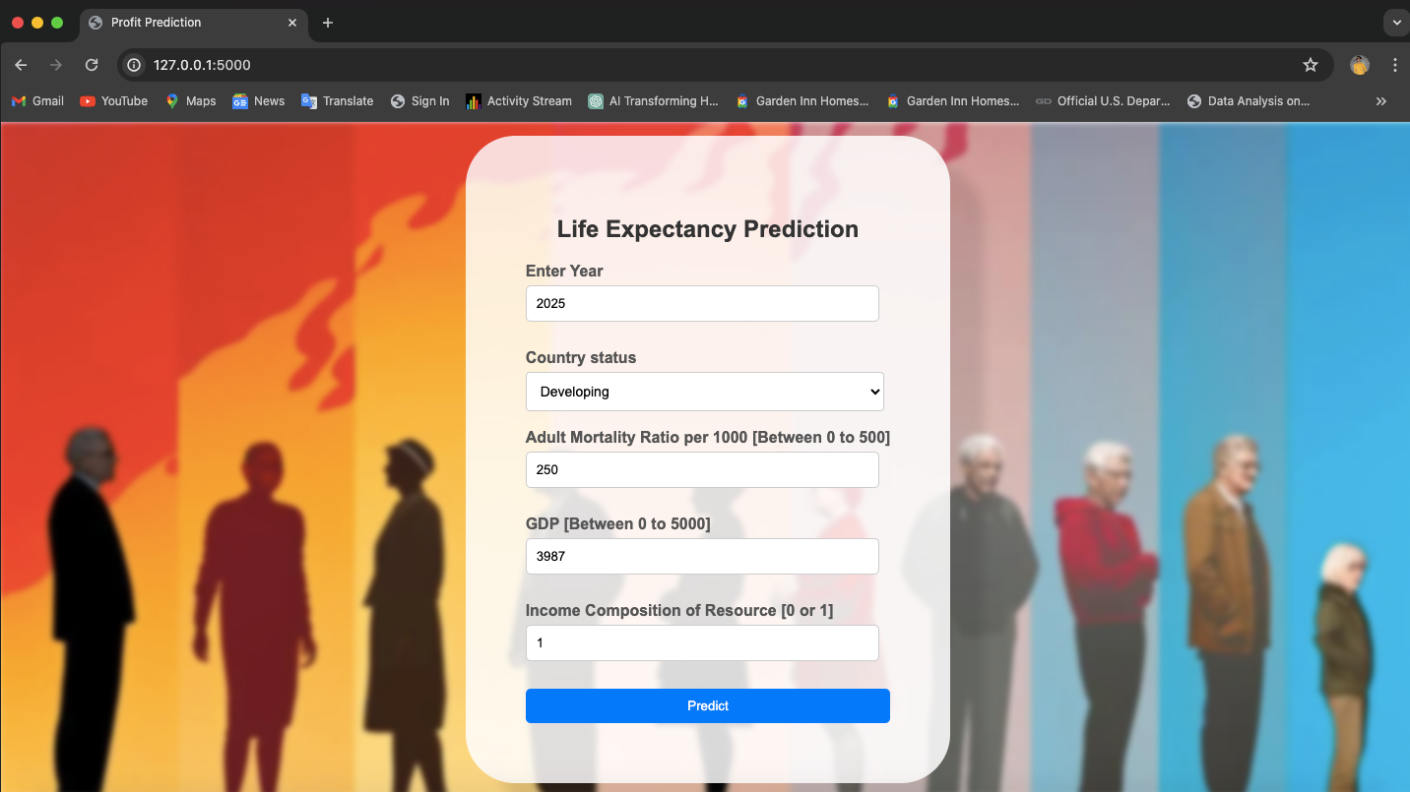
UI
2021
2022
2023
2024
2025

Slide 17
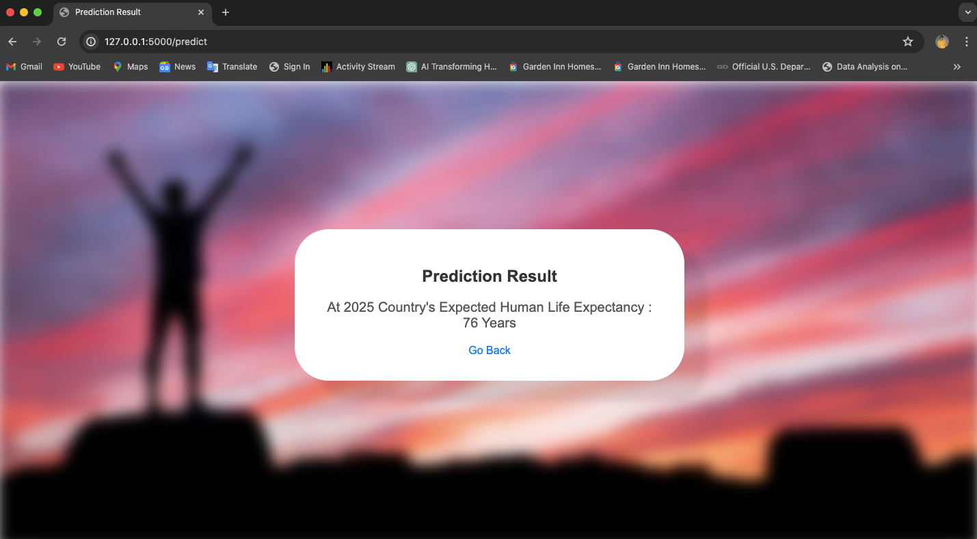
UI
2021
2022
2023
2024
2025

Slide 18
Conclusion
  In this project, we successfully developed a predictive model for life expectancy worldwide. Our analysis revealed important factors that contribute to variations in life expectancy across different regions and countries.
  By incorporating data on healthcare access, economic indicators, education levels, and other demographic variables, our model was able to provide accurate predictions for life expectancy.
  Preventative measures, such as vaccination programs and health education campaigns, are crucial for improving life expectancy.
  By prioritizing public health initiatives and promoting equitable access to resources, policymakers and organizations can work towards improving life expectancy globally.
  Moreover, continuous updates to the model with new data will ensure its relevance and accuracy over time.
2021
2022
2023
2024
2025

Slide 19

Thank you
Our team : Jonathan
Krupali, Nirali, Dhruv & Shreyansh

