Slide 1

AN ANALYSIS OF CAREER TRAJECTORIES: SALARY & EXPERIENCE ACROSS GLOBAL INDUSTRIES
Submitted By
NIRANJANA KS
10/08/2025
DATA ANALYTICS & DATA SCIENCE
Batch: May-2025

Slide 2

AGENDA
1. Objectives
2. Dataset Overview
3. Data Cleaning Process
4. SQL Query Performance
5. Pivot Tables & Charts
6. Dashboard
7. Key Insights
8. Recommendations
9. Conclusion

Slide 3
OBJECTIVES
Industry Pay Comparison – Compare average salaries across industries to determine which sectors offer higher or lower compensation.
Job Title Analysis – Examine salaries for similar roles in different industries or locations to spot variations.
Regional Salary Trends – Analyze pay differences across countries, states, or cities to identify geographic disparities.

Slide 4
DATASET OVERVIEW
Number of Entries: 28,104 rows
Number of Attributes: 16 columns
Data from a global salary survey covering various industries and job roles.
Key attributes: Age Range, Industry, Job Title, Annual Salary, Compensation, Education, and Experience.
Includes salary data from multiple countries and currencies.

Slide 5
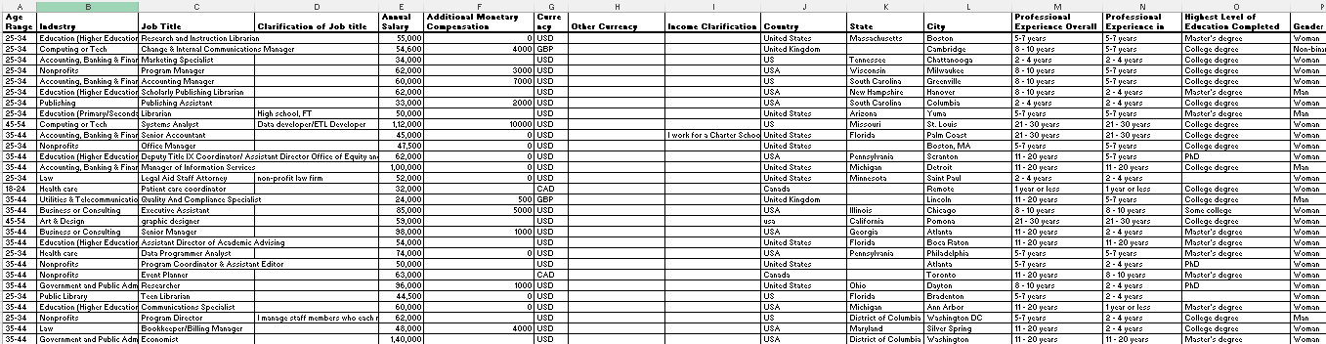
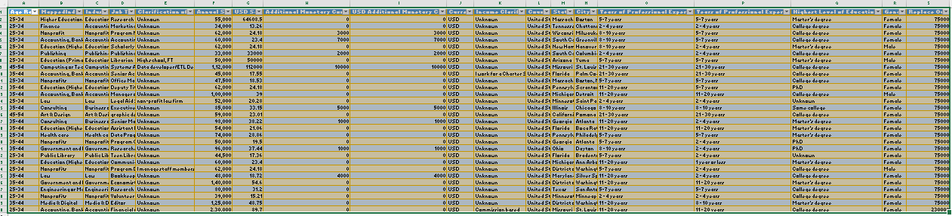
DATA CLEANING PROCESS
Row Data
▪ Removed duplicates
▪ Spell checked
▪ Standardized currency codes and country names
▪ Grouping genders
▪ Converted currency values
▪ Identified outliers
Cleaned Data

Slide 6
SQL QUERY PERFORMANCE
Average Salary by Industry and Gender
Total Salary Compensation by Job Title
Salary Distribution by Education Level
Number of Employees by Industry and Years of Experience
Median Salary by Age Range and Gender
Job Titles with the Highest Salary in Each Country
Average Salary by City and Industry
Percentage of Employees with Additional Compensation by Gender
Total Compensation by Job Title and Years of Experience
Average Salary by Industry, Gender, and Education Level

Slide 7
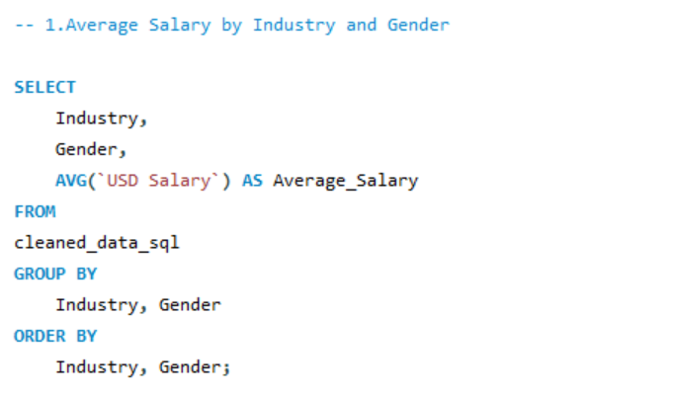
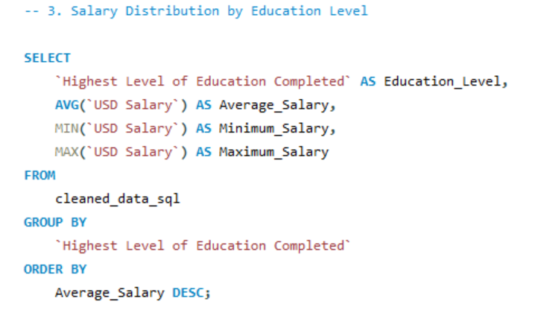
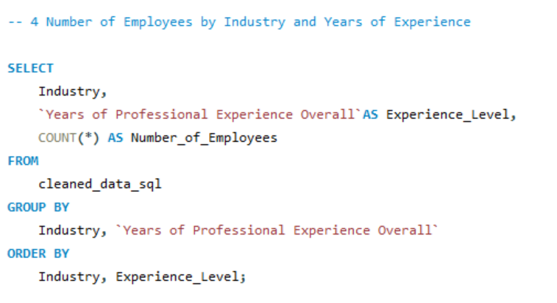
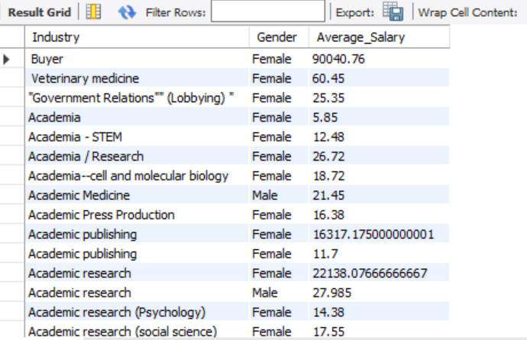
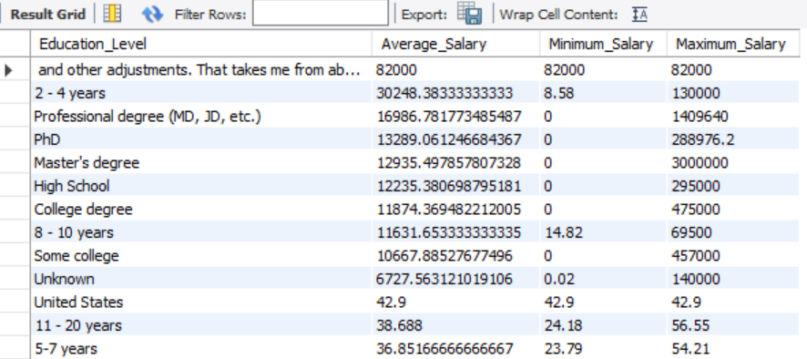
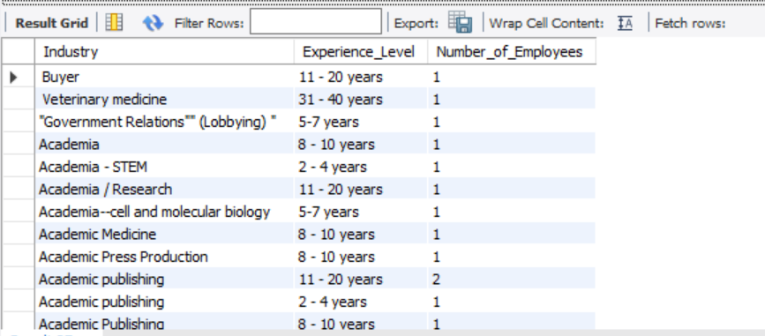

Slide 8
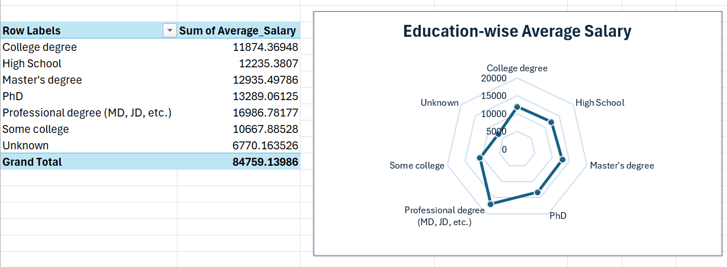
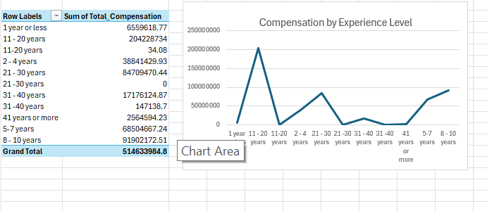
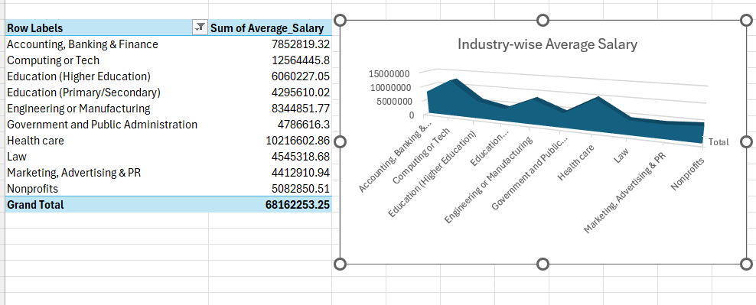
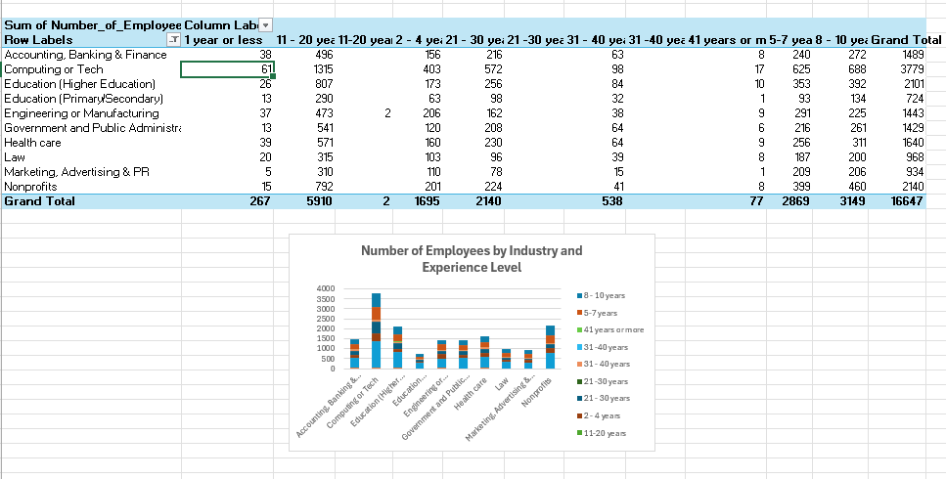
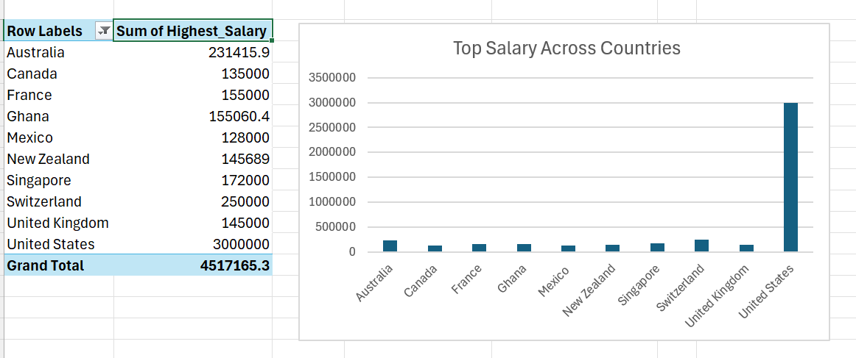
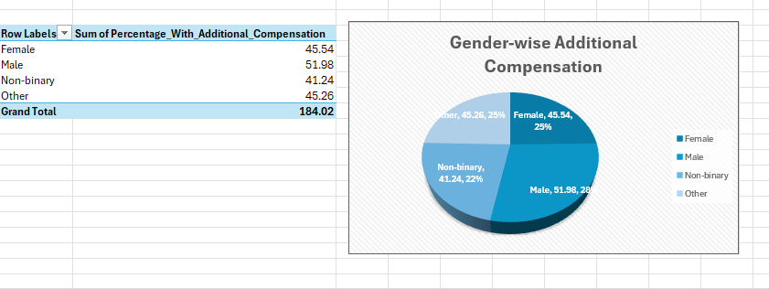
PIVOT TABLE AND CHART

Slide 9
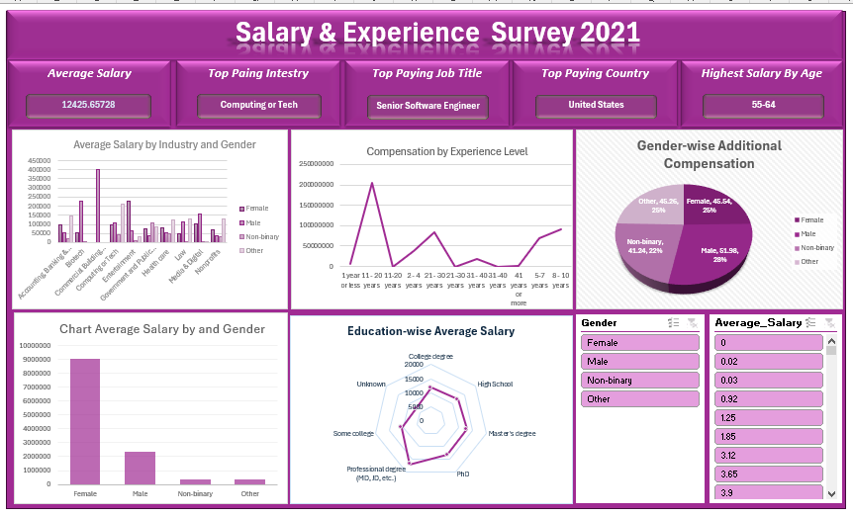
DASHBOARD

Slide 10
KEY INSIGHTS
1. Professionals with 10+ years’ experience earn 2.5× more than those with <3 years.
2. Interpretation, International Development, and Oil lead in salaries.
3. Gender pay gap of 10–15% in 60%+ of industries.
4. Master’s/College degree holders earn more.
5. USA, Canada, and Australia offer highest pay.
6. Salaries in USD are higher than other currencies.
7. Top job titles: Director, Software Engineer, Project Manager, Senior Software Engineer.

Slide 11
RECOMMENDATIONS
- Retain senior talent through competitive pay & career growth
- Audit and close gender pay gaps
- Invest in higher education & upskilling programs
- Explore high-paying industries & countries
- Standardize salary reporting in USD for comparison

Slide 12
CONCLUTION
- Salary trends are influenced by experience, education, industry, and geography.
- Insights support better career planning & recruitment strategy.
- Future work: include year-over-year salary growth tracking.

Slide 13
THANK YOU

