Slide 1
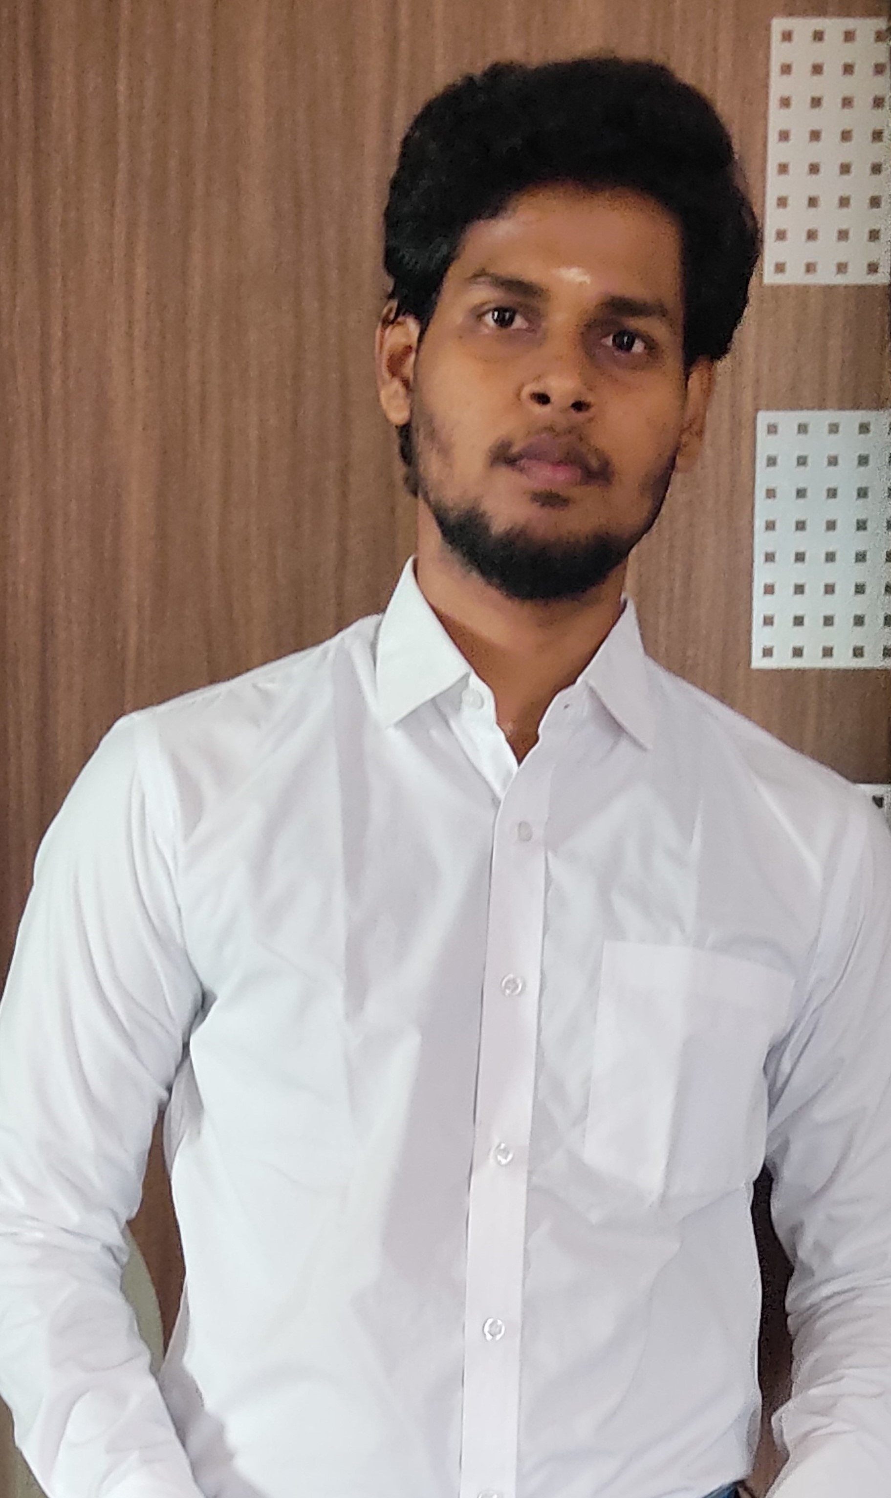



NIRANJAN J
+91 6382415910
jssn2niranjan@gmail.com
Shri Krishna nagar 5th St, Mudichur Road, mannivakkam, W.Tambaram
Web Designer / Full Stack Developer
OBJECTIVE
A passionate and enthusiastic person willing to experience industry level problem solving skills and strategies that will enhance me to utilize my problem solving skills and attention to detail to further develop my abilities in the field of interest.
SKILLS
EXPERIENCE
DCE
PROFESSIONAL
2021( April-May)
MINI PROJECT
git github
React
PHP, MySQL
Python , django HTML5,CSS3
Angular 6 Bootstrap
Developed a website to acheive e-commerce in pharmacy using html,css,javascript and PHP .
https://niranjan-2807.github.io/AdorablePharmacy/
2018-2019
College Expo
Created the Holographic message transmitter
PROJECTS / WORK
TOOLS
Windows , MS Office
Developed a complete E-commerce website-‘Adorable Pharmacy’ using html,css,javascript,php.
Developed a fitness website using javascript.
CERTIFICATIONS
IN-PROGRESS:
working in movie review websiten using django
Completed html,css crash course in pirple.com
Completed git and githib cource in Udemy.com
Completed Bootstarp course in European academy.
June 2019 - Present
B.E Computer Science at Dhanalakshmi College Of Engineering
CGPA of 7,4 on a 10.0 scale ( till 5th Semester)
2012-2016
Schooling at Shri Natesan Vidyasala Matric.Hr.School
HSC- 74.5% Scored 870 out of 1200
SSLC – 84.5% Scored 437 out of 500
Manimangalam
Tambaram
MORE INFO
LANGUAGES
Niranjan2807
Niranjan
Niranjan-2807
Tamil (Mother Tongue), English,,Telugu(intermediate).

