Slide 1
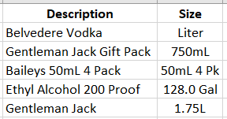
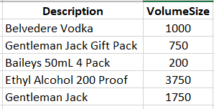
Standardized “Size” column

Slide 2
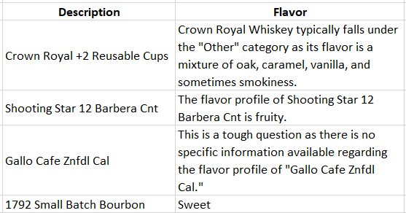
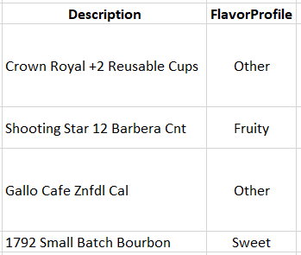

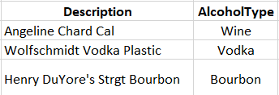

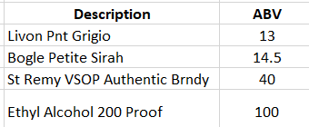
Data extraction from OpenAI dataset:

Slide 3



Generated unique product ID:

Slide 4


Formatted dates:

Slide 5


Handled missing values:

Slide 6
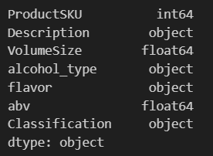
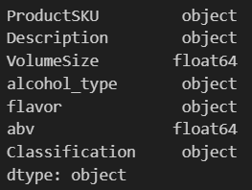




Fixed data types:

Slide 7

Combined begin and ending inventory table:

Slide 8
Build dedicated info tables.
Size of Raw Tables
2.15 GB
Size of Analytical Tables
516 MB
-75%

Slide 9
“WHEN SOMETHING GOES OUT OF STOCK, WHERE DO YOU THINK PEOPLE ARE GOING TO GO? IF YOU’RE JUST SELLING A WHITE T-SHIT, THERE’S A LOT OF OTHER PLACES WHERE PEOPLE CAN GET A SIMILAR WHITE T-SHIRT”
- Michael Keenan

Slide 11




Slide 12
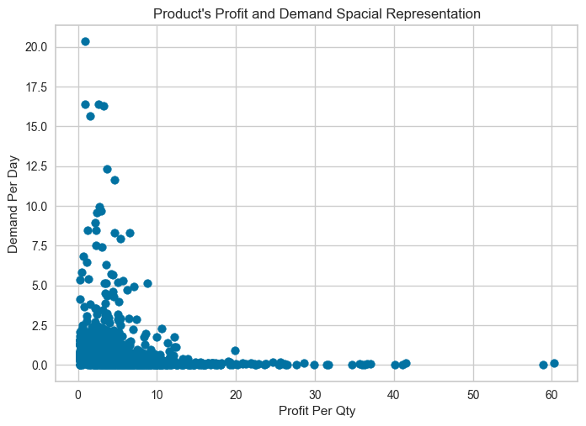
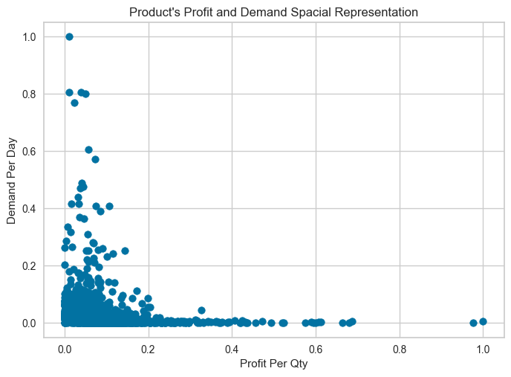

Slide 13
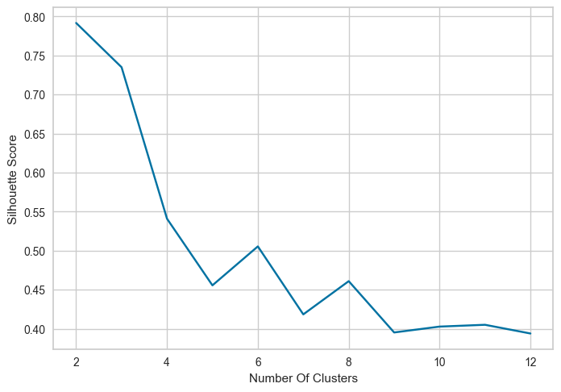
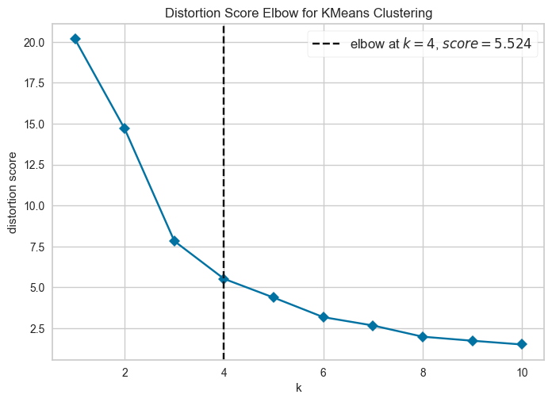
Silhouette Result
Elbow Method Result

Slide 14
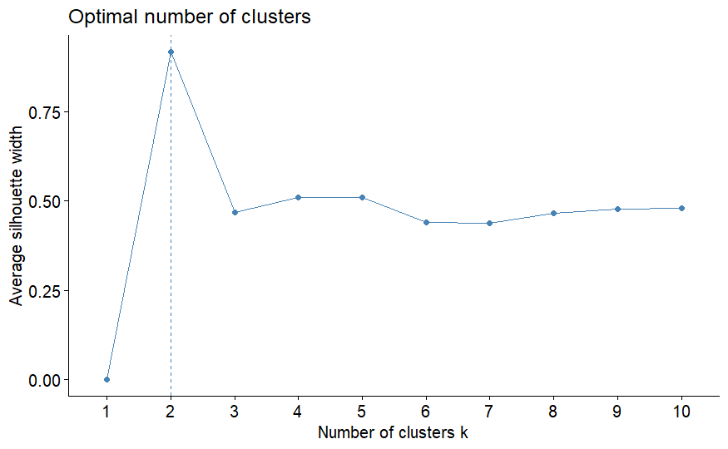
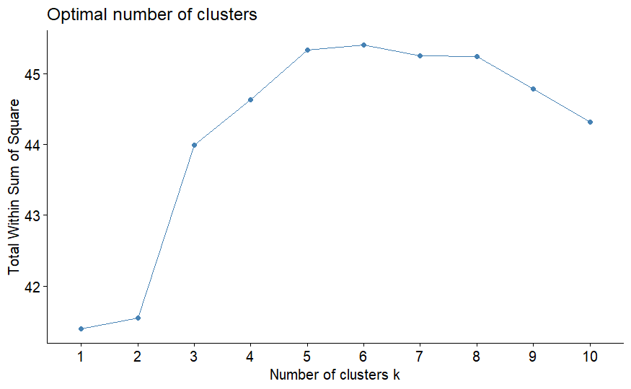
Silhouette Result
Elbow Method Result

Slide 15
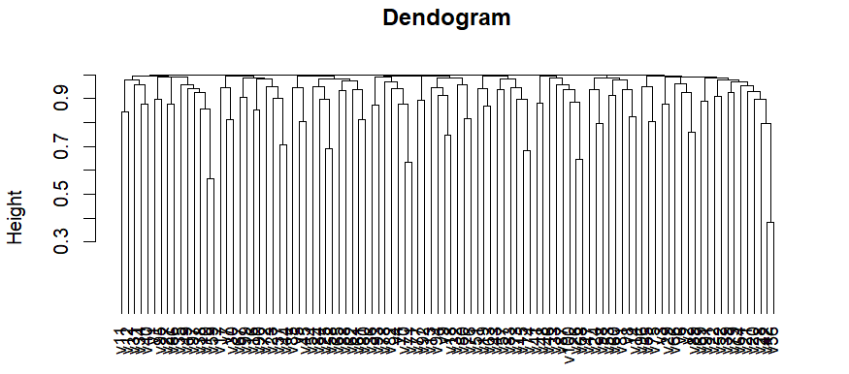

Slide 16
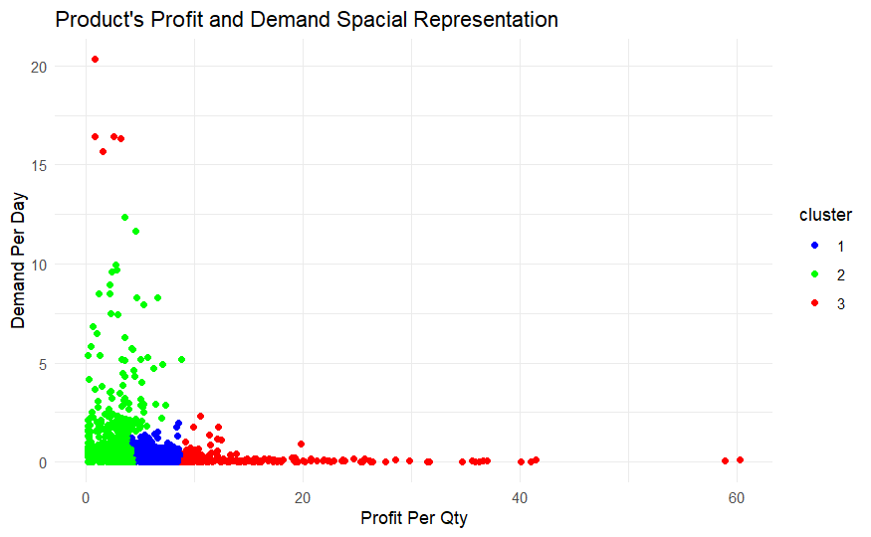

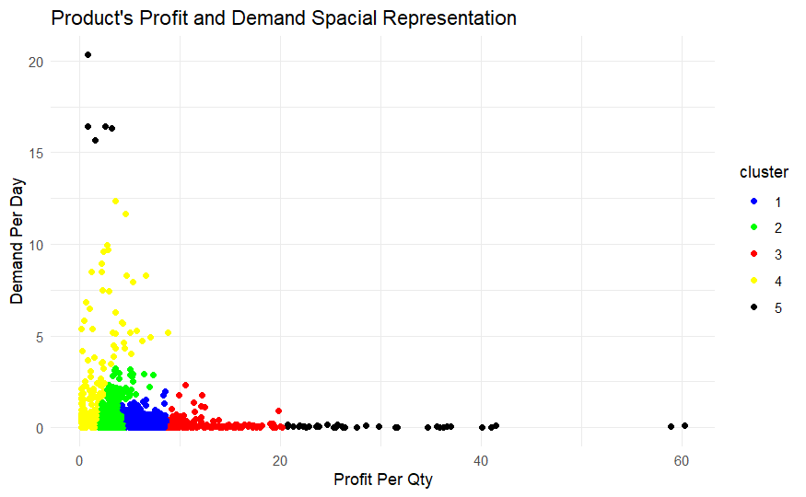
Hierarchical Clustering Result
K= 3
K= 4
K= 5

Slide 17
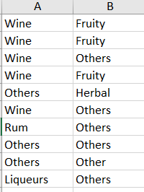

Slide 18
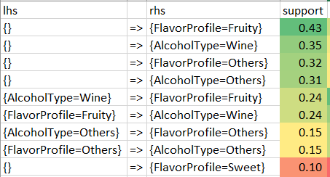
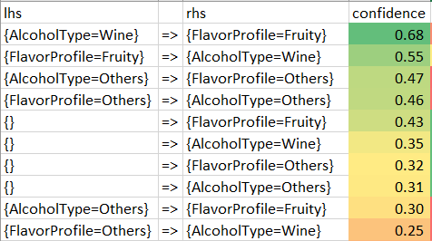
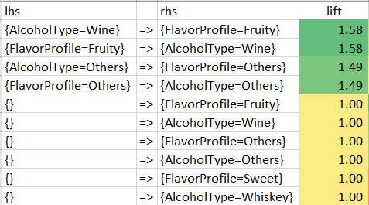
Top 10 Support
Top 10 Confidence
Top 10 Lift

Slide 19
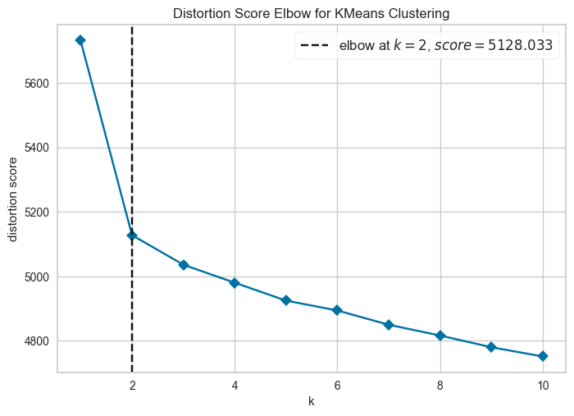
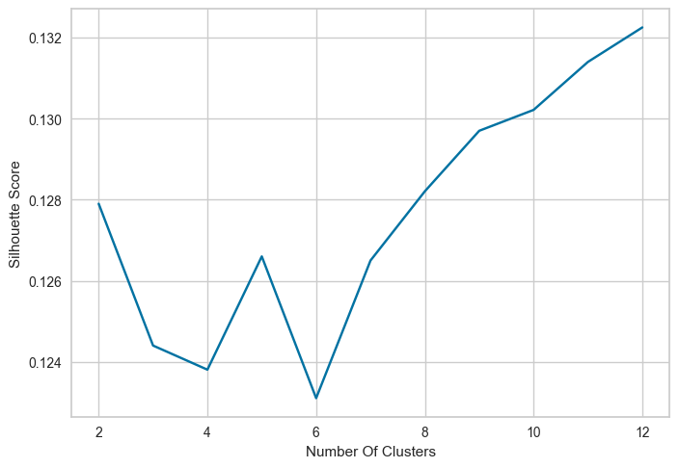
Silhouette Result
Elbow Method Result

Slide 20
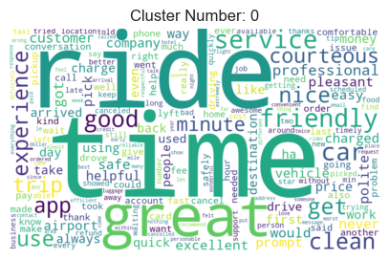
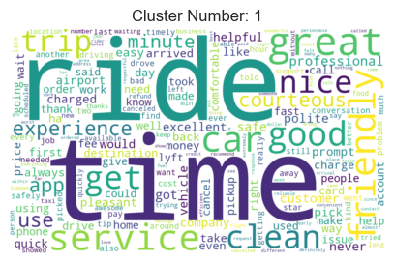
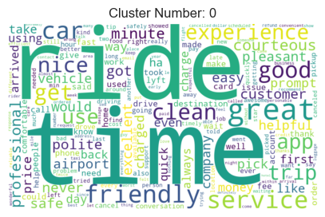
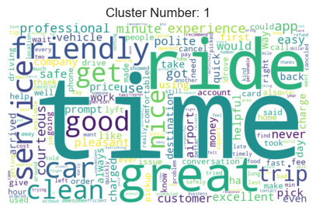
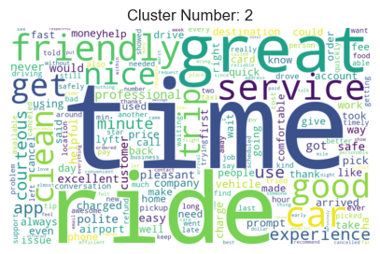
K = 2
K = 3

Slide 21
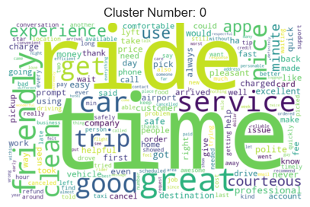
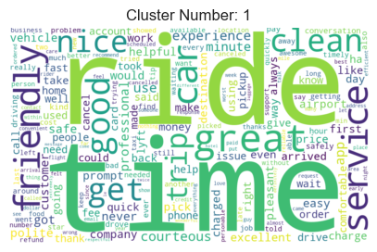
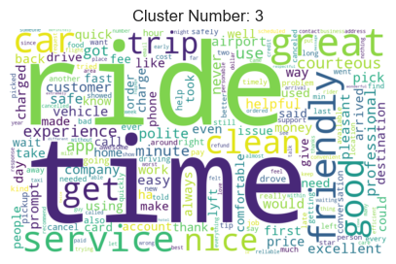
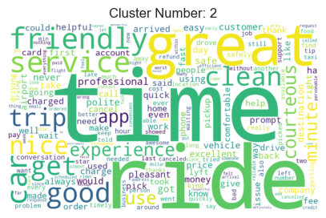
K = 4

Slide 22
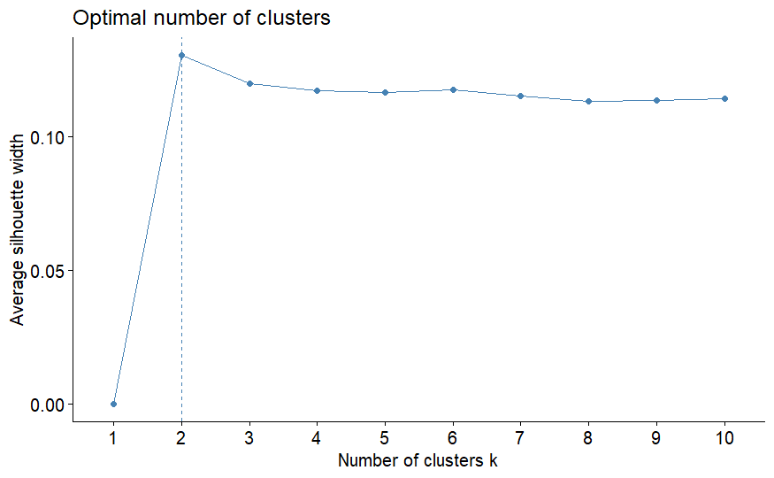
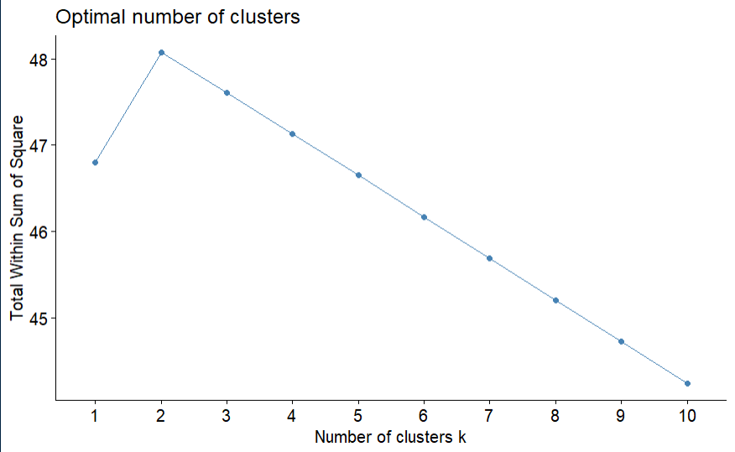
Silhouette Result
Elbow Method Result

Slide 23
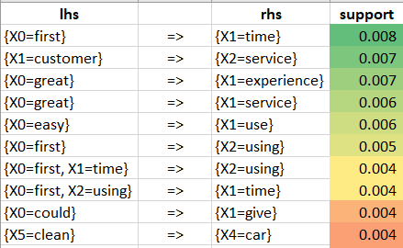
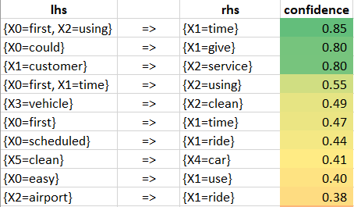
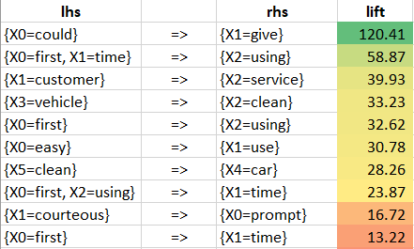
Top 10 Support
Top 10 Confidence
Top 10 Lift

Slide 24
Cluster of words by topics
Documents
Topic Modeling
Cluster of documents by topics

Slide 25
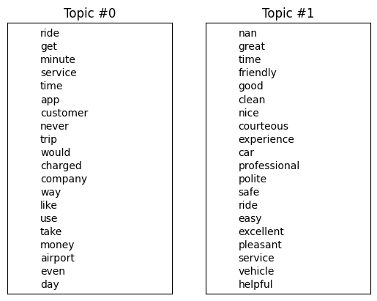
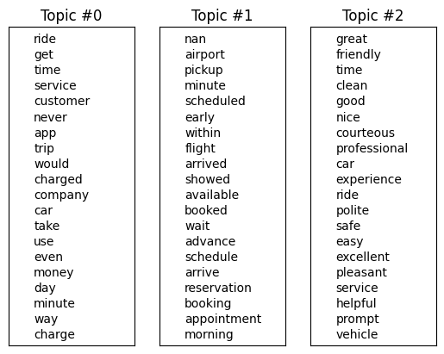
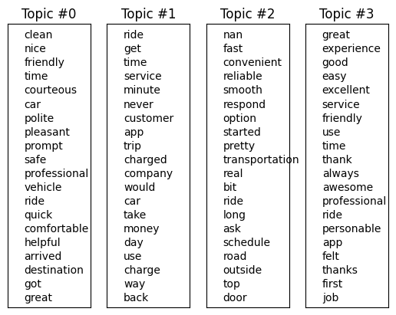
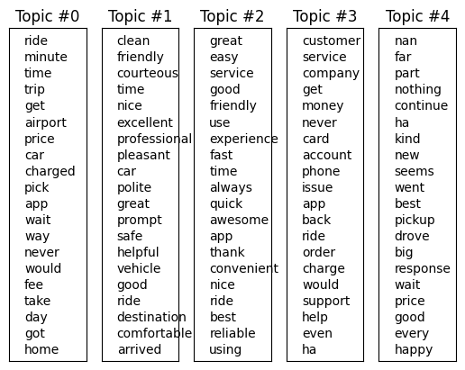
NUM_TOPICS= 2
NUM_TOPICS= 3
NUM_TOPICS= 4
NUM_TOPICS= 5

