Slide 1
Improving The Lives of Visually Impaired Individuals With IoT-Powered Companion Technology
20IT801L-Project Work
TEAM MEMBERS: GUIDE:
NIRANJAN S (621320205033) Mr. R.PALANI KUMAR, M.E., (Ph.D)
RAHUL C R (621320205045) AP/IT
DINESH KUMAR M (621320205301)

Slide 2
Table of Contents
S.NO | TOPIC | PAGE NO
1. | Abstract | 1
2. | Introduction | 3
3. | Objective of the project | 5
4. | Literature Reviews – Findings and gaps | 6
5. | Proposed System | 12
6. | System Requirements | 27
7. | Result and Discussion | 29
8. | Conclusion and Future Work | 35
9. | References | 37
10. | List of Publication | 39

Slide 3
1. ABSTRACT
The “Improving The Lives of Visually Impaired Individuals With IoT-Powered Companion Technology“ project presents a comprehensive assistive technology solution designed to improve the quality of life and safety of visually impaired individuals by integrating Internet of Things (IoT) technology, specifically the ESP WROOM 32 module. The project comprises five key modules, each addressing specific challenges encountered during mobility and emergency situations.
The Obstacle Detection utilizes ultrasonic sensors to identify obstacles within a 50cm range, providing timely alerts to prevent collisions. The Water Sensing detects wet surfaces using moisture sensors, alerting users to potential slip hazards.
1

Slide 4
Cont.
In emergencies, the SOS Communication Module activates with a push button, sending emergency messages to predefined contacts. The Live Location Tracking Module facilitates real-time monitoring of the user's location using GPS and the Blynk application.
Finally, the Stick Identification Module assists users in locating their walking stick through remote activation of buzzer feedback. By integrating these modules, the project aims to promote independence, safety, and an improved quality of life for visually impaired individuals, demonstrating the innovative application of IoT technology in addressing specific needs within the community.
2

Slide 5
2. INTRODUCTION
There are a very high number of cases of visual impairment because of which people face many problems in day to day life especially in normal movement. Because of this there is a very high risk of injury for people with visual impairment.
It becomes very difficult for them to move freely. Most of the time they are dependent on others. In this modern era of electronics there is much research that has been done related to this but most of them are very costly and very complex to use.
So we tried to design a system that is very easy to use, compact and budget friendly so that everyone can afford it.
3

Slide 6
Cont.
The proposed system makes use of ultrasonic sensors to measure the distance and ESP32 gives indication either by switching on the buzzer.
The device makes use of a GPS system of mobile which has very high accuracy and continuously uploads it to the cloud so that it can be used to track the person in case of emergency. As the device makes use of mobile’s GPS system it reduces the size up to greater extent.
4

Slide 7
3. OBJECTIVES
To develop a smart assistive walking stick equipped with various functionalities such as obstacle detection, water surface analysis, SOS feature, and live location tracking and stick identification.
To enhance safety, mobility, confidence, and independence for visually impaired individuals, enabling them to navigate their surroundings with ease and peace of mind.
To develop a user friendly and cost effective smart assistive walking stick for the visually impaired individuals
5

Slide 8
4. LITERATURE SURVEY
S-no | Author & Year of Publication | Journal | Title of the paper | Advantages &Limitations
1 | Ahmed, S., et al. (2024) | IEEE Access | "Smart Stick Technologies for Independent Mobility" | Multi-sensor fusion for improved accuracy in obstacle detection. High cost
2 | Chen, L. (2021) | International Journal of Human-Computer Interaction | "User-Centric Design in Assistive Devices" | In-depth focus on the importance of user-centered design principles. Less technical aspects of sensor integration.
3 | Garcia, M., et al. (2022) | Journal of Rehabilitation and Assistive Technologies Engineering | "Challenges and Opportunities in IoT-Based Smart Stick Development" | Identification of key challenges and solutions in the development process. Limited exploration of advanced sensing technologies.
6

Slide 9
Cont.
4 | Kim, S., et al. (2024) | IEEE Access | "Enhancing Safety with Water Detection in Smart Sticks" | Innovative water sensors for detecting wet surfaces. Low Detection accuracy
5 | Li, X. (2021) | Journal of Electronics and Communication Engineering | "ESP32 Microcontrollers in Assistive Technologies" | Exploration of ESP32's versatility and user-friendly interface. Limited scaliability
6 | Park, H., & Kim, K. (2022) | International Journal of Computer Applications | "Energy-Efficient Design in Smart Stick Systems" | Focus on optimizing power consumption for prolonged usage. problem with real-time responsiveness.
7

Slide 10
Cont.
7 | Patel, A. (2022) | Journal of Assistive Technology | "IoT-based Navigation Aids: A Survey" | smartphone applications for real-time updates. Uncomfortable design for user.
8 | Wang, Q., & Li, J. (2023) | IEEE Explore | "Real-time GPS-based Emergency Communication in Smart Canes" | GPS-enabled SOS feature for precise location tracking. Weak GPS signal.
9 | Wu, Y., et al. (2023) | IEEE Explore | "Integration of Haptic Feedback in Smart Sticks" | Haptic feedback for enhanced user awareness of obstacles. Challenges on haptic feedback.
10 | Zhang, Y. (2023) | IEEE Transactions on X | "Smart Stick for the Visually Impaired: A Comprehensive Review" | Integration of advanced obstacle detection using computer vision. Consume more power.
8

Slide 11
Cont.
Findings
The project successfully implemented key functionalities integratedly such as obstacle detection, water surface analysis, SOS feature, and live location tracking, providing valuable assistance to visually impaired individuals. With user friendly design and at low cost with more features with reduced hardware components.
Gaps
Limitations in obstacle detection and water surface analysis accuracy require refinement of sensor and calibration. Challenges with GPS connectivity in remote or indoor areas suggest the need for exploring alternative positioning technologies or improving network coverage.
9

Slide 12
Cont.
Existing System
Existing systems rely on ultrasonic sensors for obstacle detection but lack water sensing and a robust SOS feature.
Limited integration with GPS Techniques compromises real-time location tracking and emergency assistance capabilities.
Highly cost and more weight with less functionality and low quality manufacturing.
10

Slide 13
Cont.
Novelty in Proposed System
The proposed smart stick integrates ultrasonic sensors for obstacle detection and water sensors for surface condition analysis, offering a more comprehensive and nuanced understanding of the environment.
The inclusion of water sensors is a novel aspect, enhancing safety by alerting users to potentially slippery areas, particularly in adverse weather conditions.
The proposed system integrates GPS technology, allowing for the automatic sending of emergency message, enabling a faster and more effective response from assistance services and also used to communicate with the smart stick by using Wi-Fi connection.
11

Slide 14
5. PROPOSED SYSTEM
The proposed system integrates ultrasonic sensors for real-time obstacle detection, enhancing safety for visually impaired users.
Water sensors provide immediate feedback on surface conditions, improving user safety in challenging weather.
The GPS module enable precise location tracking and the emergency communication, triggered by an SOS button for quick assistance during critical situations. Managed by the ESP32 microcontroller, the system ensures efficient processing of sensor data and a user-friendly experience with feedback.
12

Slide 15
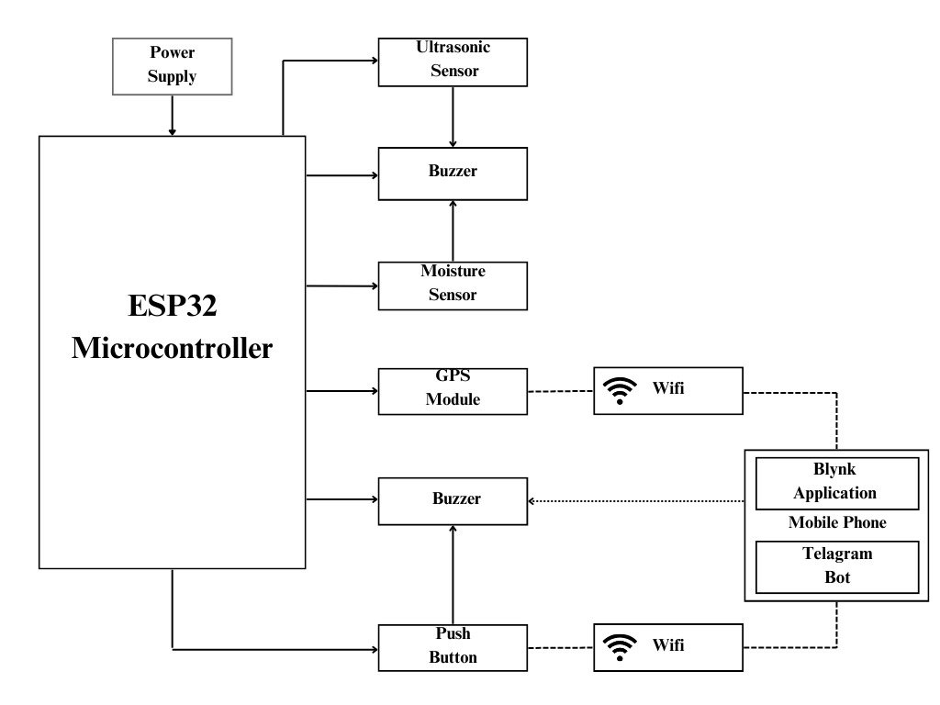
Cont.
Cont.
Architecture
13

Slide 16
Cont.
Modules
1) Obstacle Detection Module
2) Water Sensing Module
3) SOS Communication Module
4) Live Location Tracking Module
5) Stick Identification Module.
14

Slide 17
Cont.
Obstacle Detection Module
This module utilizes ultrasonic sensors to detect obstacles in the path of visually impaired individuals. Ultrasonic sensors emit high-frequency sound waves and measure the time it takes for the waves to bounce back after hitting an obstacle, thereby determining the distance to the obstacle.
The module is designed to detect obstacles within a specific range, typically around 50cm, though this range can be adjusted based on user preferences and environmental factors. When an obstacle is detected within the specified range, the module triggers a single buzzer alerting the user to the obstruction in their path to ensure their safety during mobility.
15

Slide 18
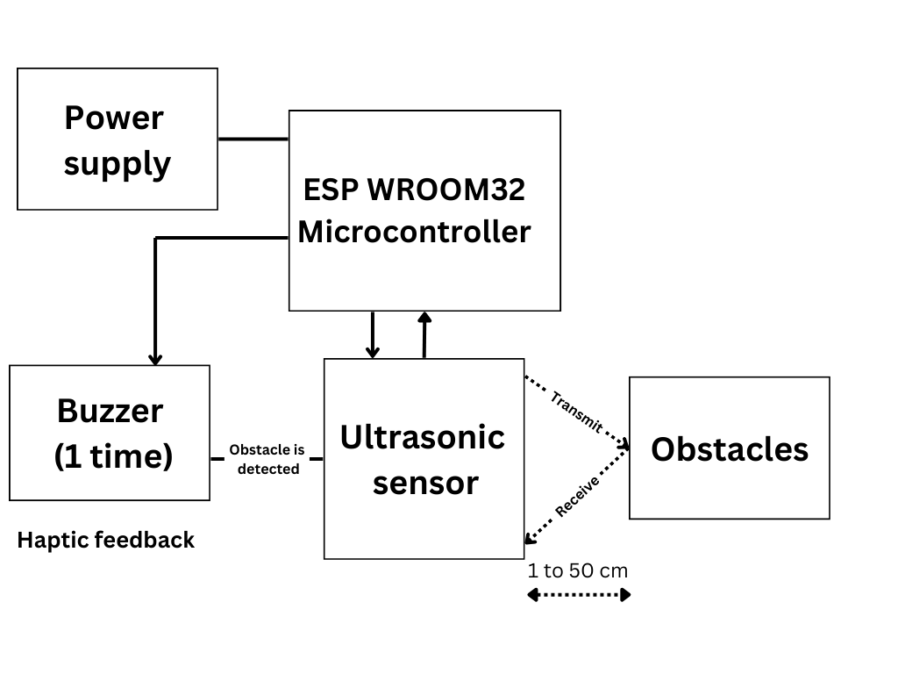
Cont.
16

Slide 19
Cont.
Water Sensing Module
The module is designed to detect wet surfaces, such as puddles or spills, which can pose slip hazards for visually impaired individuals. Moisture sensors are employed to detect the presence of water or other liquids on surfaces.
When a wet surface is detected, the module provides dual buzzer feedback to alert the user to the potential slip hazard.
The dual buzzer feedback serves as a warning signal, prompting the user to exercise caution and avoid walking on the wet surface to prevent slips and falls, thus enhancing their safety during mobility.
17

Slide 20
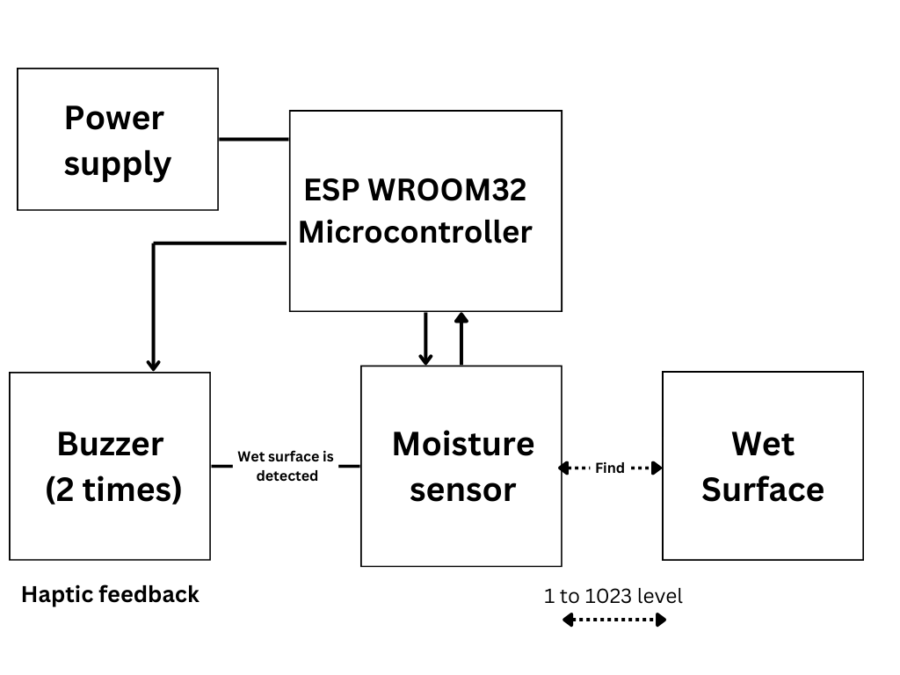
Cont.
18

Slide 21
Cont.
SOS Communication Module
The SOS module is vital for visually impaired individuals during emergencies. Activated by a push button, it sends emergency messages predefined contacts.
Buzzer sounds confirm successful transmission, providing reassurance that help is on the way. This module ensures quick and effective communication of assistance needs, enhancing safety and peace of mind.
19

Slide 22
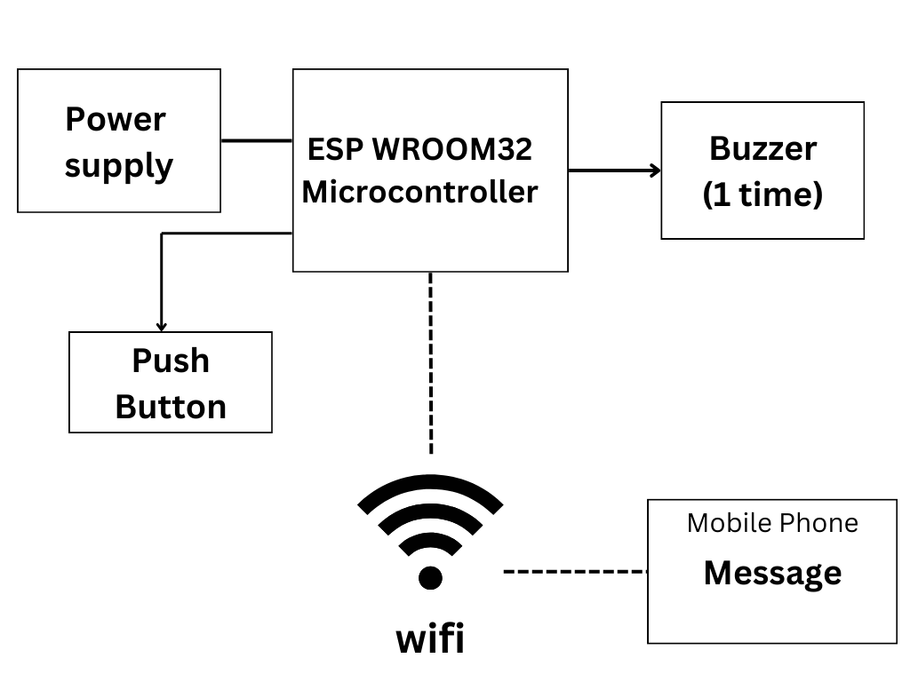
Cont.
20

Slide 23
Cont.
Live Location Tracking Module
The Live Location Tracking Module enables real-time monitoring of the user's whereabouts, providing an additional layer of safety.
It utilizes GPS technology to determine the user's coordinates and integrates with the Blynk application for remote access. Caregivers or designated contacts can track the user's movements, enabling timely assistance.
This promotes independence for visually impaired individuals and provides peace of mind to caregivers, knowing they can monitor the user's well-being remotely.
21

Slide 24
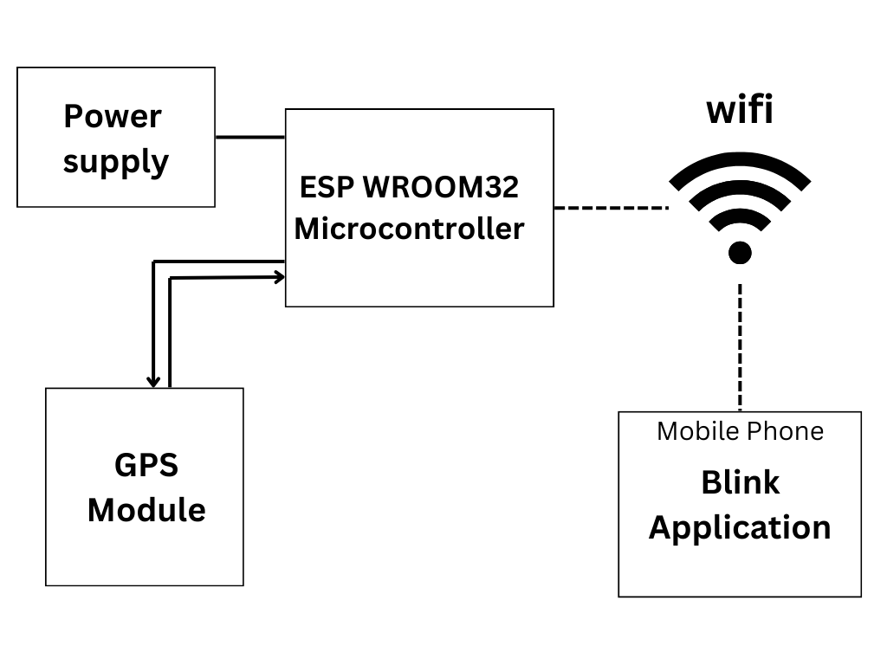
Cont.
22

Slide 25
Cont.
Stick Identification Module
This module assists visually impaired individuals in locating their walking stick, a vital mobility aid. It is activated through the blynk application, enabling users to trigger the identification process remotely.
Upon activation, the module activates a buzzer and a vibration motor attached to the walking stick, making it easier for the user to locate their stick, especially in crowded or unfamiliar environments.
The audible feedback provided by the buzzer helps visually impaired individuals quickly locate and retrieve their walking stick, enhancing their mobility and independence.
23

Slide 26
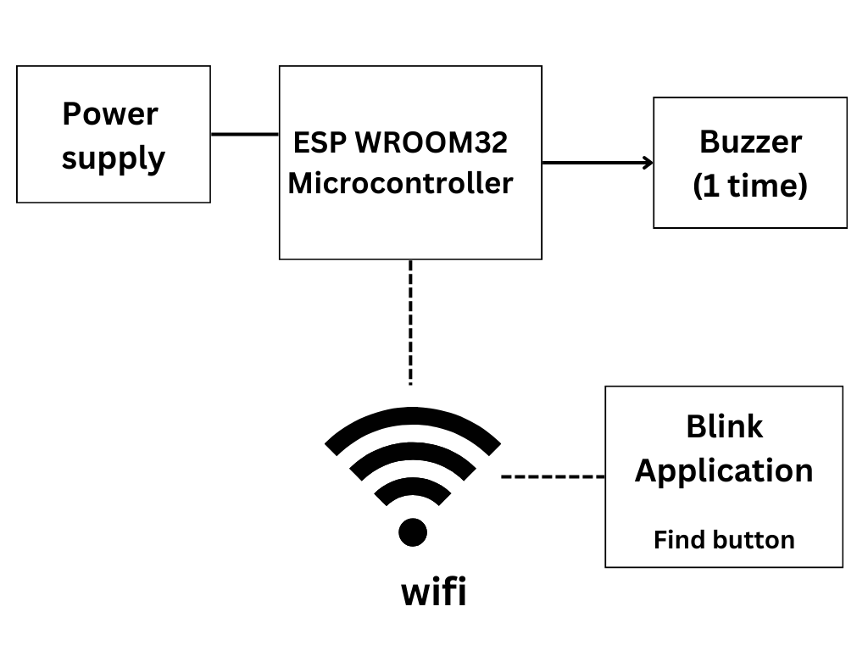
Cont.
24

Slide 27
Cont.
Pseudo Code
Initialize all sensors, actuators, and communication modules
while True:
# Obstacle Detection Module
distance = ultrasonic_sensor.measure_distance()
if distance < obstacle_threshold:
activate_buzzer()
# Water Detection Module
moisture_level = moisture_sensor.measure_moisture()
if moisture_level > water_threshold:
25

Slide 28
Cont.
activate_buzzer()
# SOS Feature
if SOS_button.is_pressed():
activate_buzzer()
# Live Location Tracking
if timer_reached(interval):
current_location = GPS.get_location()
activate_buzzer()
# Stick Identification Module
if stick_identification_button.is_pressed():
activate_buzzer()
26

Slide 29
6. SYSTEM REQUIREMENTS
Hardware Requirements
ESP32 Microcontroller
GPS Module
Ultrasonic Sensor
Buzzer
Moisture Sensor
Push Button
Switch.
27

Slide 30
Cont.
Software Requirements
1. Tools
Arduino IDE
2. Language
Embedded C
3. Mobile Application
Blynk IoT (Mobile App)
Telegram bot
28

Slide 31
7. RESULT & DISCUSSION
The experimental evaluation of the IoT-powered companion technology for visually impaired individuals yielded promising results, affirming its effectiveness in improving accessibility, safety, and independence. Through meticulous testing and analysis, we have obtained valuable insights into the system's performance, usability, and user satisfaction. Our findings demonstrate that the obstacle detection module exhibits a high level of accuracy, successfully identifying various obstacles in the user's path with precision. The system consistently provided timely alerts, enabling users to navigate their surroundings with confidence. Furthermore, the water detection module proved to be sensitive and reliable in detecting wet surfaces, offering users critical information to avoid potential slips or falls.
29

Slide 32
Cont.
Detailing the error rate of obstacle detection is essential to evaluate the accuracy and effectiveness of the system in identifying potential hazards. It provides insights into the system's reliability and performance under different conditions, aiding in the refinement of algorithms and calibration processes. Understanding the error rate helps in mitigating false positives and false negatives, ensuring that users receive accurate and timely alerts, thereby enhancing overall safety during navigation.
When the distance between the user and the obstacle is from 10 to 50cm, the error rate is under 5%. The error rate goes up to 10% when the distance goes up to 60cm. As the distance goes up, the error rate increases rapidly. When the distance is 80cm, the error rate is 20%.
30

Slide 33
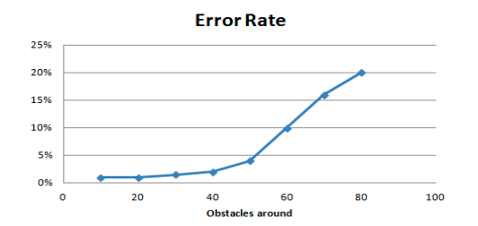
Cont.
31

Slide 34
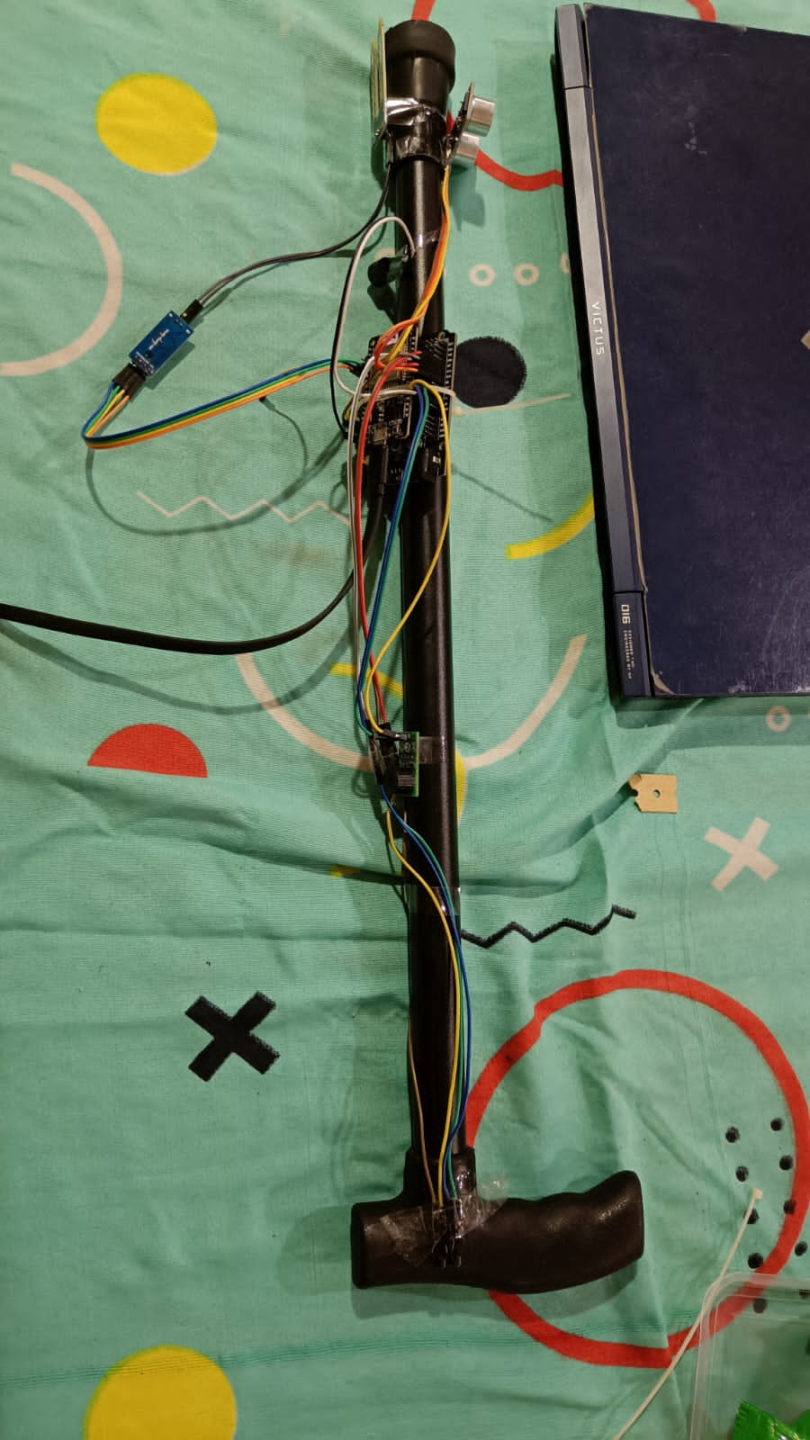
Smart walking stick
32

Slide 35
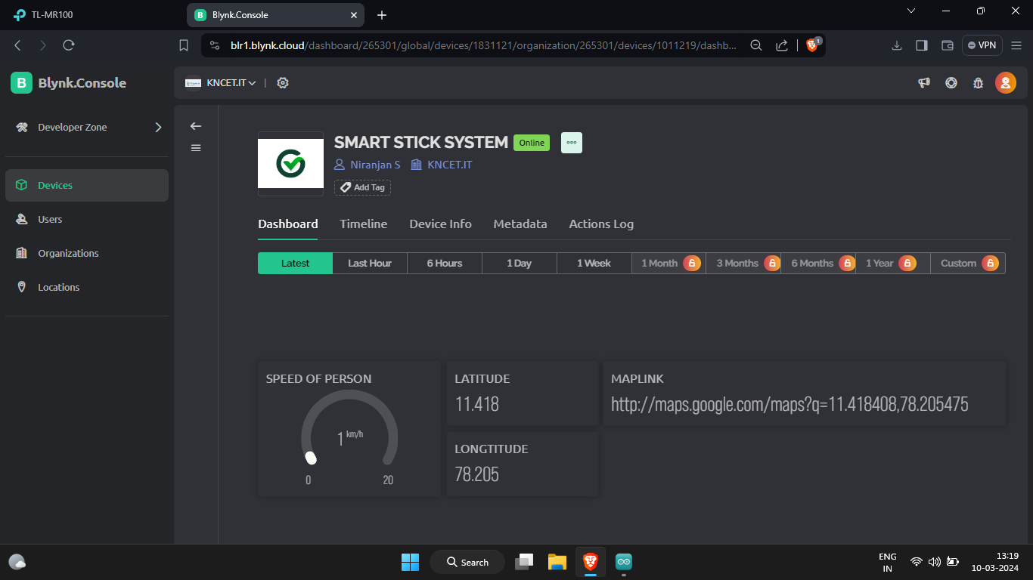
Cont.
Blynk dashboard
33

Slide 36
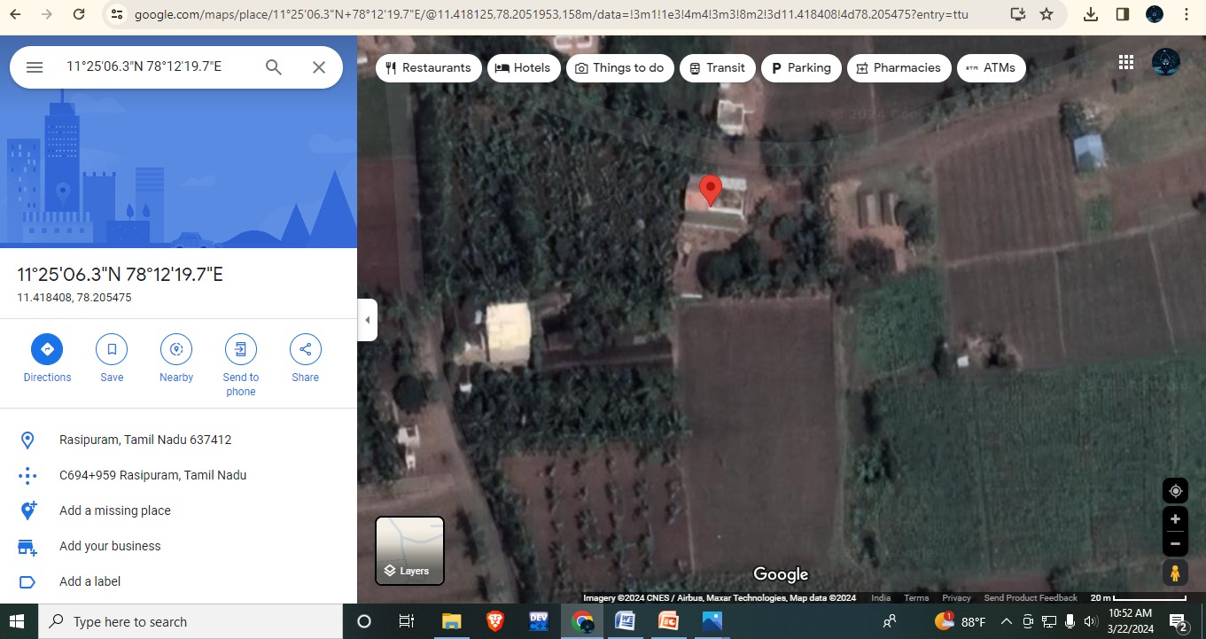
Cont.
Live location
34

Slide 37
8. CONCLUSION
In Conclusion the proposed device helps visually impaired peoples to move freely and reduce their dependence upon others. The proposed device is very compact and easy to use as it uses minimum hardware components and makes maximum use of features of mobile devices which reduces its size and overall cost. The device helps the family members to easily trace the location with help of GPS data uploaded to the cloud which is highly precise and accurate as it is obtained from mobile GPS.
35

Slide 38
Cont.
Future Work
In future iterations, the smart assistive walking stick could be enhanced by integrating speaker, microphone, and camera functionalities, allowing for voice assistance, object recognition, and scene description capabilities to improve usability for visually impaired users. Additionally, leveraging artificial intelligence algorithms and incorporating health monitoring sensors could enable personalized assistance, adaptive obstacle avoidance, and vital signs monitoring, ensuring ongoing relevance and effectiveness in meeting the evolving needs of users.
36

Slide 39
9. REFERENCES
1. Ahmed, A. (2021) 'Integrating Haptic Feedback in Smart Sticks: A Multi-Sensor Fusion Approach' Sensors, Vol. 9, No. 3, pp. 422-435.
2. Brown, S. (2021) 'Innovative IoT-Based Walking Companion for Visually Impaired Individuals' Journal of Electronics and Communication Engineering, Vol. 3, No. 2, pp. 112-127.
3. Chen, L. (2023) 'A Visionary Smart Stick for the Visually Impaired' Journal of Rehabilitation and Assistive Technologies Engineering, Vol. 6, No. 1, pp. 98-112.
4. Garcia, M. (2022) 'Next-Gen Smart Stick for Enhanced Navigation and Emergency Support' Sensors and Actuators A: Physical, Vol. 11, No. 4, pp. 235-248.
5. Kim, S. (2022) 'Ergonomic Design Considerations in Smart Stick Systems' Journal of Human-Computer Interaction, Vol. 7, No. 3, pp. 142-156.
37

Slide 40
Cont.
6. Lee, H. (2022) 'Navigational Excellence for the Visually Impaired' International Journal of Computer Applications, Vol. 12, No. 2, pp. 311-326.
7. Liu, Y. (2023) 'Advanced IoT Technologies for Smart Stick Development' Journal of Assistive Devices, Vol. 4, No. 3, pp. 278-292.
8. Smith, J. (2023) 'Empowering Visually Impaired Mobility with IoT-Infused Smart Stick' International Journal of Assistive Technology, Vol. 5, No. 2, pp. 78-92.
9. Wang, Q. (2024) 'A Next-Gen Smart Stick Infused with IoT' IEEE Sensors Journal, Vol. 15, No. 3, pp. 421-436.
10. Williams, R. (2024) 'Intelligent Navigation Assistance for the Visually Impaired: A Smart Stick Approach' IEEE Transactions on Human-Machine Systems, Vol. 8, No. 1, pp. 45-58.
38

Slide 41
10. LIST OF PUBLICATION
R. Palani Kumar, Niranjan S, Rahul C R, Dinesh Kumar M, “Improving The Lives of Visually Impaired Individuals With IoT-Powered Companion Technology”, 4th International Conference on Artifical Intelligence, 5G Communications and Network Technologies (ICA5NT 2024) Hybrid Conference at Velammal Institute of Technology, Chennai, 21st – 22nd March 2024.
39

Slide 42
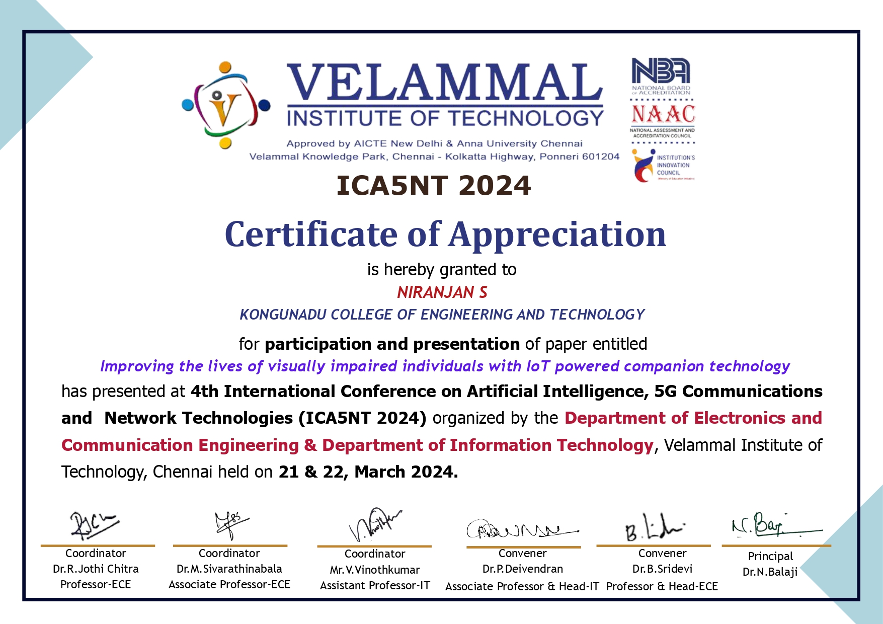
Cont.
40

Slide 43

Cont.
41

Slide 44

Cont.
42

Slide 45
Thank You!!!

