Slide 1
HTML 5

Slide 2
1.Introduction to web
Client-Server Architecture
Web Terminologies
URL
HTTP
MINE
Uniform Resource Locator : protocol://host:port/path
Hyper Text Transfer Protocol : Request/response protocol , stateless
MIME: Multipurpose Internet Mail Extension

Slide 3
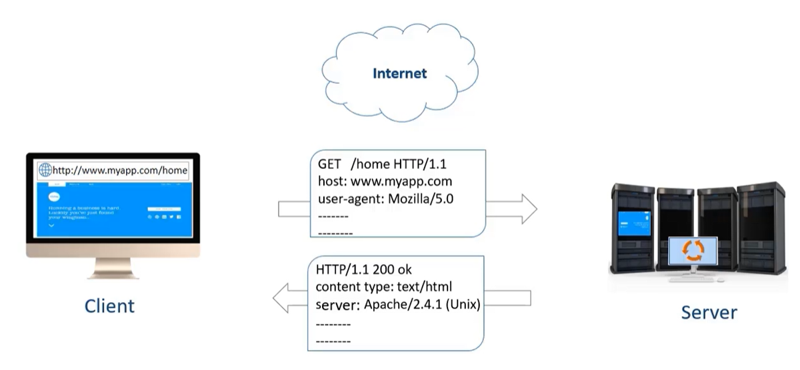
1.1 HTTP response cycle

Slide 4
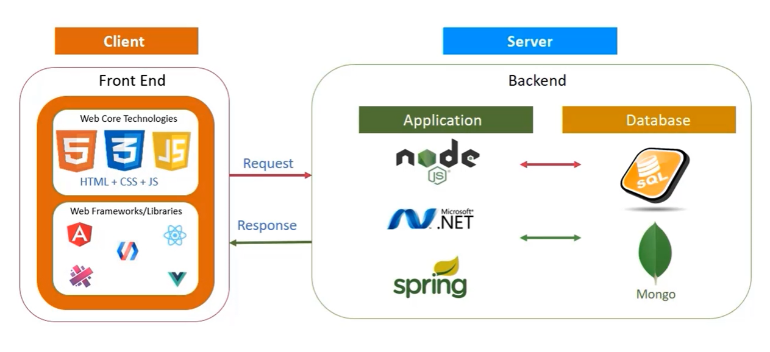
2. Full Stack Application

Slide 5
3. Environment setup for HTML
.htm .html files
Notepad++
Visual Studio Code -> Add Live Server Extension

Slide 6
4. HTML Introduction
HTML (HyperText Markup Language) is the most fundamental building block of the Web. It defines the meaning and structure of web content.
CSS(Cascading Style Sheet) is used for styling and giving better presentation to the web pages
JavaScript(JS) is used for implementing behavior required in a web page

Slide 7
4.1 . What is HTML?
Hyper Text Markup Language (HTML) is a standard markup language to create the structure of a web page.
It is not a programming language.
It annotates the content on a web page using HTML elements.
In a web page, all instructions to the browser are given in the form of HTML tags, also known as HTML elements.
The content of the web page will be rendered as per the HTML tags in which they are enclosed.

Slide 8
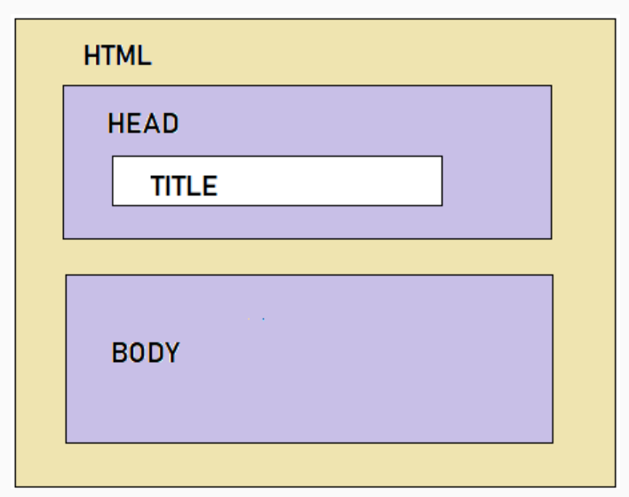
4.2 HTML Document Structure
<!DOCTYPE html>
<html>
<head>
<title></title>
</head>
<body>
</body>
</html>

Slide 9
4.2.1 Doctype Declaration
There are many versions of HTML out there such as - HTML 2.0, HTML 3.0, HTML 3.2, HTML4.0, HTML 4.01 and latest is HTML5.0.
In each version, some elements and attributes are either added or depreciated.
The appearance of your .html page depends on how the browser renders HTML elements. And how the browser renders HTML elements depends on how the browser understands them.
Thus, to ensure that the browser understands all HTML elements specific to a particular version, as a developer you need to tell the browser what version of HTML you have followed while developing your web page.
This is done by using <!DOCTYPE> declaration which stands for Document Type. It tells the browser what version of HTML it should follow for rendering the web page.
HTML 4:
<!DOCTYPE HTML PUBLIC "-//W3C//DTD HTML 4.01//EN" "http://www.w3.org/TR/html4/strict.dtd">
HTML 5:
<!DOCTYPE html>

Slide 10
4.2.2 What’s inside Head Tag
Tags | Description
<title> | Defines the title that should be displayed on the browser tab
<meta> | Metadata is in-general, data about data. Provides metadata about the HTML document. Metadata will not be displayed on the page but will be machine-readable. Used to specify page description, author of the document, last modified, etc. Used by browsers (control how to display content or reload the page), search engines (keywords), or other web services. Post HTML5, meta tag also allows web designers to take control over the viewport by setting the meta viewport tag.
<style> | Defines style information for the web page
<link> | Defines a link to other documents like CSS
<script> | Defines script like JavaScript

Slide 11
4.3 Best practice in HTML
Every HTML document/web page will have only one set of
<html>...</html> tag
<head>...</head> tag
<body>...</body> tag
HTML document/web page is saved with .htm or .html extension.
4.4 Hello World in HTML
Tryout Hello World in HTML

Slide 12
4.5 Case Insensitivity
HTML elements are case-insensitive. The browser understands the HTML tags irrespective of their cases.
4.6 Platform-independency
HTML Language is platform-independent.
That means the same HTML code can run on different operating systems as shown below.

Slide 13
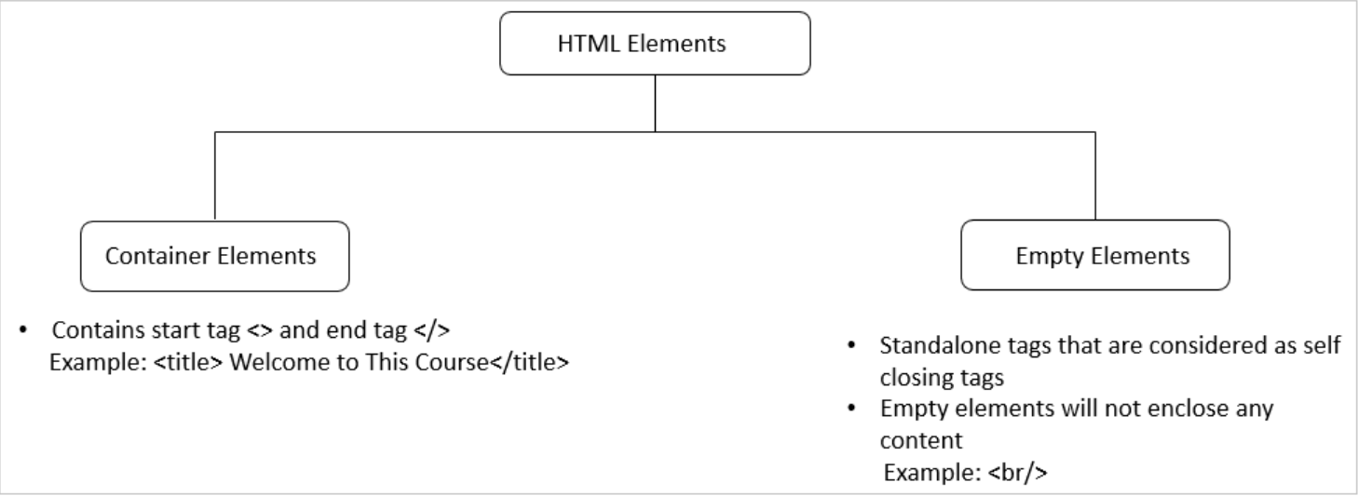
5. HTML Elements
HTML elements can be broadly categorized into two as below:

Slide 14
5. HTML Elements
HTML elements can be broadly categorized into two as below:
Semantic Elements
Non-Semantic Elements
What are Semantic Elements?
A semantic element clearly describes its meaning to both the browser and the developer.
Examples of non-semantic elements: <div> and <span> - Tells nothing about its content.
Examples of semantic elements: <form>, <table>, and <article> - Clearly defines its content.

Slide 15
5.1 Block/Inline Elements
HTML elements can be broadly categorized into two as below:
HTML elements can be further categorized into two as below:
Block Element:
A block element begins on a new line occupying the entire width of the parent tag.
Inline Element:
An inline element occupies the necessary space to accommodate the content in the element. Inline elements can be nested within other inline elements, whereas block elements cannot be nested within inline elements.

Slide 16
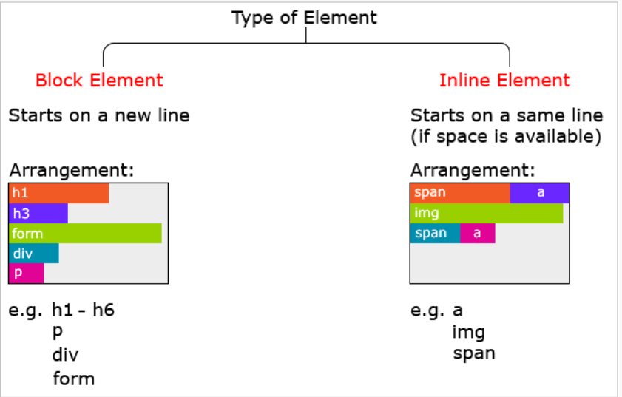
5.1 Block/Inline Elements

Slide 17
Tips: How to Comment in HTML
As a developer, you may want to document your code, so that you can easily refer to it in the future.
<!-- -->
VS Keyboard Shortcut: Ctrl + /
Comments are ignored by the browser.

Slide 18
5.2 HTML Element Attributes
HTML elements can contain attributes that can be considered as an additional feature to set various properties and they are optional.
Some of the attributes can be used with any of the HTML elements and there can be referred to as ‘global attributes. Also, some attributes can be used only with particular elements.
Following are some features of attributes:
All the attributes can contain properties like name and value which can be used by a developer to assign respective details for that HTML elements.
Attributes are to be set only in the start tag of a container HTML element.
Attributes are case-insensitive, but it is recommended to use lowercase as a best practice.
The best practice is always to quote attribute value even though we will not get any execution errors if they are not provided in quotes.

Slide 19
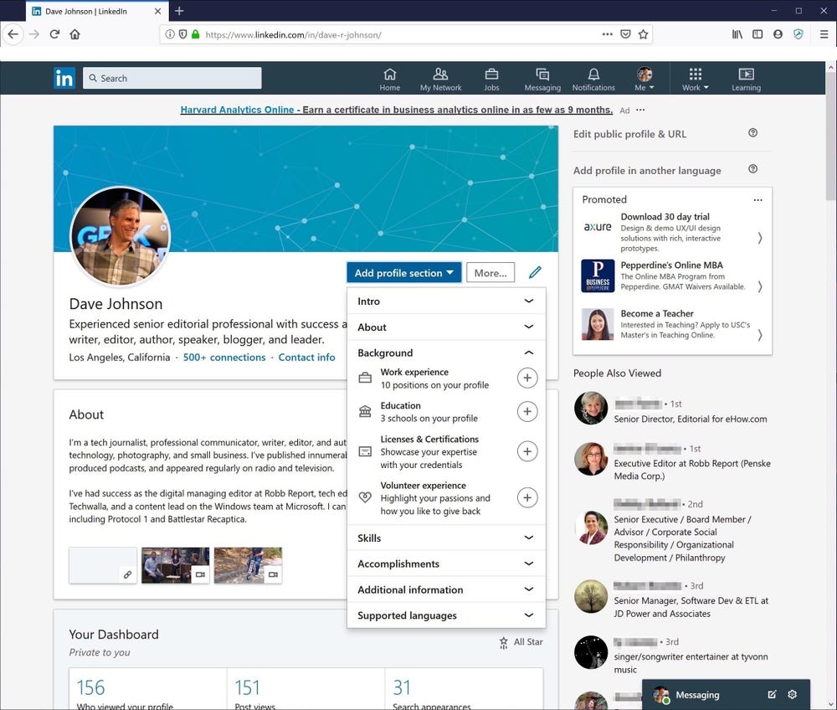
5.3 Sectioning Elements
What is a landing page

Slide 20
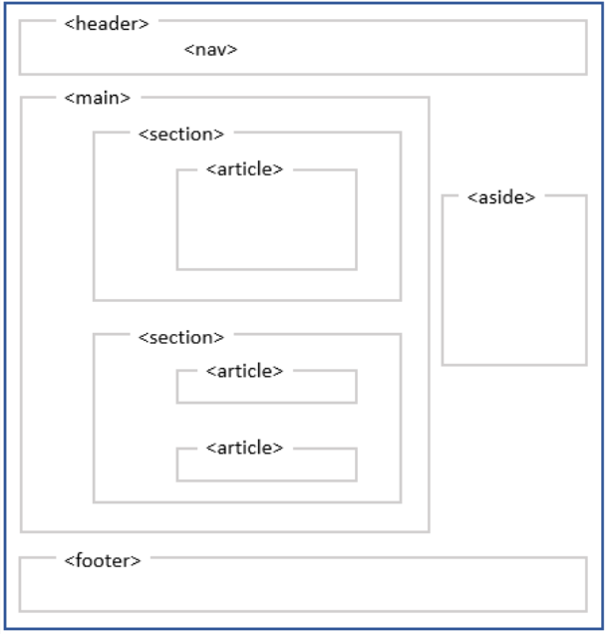
5.3 Sectioning elements

Slide 21
5.3.1 Header and Footer Element
<header>
The <header> element is used to include header content like web page logo, login link, website settings link, etc. Ideally, every web page has one header. However, multiple headers may also be included as per need.
<footer>
The <footer> element is used to include footer content like copyright, about us, terms and conditions link, etc. One footer is included per page.
5.3.2 Nav Element
<nav>
The <nav> element is used for navigational content like navigation menu for the website.
There is no limit to the number of times <nav> tag can be used on a web page.
As long as there are navigation links, links can be wrapped inside <nav>.

Slide 22
5.3.2 Main Element
<main>
The <main> tag specifies the main content of a document.
The content inside the <main> element should be unique to the document. It should not contain any content that is repeated across documents such as sidebars, navigation links, copyright information, site logos, and search forms.
Note: There must not be more than one <main> element in a document. The <main> element must NOT be a descendant of an <article>, <aside>, <footer>, <header>, or <nav> element.
<section>
The <section> element is used to organize the web page into different sections.

Slide 23
5.3.2 Article and Aside
Article :
The <article> tag specifies independent, self-contained content.
An article should make sense on its own and it should be possible to distribute it independently from the rest of the site.
Note: The <article> element does not render as anything special in a browser. However, you can use CSS to style the <article> element
Aside:
The <aside> tag defines some content aside from the content it is placed in.
The aside content should be indirectly related to the surrounding content.
Tip: The <aside> content is often placed as a sidebar in a document.
Note: The <aside> element does not render as anything special in a browser. However, you can use CSS to style the <aside> element

Slide 24
5.3.2 Address
Address:
The <address> element helps to semantically organize address details in HTML content.
The <address> tag defines the contact information for the author/owner of a document or an article.
The contact information can be an email address, URL, physical address, phone number, social media handle, etc.
The text in the <address> element usually renders in italic, and browsers will always add a line break before and after the <address> element.

Slide 25
Tryout - Enhance the semantics of content by adding appropriate sectioning elements
<!DOCTYPE html>
<html>
<head>
<title>Hussian's Shopping</title>
<meta name="keywords" content="Online, Shopping" />
</head>
<body>
Login | SignUp | Track order Welcome to Hussian's Shopping Clothing | Media Hussain's very own one-stop solution for all your shopping needs !
Dont believe us? Click on the offers and check it out for yourself !! Clothing Media About
Us | Privacy Policy |Contact Us | FAQ | Terms & Conditions Copyright 2018 | Giri Like and Connect with us
FB Twitter g+
</body>
</html>

Slide 26
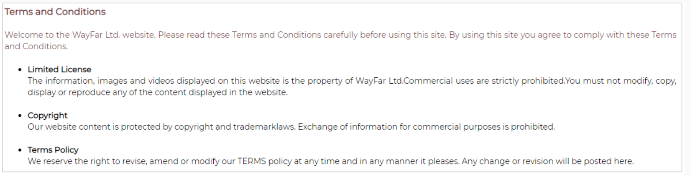
5.6 Grouping Elements
Why Grouping?
The need to associate mandatory visual spacing between logical portions of the textual description to improve text readability.
The need to group various portions of a web page for various reasons like applying some common styling

Slide 27
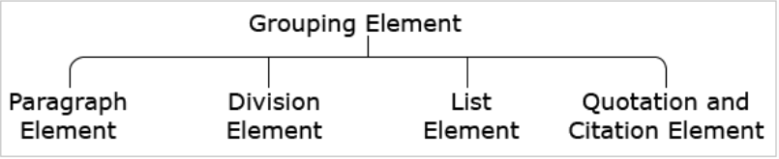
5.6.1 Grouping Elements
<p>
The <p> tag defines a paragraph.
Browsers automatically add a single blank line before and after each <p> element.
<div>
The division element is used to group various other HTML tags.
This element helps us in organizing the web page into different sections.
If any common rule or style needs to be added to a particular section, the same can be applied to the corresponding division.
The rule or style gets applied to all the contents of the division thereby.
It is defined using <div>…</div> tag.

Slide 28
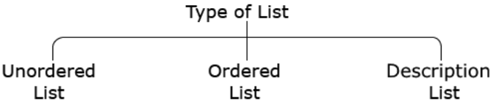
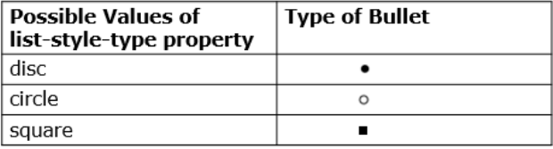
5.6.2 List Element
HTML lists come in three basic flavors and each one has a specific implementation.
Unordered list
An unordered list is used to create a list of related items, in no specific order, like in the Terms and Conditions page where there is more focus on ensuring the readability of content by listing out points but not much concern about the specific order of points.
An unordered list starts with the <ul> tag.
Each item within the list technically referred to as 'list-item' enclosed within the <li> tag.

Slide 29
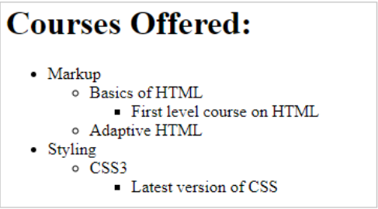
5.6.2 Tryout
Recreate

Slide 30
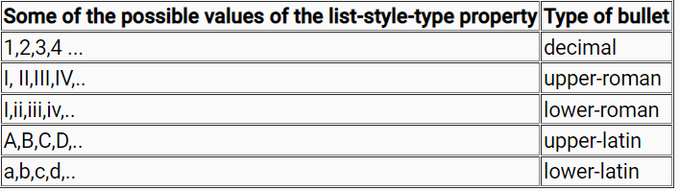
5.6.2 List Element
Ordered List:
An ordered list is used when the order of items is important and we want to create a list of related items, in a specific order.
An ordered list starts with the <ol> tag.
Each item within the list technically referred to as 'list-item' enclosed within the <li> tag.
By default, the 'decimal' value will be set to the CSS property. We can also have 'none' value for the list-style-type property if we do not need any bullets to be present in the list.

Slide 31
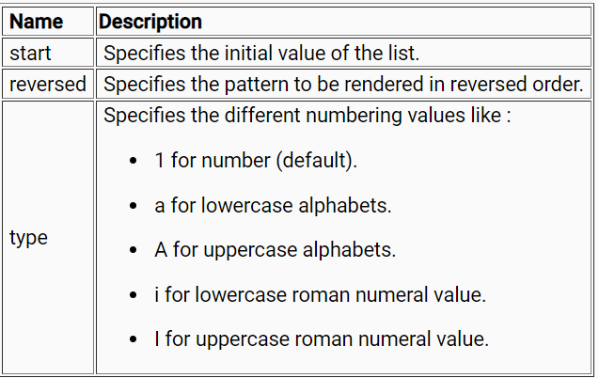
5.6.2 List Element
Ordered List Attributes:
Some of the attributes which can be used with this element are:

Slide 32
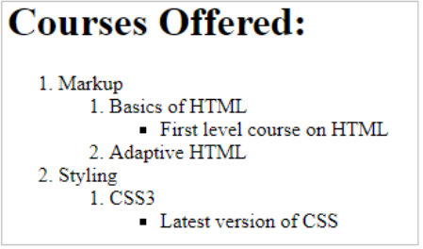
5.6.2 Tryout
Recreate

Slide 33
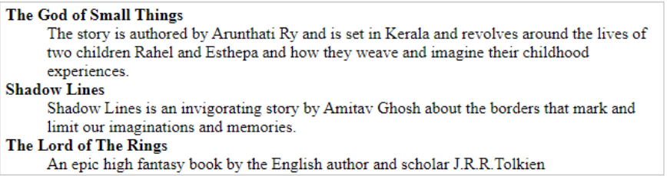
5.6.2 List Element
Description List:
Description lists are used to contain name-value groups, where names can be a list of terms and values can be their related descriptions.
The description list otherwise called definition list arranges items in the same way as the meaning associated with each word is arranged in a dictionary
Description lists are created with the <dl> tag.
The term is placed within <dt>.. </dt>
Description is placed between <dd>...</dd> tag.

Slide 34
5.7 Quotation Element
While designing a website, we might include quotations or blocks of text from another source on our web page.
Visually, such quotes if included, should be identifiable. Also, the browser needs to render this appropriately. Therefore, the quotation and citation element is introduced in HTML.
The quotation element helps to display the quotation texts with an alignment such that it looks unique and different from the remaining textual content.
By default, the quotation element is rendered visually with indentation by the browsers.
The quotation element also helps to include the citation, i.e., the URL from where the quote has been picked. This helps to retain the reference courtesy to the original site.
Quotation element is defined using <blockquote>...</blockquote> tag.

Slide 35
5.8 Link Element
A website necessarily is a collection of related web pages, where each web page is typically created for a particular purpose.
When developing any website:
Each web page is necessarily coded in individual HTML files.
To see a particular web page, the respective HTML file must be opened in a browser.
Need for link element:
If you are trying to access the website over a network as a regular user, then also you will not be able to view the individual web pages unless you know the exact HTML file name and path.
Advantages if hyperlinks are used:
We can create connections or links between HTML documents/web pages and users can navigate from one web page to another by clicking on "hyperlinks".
We would now feel that we have a website which is a collection of interconnected web pages.

Slide 36
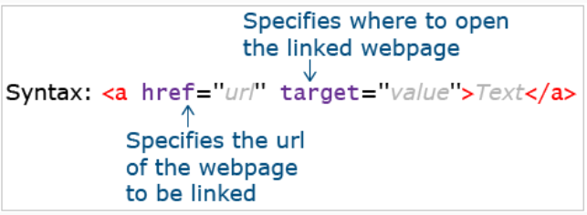
5.8.1 Anchor Tags
Link elements are defined using <a> .. </a> tag

Slide 37
5.8.1 Anchor Tags
A hyperlink is a prime way in which users can navigate from one web page to another. A hyperlink can point to another web page, or website, or files, or even specific locations on the same web page.
Hyperlinks can be of any of the below types:
Text hyperlink:
A clickable text is used to take the user to another web page. Largely, we use text-based hyperlinks.
This text usually appears with an underline and in a different color.
This color mapping is automatically done by the browser for all text hyperlinks.
Image hyperlink:
A clickable image is used to take the user to another web page.
Bookmark hyperlink:
A clickable text/image is used to take the user to another part of the same web page.
Email hyperlink:
It allows users to send an email by clicking on that link.
Contact number hyperlink:
It allows the user to call a number by clicking on that link.

Slide 38
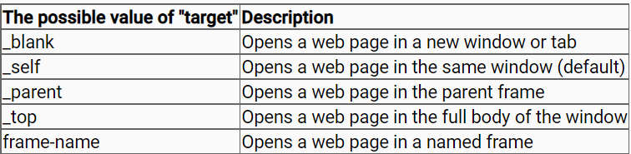
5.8.1 Anchor Tags Target attribute

Slide 39
5.9 Text Level Semantic Elements
Element | Description
abbr | Defines abbreviation or acronym
q | Represents text quoted from another source by adding quotation mark (" ")
small | Displays text in relatively smaller font-size
mark | Highlights text
strong | Displays text in bold
em | Displays text in the italic or emphasized format
sub | Displays text as subscript
sup | Displays text as superscript
span | Provides styling to text
br | Breaks line of text

Slide 40
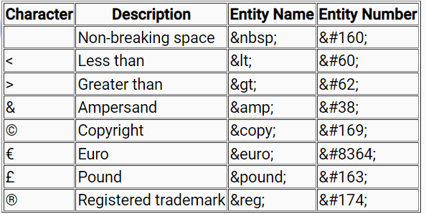
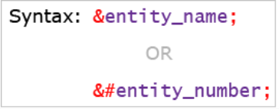
5.10 Character Entities
Some characters are reserved in HTML.
For example: If you use the less than (<) or greater than (>) sign in your content, the browser may mix them with HTML tags.
Also, some characters are unavailable on the keyboard.
For example: ©
Character entities are used to include such character content on a web page.

Slide 41
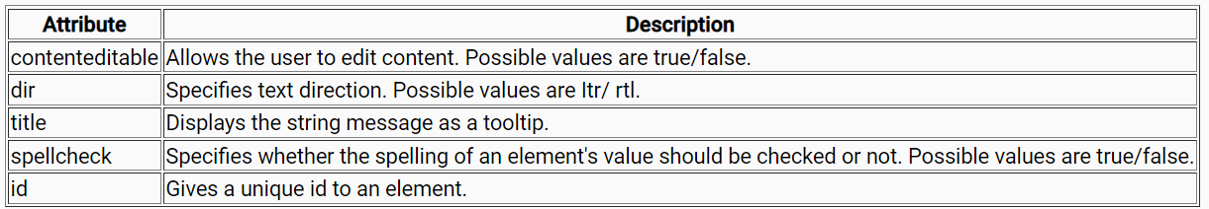
5.11 Global Attributes
Attributes that can be used with all HTML elements are called "Global attributes".

Slide 42
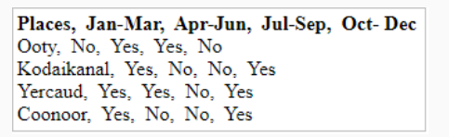
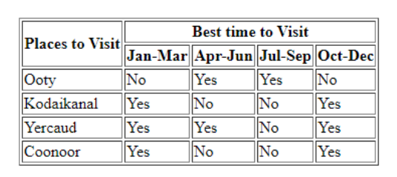
5.12 Table Elements
It is quite difficult to comprehend this information from this display. We will need to go line by line and find out yes/no by looking at the order of data displayed in each line. If we miss the correct order of data in each line, there is a possibility of miscalculating the required information. If this data is displayed in a ‘tabular format’, we can quickly get the required data.
With a tabular format of data display, the information we need can be easily interpreted by making visual associations between row and column headers.
Therefore, we need HTML Tables. HTML Tables provide a means by which we can create a tabular format of data on the web.

Slide 43
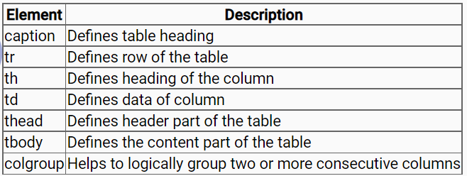
5.12 Table Elements Syntax
The table element is defined in HTML using <table>...</table> tag
It contains table header <thead> and table body <tbody>.
The table header is for adding header information like column headers and the table body is for table contents.
<table>
<caption>Table heading</caption>
<thead>
<tr>
<th>Column 1 heading</th>
<th>Column 2 Heading</th>
</tr>
</thead>
<tbody>
<tr>
<td>Column 1 data</td>
<td>Column 2 data</td>
</tr>
</tbody>
</table>

Slide 44
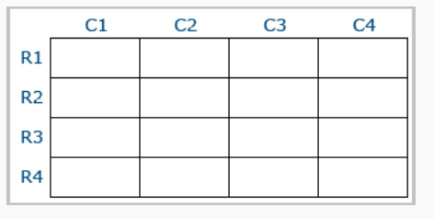
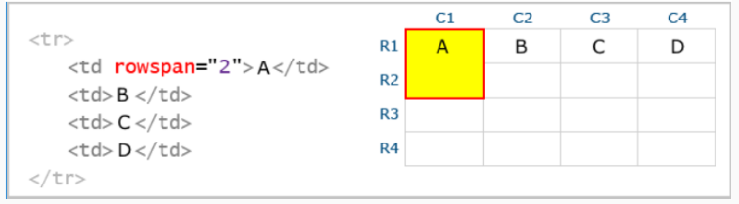
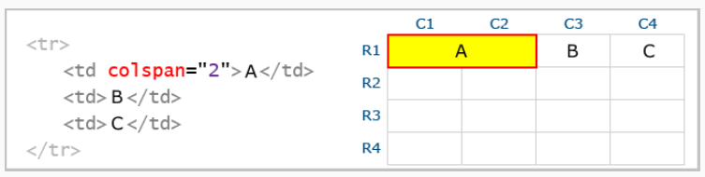
5.12 Col group, col span, row span
<colgroup>
The <colgroup> element in HTML helps us to group the related columns specially to provide some common CSS property.
Colspan Rowspan
The elements <td > and <th> supports the attributes namely colspan and rowspan which helps to merge the table cells accordingly.
The colspan attribute accepts a numeric value and merges specified numeric value of columns together whereas, the rowspan attribute accepts a numeric value and merges specified numeric value of rows together.

Slide 45
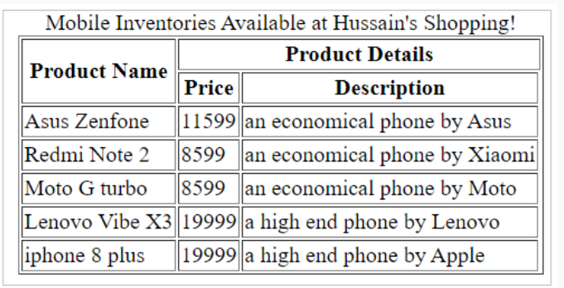
5.12 Tables
Recreate

Slide 46
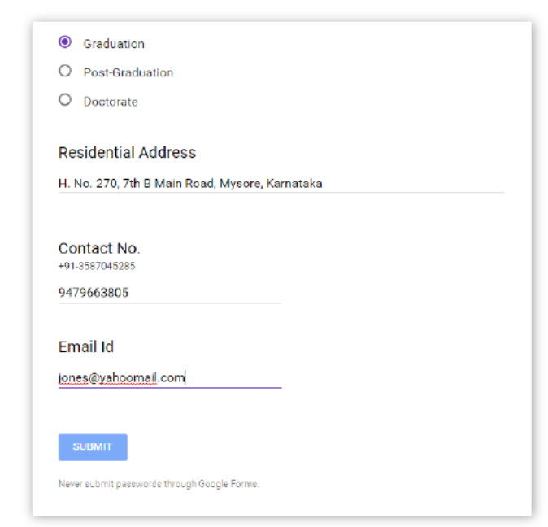
5.13 Form Elements
HTML Forms, also known as Web Forms, help in capturing information from the user of a web application.
Users can key-in the details such as name, email, phone numbers, comments, dates, and other needed values using the HTML form inputs. Users can also select from a predefined set of values.

Slide 47
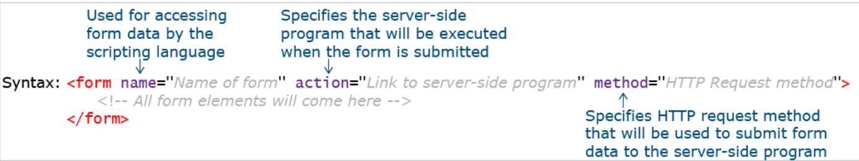
5.13 Form Elements - Syntax
The form can be created using <form>...</form> tag of HTML.
The <form> tag has the below attributes:
method: Defaults to HTTP "get" method of submission to the server. To use HTTP "post", use method="post"
action: The URL to which the form data must be submitted
target: Specifies if the submitted result will open in the current window, a new tab, or on a new frame

Slide 48
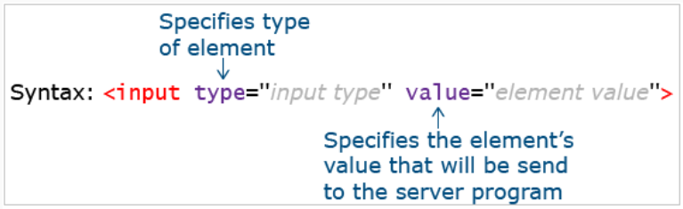
5.13. Form Input Elements - Syntax
The form input element is used to collect details from the user.
text | Creates textbox
password | Creates textbox that accepts the only password
checkbox | Creates checkbox
radio | Creates a radio button
button | Creates button
submit | Creates a button that submits values of all form elements to the server
reset | Creates a button that resets values of all form elements to their default value
image | Creates a graphical version of a button
file | Creates control to upload the file to the server
hidden | Creates a hidden text field
email | Creates textbox that accepts only valid email id
number | Creates spinbox that accepts only whole numbers
range | Creates a range slider
search | Creates a search bar
URL | Creates textbox that accepts only valid URL
color | Creates color picker
date | Creates date picker to select date
month | Creates date picker to select a month
week | Creates date picker to select week

Slide 49


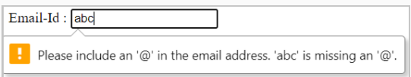
5.13 Form Elements – Text/Password/Email
Input type - text:
A single-line text field. The value attribute defines the value of the input field.
Name: <input type="text" value="">
Input type - password:
An input field can be used to enter a password.
Input type - email:
An input field that accepts email addresses.
It has in-built validation for an email.

Slide 50



5.13 Form Elements – Number/Checkbox/Radio
Input type - number:
Defines an input text box, where the user can enter only numerical input.
Gives an error on form submission if the value entered goes beyond the min and max limits and includes built-in validation to reject non-numerical values.
Attributes min and max can be used to define a boundary and step attribute value which can be used for defining the difference between consecutive numbers.
Input type - checkbox:
Defines a checkbox.
The checked attribute checks that particular checkbox value.
Also, multiple checkboxes can be checked at a time.
Input type - radio:
Defines a radio button.
The name attribute specifies the associated name of that radio button.
Radio buttons in a group should have the same name.

Slide 51


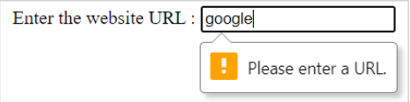
5.13 Form Elements – File/Button/URL
Input type - file:
Creates a control to upload a file to the server.
<button> element:
Defines a clickable button that can be used to submit the form.
The button can be of 3 types:
submit (default with <button> tag)
reset (to reset the form)
button (just a clickable button)
Input type - URL:
Defines a text input that can capture any input value starting with http:// or https://. If there is a pattern mismatch, it shows an error on form submission.

Slide 52
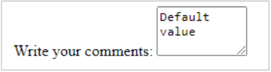
5.13 Form Elements – Textarea/Hidden
<textarea> element:
Defines a multi-line text field.
It is not possible to set a default text using the value attribute. Hence, default text can be placed into <textarea>…</textarea> tag.
Input type: Hidden:
You may want to submit supplementary data (such as users' language of user input) to the server, without any user interaction.
This can be done using a hidden element.
Note: While the value is not displayed to the user in the page's content, it is visible (and can be edited) using any browser's developer tools or "View Source" functionality. Do not use hidden inputs as a form of security!

Slide 53
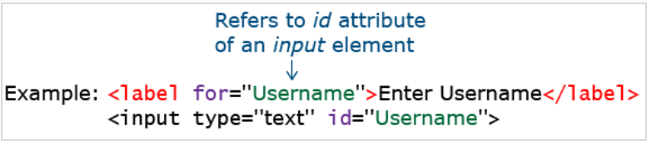
5.13 Form Elements - Label
Label:
The <label> element is used to associate a text label with a form <input> field.
Additionally, the "for" attribute of the label can point to the "id" of input control. This ensures the cursor focuses on the respective input control on the click of the label.

Slide 54
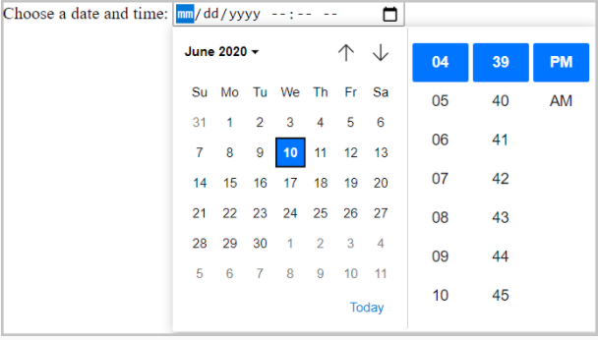
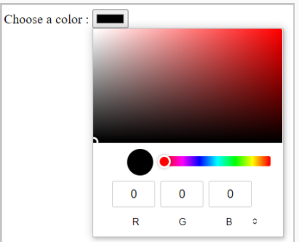
5.13 Form Elements - Syntax
Input type - color:
Defines a color picker.
Input type – datetime-local:
Defines a date-time picker, where the user can pick a date as well as time
Input type – week:
Defines a date picker, where the user can pick a week.
Input type – month:
Defines a date picker, where the user can pick a month.

Slide 55
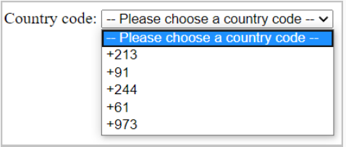
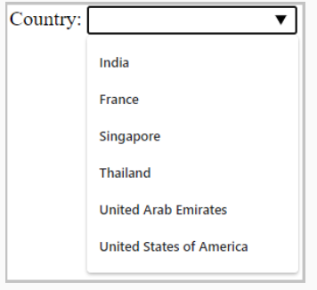
5.13 Form Elements – Select/Datalist
<select> element :
Defines a drop-down list.
The "multiple" attribute can be used for having a multi-select dropdown menu.
<datalist> element:
Defines a set of pre-defined options available to choose for an <input> element.
In the below example list attribute holds lists of possible options, the value assigned to the list attribute of the input element and id attribute of datalist attribute should be the same and the value sent to the server should be assigned to the option element value attribute

Slide 56


5.13 Form Elements – Range/Meter/Progress/Output
Input type – range:
Defines a range slider, where the user can select input.
Meter:
Can be used to represent a scalar measurement within a known range.
Progress:
Can be used to represent the progress of a task.
Output:
The 'oninput' attribute carries the logic of generating the output, and the 'for' attribute of <output> tag specifies the control for which output has to be calculated.

Slide 57
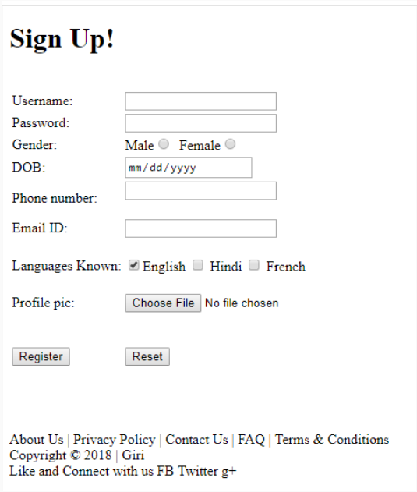
5.13 Form Elements – Tryout

Slide 58
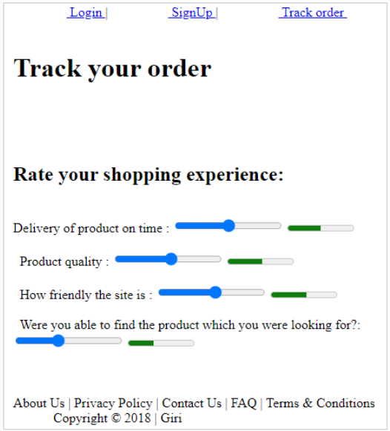
5.13 Form Elements – Tryout

Slide 59



5.14 Form Element - Attributes
Placeholder:
The placeholder attribute specifies a value that appears in the textbox .
Pattern:
The pattern attribute creates a custom pattern validator.
The value entered by the user is checked for validity against a specified pattern.
If the user input value does not match with a specified pattern, an error message appears.
Min, Max, and Step:
The following are some of the attributes which are used only with range and number input types
min: Specifies a minimum acceptable value.
max: Specifies maximum acceptable value.
step: Specifies a difference of consecutive values when the user uses the range/number input element.

Slide 60
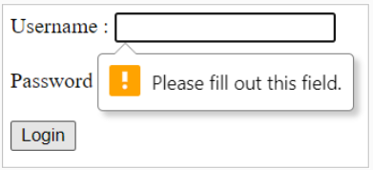

5.14 Form Element - Attributes
Required:
The required attribute specifies that user input is a must.
If the user does not enter any value in the input field which is associated with this attribute, a default error message appears on the screen.
Multiple:
The multiple attribute value allows the user to enter/select/upload more than one value.

Slide 61
5.14 Form Element - Attributes
Form-override attribute | Description
formaction | Overrides the form action attribute
formnovalidate | Overrides the form novalidate attribute
formmethod | Overrides the form method attribute
formtarget | Overrides the form target attribute
Form Method:
In the below example, you can observe that the default form submission method 'GET' has been overridden to the 'POST' method due to the usage of 'formmethod' attribute in the submit input tag.
<form method="GET" action="">
<input type="submit" formmethod="POST">
</form>
Form NoValidate:
To test the form's functionality we may want to temporarily by-pass in-built validations done by form input type elements. This can be done by novalidate attribute.
For example, if we want to bypass an email validation, you can use the below code:
<form novalidate action='xyz.html'>
<input type="email"/>
<input type ="submit">
</form>

Slide 62
5.14 Form Element - Attributes
autocomplete:
It allows the browser to predict user input value.
When the user starts typing, the browser displays possible options, based on earlier typed values.
Possible values of autocomplete are on and off where the default value is "on"
autofocus:
Specifies that an element should automatically get focus when a web page loads.

Slide 63
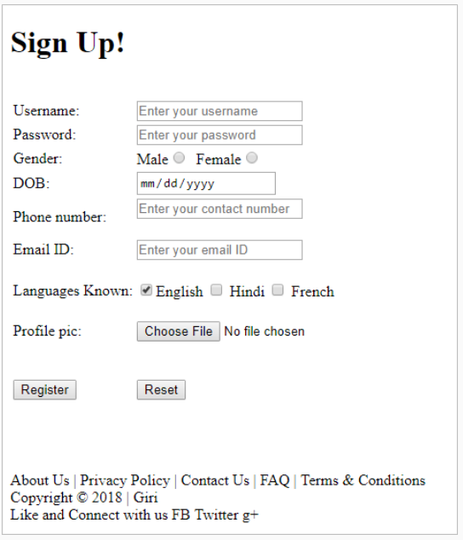
5.14 Tryout - Form Element - Attributes
Recreate

