Slide 1

PatchPilot
[ PS-05 · Bug-fix agent ]
Paste a GitHub issue. Get a fix proven by a failing-then-passing test, and a PR you approve.
Team · Niranjan Iyer · Swarali Patil · Devansh Narlawar · Sarthak Viche
Notes:
Open in one breath: triage eats hours before a fix can even start. PatchPilot's answer is a fix you can check: a test that fails before and passes after, and a PR you approve.
Introduce the team.

Slide 2
[ The problem ]
[ The solution ]
Bugs eat hours before any fix begins.
Paste an issue link. Get a proven fix.
PatchPilot reproduces the bug in a locked-down sandbox and writes a small fix. It proves the fix with a test that fails before and passes after, and opens a pull request only when you approve.
Decode what the reporter meant
Reproduce the bug by hand
1
Reproduce
3
Verify
A test that fails because of the bug
The test passes in a fresh sandbox
Hunt for the code responsible
17.3 hrs
2
Fix
4
You approve
A small, focused change
The PR opens only after you say yes
a week, on average, that a developer spends on debugging and maintenance.
Source: Stripe, Developer Coefficient, 2018
PatchPilot
02 / 06
Notes:
Left, the problem: before anyone can write a fix, someone has to decode the report, reproduce it by hand and find the code responsible. Stripe's 2018 survey puts debugging and maintenance at about 17 hours a week per developer.
Right, the solution in one line: paste an issue link, get a proven fix. Four steps: reproduce the bug with a failing test, fix it, verify the test now passes in a fresh sandbox, and you approve before any pull request opens.

Slide 3
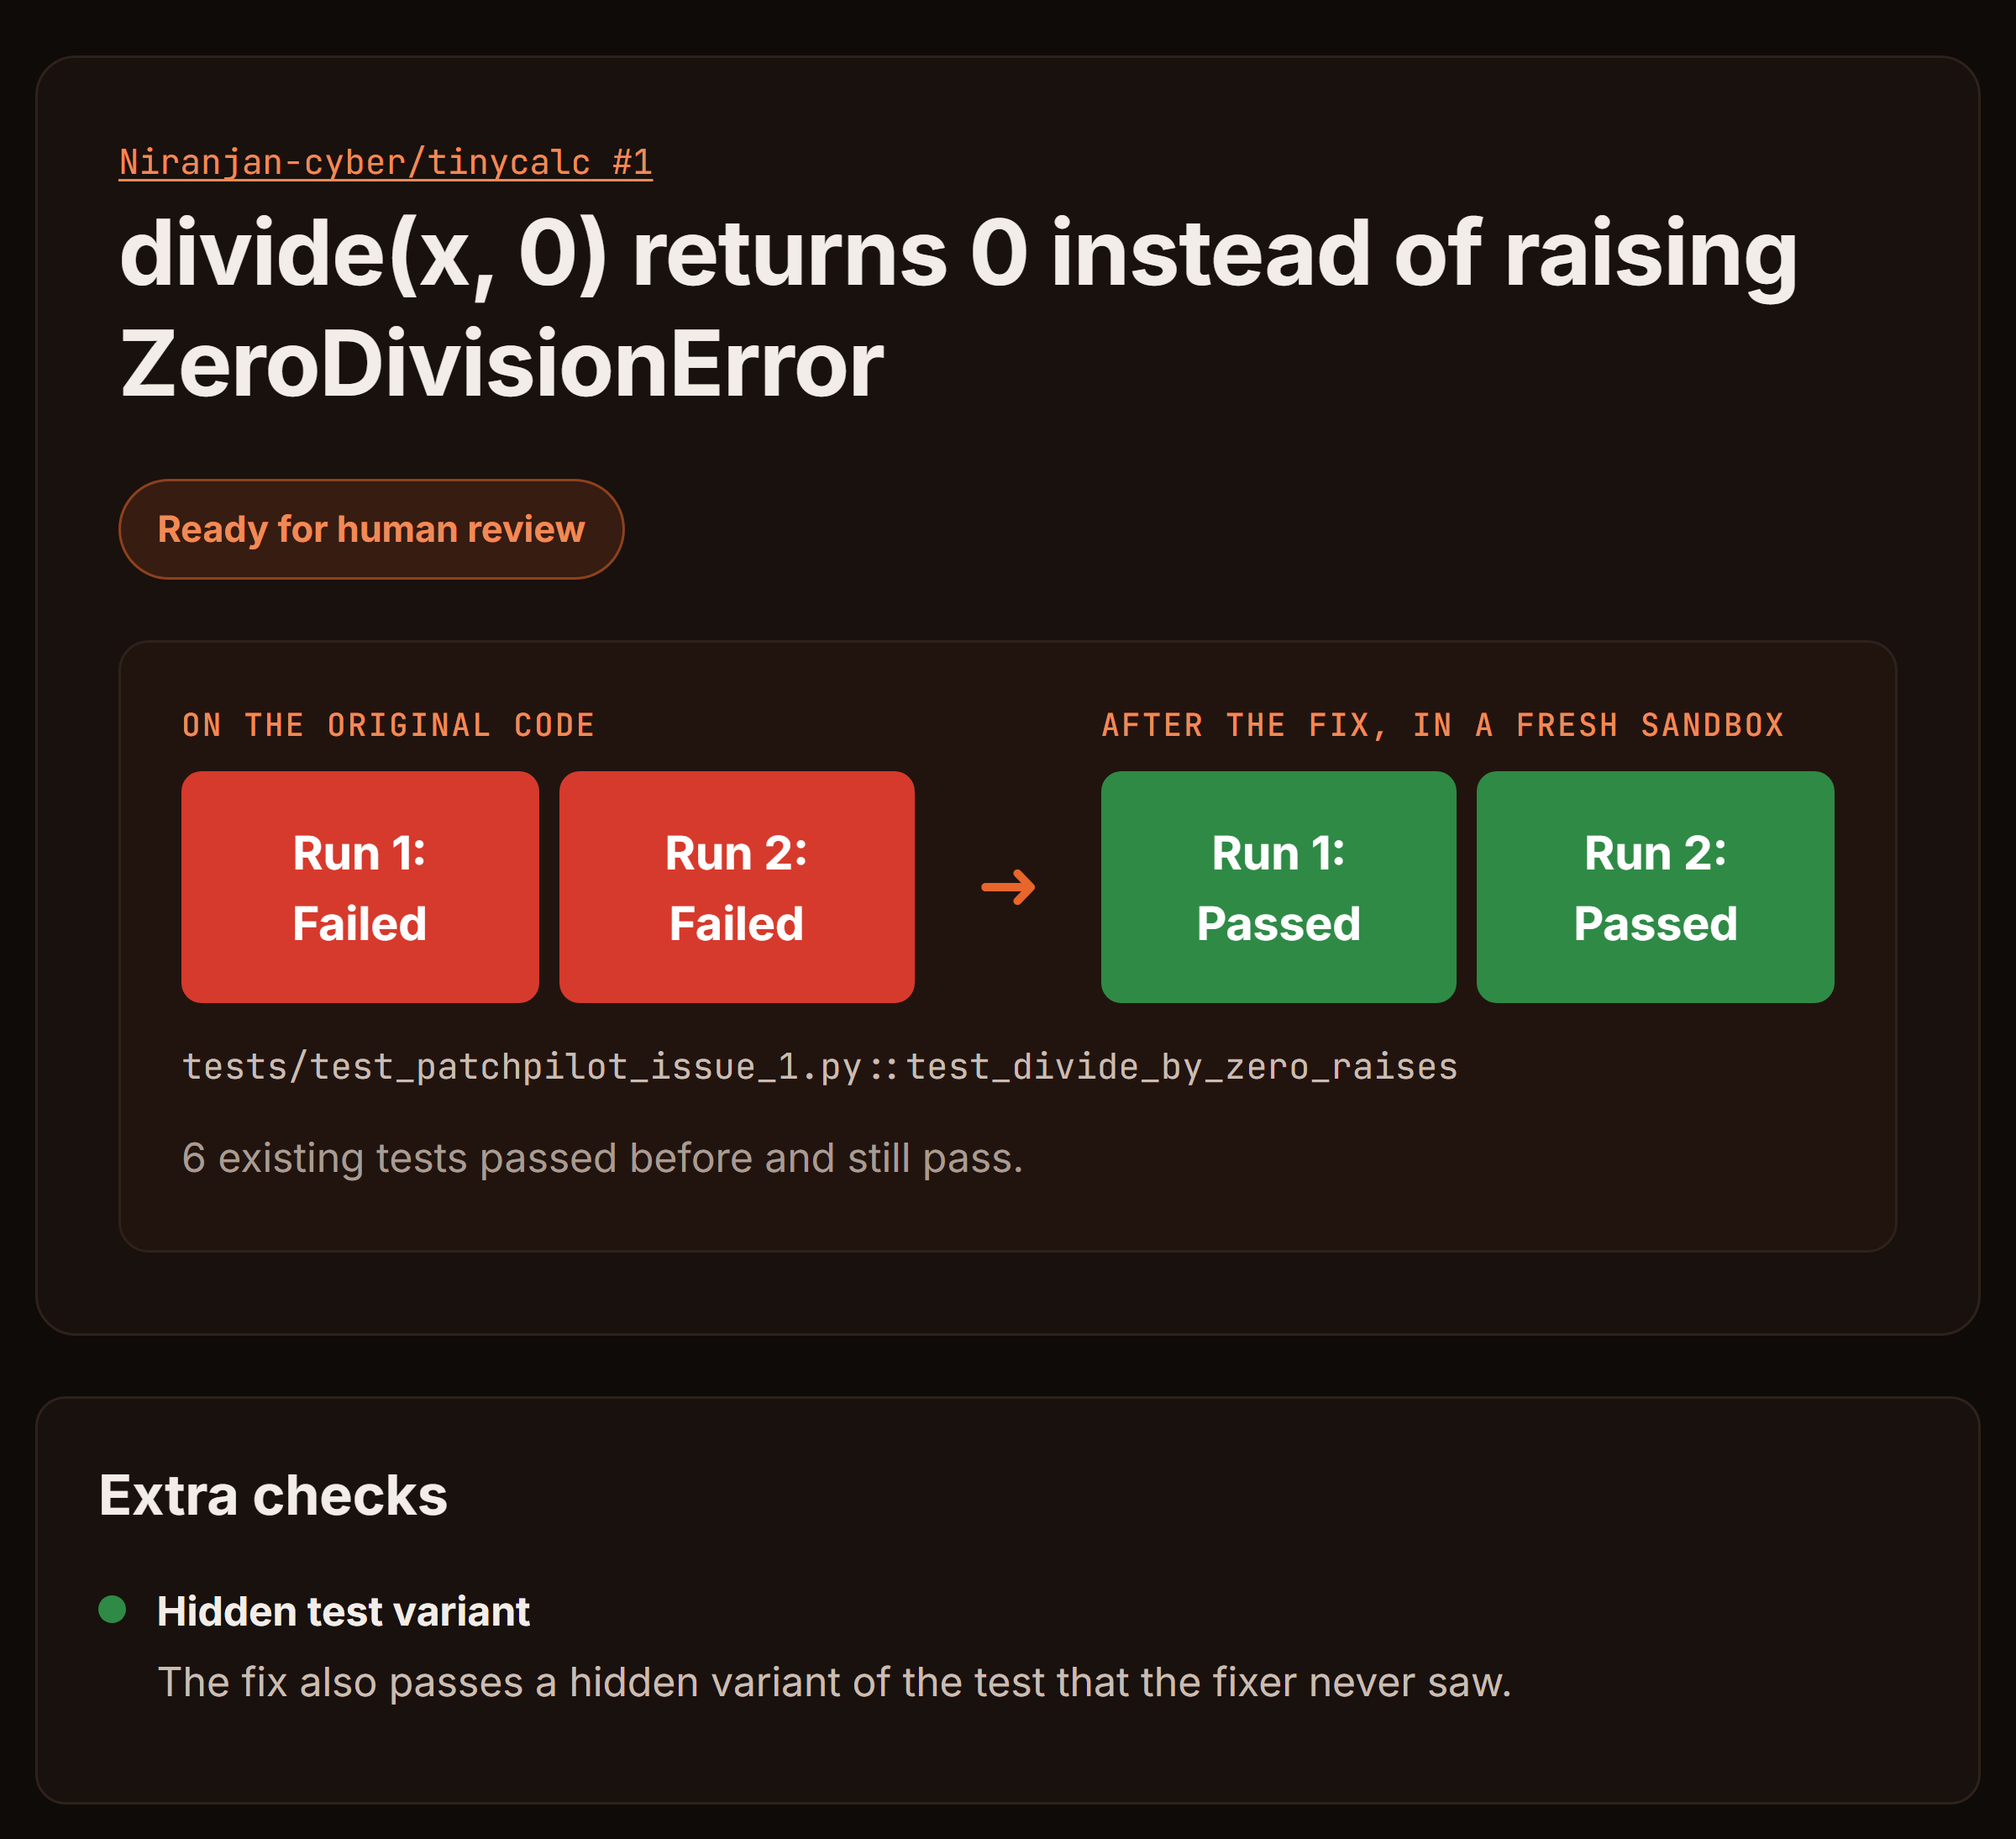
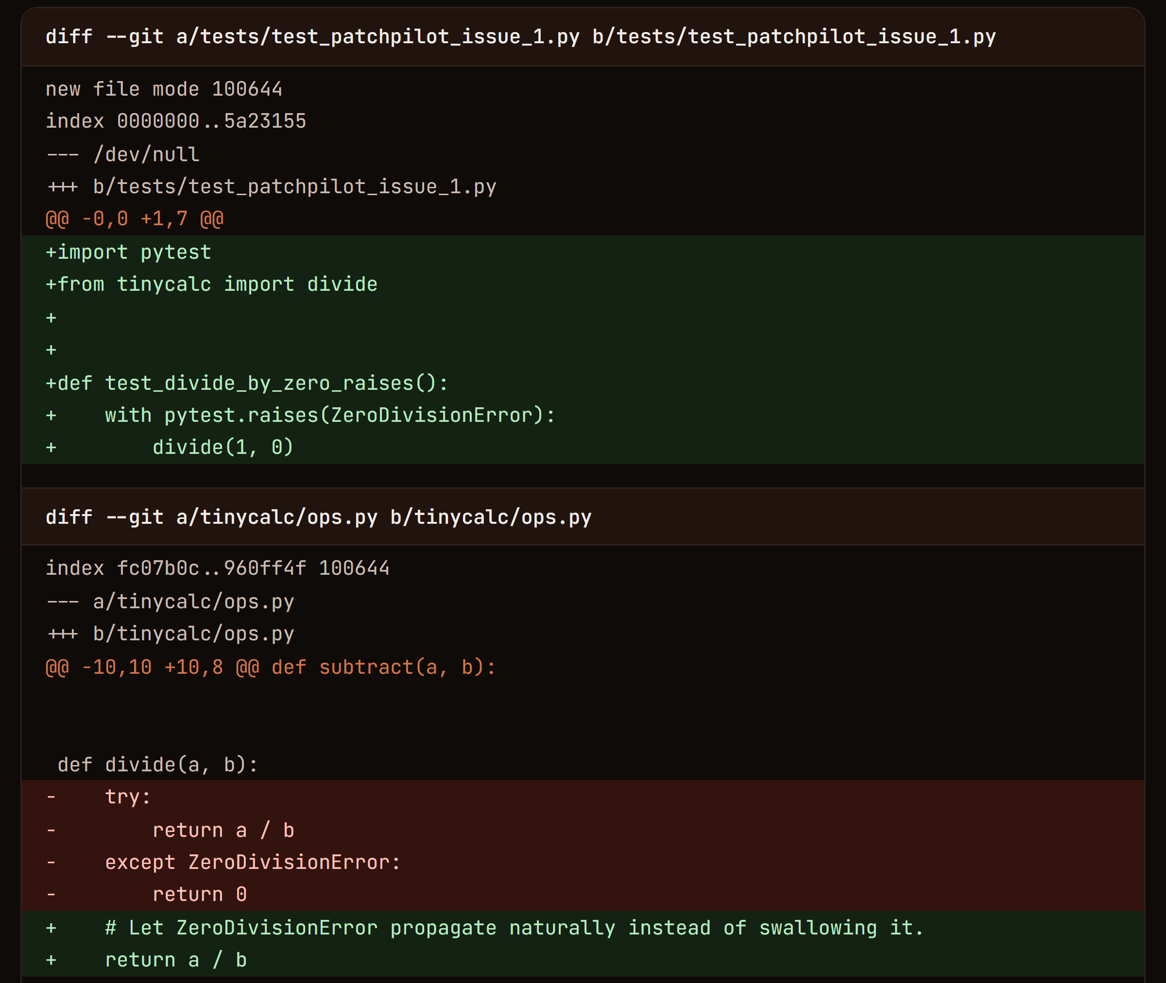


One link in. One proven PR out.
[ The product ]
Live run · a planted bug in our demo repo (tinycalc #1), fixed and verified
3
Fails 2/2 before. Passes 2/2 after.
1
1
2
Also passes a hidden test the fixer never saw.
3
You approve this exact diff. Nothing ships without you.
2
Live today: 3 of 3 planted bugs fixed, 2-7 min each · 2 real draft PRs opened (tinycalc #4, #5)
PatchPilot
03 / 06
Notes:
This is a live PatchPilot run (about 7 minutes) on a bug we planted in tinycalc, our own small demo repo. Every gate passed, and we checked the fix by hand.
Today PatchPilot fixed all 3 planted bugs (2 verified, 1 where the reviewer flagged a behaviour change), and the full path ran twice on the public URL with real GitHub sign-in, opening draft PRs tinycalc #4 and #5.
1: the new test fails twice on the original code and passes twice after the fix, in a fresh sandbox.
2: the fix also passes a hidden variant of the test that the Fixer never saw, so it can't just special-case the test.
3: nothing is published until a human reads and approves this exact diff.

Slide 4
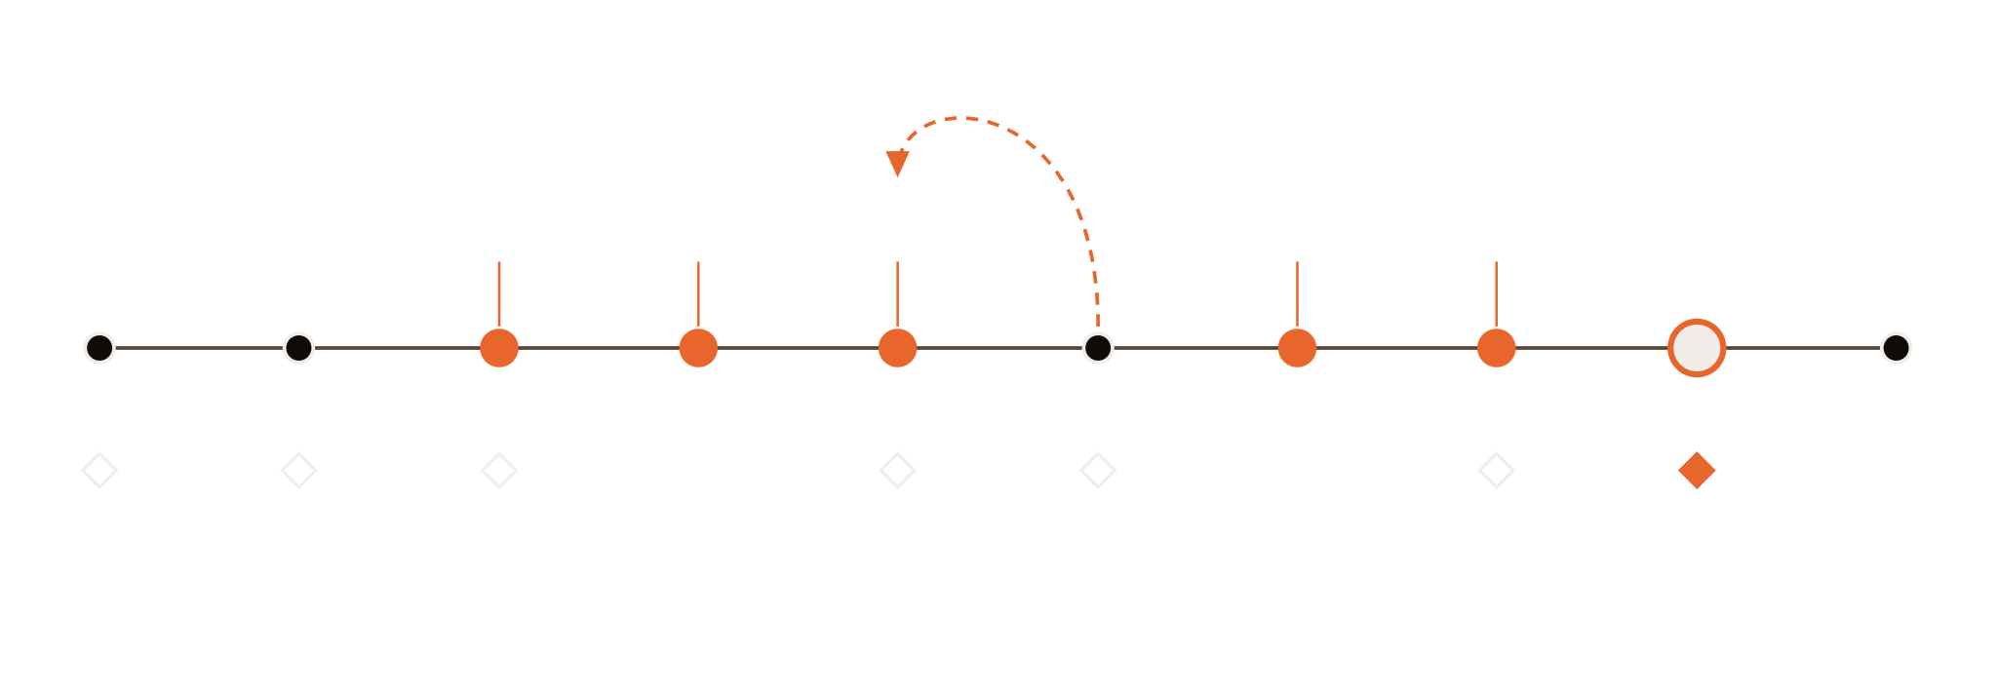


Five AI roles. Seven code gates.
[ Agent orchestration ]
AI proposes
Code decides
fails? back to Fix: 3 tries, then re-diagnose
Test
designer
Investigator
Fixer
Reviewer
Explainer
Intake
Setup
Reproduce
Diagnose
Fix
Verify
Review
Report
Approve
Publish
Eligible?
Scan, then install
Fails 2 of 2
Diff rules
Passes 2 of 2
Claims match logs
You approve the diff
If a fix still can't be proven, the run ends with a triage report. Never a fake fix.
PatchPilot
04 / 06
Notes:
One run, left to right, and the only place the pipeline appears. Orange dots are AI roles that propose work. Diamonds are code gates that run the tests and decide pass or fail; the AI never writes a status.
If Verify fails, the run goes back to Fix: the Fixer gets up to three tries, then one re-diagnosis, then the run ends with a triage report (config/limits.toml: fixer = 3, rediagnose = 1).
A human approves the exact diff before anything is published.

Slide 5





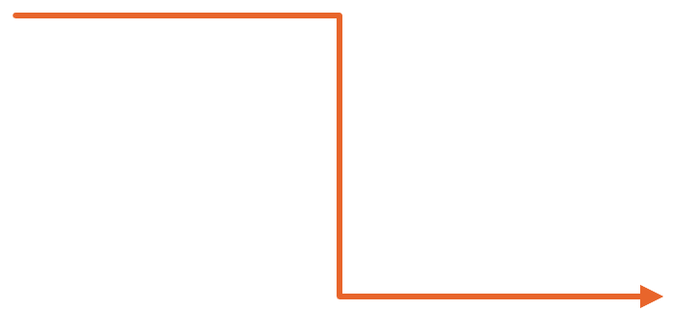



Three zones. One write token.
[ Why it's safe · system view ]
Built with
LG
LL
React
FastAPI
LangGraph
LiteLLM
Python
Docker
GitHub
SupplyGuard, our own scanner, checks every dependency before anything installs. The AI never holds the write token.
TRUSTED
SEMI-TRUSTED
React UI
FastAPI
LLM gateway
run timeline
REST + SSE
Orchestrator
LiteLLM: Groq, then Nebius, then Gemini by quota. Budgets and logs.
LangGraph
7 gates
Job queue
Human gate
async runs
UNTRUSTED
Docker sandbox
Intake
SupplyGuard
One container per step, deleted after the run.
GitHub
read-only
dependency scanner
issues and PRs
Publisher
State store
Setup reaches PyPI only. Every later step runs offline.
write token
SQLite
PatchPilot
05 / 06
Notes:
This is the system view, kept light on purpose. Read it left to right. The user talks to a UI and an API that never runs repository code. The orchestrator owns state and gates.
Anything that runs repository code lives in the untrusted Docker zone, with no credentials and no network after setup. Only the publisher holds a GitHub write token.
SupplyGuard is our dependency scanner: it checks the repo's lock file before anything is installed.

Slide 6

Bugs in. Proof out.
[ Who it's for ]
Who gets time back.
[ In one line ]
Open-source maintainers
Clear the bug backlog with proven PRs.
New contributors
Learn a codebase in plain language.
Teams (next)
Private repositories and team plans.
PatchPilot turns a GitHub issue into a verified fix and a draft PR. A human approves every one.
Our promise
It proves the fix, or says it can't.
Niranjan Iyer · Swarali Patil · Devansh Narlawar · Sarthak Viche
PatchPilot
06 / 06
Notes:
Leave this on screen for Q&A. Left: who it's for. Maintainers get proven PRs, newcomers get explanations, teams come next (a proposal, not a commitment).
What sets it apart: other coding agents open a PR and hope. PatchPilot proves the fix with a test that fails before and passes after, or hands back an honest triage report.
Right: bugs in, proof out.

