Slide 1

Student Expense Tracker
Subject: Web Programming
Faculty: Swathi Lakshmi S
Presented by: Dhaneshwaran S
Department and College: Computer Science Engineering(Cyber Security)
Rajalakshmi Engineering College

Slide 2
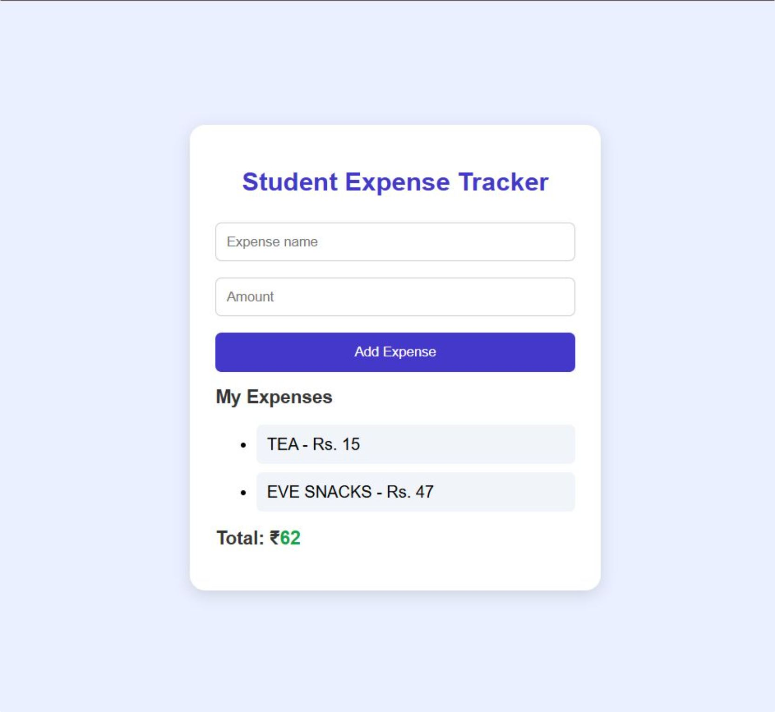
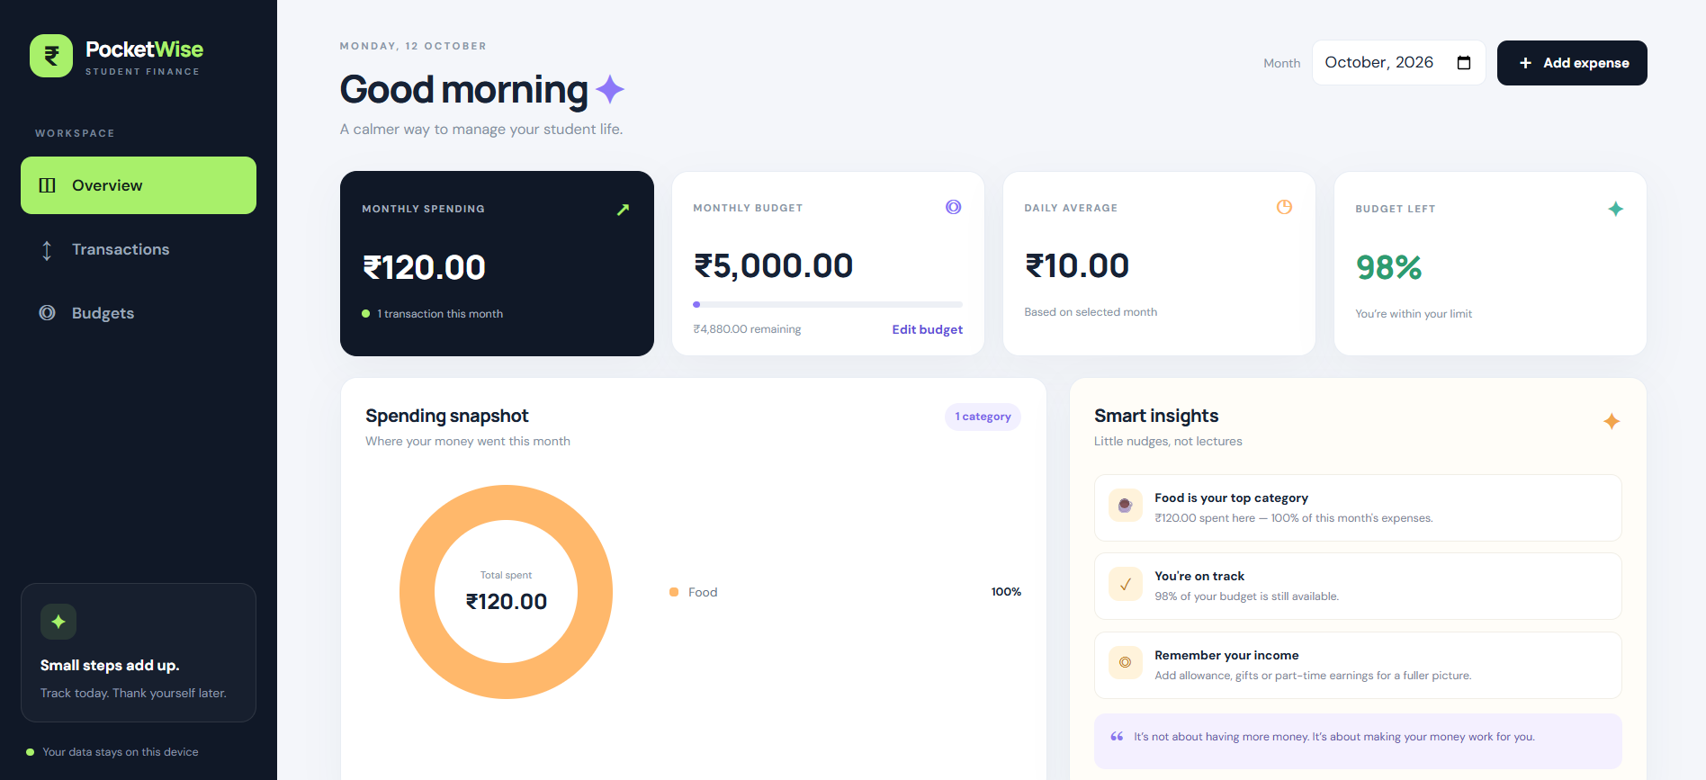
Track daily spending with less effort
Student Expense Tracker is a simple web application for recording daily expenses.
Helps students monitor their spending and manage money.
Objective: Make expense tracking easy and calculate total spending automatically.

Slide 3



Three technologies power the project
HTML: Creates the structure of the website.
CSS: Provides styling, colours, layout, and design.
JavaScript: Adds expenses, validates user input, and calculates total expenses.

Slide 4
From expense entry to total spending
Enter an expense name and amount.
Add expenses to a list.
Display all entered expenses.
01
02
03
04
Calculate and display the total expense automatically.
05
Validate inputs to prevent empty names and invalid amounts.
Flow diagram: Enter Expense → Validate Input → Add to List → Calculate Total

Slide 5
A simple foundation for better money habits
The project demonstrates the practical use of HTML, CSS, and JavaScript.
It helps students track expenses in a simple way.
Future enhancements: Delete expenses, save data using Local Storage, add expense categories, and display monthly reports.
Thank You

