Slide 1
Data Normalization
With Diagrams & SQL Examples

Slide 2
What is Data Normalization?
Data normalization is the process of organizing data in a database to:
Reduce redundancy (duplicate data)
Improve data integrity
Make data easier to maintain

Slide 3
Why Normalization is Important?
Eliminates duplicate data
Prevents data anomalies (update, delete, insert issues)
Ensures consistency
Optimizes storage

Slide 4
1NF (First Normal Form)
Atomic values
No repeating groups
Each column contains atomic (single) values.

Slide 5
1NF SQL Example
CREATE TABLE StudentSubjects (Student VARCHAR(50),Subject VARCHAR(50));

Slide 6
1NF SQL Example –(Before 1NF)
ID | STUDENT | SUBJECT
1 | JOHN | MATHS,SCIENCE

Slide 7
1NF SQL Example –(AFTER 1NF)
1D | STUDENT | SUBJECT
1 | JOHN | MATHS
1 | JOHN | SCIENCE

Slide 8
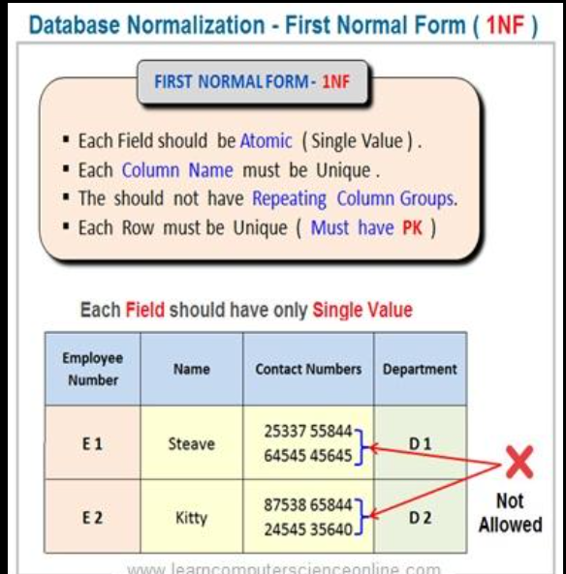
1NF SQL

Slide 9
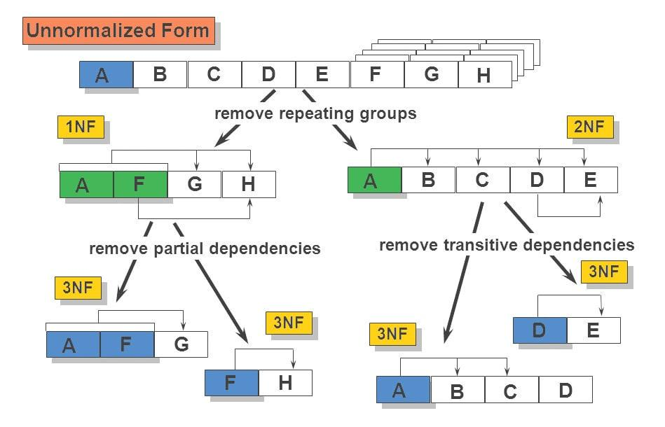
1NF SQL
CREATE TABLE StudentSubjects (Student VARCHAR(50),Subject VARCHAR(50));

Slide 10
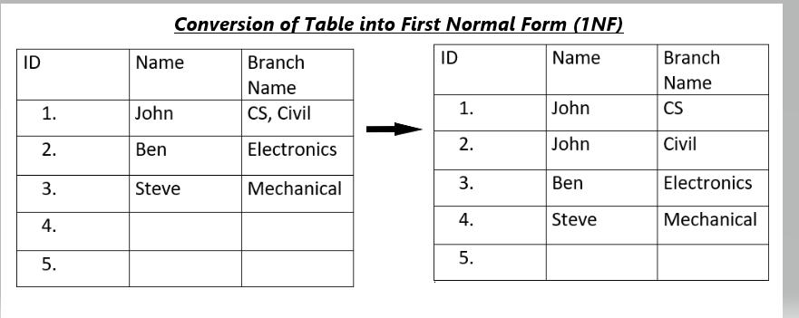
1NF SQL

Slide 11
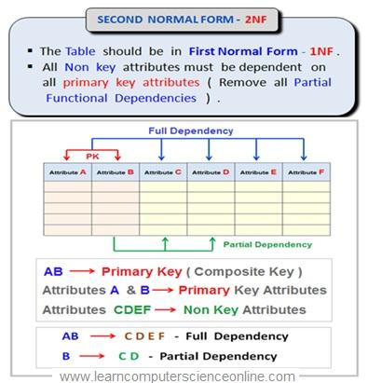
2NF (Second Normal Form)
Remove partial dependency

Slide 12
2NF SQL
Must be in 1NF.

Slide 13
2NF SQL Example
CREATE TABLE Courses (CourseID INT,Instructor VARCHAR(50));

Slide 14
3NF (Third Normal Form)
Remove transitive dependency.
Must be in 2NF

Slide 15
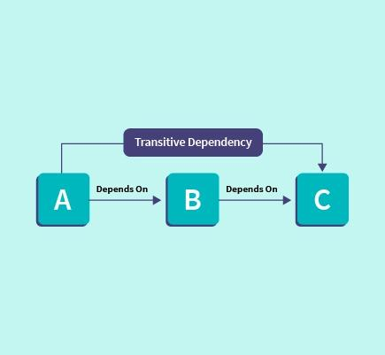
3NF (Third Normal Form)

Slide 16
3NF SQL Example
CREATE TABLE Departments (DeptID INT,DeptName VARCHAR(50));

Slide 17
BCNF
Every determinant is a candidate key
Strong Version of 3NF

Slide 18
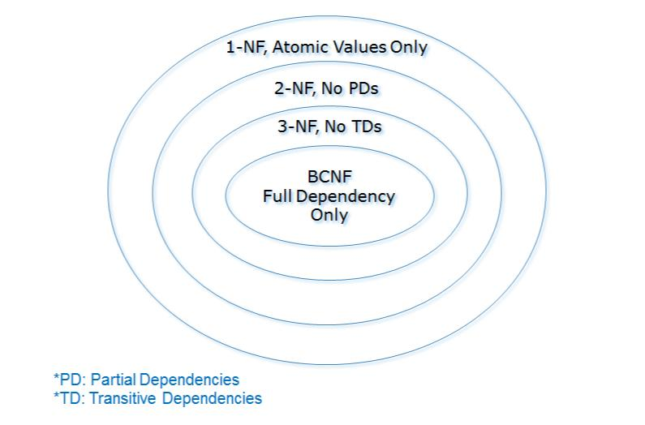
BCNF

Slide 19
Normalization Example (Step-by-Step)
ORDER ID | COUSTOMER | PRODUCT
1 | JOHN | Pen, Book
After Normalization:
Orders Table: (OrderID, Customer)
OrderDetails Table: (OrderID, Product)

Slide 20
Types of Anomalies (Problems Without Normalization)
Insert anomaly → Cannot add data without other data
Update anomaly → Same data must be updated in many places
Delete anomaly → Losing important data accidentally

Slide 21
Advantages
Clean database structure
Reduces redundancy
Improves consistency
Easier Maintaines

Slide 22
Disadvantages
More tables → complex queries
Requires joins (can reduce performance in some cases)

Slide 23
Summary
1NF → Atomic
2NF → No partial
3NF → No transitive

