Slide 1
Employee Data Analysis using Excel
STUDENT NAME:NIRANJAN.R
REGISTER NO : 312204500, 77FF5FF387560F691AA41DA74DD8761F
DEPARTMENT :COMMERCE
COLLEGE : KCS KASI NADAR COLLEGE OF ARTS & SCIENCE

Slide 2
PROJECT TITLE
Employee Rating Analysis

Slide 3


AGENDA
Problem Statement
Project Overview
End Users
Our Solution and Proposition
Dataset Description
Modelling Approach
Results and Discussion
Conclusion
3/21/2024 Annual Review

Slide 4

PROBLEM STATEMENT
THE PROBLEM IS TO IDENTIFY THE EMPLOYEES SCORE ANALYSIS ACCORDING THEIR : Name, Gender, Department, Problem Solving, Punctuality, Communication, Technical Knowledge, Teamwork, Meeting Deadline, Total Score
.

Slide 5

PROJECT OVERVIEW
IN THIS ANALYSIS IM GOING TO EASE THE PROCESS OF IDENTIFY THE EMPLOYEES RATING USING EXCEL, WITH THE HELP OF BELOW MENTIONED TOOLS IN EXCEL.
TABLES.
SLICERS.
PIVOT CHART(LINE CHART,PIE CHART & BAR CHART).
INSERTING FORMULAS

Slide 6

WHO ARE THE END USERS?
Human Resources (HR) Department
Finance Department
Compensation and Benefits Specialists
Operational Managers
IT and Data Management Teams

Slide 7

OUR SOLUTION AND ITS VALUE PROPOSITION
User-Friendly Interface:
Accessibility
Ease of Use
Comprehensive Data Management:
Data Organization
Data Integration
Advanced Analytical Tools:
Formulas and Functions
PivotTables
Visual Representation:
Charts and Graphs
Scenario Analysis:
Used to analyse different situation

Slide 8
Dataset Description
Data Overview:
The dataset contains information about employees within an organization, about their performance. This data is used to calculate and analyze the project progress metrics.
Data Fields:
Name
Gender
Department
Problem Solving
Punctuality
Communication
Technical Knowledge
Teamwork
Meeting Deadline
Total Score

Slide 9

THE "WOW" IN OUR SOLUTION
Dynamic Dashboards
Advanced Data Visualization
Segmentation Analysis
Comparative Analysis
Interactive Reports
Slicers
3/21/2024 Annual Review
9

Slide 10
MODELLING
Data cleaning.
Creating table.
Creating pivot chart.
Creating dashboard.
Inserting pivot chart in dashboard.
Creating interactive dashboard by putting all together elements.
10

Slide 11

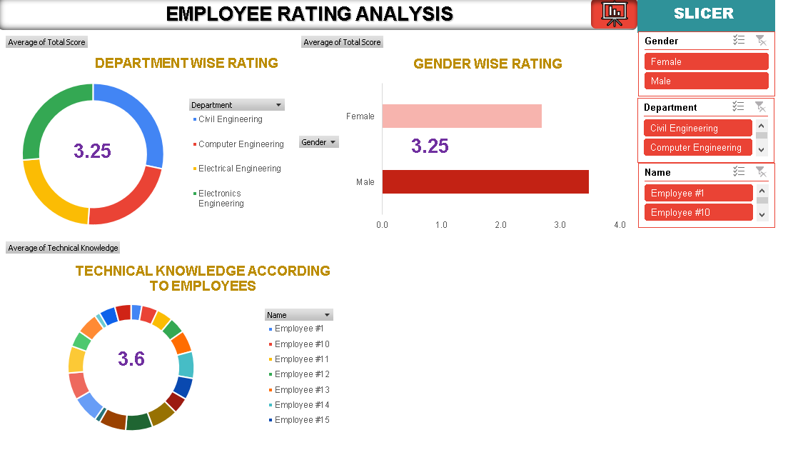
RESULTS
(click to open file)
11

Slide 12
conclusion
“In essence, the analysis sheds light on performance patterns, departmental differences, and potential areas for improvement, guiding better management practices and development strategies”

