Slide 1
Enhancing Email Security: Advanced Spam Detection Strategies

Slide 2




Introduction
Welcome to the presentation on Enhancing Email Security! In this session, we will explore
strategies to safeguard your organization's communication. Let's delve into the latest techniques to combat malicious email threats.

Slide 3



Email Security Threats
Understanding the is
crucial for effective protection. From to
, cybercriminals are constantly evolving their tactics.
Stay ahead of the game to safeguard your organization's data and reputation.

Slide 4




Spam Filtering Techniques
Explore techniques to
minimize the impact of unwanted emails. From
to
, discover the arsenal of tools available to fortify your email security.

Slide 5


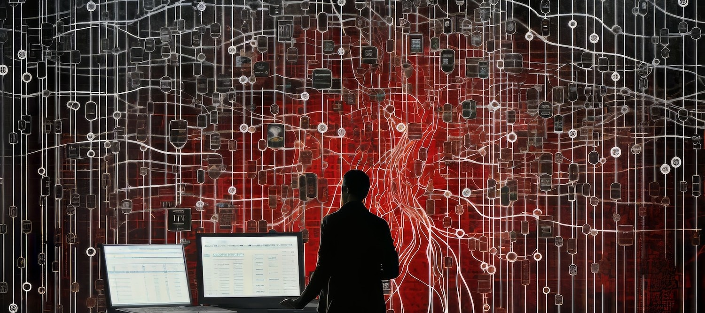

ADVANCED MACHINE LEARNING
Harness the power of to detect subtle patterns and anomalies in email content. By leveraging sophisticated algorithms, organizations can signiﬁcantly enhance their ability to identify and quarantine potential .

Slide 6



BEHAVIORAL ANALYSIS
Implement to scrutinize email interactions and detect abnormal patterns. By understanding normal user behavior, organizations can swiftly identify and mitigate potential security risks.

Slide 7


SENDER REPUTATION MANAGEMENT
Establish robust sender reputation management protocols to assess the trustworthiness of incoming emails. By evaluating sender reputation, organizations can effectively ﬁlter out suspicious or untrustworthy sources.

Slide 8

Real-time Threat Intelligence
Leverage real-time threat intelligence feeds to stay ahead of emerging email threats. By integrating up-to-date threat data, organizations can proactively identify and block sophisticated spam campaigns before they inﬁltrate the network.

Slide 9


EMPLOYEE AWARENESS TRAINING
Empower your workforce with comprehensive email security training to enhance their ability to recognize and report potential email threats. By fostering a culture of cybersecurity awareness, organizations can strengthen their defense against email-based attacks.

Slide 10

Continuous Improvement Strategies
Embrace a culture of continuous improvement by regularly evaluating and reﬁning email security measures. By staying agile and adaptive, organizations can effectively respond to evolving email threats and fortify their defense mechanisms.

Slide 11
CONCLUSION
In conclusion, the landscape of email security is constantly evolving. By implementing advanced spam detection strategies and fostering a culture of vigilance, organizations can effectively safeguard their communication channels from malicious email threats.

Slide 12



Thanks!
ANY QUESTIONS?
youremail@freepik.com
+91 G20 421 838
yourwebsite.com

