Slide 1
ADA Lab
Week-7 Internal Evaluation Question
Two Questions under Dynamic Programming
7a. Printing Longest Common Subsequence 7b. 0-1 Knapsack Problem

Slide 2
Week-7a: Internal Evaluation Question
Printing Longest Common Subsequence (LCS):
Given two sequences, print the longest subsequence present in both of them.
Examples: LCS for input Sequences “ABCDGH” and “AEDFHR” is “ADH” of length 3. LCS for input Sequences “AGGTAB” and “GXTXAYB” is “GTAB” of length 4.

Slide 3
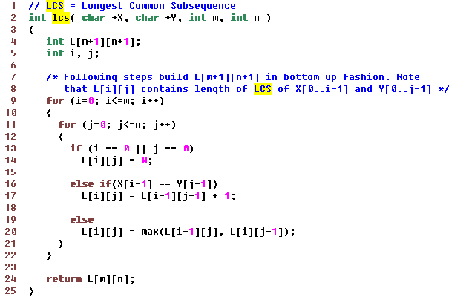
Finding length of LCS

Slide 4
Printing LCS
int index = L[m][n];
char lcs[index+1];
lcs[index] = '\0'; // Set the terminating character
//Start from the right-most-bottom-most corner and one by one store characters in lcs[]
int i = m, j = n;
while (i > 0 && j > 0)
{
if (X[i-1] == Y[j-1])
{
lcs[index-1] = X[i-1]; // Put current character in result
i--; j--; index--;
}
else if (L[i-1][j] > L[i][j-1])
i--;
else
j--;
}
Print lcs

Slide 5
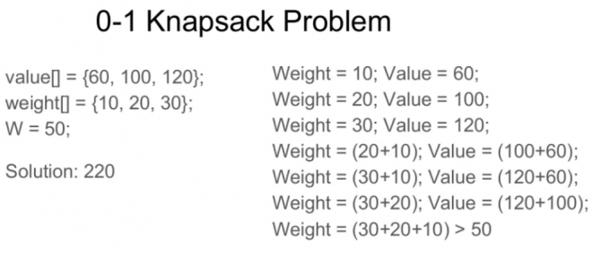
Week-7b: Internal Evaluation Question
0-1 Knapsack Problem:
Given weights and values of n items, put these items in a knapsack of capacity W to get the maximum total value in the knapsack. In other words, given two integer arrays val[0..n-1] and wt[0..n-1] which represent values and weights associated with n items respectively. Also given an integer W which represents knapsack capacity, find out the maximum value subset of val[] such that sum of the weights of this subset is smaller than or equal to W. You cannot break an item, either pick the complete item, or don’t pick it (0-1 property).

Slide 6
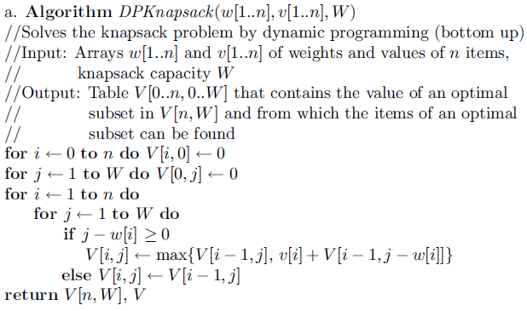
Algorithm

