Slide 1
A Presentation on,
“ LED LAMP”
By
MEHUL PATIL (Scsb305)
NIRANJAN PATIL (Scsb307)
ABHISHEK SARRAF (Scsb320)

Slide 2
Motivation
We’ve been to several places where the lamp is either too bright or too dark or it just doesn’t fit with the surroundings. That just spoils the ambience and feel of the room and also it generates huge amount of electricity bill per month. After observing, even more, we came to realise that such lamps consume a lot load of energy than they actually should.
It was this that motivated us to build a lamp that solves all these issues.

Slide 3
Survey
#We’ve seen that lamps of many varieties are available in the market. But the lamp our team is offering is special one.
#It uses less power than most of the lamps present there. Also, the amount of light is emits is unmatched in its power bracket. Its sleek looks are its main characteristic.
#The lamp is beautifully engineered to perfection giving it a finishing touch. The glass addition makes it a real eye catcher.
#The led technology used helps to save power hence the electricity bill generated is comparatively low as compared to other lamps without compromising with the quality of usage.

Slide 4
Interaction
During product survey we asked the following questions to the costumers –
1Do you find our lamp design attractive?
2.Do you find it useful?
3.Where will you prefer to keep this lamp?
4.Are there any ideas from your side which we should implement?
5.What should be the cost according to you?

Slide 5
Concept Presentation
#Led Light is a product that is an all-purpose lamp. It can be used as a night lamp, it can be used in any party/function.
# It’s dark but sufficient amount of light makes the atmosphere more pleasant and in some cases, more romantic :)
#Its 12v SMD LED covered by wood and glass framework emits enough light to create an eye catching effect. Also the decorations on it make it a real eyecatcher.
# The product is designed to consume as little electricity as possible without compromising with the quality and quantity of usage.

Slide 6
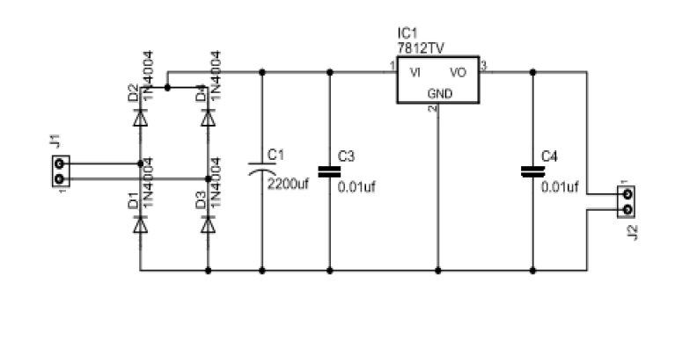
Circuit Diagram

Slide 7
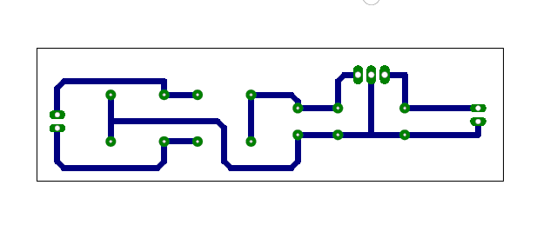
PCB Track Layout

Slide 8
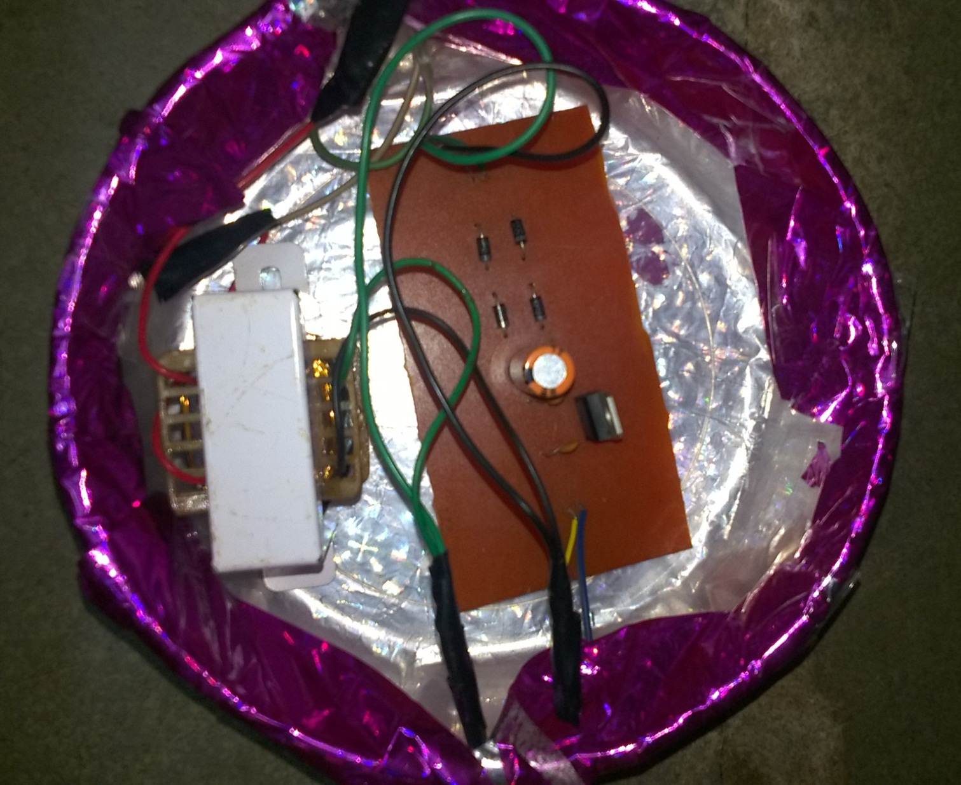
PCB

Slide 9
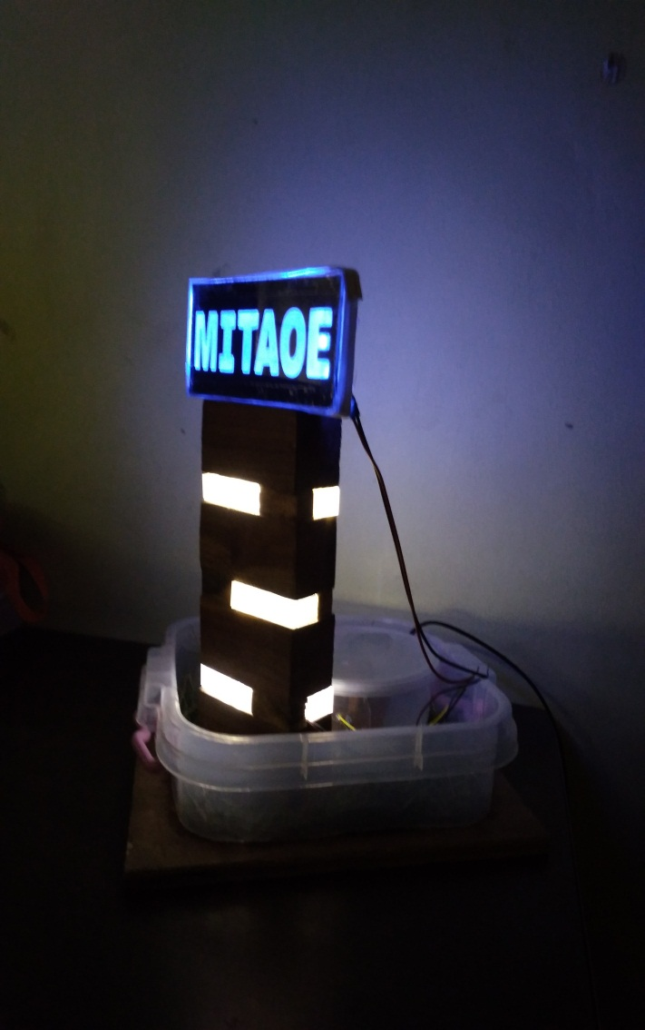
Product Snapshots

Slide 10
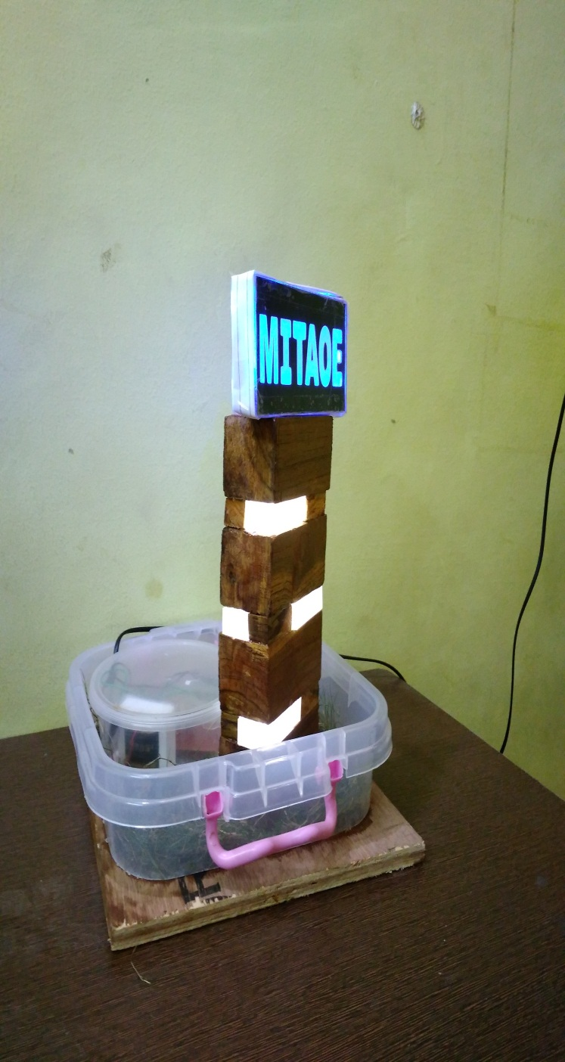

Slide 11
Result Analysis
1.Reviews of people about the lamp were very good.
2.People found lamp very attractive and were ready to keep it in their house for a dazzling look.
3.People advised us to keep it in a reasonable cost for middle class people also.

Slide 12
Financial Aspects
The electrical portion of the lamp costs around Rs. 360/- The total cost of all the other decorative materials used such as wood, glass, pins, glue, etc. is Rs. 150/-
The final packaging, marketing and sales and transportation charges cost around Rs. 30/-
Total manufacturing price of the lamp amounts to a total of Rs. 540/-
Selling price to the customers will be Rs. 600/-.
Company will make a profit of Rs 60/- per piece.

Slide 13
References
https://youtu.be/2Suhlltm_-w/
https://www.youtube.com/watch?v=yPiidwksnhs
https://www.youtube.com/watch?v=M-k7QGaKEM8

Slide 14
Thank You!

