Slide 1
Digital Portfolio
NIRANJANA SHREE . P
STUDENT NAME:
REGISTER NO AND NMID: 222402624
DEPARTMENT: Data science🔬
COLLEGE: Prince shri venkateshwara arts and science college

Slide 2
PROJECT TITLE
𝐃𝐢𝐠𝐢𝐭𝐚𝐥 𝐣𝐨𝐮𝐫𝐧𝐞𝐲

Slide 3


AGENDA
Problem Statement
Project Overview
End Users
Tools and Technologies
Portfolio design and Layout
Features and Functionality
Results and Screenshots
Conclusion
Github Link
3/21/2024 Annual Review

Slide 4

PROBLEM STATEMENT
active overview.
Students and job seekers often rely only on resumes to showcase skills.
Traditional resumes lack interactivity and creativity.
Recruiters find it hard to assess true potential.
A digital portfolio can bridge this gap effectively.

Slide 5

PROJECT OVERVIEW
Interactive Skills Portfolio The project focuses on showcasing my technical and analytical skills in Data Science. My skills are displayed with progress bars or charts, along with About Me, Education, Hobbies, and Contact sections supported by my profile image.

Slide 6

WHO ARE THE END USERS?
Students – to creatively present their academic journey and skills Job Seekers – to highlight programming, design, and professional abilities beyond resumes Recruiters & Employers – to evaluate true potential through an interactive portfolio Academic Institutions – for project assessments, reviews, and networking

Slide 7

TOOLS AND TECHNIQUES
HTML – Structure of the website (content & layout)
CSS – Styling, colors, fonts, and responsiveness
JavaScript (JS) – Adding interactivity and dynamic behavior
VS Code – Code editor for development and debugging
GitHub Pages – Hosting the website online

Slide 8
POTFOLIO DESIGN AND LAYOUT
Header/Nav Bar – Sticky top navigation with links (Home, About, Contact)
Hero Section – Profile photo, name, and tagline (intro)
About Me – Short bio + skills (Programming & Designing) in grid layout
Footer – Contact form, social media icons, copyright info
8

Slide 9
FEATURES AND FUNCTIONALITY
Navigation Bar – Smooth scrolling, easy movement across sections. Responsive Design – Adjusts neatly on all devices (mobile & desktop). About Me & Skills – Highlights personal intro, strengths, and coding skills. Projects & Education – Showcases academic details and project work.

Slide 10
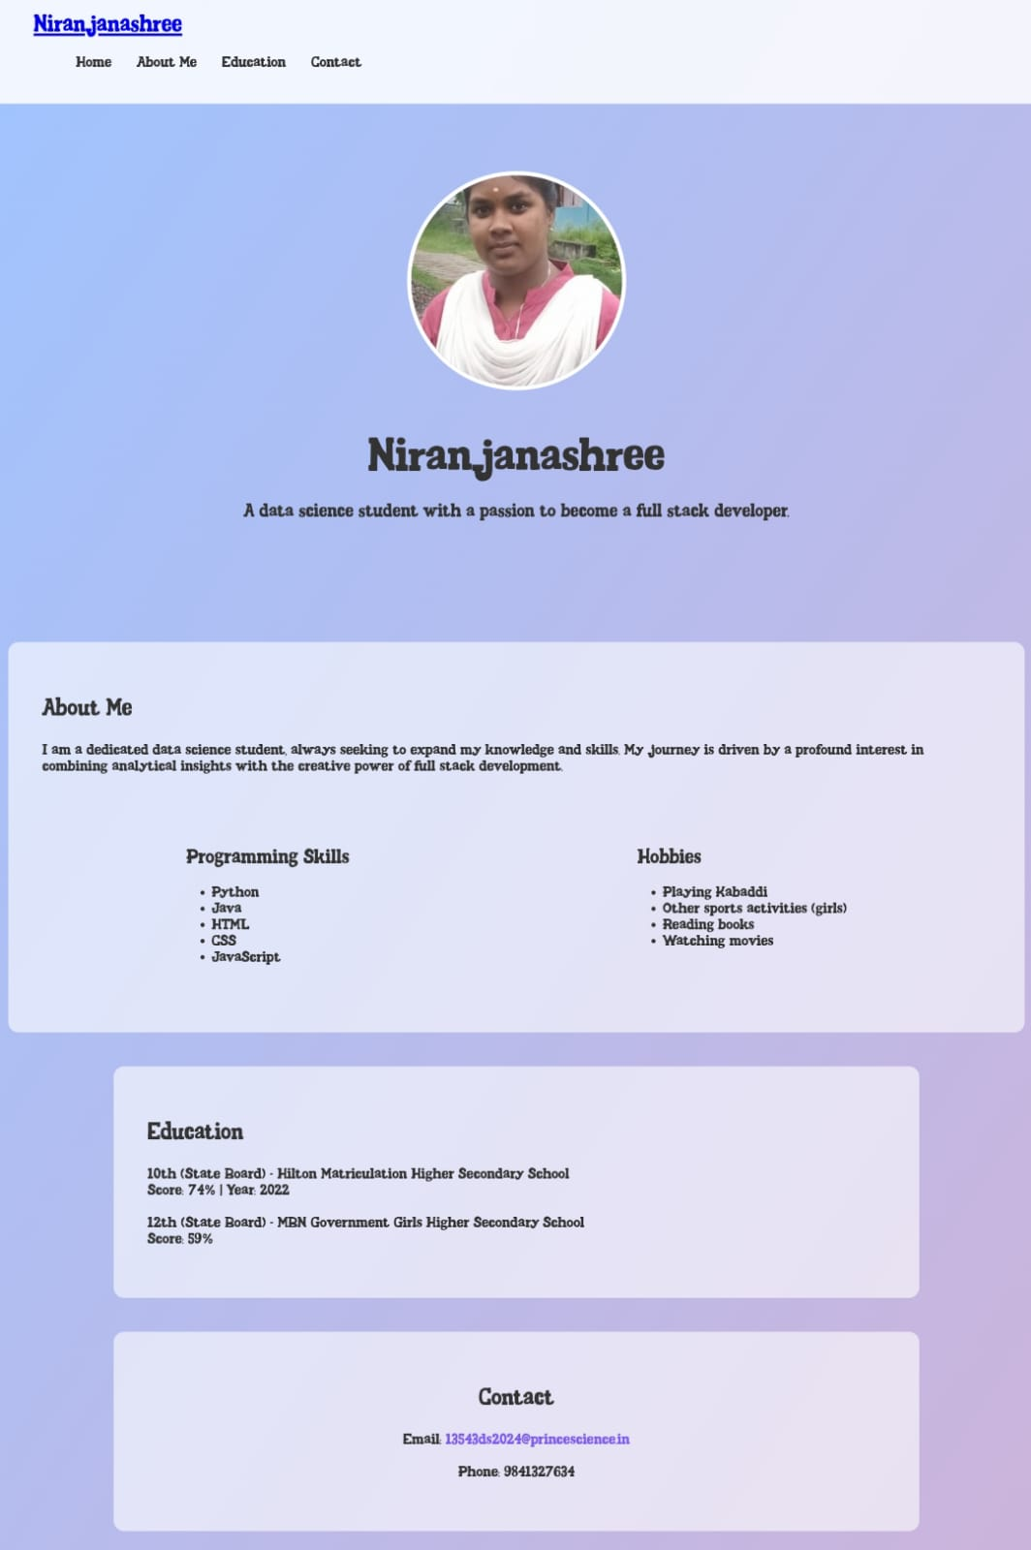

RESULTS AND SCREENSHOTS
3/21/2024 Annual Review
10

Slide 11
CONCLUSION
My digital journey portfolio reflects my growth, skills, and creativity. It showcases my learning path, projects, and achievements in an organized way. This portfolio not only highlights my technical and personal strengths but also represents my continuous progress toward future goals.
GITHUB: https://niranjana543.github.io/TNSDC-FWD-DP/
11

