Slide 1
NIRANJANA J
2021506057
DEPARTMENT OF INFORMATION TECHNOLOGY
MADRAS INSTITUTE OF TECHNOLOGY

Slide 2
PROJECT TITLE
Personalized Emoji Generator: Empowering Expression with GAN and Segmentation

Slide 3
AGENDA
Input Generation:
Develop a user interface for inputting desired emoji characteristics.
Data Preparation:
Collect, segment, and annotate emoji images for training.
GAN Training:
Implement and train a GAN architecture for generating segmented emoji parts.
Segmented Output:
Generate segmented outputs based on user input.
Assembly of Emoji:
Combine segments to create complete emoji images.
Quality Evaluation:
Evaluate emoji quality based on visual metrics.
Output Presentation:
Present generated emojis with customization options.

Slide 4
PROBLEM STATEMENT
Developing a user-friendly system that enables users to create customized emojis poses several challenges, including designing an intuitive input interface, collecting and segmenting a diverse dataset of emoji images, training a Generative Adversarial Network (GAN) architecture, generating segmented outputs for each emoji part, assembling coherent emoji images, evaluating emoji quality, and presenting the final emojis to users with customization options. The goal is to create a seamless and engaging experience for users to express themselves through personalized and visually appealing emojis.

Slide 5
PROJECT OVERVIEW
The project aims to develop a user-friendly system for creating personalized emojis using Generative Adversarial Networks (GANs) and image segmentation. The key aspects of the project include:
Objective: Enable users to express themselves through customized and visually appealing emojis.
Challenges: Designing an intuitive input interface, segmenting diverse emoji datasets, training GANs for emoji generation, evaluating emoji quality, and presenting customized emojis to users.
Value Proposition: Empower users to enhance digital communication with unique emojis, ensure user satisfaction through a user-friendly interface, and provide high-quality emoji outputs.
Outcome: Deliver a robust and scalable system capable of generating diverse and high-quality emojis, fostering user engagement and self-expression.
Implementation: Utilize advanced technologies like GANs and image segmentation, conduct thorough testing and validation, and iterate based on user feedback and performance evaluations.

Slide 6
END USERS
The project caters to a diverse range of end users, including:
General Users:
Individuals using emojis in daily communication and seeking personalized expressions.
Content Creators:
Social media influencers, bloggers, and designers incorporating emojis for engaging content.
Businesses and Brands:
Companies using emojis in branding and marketing efforts to connect with their audience.
Educational Institutions:
Schools and educators integrating emojis into educational materials for interactive learning.
Developers and Technologists:
Tech enthusiasts exploring advanced technologies like GANs and segmentation for emoji innovation.
Digital Communication Platforms:
Messaging apps and social media platforms enhancing user experience with personalized emojis.

Slide 7
SOLUTION AND ITS VALUE PROPOSITION
The project's solution involves developing a robust system that enables users to create customized emojis based on their preferences. Key components of the solution include:
Input Interface:
Design an intuitive and user-friendly interface for users to input desired emoji characteristics.
Data Collection and Segmentation:
Collect a diverse dataset of emoji images and segment them into distinct parts.
Generative Adversarial Networks (GANs):
Train a GAN architecture to generate realistic and diverse emoji variations.
Segmented Output Generation:
Develop algorithms to generate segmented outputs for each emoji part based on user input.
Quality Evaluation:
Establish metrics for evaluating the quality of generated emojis.
Output Presentation and Customization:
Present the generated emojis to users with customization options.

Slide 8
SOLUTION AND ITS VALUE PROPOSITION
The project's solution offers several value propositions:
Enhanced User Experience:
Provide a seamless and engaging emoji generation experience for users.
Personalized Expressions:
Empower users to express themselves uniquely through customized emojis.
High-Quality Outputs:
Deliver high-quality and visually appealing emojis that meet user expectations.
Coherent and Aesthetic Compositions:
Ensure coherence and consistency in emoji compositions for user satisfaction.
Continuous Improvement:
Incorporate user feedback mechanisms to iteratively improve the emoji generation process and output quality.

Slide 9
WOW FACTOR IN THE SOLUTION
Cutting-Edge Technology:
Utilizes GANs and segmentation for realistic and diverse emoji generation.
Employs advanced algorithms for accurate composition.
Intuitive User Interface:
User-friendly input with interactive elements.
Enables detailed emoji customization.
Personalization and Customization:
Offers extensive options for unique emoji creation.
Reflects users' personalities and emotions.
Quality and Coherence:
Ensures high-quality, visually appealing emojis.
Maintains coherence and industry standards.
User Feedback Integration:
Incorporates feedback for continuous improvement.
Refines processes based on evolving trends.

Slide 10
MODELLING
Generative Adversarial Networks (GANs):
Two neural networks: generator and discriminator.
Generator creates realistic emoji variations based on input.
Image Segmentation:
Divides emoji images into segments like mouth, eyes, ears, etc.
Enables manipulation and customization of specific emoji feature.
Training and Optimization:
GAN model trained on diverse segmented emoji dataset.
Enhances model performance and emoji generation quality.
Evaluation and Quality Assurance:
Evaluate generated emojis using visual similarity, diversity, and coherence metrics.
Implement quality assurance measures to meet industry standards and user expectations.

Slide 11
RESULTS
Emoji Generation:
Diverse and realistic emojis generated based on user input.
Emojis reflect various facial expressions, features, and accessories.
Customization Options:
Extensive customization options for personalized emojis.
Users can modify facial expressions, colors, and accessories.
Quality Assessment:
Emojis evaluated for visual appeal, diversity, and coherence.
High-quality output meeting industry standards.

Slide 12
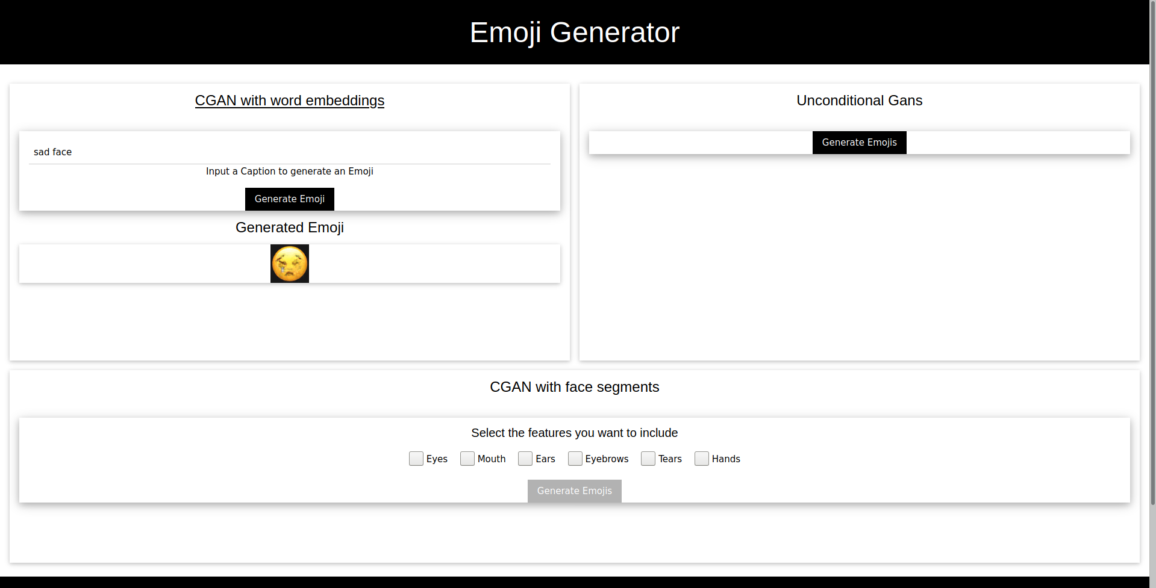
DEMO IMAGE

