Slide 1



STUDENT MANAGEMENT SYSTEM
PROJECT MEMBERS :
NIRANJANA Y(23CDR110)
MUTHAMIL S(23CDR104)

Slide 2
Problem Description
Managing student data manually is time-consuming, error-prone, and inefficient.
A Student Management System is needed to automate tasks like storing student details, tracking attendance, managing grades, and handling course enrollment.
This system will improve accuracy, save time, and provide secure, easy access to information for students, teachers, and administrators.

Slide 3
Abstract
The Student Management System (SMS) utilizes Structured Query Language (SQL) and the Flask framework to manage and streamline academic and administrative operations in educational institutions. By automating essential tasks such as student registration, course enrollment, attendance tracking, academic performance management, and feedback collection, the SMS enhances data accuracy and operational efficiency. A robust SQL-based database ensures secure, centralized storage and retrieval of critical student-related data, maintaining data integrity and consistency across all modules.This system reduces manual workload, minimizes human errors, and facilitates fast and reliable access to student information. It supports role-based access for students, faculty, and administrators, ensuring that each user interacts only with relevant modules and data. The SMS also includes built-in analytics and reporting features, aiding in academic planning and institutional decision-making.This implementation of a Student Management System using Python (Flask) and MySQL includes the creation of essential tables: Students, Courses, Enrollments, Attendance, Academic Performance, Feedback, Staff, Departments, and Users. It supports full CRUD functionality, secure user authentication, and scalable data management. The system is designed to simplify institutional processes and provide a comprehensive, efficient, and user-friendly platform for managing educational data.
3

Slide 4
Introduction
1.1 Overview of the Project
The project titled “Student Management System” is developed to enhance academic and administrative operations in educational institutions. It uses Python (Flask) for the backend and MySQL as the database. The system captures and processes student data for registration, course enrollment, attendance, academic performance, and feedback.By providing role-based access to students, faculty, and administrators, it ensures secure and efficient data management. The system automates repetitive tasks, supports real-time data tracking, and reduces administrative workload, thereby improving communication and decision-making within the institution.
4

Slide 5
1.2 About Existing System – Manual System
Most institutions still depend on manual or semi-digital methods like spreadsheets and documents to manage student information. These methods are inefficient, error-prone, and not scalable for large datasets. Processes like registration, attendance tracking, and performance monitoring take significant time and often result in inconsistent records. A digital Student Management System is needed to streamline these processes, maintain accurate data, and support institutional growth.
1.3 Drawbacks of the Existing System
Tedious and inefficient handling of large volumes of student dataHigh time consumption for basic academic task sDifficulty in maintaining and retrieving historical dataNo centralized or integrated system for academic recordsLack of role-based access and data securityDelays in generating reports and making informed decisions
5

Slide 6
Existing System
Student data is managed manually or using basic tools like spreadsheets and offline documents. Data is often fragmented and inconsistent across departments.
Student registration and course enrollment processes are delayed and inefficient. Tracking of attendance and academic performance is difficult and error-prone. There is no centralized system for integrated reporting and analytics.
Lack of role-based access leads to limited control over data visibility and operations. Administrative tasks are time-consuming and not scalable for growing student populations.
Communication between students, faculty, and administration is often mismanaged or delayed.
6

Slide 7
Proposed System
Course & Enrollment Management : Enables students to register for courses and administrators to manage course offerings and schedules.
Attendance Tracking : Automates daily attendance recording and provides reports for both students and staff.
Marks & Grade Management : Allows teachers to enter grades, calculate results, and generate academic reports.

Slide 8
System Specification
2.1 Hardware Specification
Processor : Intel Core i3 or higher
RAM : 4 GB or above
Hard Disk : 100 GB
Monitor : 15’’ HD Color Monitor
Keyboard : Standard 104 keys
Pointing Device : Optical Mouse

Slide 9
2.2 Software Specification
Operating System : Windows 10
Programming Language : Python (Flask Framework)
Database : MySQL
Database Management Tool : phpMyAdmin
Web Server : Apache (via XAMPP/WAMP)
IDE : Visual Studio Code
Browser : Chrome / Firefox (for testing web interface)

Slide 10
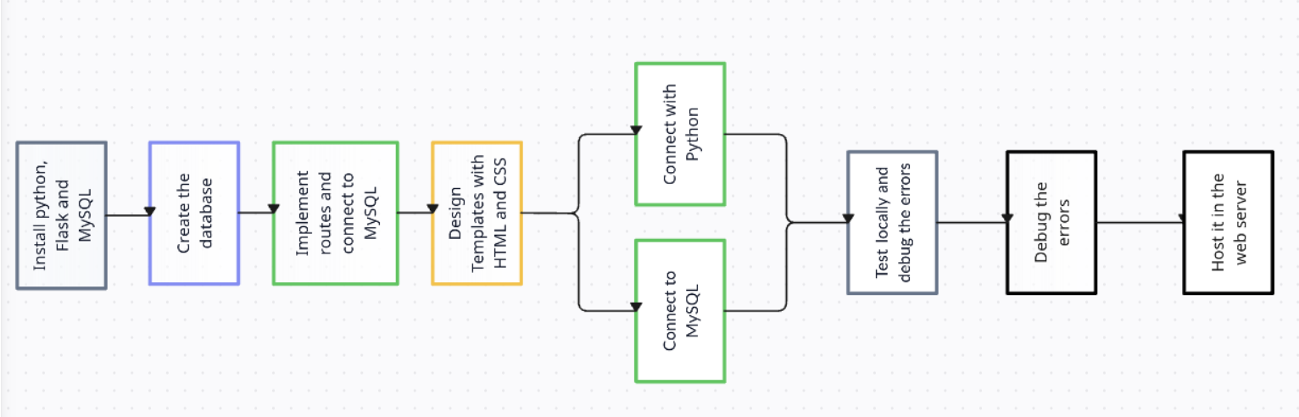
Data Flow Diagram

Slide 11
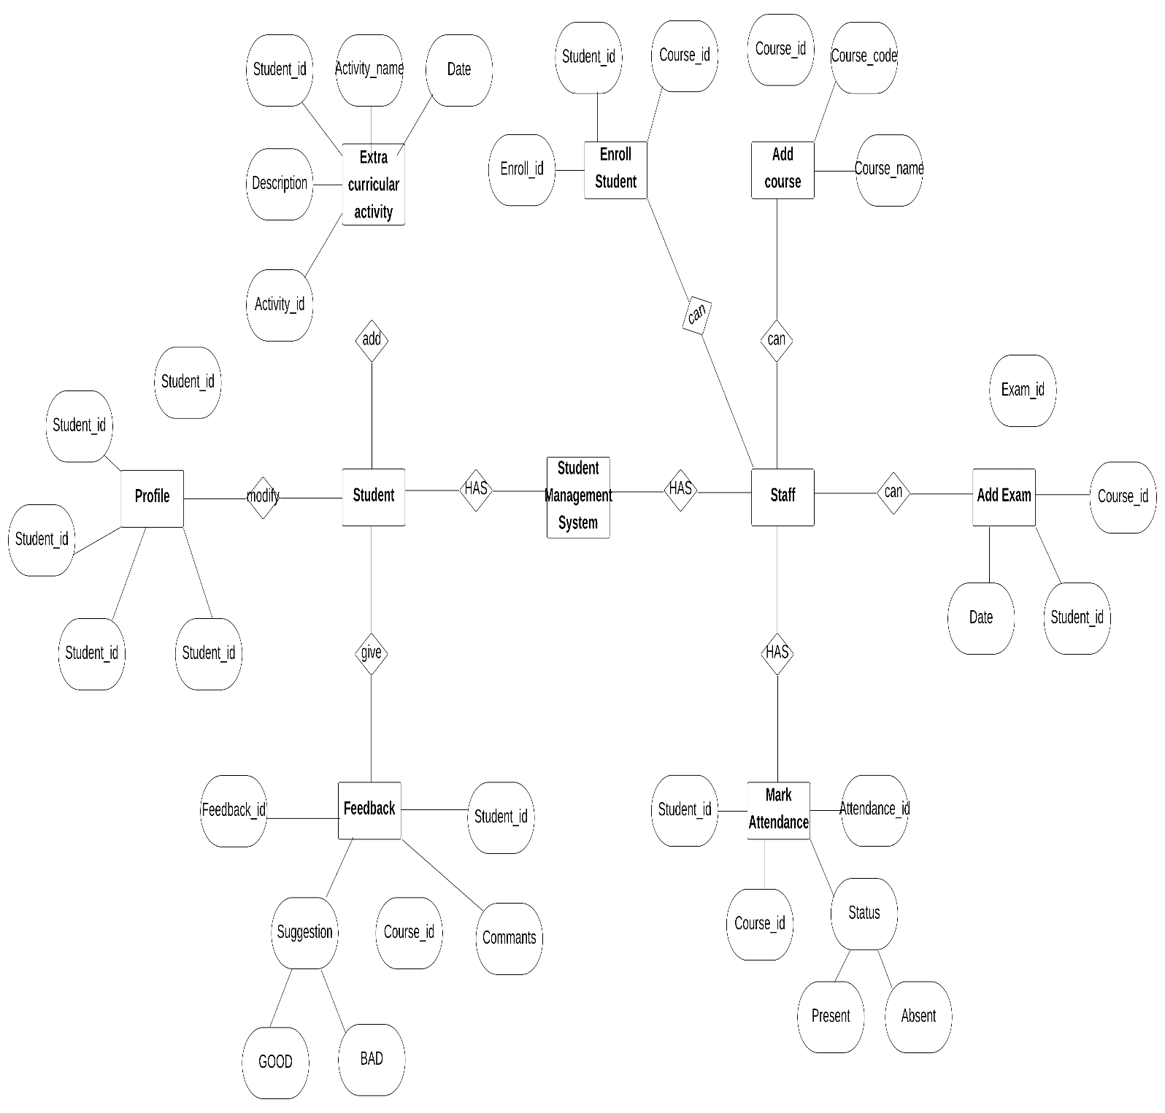
ER Diagram

Slide 12
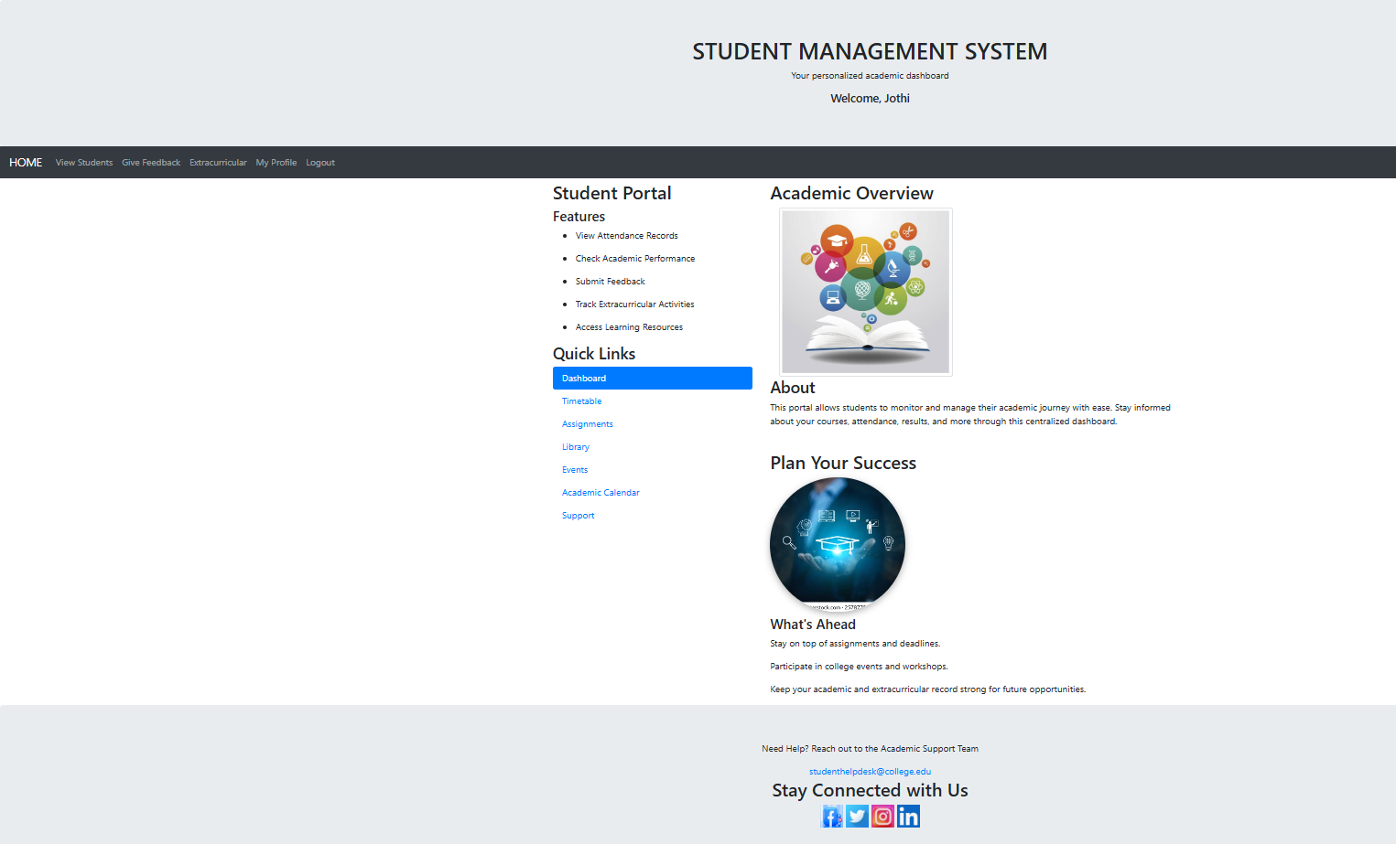
Sample Input And Output
. Home Page(For Students)

Slide 13
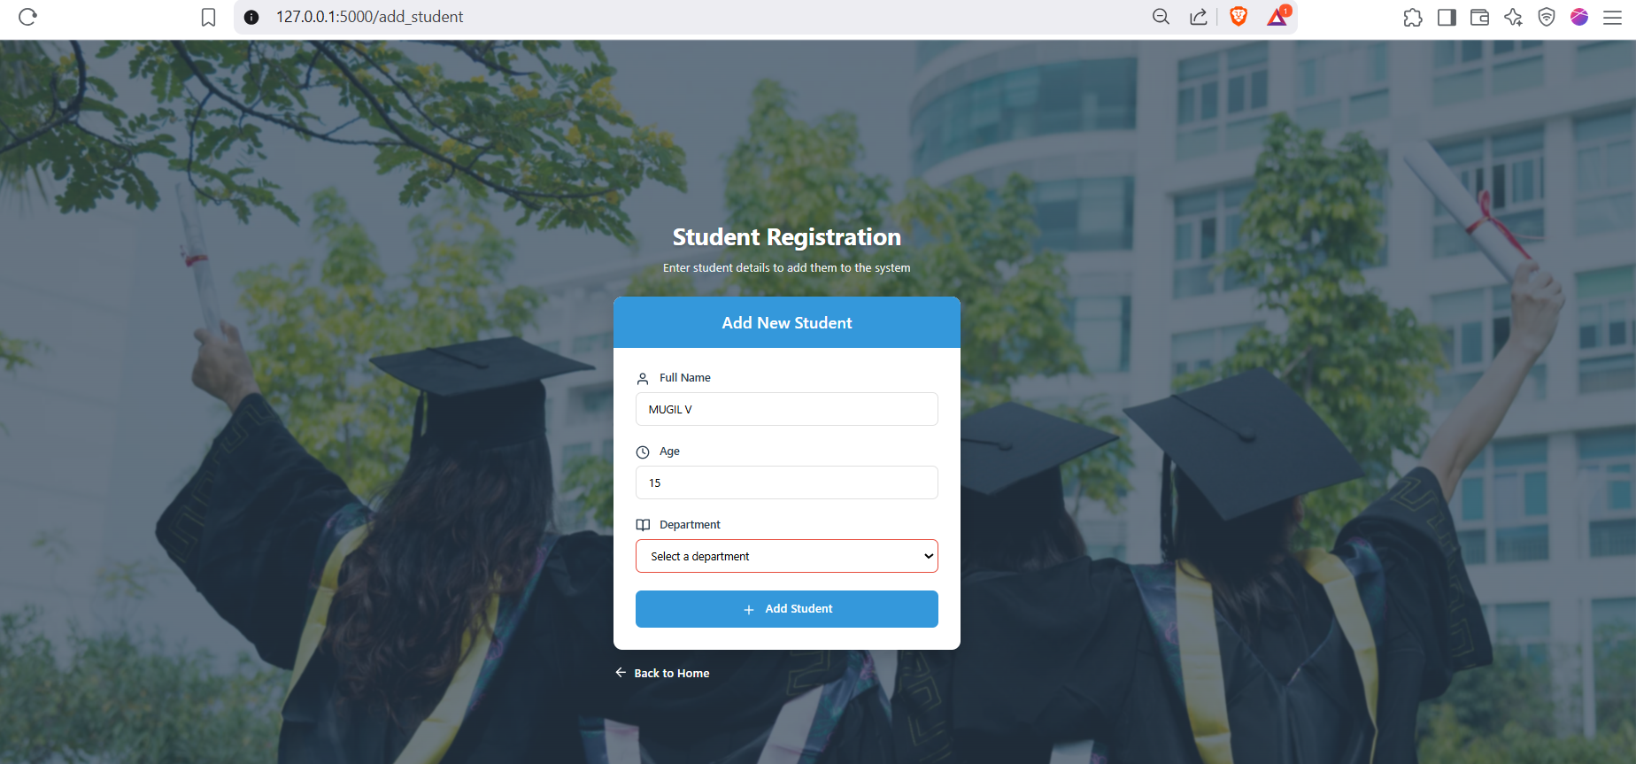
Student Registration Page

Slide 14
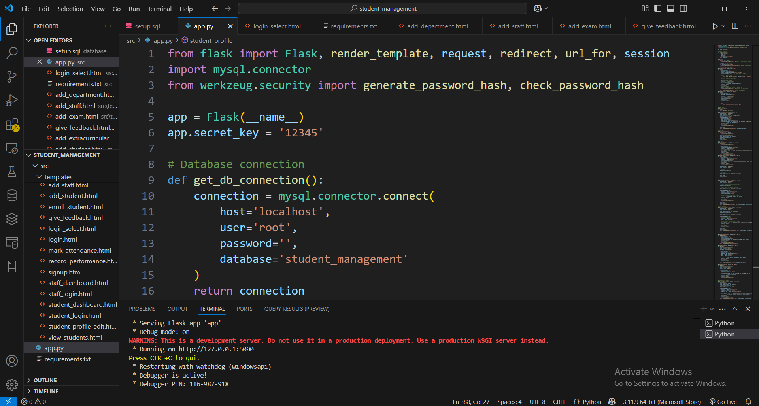
Main Code for Student Management System

Slide 15
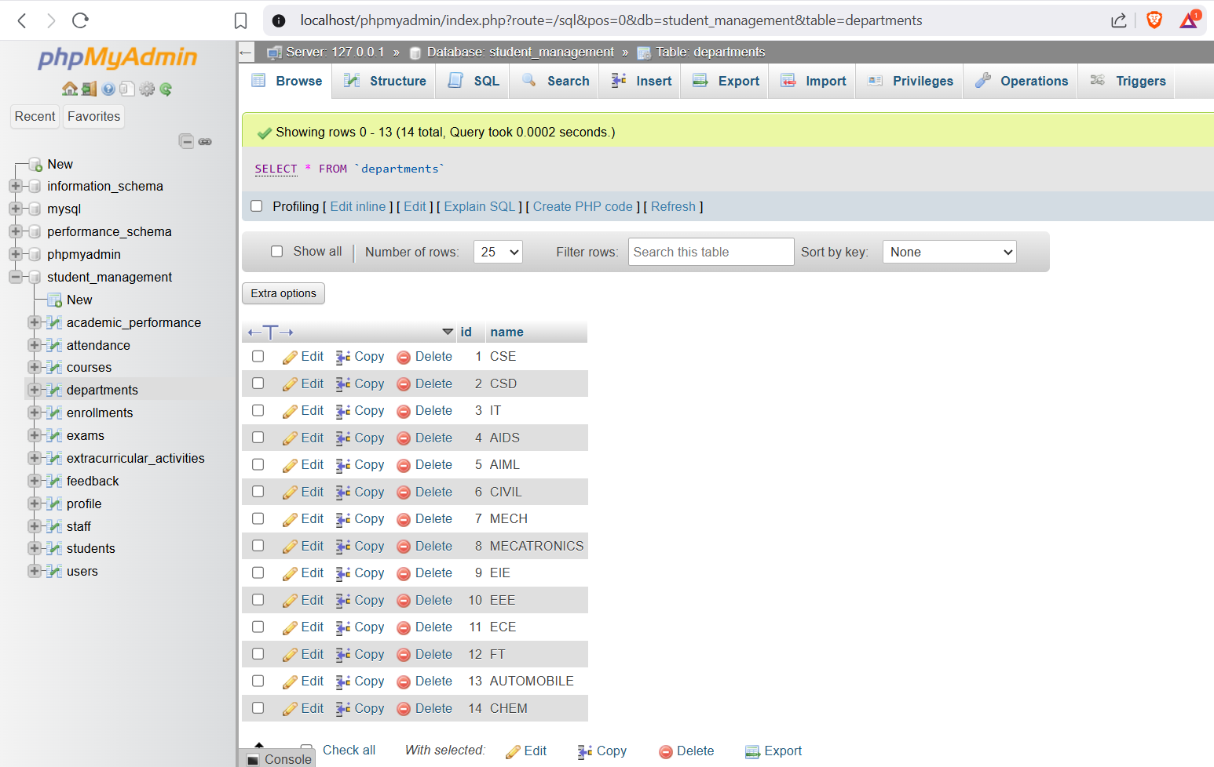
Data Stored in Database for Student Management System

Slide 16
Types of Modules
Student Management Module
Management Enrollment Module
Attendance Management Module
Mark attendance Module
Performance Tracking Module
16

Slide 17
Reference
1.MySQL. (2023). MySQL Documentation. Retrieved from https://dev.mysql.com/doc/
2.Python Software Foundation. (2023). Python Documentation. Retrieved from https://docs.python.org/3/
3.MySQL Connector/Python Developer Guide.(2023). Retrieved from https://dev.mysql.com/doc/connector-python/en/
4.GitHub. (2023). GitHub Documentation. Retrieved from https://docs.github.com
5.W3Schools. (2023). SQL Tutorial. Retrieved from https://www.w3schools.com/sql/

Slide 18
Thank you!

