Slide 1

Pimpri Chinchwad College Of Engineering & Research, Ravet
TESTING OF COMPUTER ENGINEERING COURSE DETAILS WEBSITE USING SELENIUM AND QTP TOOLS
Guide Name:
Mrs. Manasee Kurkure
Presented By:
Shrutika Haribhau Phalke(44)
Niranjani Kailas Wagh(62)

Slide 2
Software Testing
Software testing is the process used to identify the correctness, completeness and quality of developed computer software.
It is the process of executing a program/application under positive and negative conditions by manual or automated means. It checks for the :-
Specification
Functionality
Performance

Slide 3

Why Testing tools?
Automated Testing
No Testing
Manual Testing
- Speed
- Repeatability
- Programming capabilities
- Coverage
- Reliability
- Reusability
- Save Time
- Time consuming
- Low reliability
- Human resources
- Inconsistent

Slide 4
Problem Statement
“Computer Engineering Course Details Website” is the website used to find the details of computer engineering course. And task is to apply various test cases on the website using Selenium IDE and QTP tool.

Slide 5
System Requirements
Software Requirements
Selenium Library,
Mozilla Firefox
Eclipse IDE
QTP IDE
Gecko Driver.
Hardware Requirements
4GB RAM
500GB Hard Disk

Slide 6
Selenium
Selenium is a Functional Automation tool for Web applications.
Selenium is an open source tool (No cost Involved in it).
Selenium supports the languages like HTML, Java, PHP, Perl, Python, Ruby and C#.
It supports the browsers like IE, Mozilla Firefox, Safari, Google Chrome and Opera.
It supports the operating systems like Windows, Linux and Mac.

Slide 7
Selenium
Selenium is mainly built on 3 components.
Selenium IDE
Selenium RC
Selenium Grid
We can perform various types of testing with selenium
Regression testing by writing Reusable Scripts in the form of Functions or Methods.
Retesting with looping concepts.
Validation of the application by using conditional statements.
Database testing.

Slide 8
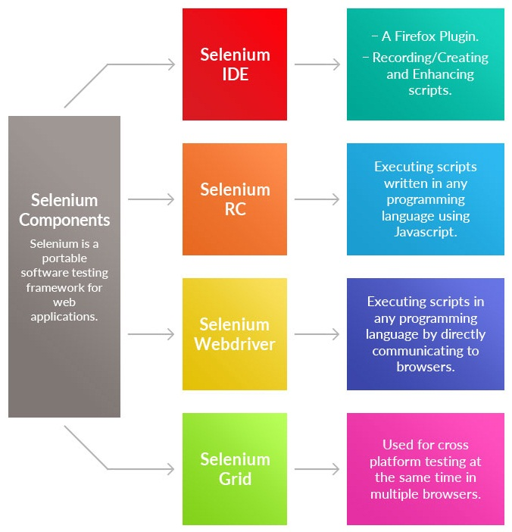
Components Of Selenium

Slide 9
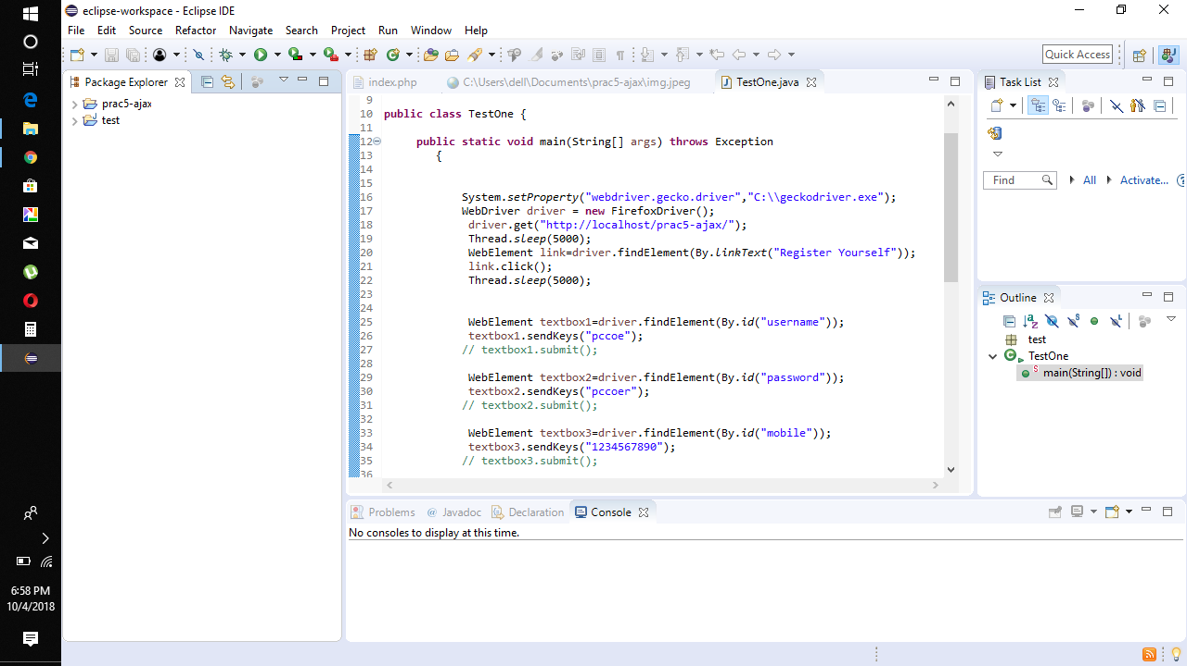
Testing using Selenium

Slide 10
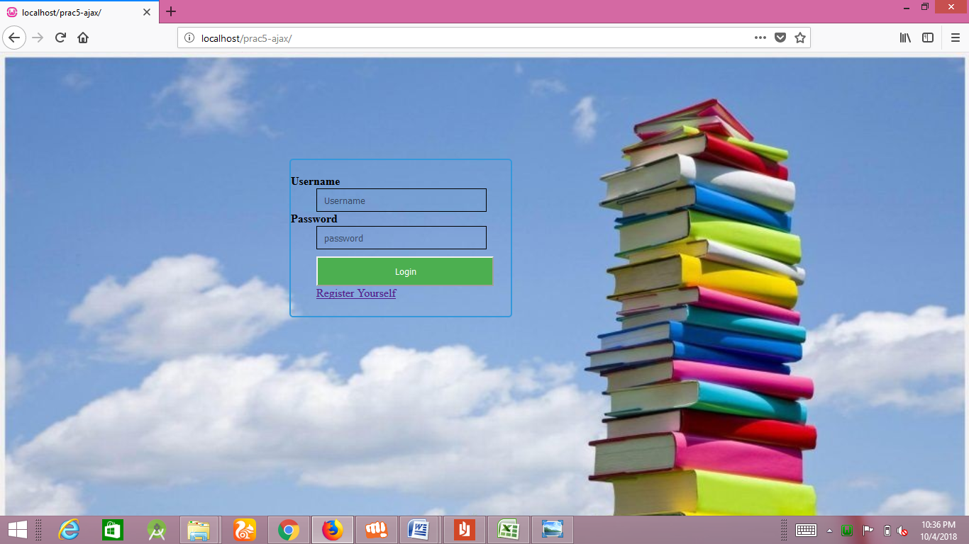
Selenium Output

Slide 11
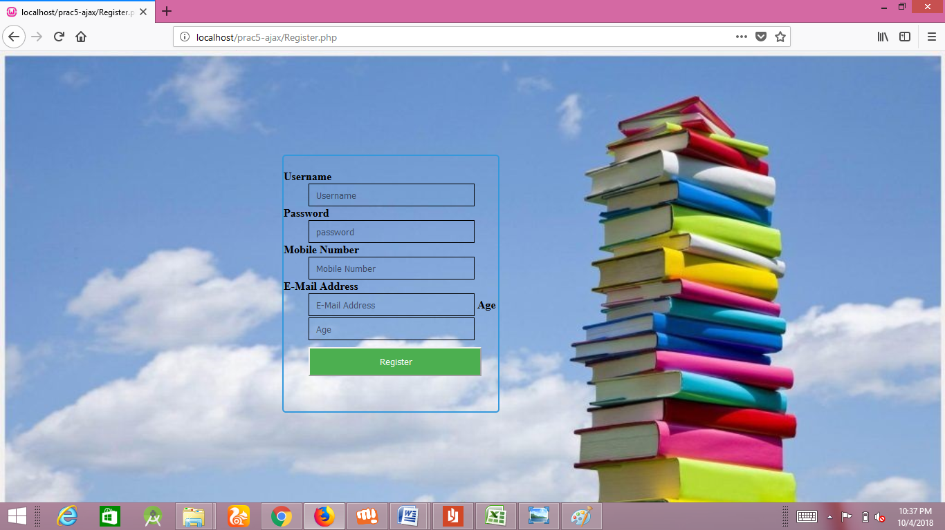
Selenium Output

Slide 12
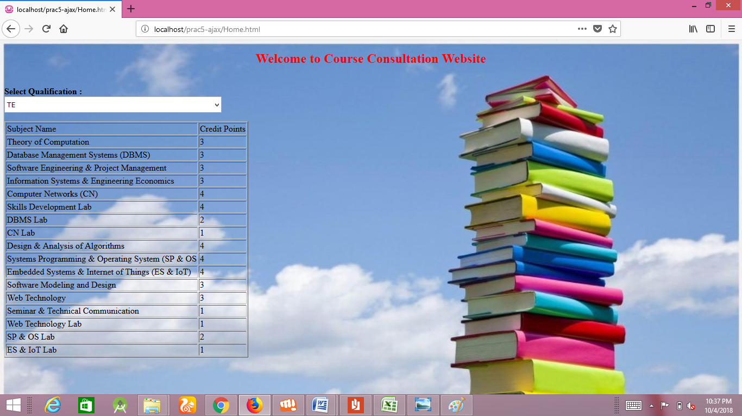
Selenium Output

Slide 13
QTP
Developed by Mercury interactive now owned by HP
Developed for web functionality
QTP supports both web applications & windows applications
QTP Developed in 2002, present version in the market is 9.5
Test Script developed on VB Script
QTP supported Technology
.NET. J2EE, Main Frame, XML, Java, Delphi
ERP -> SAP, Seibel, People soft
QTP Supports both Technical & Non Technical People
QTP run on only windows platform not supporting UNIX, Linux etc

Slide 14
Architecture Of QTP
Script(.mts file)
Action1 Rep1 (.mtr file)
Sheet1 (localSheet)
Shared Repository t (.tsr file) Global Parameter
Parameters - Action Parameters
Action2 Rep 2 (.mtr file)
Environment Parameter
Sheet 2 (localSheet)
Parameters - Action Parameters
Test Parameter
Action3 Rep 3 (.mtr file)
Sheet3 (localSheet)
Parameters – Action Parameters

Slide 15
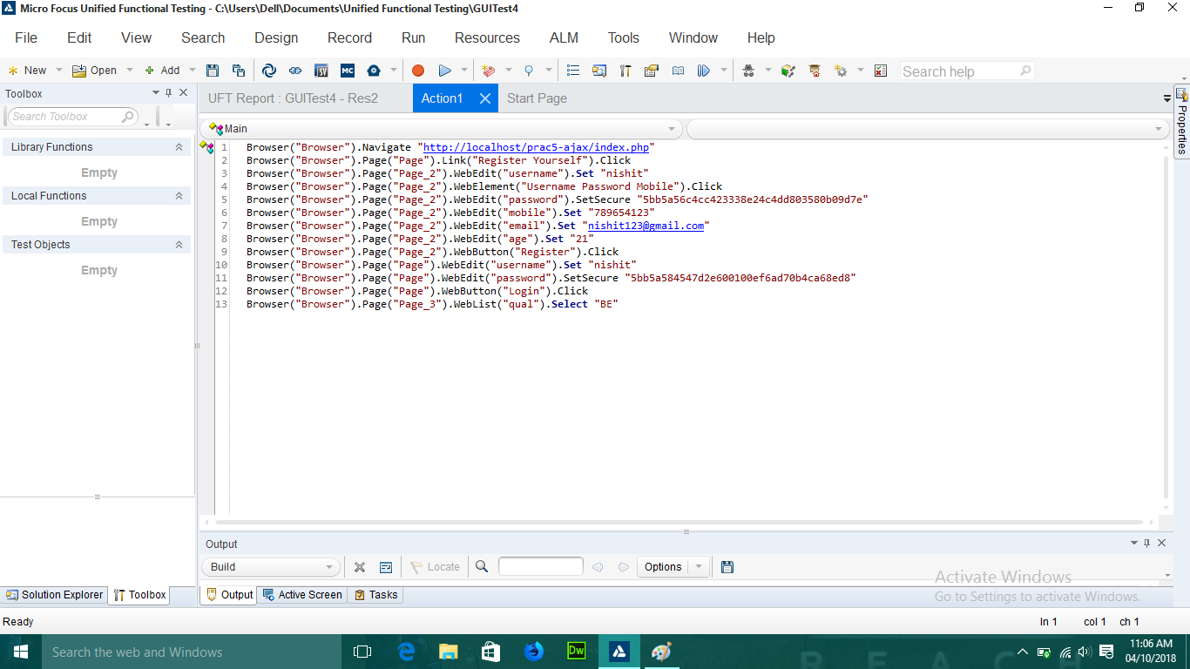
Testing using QTP

Slide 16
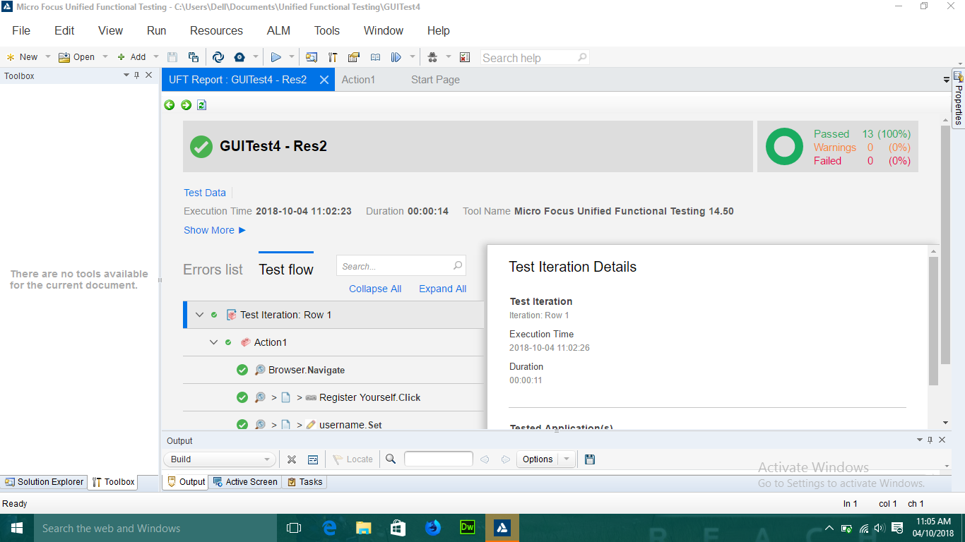
QTP Output

Slide 17
QTP Output

Slide 18
QTP Output

Slide 19
QTP Output

Slide 20
Conclusion
We have performed various test cases on “Computer Engineering Course Details” website using Selenium IDE and QTP tool. In this we have performed test cases on various modules such as Login page, Registration page and course details page.

