Slide 1
Use-case: 7 – Image Segmentation & Classification Analysis
Niranjan Kumar

Slide 2
Use-case Context and Objective
Healthcare organizations handle large volumes of handwritten documents, which are time-consuming and error-prone to digitize manually.
Manual digitization leads to inefficiencies and potential errors in patient care.
An automated system is needed to accurately digitize and classify handwritten characters on medical documents.
A proposed solution involves developing a deep learning-based system using the MNIST dataset to classify handwritten digits (0-9).
The primary objective is to improve the efficiency, accuracy, and reliability of digitization processes in healthcare, ultimately enhancing patient care and administrative workflows.

Slide 3

MNIST Data OVERVIEW
The MNIST (Modified National Institute of Standards and Technology) dataset is a large database of handwritten digits commonly used for training various image processing systems.
Number of samples: 70,000 images
  Training set: 60,000 images
  Test set: 10,000 images
  Image size: 28x28 pixels
  Color: Grayscale (single channel)
  Classes: 10 (digits 0-9)

Slide 4
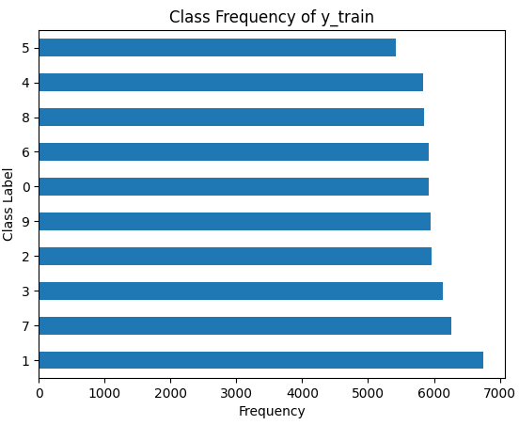
Exploratory Data Analysis
The MNIST dataset contains 70,000 grayscale images of handwritten digits (0-9), with 60,000 images for training and 10,000 images for testing. Each image is 28x28 pixels.
The dataset is evenly distributed across 10 classes (digits 0-9), with each class having roughly the same number of images, ensuring balanced representation.
Classes 1, 7, and 3 have the highest frequencies, with 6742, 6265, and 6131 occurrences respectively.
Class 5 has the lowest frequency among the classes listed, with 5421 occurrences.
Despite these differences, the distribution is relatively even, which helps in training balanced machine learning models.

Slide 5
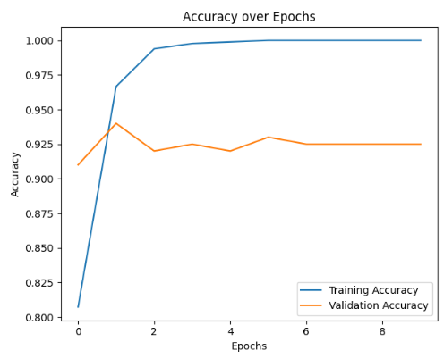
MLP MODEL TRAINING
A simple MLP model is defined with one hidden layer consisting of 784 neurons (same as the input dimension) and an output layer with 10 neurons (one for each digit class).
The labels are one-hot encoded to prepare them for multi-class classification.
The model has high training accuracy (close to 100%) but lower validation and test accuracy (around 88-93%), indicating it’s over-fitting to the training data.
The validation loss decreases initially but then fluctuates, showing inconsistent performance on the validation set.
We can consider adding regularization techniques like dropout and using early stopping to improve generalization.

Slide 6
PERFORMANCE IMPROVEMENT WITH DROPOUT REGULARIZATION
The test loss has decreased significantly to 0.104, and the test accuracy has increased to approximately 97%, demonstrating a substantial improvement over the previous model.
The inclusion of dropout regularization (0.1 in each layer) has helped reduce over-fitting, leading to better generalization on the test set.
Enhanced Generalization:
  Better performance on unseen data compared to the previous MLP model
Reduced Over-fitting:
  Narrowed the gap between training and test accuracy
  Demonstrates the effectiveness of dropout in mitigating over-fitting

Slide 7
CNN MODEL PERFORMANCE WITH DROPOUT REGULARIZATION
Utilized Conv2D layers with 32 and 64 filters, followed by MaxPooling2D layers for down-sampling.
Applied dropout (0.2) after Conv2D and Dense layers, with a final Dense layer of 128 units and a 10-unit output layer with soft-max activation.
Model Performance
Achieved a test loss of 0.036 and a test accuracy of 99.18%.
Dropout regularization helped prevent over-fitting, leading to high accuracy and improved generalization.
Model generalizes exceptionally well to unseen data, indicated by high test accuracy.
Effective combination of Conv2D, MaxPooling2D, and Dense layers achieved a balance between complexity and performance.

Slide 8
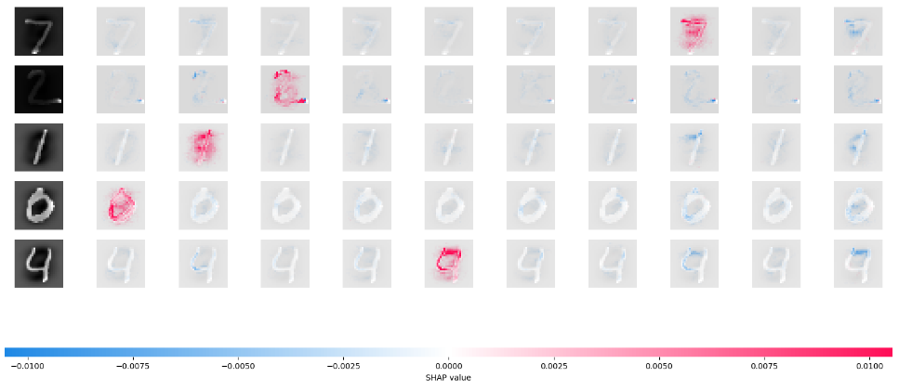
MODEL PREDICTIONS WITH SHAP VALUES
To understand the predictions from the CNN model, we will use SHAP python library for model explain-ability. SHAP values highlight influential pixels, revealing the model's decision-making process.
SHAP visualizations make the neural network's predictions transparent and understandable by showing specific pixel contributions
Key Features for Digits:
  7: Horizontal and diagonal strokes are crucial.
  2: Top curve and bottom line are emphasized.
  1: Vertical line is the main feature.

