Slide 1
Analysis of Model Overfitting due to increase in complexity
NiranjanKumar – D18023

Slide 2
Introduction
In this project we will see the
Analysis of Test Error (RMSE) for increase in Sample Size.
Analysis of Model overfitting due to increase in model complexity.
Code for the analysis at -
https://github.com/Niranjankumar-c/OverFitting

Slide 3
Data Description
Data contains 1850 observations from a ads campaign for an e-commerce store
Data Dictionary:
ad_group : Ad Set ID and targeting settings.
reach: Number of people who’ve seen the ad set.
clicks: Number of clicks for the ad set.
cpc: Average cost per click.
purchases: Number of purchases from the store that were attributed to the ad set.
total_purchase_value: Total revenue from purchases attributed to the ad set.
Data Reference: Machine Learning Textbook (under publication)

Slide 4
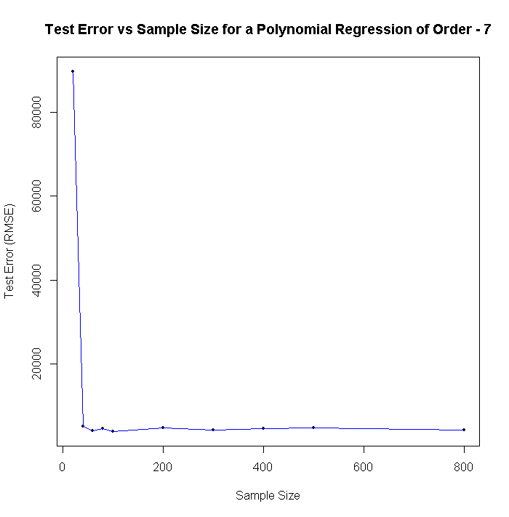
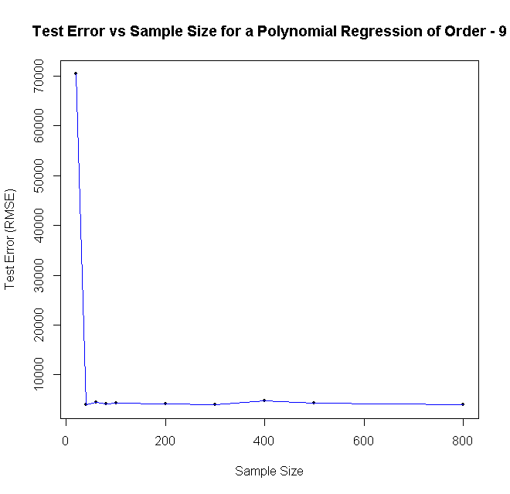
RMSE vs Sample Size
Analysing the Test Error(RMSE) for increasing sample size of training data.
Same Experiment has been repeated for different model complexities.

Slide 5
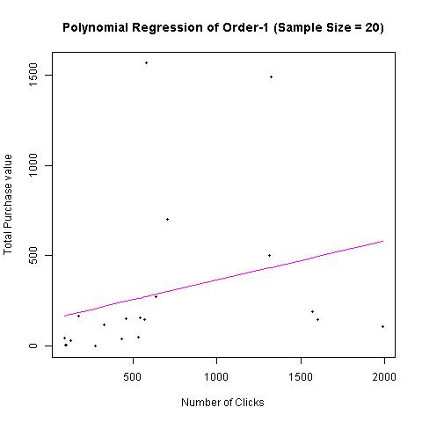
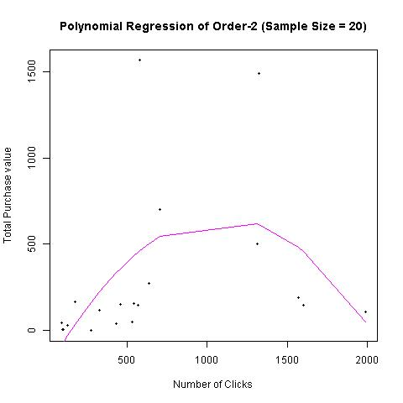
Model overfitting with increase in complexity
Training RSS: 3644090
Testing RSS: 253876651
Training RSS: 2789473
Testing RSS: 1318721361

Slide 6
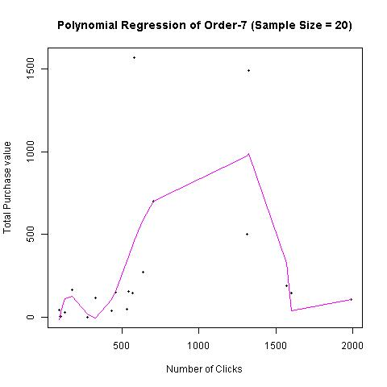

Training RSS: 2059065
Testing RSS: 3.188403e+18
Training RSS: 2058145
Testing RSS: 3.816785e+16

Slide 7
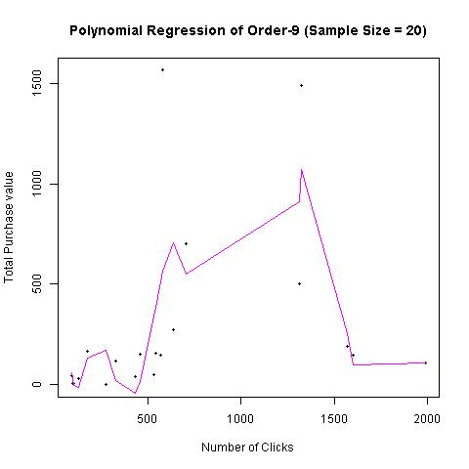
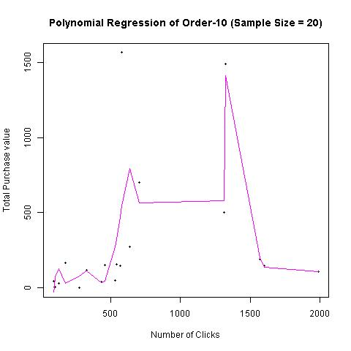
Training RSS: 1896392
Testing RSS: 2.851532e+23
Training RSS: 1582107
Testing RSS: 1.960431e+26

Slide 8
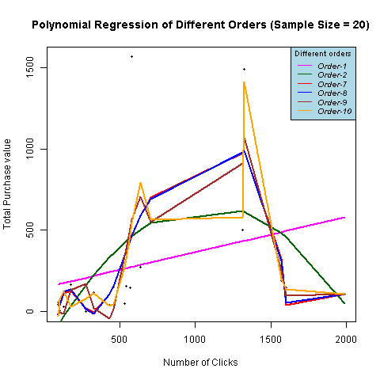
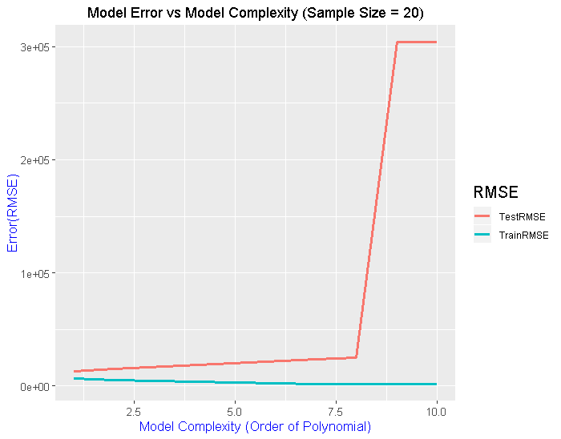

Slide 9
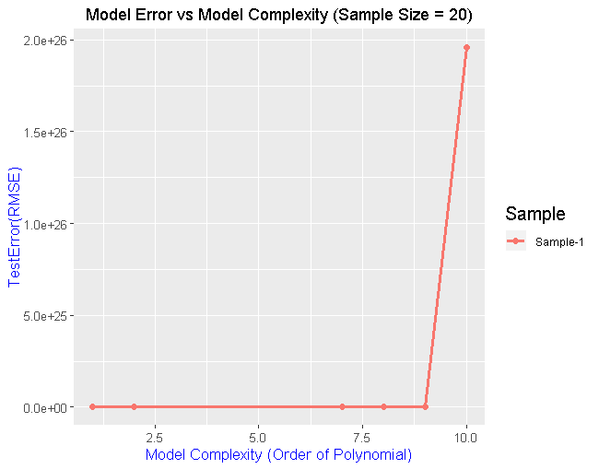
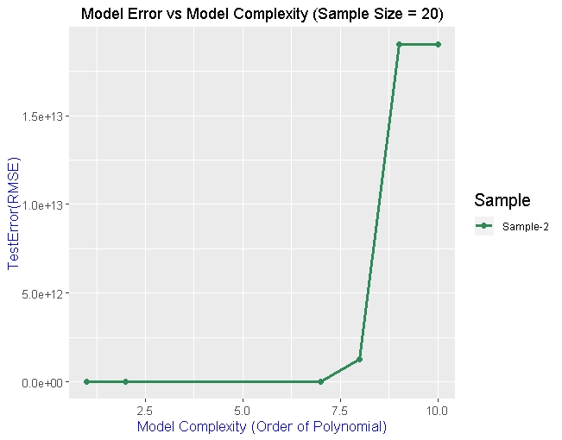
Variation of Test RMSE
Variation of Test RMSE for 4 different samples of fixed sample size of 20 observations

Slide 10
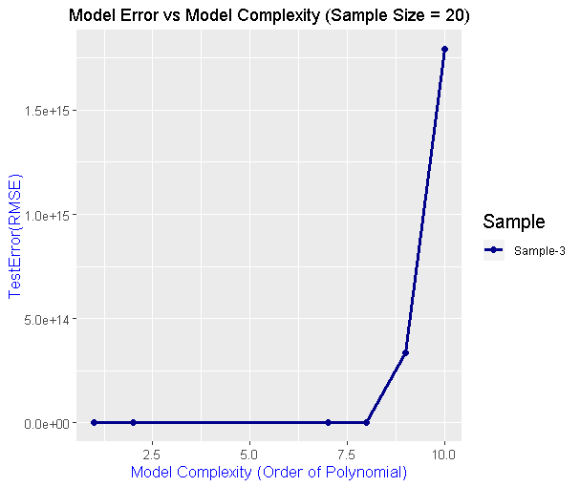
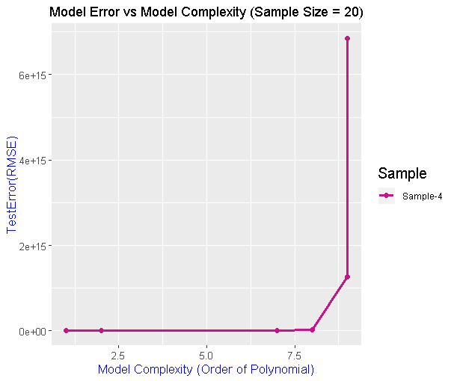
Variation of Test RMSE
Variation of Test RMSE for 4 different samples of fixed sample size of 20 observations

Slide 11
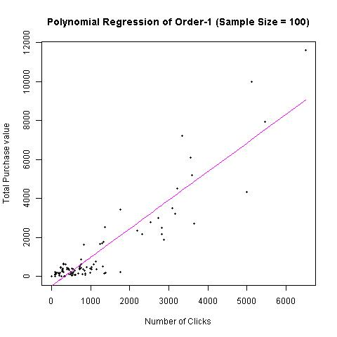
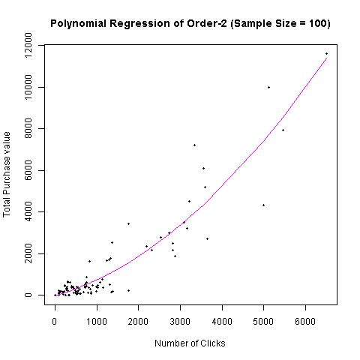
Training RSS: 68318125
Testing RSS: 19957229
Training RSS: 52167493
Testing RSS: 15265155

Slide 12
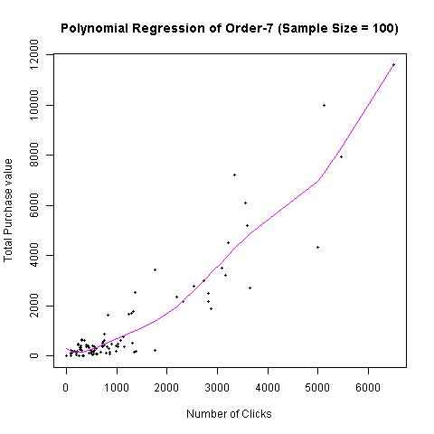
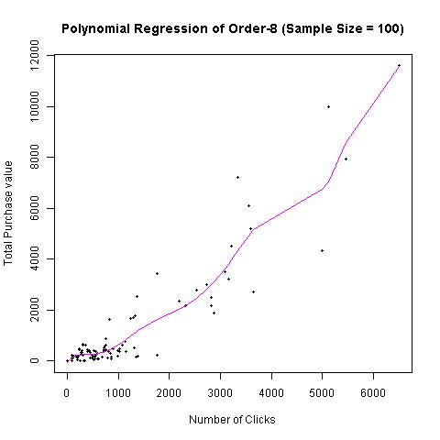
Training RSS: 50384814
Testing RSS: 15443110
Training RSS: 49044863
Testing RSS: 16150030

Slide 13
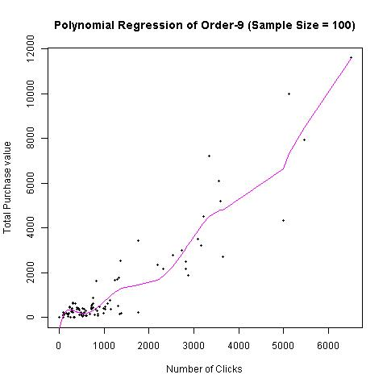
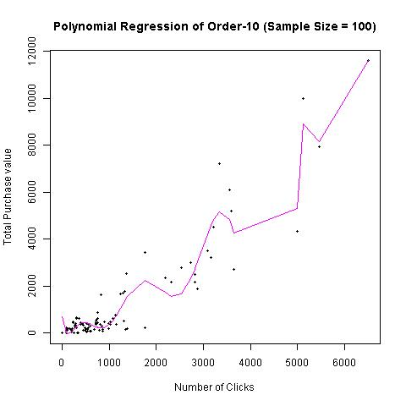
Training RSS: 47441227
Testing RSS: 17716907
Training RSS: 34921705
Testing RSS: 22598199

Slide 14
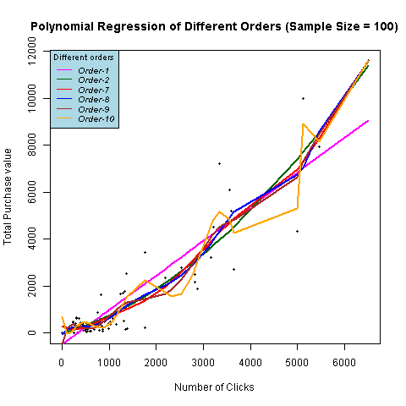
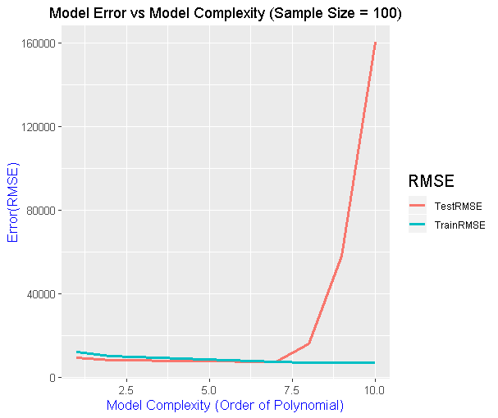

Slide 15
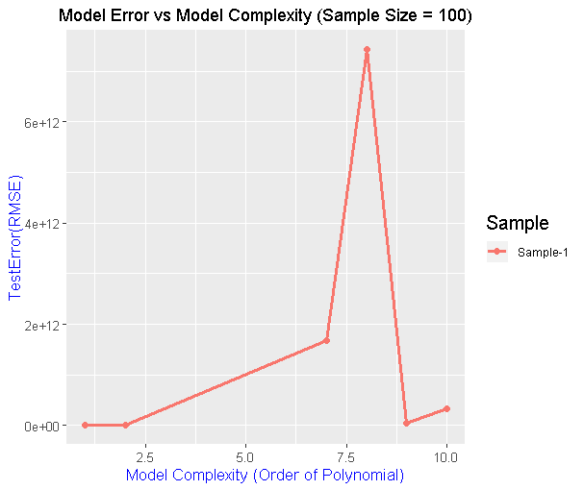
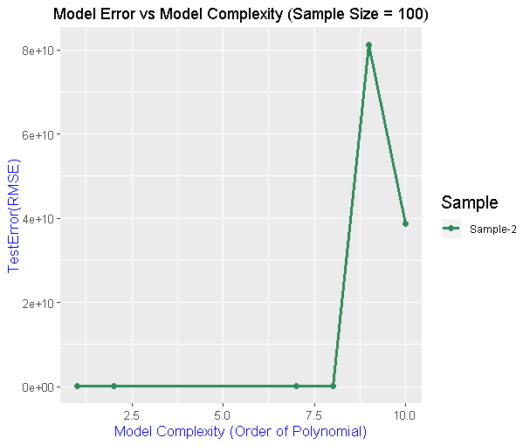
Variation of Test RMSE
Variation of Test RMSE for 4 different samples of fixed sample size of 100 observations

Slide 16
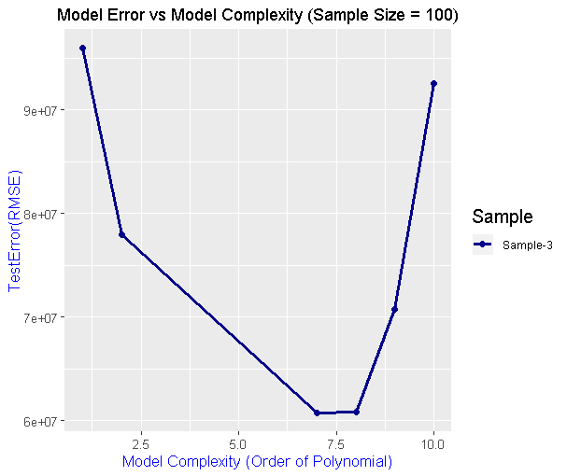
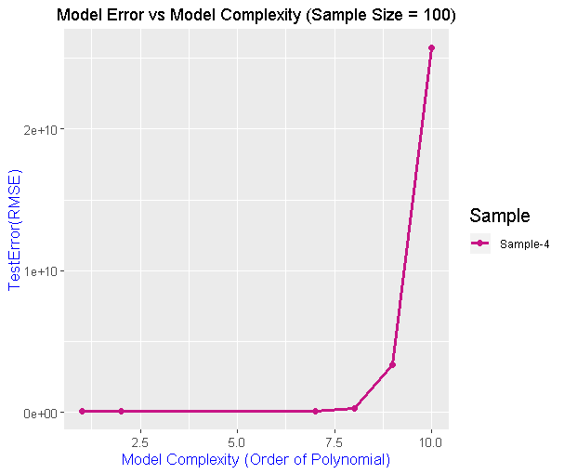
Variation of Test RMSE
Variation of Test RMSE for 4 different samples of fixed sample size of 100 observations

Slide 17
GitHub Code
Code for above analysis at -
https://github.com/Niranjankumar-c/OverFitting

