Slide 1
Use-case: 3 – Time Series Analysis
Niranjan Kumar

Slide 2
Use-case Context and Objective
One of the leading retail stores in US, ABC would like to predict the customers and demand accurately. There are certain events and holidays which impact sales on each day.
The company runs several promotional markdown events throughout each year. These markdowns precede prominent holidays such as super bowl, labor day, thanksgiving and christmas.
Main part of the use-case is to model the effects of markdowns on these holiday weeks in absence of the complete historical data.
The objective is to build an ideal ML algorithm that will predict demand accurately and ingest factors like promotions, state and school holidays.

Slide 3
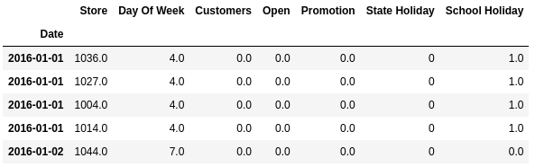
Data Summary
Historical data for 51 stories having customers data along with details like day of the week, store id, promotion and holidays details from Jan 2014 to 2016.
The data is provided in the excel format, need to be imported using pandas library.
52 stores historical data from the last 2 years is present in the given data.

Slide 4
Exploratory Data Analysis
Historical data contains more than 43,000 observations and 1,530 of these observations have missing values, which represents approximately 3.5% of the total data.
The historical data includes 52 unique stores. The store with the highest number of observations has 852 data points. Additionally, 9 stores have fewer than 852 observations each.
Analysis of customers for 2 stores:
  Store 1041: Avg customers – 700
  Store 1044: Avg customers – 474

Slide 5
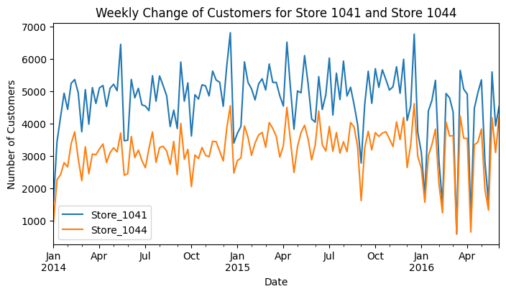
Analyzing Customers for Store 1041 & 1044
The chart displays the weekly change in customer numbers for Store 1041 and Store 1044 from January 2014 to mid-2016:
  Store 1041 consistently has more customers per week compared to Store 1044.
  Customer numbers for Store 1041 show more significant peaks and troughs, indicating higher volatility.
  Store 1041 & 1044 exhibit seasonal trends, with peaks often occurring at the start of each year(Jan), particularly for Store 1041

Slide 6
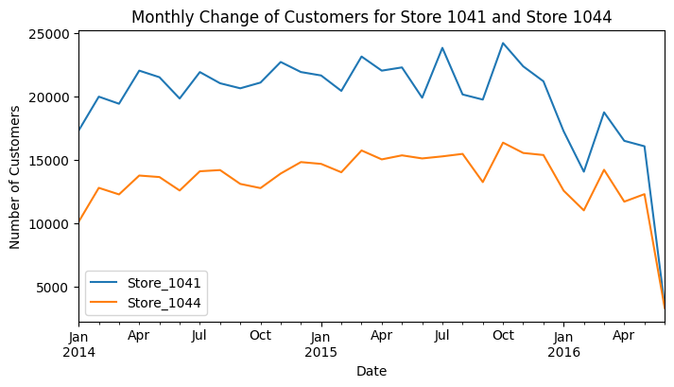
Analyzing Customers for Store 1041 & 1044
The chart displays the monthly change in customer numbers for Store 1041 and Store 1044 from January 2014 to mid-2016:
  Monthly chart confirms the observations from the weekly chart regarding higher customer numbers and greater volatility for Store 1041 compared to Store 1044.
  it also provides a clearer view of seasonal patterns and overall trends, especially the downward trend in customer numbers towards mid-2016.
  Store 1041 dominates the 1044 store in weekly and monthly aggregated customers.

Slide 7
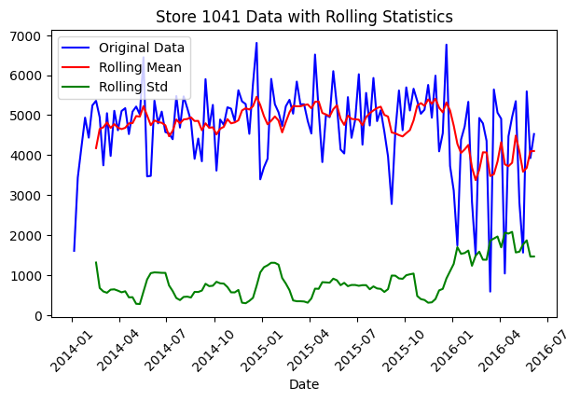
Stationary Test Analysis for Store 1041
The chart shows the weekly customer data for Store 1041, including its rolling mean and rolling standard deviation, over the period from January 2014 to mid-2016.
ADF test is performed on the weekly aggregated store 1041 data, ADF statistics:
  ADF Statistic: -3.45180
  P-value: 0.04484
The weekly aggregated customer data for Store 1041 is stationary. This conclusion is based on the p-value being less than the 0.05 significance level, leading us to reject the null hypothesis that the time series has a unit root.

Slide 8
Stationary Test Analysis for Store 1044
The chart shows the weekly customer data for Store 1044, including its rolling mean and rolling standard deviation, over the period from January 2014 to mid-2016.
ADF test is performed on the weekly aggregated store 1041 data, ADF statistics:
  ADF Statistic: -3.442846
  P-value: 0.04592
The weekly aggregated customer data for Store 1044 is stationary. Since the p-value is less than 0.05, we reject the null hypothesis, indicating that the data is stationary.

Slide 9
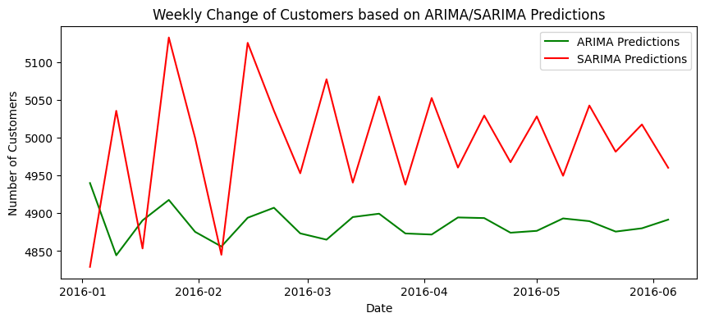
ARIMA/SARIMA Model Training
Time series models like ARIMA & SARIMA model has been fitted on the store 1041 data-set.
The store 1041 data is divided into training and test sets, with the data from the year 2016 designated as the test set.
Initial p and q values came from ACF and PACF plots, with d set to zero due to stationarity.
The optimal p, d, and q values for the ARIMA model were selected based on the lowest AIC values using grid search criteria.
An ARIMA/SARIMA model with a seasonality of 7, reflecting the weekly data pattern, is fitted on the training set of store 1041.

Slide 10
ARIMA/SARIMA Model Results Analysis
ARIMA Model:
  Predictions from the ARIMA model are stable and less volatile, centered around 4900 customers.
  Performance:
    Mean Squared Error (MSE): 3,511,434
    Root Mean Squared Error (RMSE): 1,873.88
SARIMA Model:
  Captures significant seasonal fluctuations with noticeable peaks.
  Higher variability, potentially indicating over-fitting to seasonal patterns.
  Performance:
    Mean Squared Error (MSE): 3,723,736
    Root Mean Squared Error (RMSE): 1,929.70

Slide 11
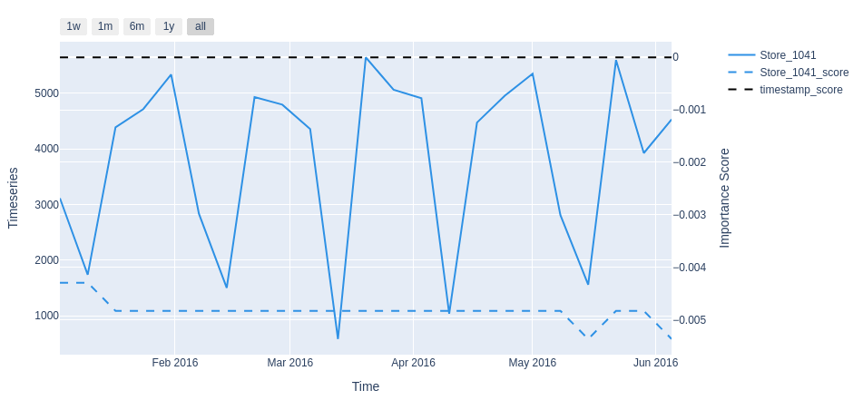
SHAP Analysis of Model Output
To understand the predictions from the time series model, we will use OmniXAI python library.
The Store 1041 timeseries displays clear periodic peaks and troughs, suggesting regular weekly patterns in customer visits.
The SHAP score for Store 1041 remains stable, indicating a steady influence of the timeseries data on the model's predictions.
This consistency implies that the timeseries data is a reliable feature for forecasting customer visits.
The dash lines show the importance scores and the counterfactual example, respectively. SHAP shows the most important timestamps make this test instance detected as an anomaly.

