Slide 1

Segmentation Of the Transverse section of the Carotid Artery using U-Net
cv
Team members
Nagaraj K
N Niranjan Reddy
Rahula Akhilesh Reddy
Naga Swaroop
Under the guidance of Prof Anitha M, Assistant Professor,
Dept of Computer Science and Engineering

Slide 2
INDIVIDUAL CONTRIBUTION
cv
 | Nagaraj K Implementatation of the Unets U-Net, EAR-Unet Creating the UI using Flask | N Niranjan Reddy Implementatation of the Unets U-Net, EAR-Unet
 | Rahula Akhilesh Reddy Implementatation of the Unets U-Net, Attention Unet Creating the UI using the Flask | Naga Swaroop Data Preprocessing Data Collection Implementation of Unets
2

Slide 3
TABLE OF CONTENTS
Problem Statement
Abstract
Introduction
Methodology
EAR U-Net
System Architecture
Encoder-Decoder Framework
Attention U-net
Skip-Connections
System Block Diagram and Data Flow Diagram
5. Evaluation Metrics
6. Evaluation
7. Results
8.Conclusion
9. References
03
05
06
09
10
11
13
15
17
18
19
20
22
23
cv

Slide 4
PROBLEM STATEMENT
The study focuses on the segmentation of the transverse section of the common carotid artery. It aims to compare the performance of EAR U-Net, attention-based U-Net, and traditional U-Net models for this task. The goal is to identify the most accurate and effective model for accurately segmenting the carotid artery in the transverse section.
cv

Slide 5
ABSTRACT
Image segmentation is critical in medical imaging analysis for precise extraction of anatomical structures and regions of interest. Common carotid artery (CCA) segmentation is particularly important in cardiovascular health, aiding in the detection and evaluation of various conditions. Atherosclerosis, characterized by plaque formation due to lipid accumulation, narrows and hardens arteries, leading to serious complications like heart attacks and strokes. Atherosclerosis-related diseases are significant causes of mortality globally.
Traditional CNN architectures, like U-Net, face challenges in preserving spatial information during downsampling and upsampling, resulting in reducing the efficiency and accuracy of segmentation. U-Net uses skip connections to address this by fusing feature maps to retain fine details. U-Net has successfully been used in medical image analysis.
This paper aims to enhance the automation process of CCA segmentation using the EAR U-Net model, which combines U-Net with attention mechanisms and Residual blocks. Attention mechanisms focus on relevant features and suppress noise, while Residual blocks facilitate gradient propagation and network optimization. By leveraging EAR U-Net’s strengths, we aim to overcome CNN limitations in CCA segmentation, contributing to improved diagnosis, treatment, and monitoring of cardiovascular diseases while preserving data integrity.
cv

Slide 6
INTRODUCTION
The malignant liver tumor is the second leading cause of cancer-related death and the sixth most common cancer, according to Cancer Analysis 2020. To help the doctors make exact evaluations and treatment at the beginning phase, the figured tomography (CT)- based division is broadly utilized in the screening, finding, and cancer estimation. Notwithstanding, increasingly live cancers show a serious level of fluctuation in shape, appearance, and area and change from one individual to another subsequent in the manual division of the liver being work escalated and mistake inclined. As a result, learning how to automatically and precisely segment the liver has evolved into an important and difficult task.
cv

Slide 7
EAR U-Net
They Used a modified EfficientNet-B4 as the encoder to extract more feature information in the encoder stage.
An attention gate to the original skip connection to eliminate irrelevant regions and focus on the liver area to be segmented.
Employ the residual structure to replace the convolutional layer in the U- Net decoder and add a batch normalization layer to eliminate the gradient vanishment problem, accelerate the convergence speed, and achieve higher accuracy.
Hence The Name E-A-R U-Net
E - EfficientNet-B4
A - Attention gate
R – Residual
cv

Slide 8
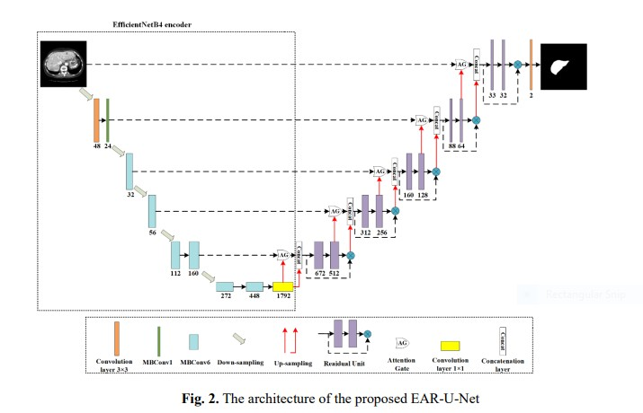
Architecture
cv

Slide 9
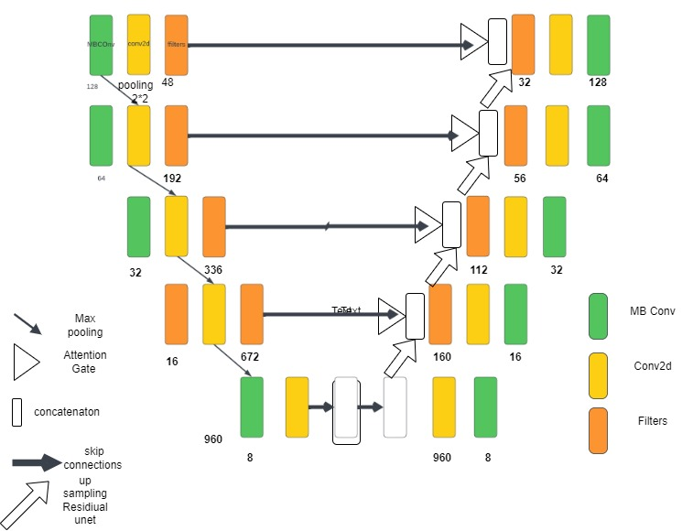
Encoder-Decoder Framework

Slide 10
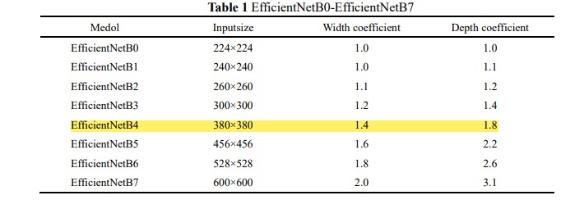
EfficientNet has attracted extensive attention because it can balance the model's depth, width, and image resolution.
EfficientNet is a convolutional neural network architecture and scaling method that uniformly scales all dimensions of depth/width/resolution using a compound coefficient.
EfficientNet has the structures of the eight models from EfficientNetB0- EfficientNetB7. This paper adopts the improved EfficientNetB4.
cv

Slide 11
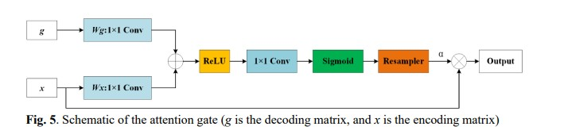
The attention mechanism has been popular in classification and segmentation communities because of its lower complexity and fewer parameters than CNN and RNN and its ability to capture global and local information
It Reduces the Computational resources wasted on irrelevant activations and provides a better generalization of the network
First, g and x go through the 1×1 Conv operation in parallel and implement the add operation at the corresponding points. Then perform the ReLU activation, 1×1 Conv, and Sigmoid function operations sequentially, and resample to get the attention coefficient α. Finally, the attention coefficient α is multiplied by the input coding matrix x to obtain the final output.
cv

Slide 12
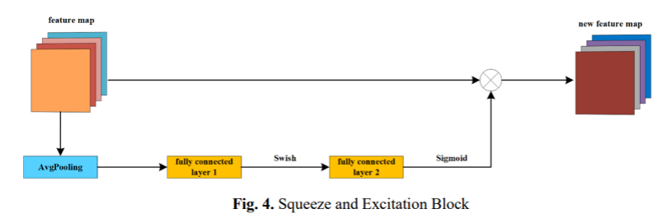
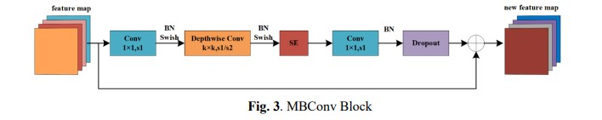
SKIP-CONNECTIONS
Skip connections, also known as residual connections, are a technique employed in deep neural networks to address the vanishing gradient problem and enhance gradient flow during training. These connections enable the direct propagation of information from earlier layers to deeper layers, thereby facilitating the learning process.
cv

Slide 13
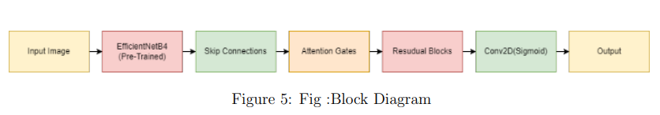
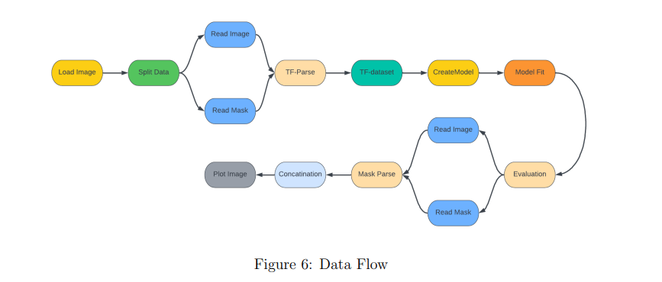
System Block Diagram and Data Flow Diagram

Slide 14
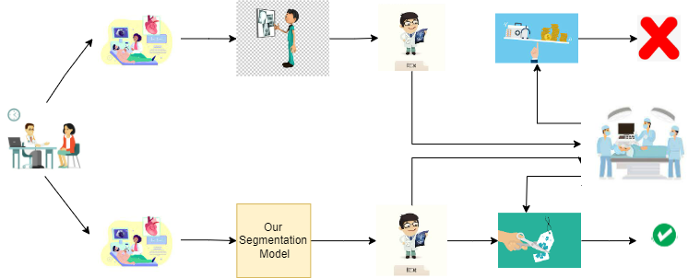

Slide 15

Evaluation Metrics
Dice: The similarity of the two sets. The larger the value, the better the segmentation effect
cv

Slide 16
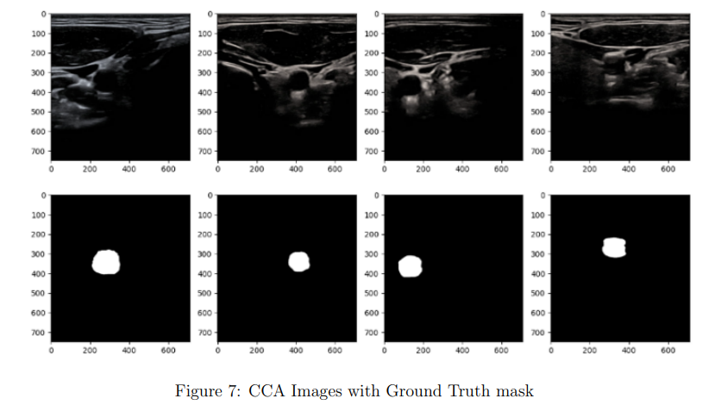
Evaluation
We utilized a comprehensive dataset comprising aquistified ultrasound images of the common carotid artery. The images were acquired using a Mindary UMT-500Plus ultrasound machine equipped with an L13-3s linear probe.
The ultrasound images in the dataset possess a resolution of 709 x 749 x 3 pixels, and the total number of images amounts to 2200. Each image is stored in PNG format, ensuring compatibility and ease of use across various platforms and software.
cv

Slide 17
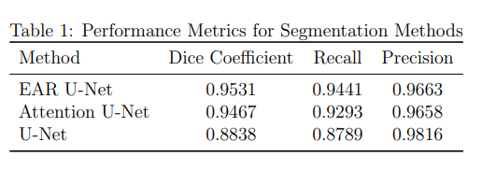
RESULTS
The results vividly portray the remarkable performance of the proposed EAR U-Net model across all the evaluation metrics. The significantly higher Dice coefficient achieved by the EAR UNet serves as a strong indicator of its ability to produce highly accurate and robust segmentation results, surpassing both alternative models. Furthermore, the EAR U-Net showcased superior recall and precision values, underscoring its efficacy in detecting true positives and minimizing the occurrence of false positives.
The findings endorse the considerable potential of the EAR U-Net model in advancing medical image segmentation tasks, particularly in the domain of segmenting the Common Carotid Artery.

Slide 18
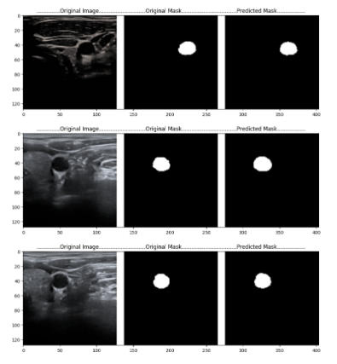
Fig: Segmented Final Mask (Predicted)

Slide 19
CONCLUSION
In conclusion, this paper introduces the novel EAR U-Net architecture, specifically designed for the segmentation of the common carotid artery (CCA) in ultrasound images. By incorporating attention gates and residual blocks, the EAR U-Net model demonstrates superior performance compared to a standard U-Net and a U-Net with attention gates. The experimental evaluation showcases the effectiveness of the proposed method, achieving remarkable results in terms of dice coefficient, recall, and precision on the test dataset.
In summary, the proposed EAR U-Net architecture offers a promising approach for CCA segmentation in ultrasound images. Its ability to outperform existing models underscores its effectiveness and potential utility in clinical practice. Further research and development in medical image segmentation, particularly in the context of vascular diseases, can leverage the advantages of the EAR U-Net to advance diagnostic accuracy and improve patient outcomes.
cv

Slide 20
REFERENCES
[1] Momot, Agata (2022), “Common Carotid Artery Ultrasound Images,” Mendeley Data, V1, doi: 10.17632/d4xt63mgjm.
[2] Ozan Oktay, Jo Schlemper, Loic Le Folgoc (2018), “Attention U-Net: Learning Where to Look for the Pancreas,” arXiv:1804.03999v3.
[3] Wei Yu, Bin Fang, Yongqing Liu (2019), “Liver Vessels Segmentation Based On 3D Residual U-NET.”
[4] Jinke Wang, Xiangyang Zhang, Peiqing Lv, “Automatic Liver Segmentation Using EfficientNet and Attention-Based Residual UNET,” DOI: 10.007/s10278-022-00668-x.
[5] B. Behboodi and H. Rivaz, ”Ultrasound segmentation using U-Net: learning from simulated data and testing on real data,” 2019 41st Annual International Conference of the IEEE Engineering in Medicine and Biology Society (EMBC), 2019, pp. 6628-6631, DOI: 10.1109/EMBC.2019.8857218
[6] Amiri, M., Brooks, R., Behboodi, B. et al. Two-stage ultrasound image segmentation using U-Net and test time augmentation. Int J CARS 15, 981–988 (2020). https://doi.org/10.1007/s11548-020-02158-3
cv

Slide 21
REFERENCES
[7] J. Ding, Z. Huang, M. Shi and C. Ning, ”Automatic Thyroid Ultrasound Image Segmentation Based on U-shaped Network,” 2019 12th International Congress on Image and Signal Processing, BioMedical Engineering and Informatics (CISP-BMEI), 2019, pp. 1-5, doi: 10.1109/CISPBMEI48845.2019.8966062.
[8] M. Xie et al., ”Two-stage and dual-decoder convolutional U-Net ensembles for reliable vessel and plaque segmentation in carotid ultrasound images,” 2020 19th IEEE International Conference on Machine Learning and Applications (ICMLA), 2020, pp. 1376-1381, DOI: 10.1109/ICMLA51294.2020.00214.
[9] Meshram NH, Mitchell CC, Wilbrand S, Dempsey RJ, Varghese T. Deep Learning for Carotid Plaque Segmentation using a Dilated U-Net Architecture. Ultrason Imaging. 2020 Jul-Sep;42(4- 5):221-230. doi: 10.1177/0161734620951216. PMID: 32885739; PMCID: PMC8045553.
[10] J. Li, L. Cheng, T. Xia, H. Ni and J. Li, ”Multi-Scale Fusion U-Net for the Segmentation of Breast Lesions,” in IEEE Access, vol. 9, pp. 137125-137139, 2021, doi: 10.1109/ACCESS.2021.3117578.
cv

Slide 22
THE END

