Slide 1

IBM Data Science Capstone Project SPACEX Data
Niranjhan Palanikumar
May 02, 2022

Slide 2
Presentation
Outline
Executive Summary
Introduction
Methodology
Results
Conclusion
Appendix

Slide 3

Executive Summary
The main aim of this project was to determine if the first stage of the rocket launch will successfully land.
Summary of methodologies
-The dataset used was SpaceX's previous Falcon 9 launches
-Data collection and data wrangling
-Interactive maps
-Building models for predictive analysis
Summary of all results
-Interactive dashboard for visual analytics.
-Comparing accuracy to choose the best model performance.

Slide 4
Project background and context
We will predict if the Falcon 9 first stage will land successfully. SpaceX advertises Falcon 9 rocket launches on its website with a cost of 62 million dollars, other providers cost upward of 165 million dollars each, much of the savings is because SpaceX can reuse the first stage. Therefore if we can determine if the first stage will land, we can determine the cost of a launch. This information can be used if an alternate company wants to bid against SpaceX for a rocket launch.
Problems you want to find answers
- Factors for a successful landing of stage one
- Impact/effect of other factors on the landing outcome
Introduction

Slide 5

Methodology

Slide 6
Methodology
Data collection methodology:
Using SpaceX REST APIs
Web Scrapping from Wikipedia
Data wrangling:
Missing values, One Hot Encoding the categorical fields
Perform exploratory data analysis (EDA) using visualization and SQL
Scatter plots and bar graphs to identify patterns and trends
Perform interactive visual analytics using Folium and Plotly Dash
To help in quick visual analysis of major parameters like launch site and payload mass.
Perform predictive analysis using classification models
Building the model with multiple algorithms and comparing their performance

Slide 7
Data Collection
The dataset used for this analysis was collected from a combination of SPACEX REST APIs.
SPACEX REST API endpoint -> https://api.spacexdata.com/v4/
Different REST API urls contain their specific information, eg.
https://api.spacexdata.com/v4/cores contains information on the type of "cores" used.
https://api.spacexdata.com/v4/capsules contains information on the type of "capsules" used.
Custom functions were written and applied to obtain specific information from their respective API endpoints.
The information were put together and converted into .csv file for storage, and into a dataframe for initial exploratory analysis.

Slide 8





Data Collection from API Flowchart
1. Data from API end point
2. Converting JSON to a dataframe
3. Applying custom functions to get specific attribute information
4. Combine all the data and filter them into a dataframe
5. Save the dataframe as a .csv file
GitHub URL

Slide 9

Finalizing Data Collection
The last step in data collection and preparing the data for analysis is identifying and dealing with missing values
isnull() - returns value '1' for 'True' case and value '0' for 'False' cases
sum() - performs simple addition on the given set of numbers
Here the missing PayloadMass was replaced with the mean of the column, and the missing values in LandingPad were retained to signify that landing pads were "not used" in these launches.
GitHub URL

Slide 10




Data Collection Webscrapping Flowchart
Get html data from wikipedia url
Finding the required table
Obtaining the column names
Appending the data into a dictionary
Converting to dataframe
Applying BeautifulSoup object
Save the dataframe as a .csv file
GitHub URL

Slide 11
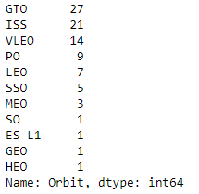

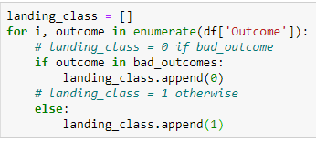



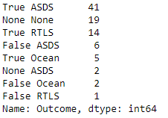

Data Wrangling steps
Calculate number of launches at each site
Calculate the number and occurrence of each orbit
Calculate the number of occurrence and mission outcome per orbit
Create a new landing outcome label
-Value = '1' for successful landing
-Value = '0' for unsuccessful landing
GitHub URL

Slide 12
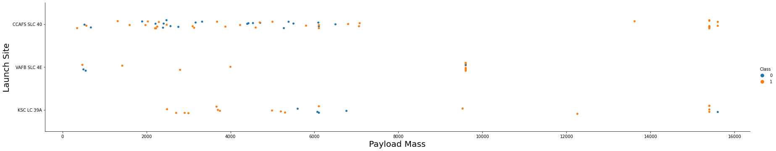
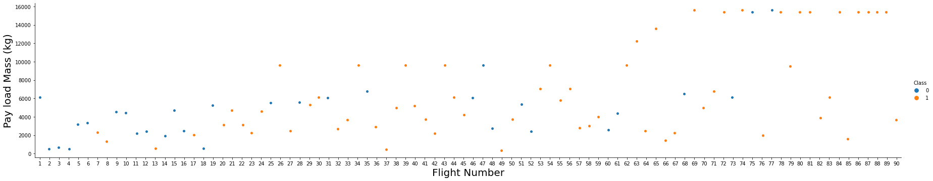
EDA with Data Visualization
Scatter plot indicating their respective outcome class were drawn for:
Flight Number vs Pay Load Mass
Flight Number vs Launch Site
Launch Site vs Payload Mass
Flight Nuber vs Orbit
Orbit vs Pay Load Mass
GitHub URL

Slide 13
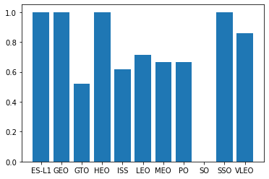
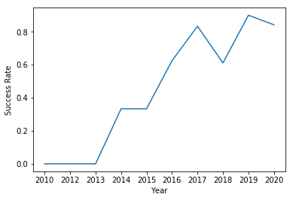
EDA with Data Visualization
Bar chart on the success rate of each orbit type
Line plot on the yearly success trend
Success Rate
Orbit
GitHub URL

Slide 14
EDA with SQL
The SQL queries performed to extract:
Names of unique launch sites
Records where launch sites begin with string 'CCA'
The total payload mass carried by boosters launched by NASA(CRS)
Average payload mass carried by booster version F9 v1.1
Date when the first successful landing outcome in ground pad was achieved
Names of boosters which have success in drone ship and have payload mass greater than 4000 but less than 6000
Total number of successful and failure mission outcomes
Names of the booster versions which have carried the maximum payload mass
Booster versions and launch site for failed landing outcomes on drone ship in 2015
Rank the count of landing outcomes (eg Failure (drone) or Success (ground pad)) between 2010-06-04 and 2017-03-20 in descending order
GitHub URL

Slide 15
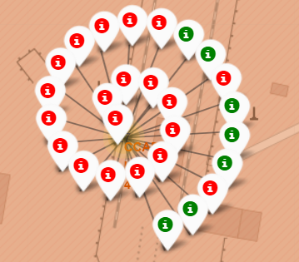
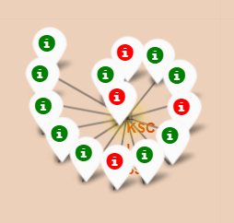
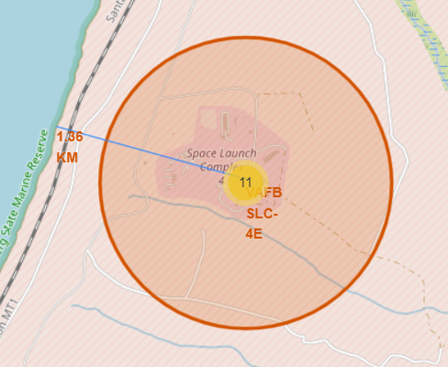
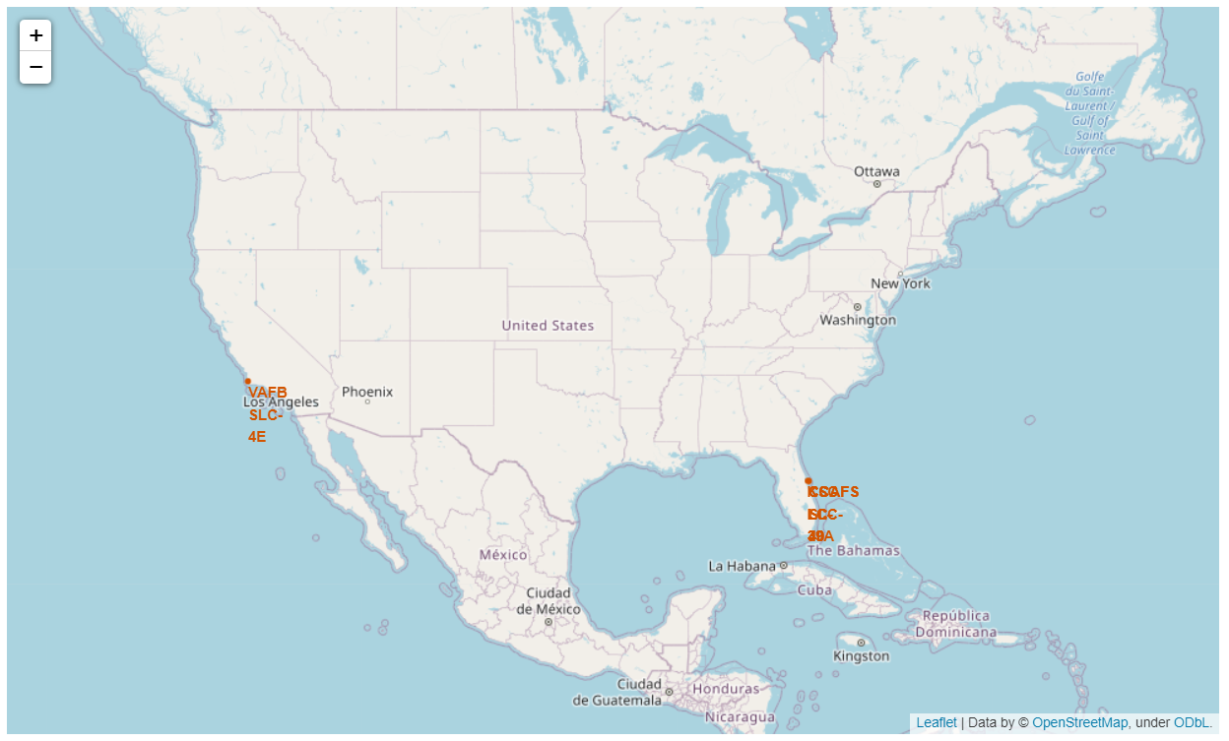
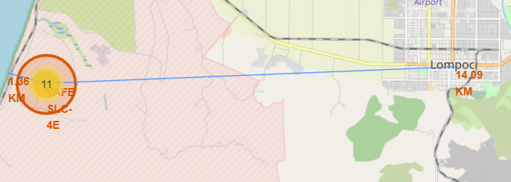
Build an Interactive Map with Folium
The latitude and longitude coordinates of each launch site were marked with a circle and a label.
Depending on the outcome of each launch an icon_marker was used in their respective color, "Green" for "Success" and "Red" for "Failure".
The distance between different landmarks or entities were from each launch sites eg. Coastline, Railway, City.
A major trend observed here was that every launch site is situated very close to a coastline and far away from the cities.
GitHub URL

Slide 16
Build a Dashboard with Plotly Dash
The plotly dashboard built has two main categories for visual analytics:
Selection of launch site
Weight (kg) parameter for payload mass
The two graphs for analysis:
A pie-chart depicting the success and failure rate of a selected launch site
A scatter plot showing the correlation between the payload mass and success of the launch, for a selected launch site with a modifiable weight parameter for payload
GitHub URL

Slide 17
Predictive Analysis (Classification)
Splitting the dataset into feature set and target set.
Feature engineering and standardizing the dataset
Splitting the dataset into training and test set
Building multiple classification model, and choosing the best parameters using Grid Search method:
- Logistic Regression
- Support Vector Machine
- Decision Tree
- K-Nearest Neighbors
GitHub URL

Slide 18
Exploratory data analysis
Interactive visual analytics
Predictive analysis using Machine Learning
Results

Slide 19

Insights from Exploratory Data Analysis

Slide 20
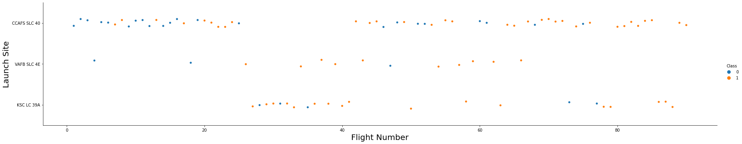
Flight Number vs. Launch Site
Scatter plot of Flight Number vs. Launch Site
Explanation:
Launch Site VAFB SLC-4E has the highest success rate (10/13) and the last five flights have all been success.
All flights after 77 have been a success.
CCAFC-SLC-40 has the highest number of launches with steadily improving success rate.

Slide 21
Payload vs. Launch Site
Scatter plot of Payload vs. Launch Site
Explanation:
All flights launched from KSC-LC-39A with a lower payload have a successful outcome.
Rockets with low payload mass have been mostly launched from site CCAFS-SLC-40.
Almost all rockets having a higher payload have seen a successful outcome.
Site VAFB-SLC-4E has the lowest number of launches

Slide 22
Orbit Type vs. Success Rate
Bar chart for the success rate of each orbit type
Success Rate
Orbit
Explanation:
Orbits ES-L1, GEO, HEO, SSO have the highest success, followed by VLEO close to 90% success.
Orbit SO is the only orbit which has no successful outcome yet.

Slide 23
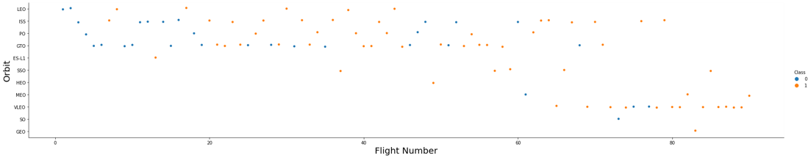
Flight Number vs. Orbit Type
Scatter point of Flight number vs. Orbit type
Explanation:
Orbits LEO, ISS, PO, GTO have the highest number missions.
Latest missions targeting orbits LEO, ISS, and VLEO have all had a successful outcomes.
There have been only 1 mission targeting orbits ES-L1, HEO, GEO, SO.

Slide 24
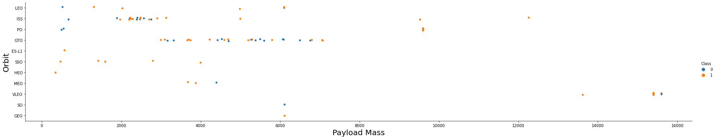
Payload vs. Orbit Type
Scatter point of payload vs. orbit type
Explanation:
Higher payload have a significant success rate compared to lower payload missions.
SSO orbit missions are the only one to have 100% success rate across a payload range.
Orbits LEO, ISS, and PO have failure outcomes with payload on the lower scale, whereas have a successful outcome with higher payloads.

Slide 25
Launch Success Yearly Trend
Line chart of yearly average success rate
Explanation:
There is an overall steady increase in the success rate.
The success increased tremendously after 2015

Slide 26
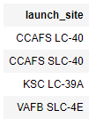

All Launch Site Names
SQL command for finding the names of unique launch sites
Query Explanation:
Unique() function selects all the distinct categories

Slide 27

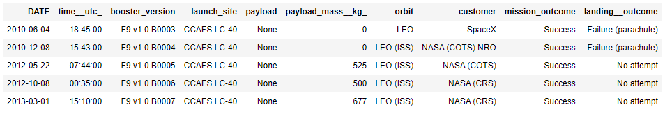
Launch Site Names Begin with 'CCA'
SQL command to find 5 records where launch sites begin with `CCA`
Query Explanation:
'like' command searches for the specified string pattern, in this case 'CCA'.

Slide 28


Total Payload Mass
Calculate the total payload carried by boosters from NASA
Query Explanation:
Sun() add the values in the selection, and 'like' command searches for the specified string pattern, in this case 'NASA'.

Slide 29


Average Payload Mass by F9 v1.1
Calculate the average payload mass carried by booster version F9 v1.1
Query Explanation:
Avg() calculates the average value of the selected values, and the comparing the booster string

Slide 30


First Successful Ground Landing Date
Find the dates of the first successful landing outcome on ground pad
Query Explanation:
Min() selects the minimum value, and the where statement selects the specific cases

Slide 31
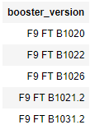
Successful Drone Ship Landing with Payload between 4000 and 6000
List the names of boosters which have successfully landed on drone ship and had payload mass greater than 4000 but less than 6000
Query Explanation:
Selecting booster_version where certain specific cases are satisfied using the "where" clause.

Slide 32
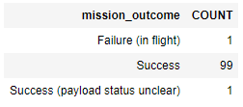

Total Number of Successful and Failure Mission Outcomes
Calculate the total number of successful and failure mission outcomes
Query Explanation:
Count() function counts the number of occurrence, in this case the occurrences of the mission_outcomes.

Slide 33
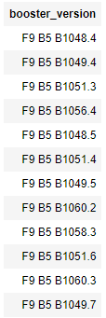

Boosters Carried Maximum Payload
List the names of the booster which have carried the maximum payload mass
Query Explanation:
A sub-query is used here to select the maximum value of the payload

Slide 34

2015 Launch Records
List the failed landing_outcomes in drone ship, their booster versions, and launch site names for in year 2015
Query Explanation:
Selecting the failed landing outcomes for the specified scenarios

Slide 35
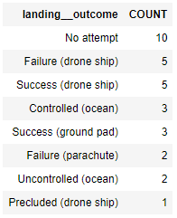
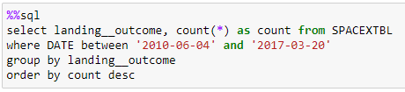
Rank Landing Outcomes Between 2010-06-04 and 2017-03-20
Ranking the count of landing outcomes (such as Failure (drone ship) or Success (ground pad)) between the date 2010-06-04 and 2017-03-20, in descending order
Query Explanation:
Grouping the count of different landing_coutcomes between a range of dates using "group by" function.
"Order by" function orders the attribute in specified order

Slide 36

Launch Sites Proximity Analysis
This Photo by Unknown author is licensed under CC BY-SA.

Slide 37
Locations of the launch sites
The launch sites are marked on the world map with a circular marker.
It can be seen that all the launch sites are located on the coastal sides

Slide 38
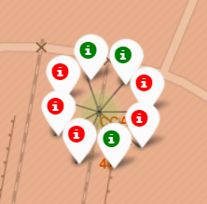
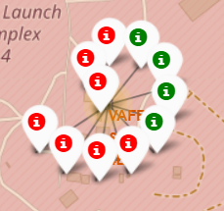
The Success and Failures at launch sites
CCAFS SLC-40
KSC LC-39A
A cluster of markers are used here to show multiple launches from a single launch site.
The "green" color denotes successful outcome and "red" denotes failure outcome.
It can be seen site "CCAFS LC-40" has the most number of launches, and site "CCAFS SLC-40" has the least.
VAFB SLC-4E
CCAFS LC-40

Slide 39
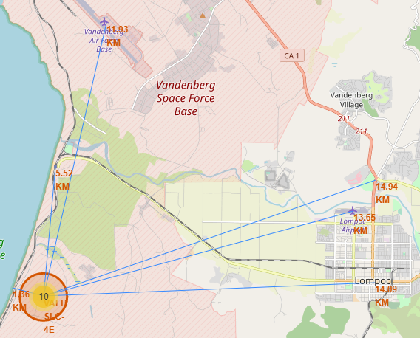
Location proximities from launch site
Proximities of various landmarks are shown for the launch site "VAFB SLC-4E".
Landmarks:
Coast
Nearest City
Highway
Railway station
Nearest Airports
It can be seen that the launch site is chosen such that it is far away from populated location, and close to coast.

Slide 40

Build a Dashboard with Plotly Dash

Slide 41
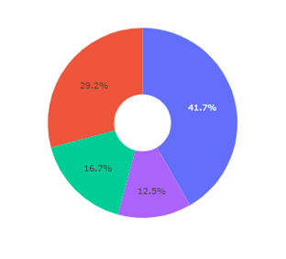

Successful launches for all sites
The successful outcomes are shown for all the sites in a pie chart for comparison.
It can be seen that KSC LC-39A has the highest success rate with 41.7%, followed by CCAFS LC-40 with 29.2%.

Slide 42

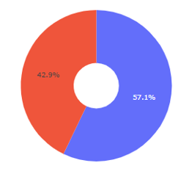
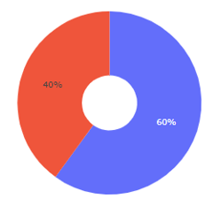
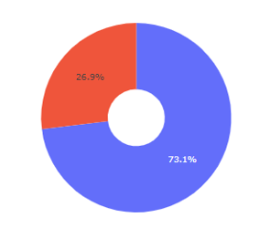
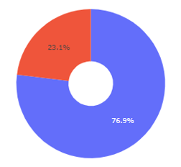
Highest successful launches
Ranking each launch site according to their successful outcomes
1 | 26.9%
0 | 73.1%
1 | 23.1%
0 | 76.9%
CCAFS LC-40
[3]
KSC LC-39A
[4]
CCAFS SLC-40
[1]
VAFB SLC-4E
[2]
1 | 42.9%
0 | 57.1%
1 | 40%
0 | 60%

Slide 43
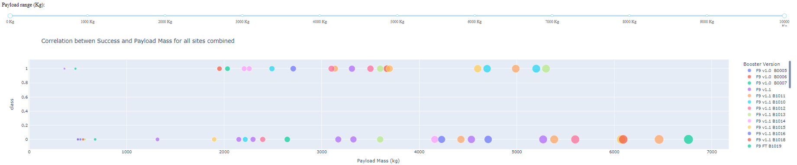
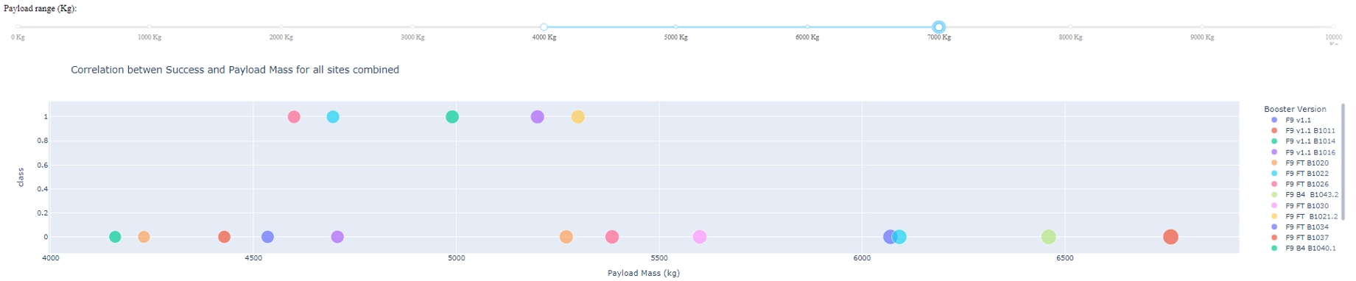
Scatter plot for different payloads
Scatter plot showing launches for all payload types
Scatter plot showing launches for payload in range 4000Kg and 7000Kg

Slide 44

Prediction Analysis [Classification]

Slide 45
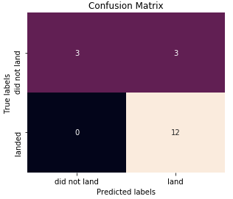

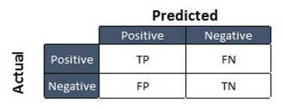
Confusion Matrix
Logistic Regression
Support Vector Machine
Confusion matrix labels:
Decision Tree
K-Nearest Neighbors
TP – True Positive
FN – False Negative
FP – False Positive
TN – True Negative

Slide 46
Accuracy Scores
The accuracy and test accuracy scores for all the algorithms are shown in the following table:
Algorithm​ | Accuracy​ | Test set score​
Logistic Regression​ | 0.8476 | 0.8333​
Support Vector Machine​ | 0.8482 | 0.8333​
Decision Tree​ | 0.8875 | 0.8333​
K-Nearest Neighbors​ | 0.8472​ | 0.8333​
The best parameters found through GridSearch:
Algorithm | Best Parameters
Logistic Regression | c= 0.01
Support Vector Machine | c= 1.0, gamma = '0.0316', kernel = 'sigmoid'
Decision tree | criterion = 'entropy, max_depth = 6, max_features='sqrt', min_samples_leaf = 2, min_samples_split = 5, splitter = 'random,
K-Nearest Neighbors | algorithm = 'auto', n_neighbors = 10, p = 1

Slide 47
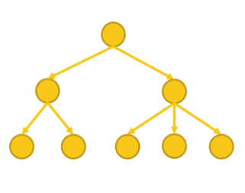
Conclusions
The orbits ES-L1, GEO, HEO, SSO have the highest success rate.
The overall success has been increasing since 2015.
Decision Tree classifier performs the best in predicting a successful landing
Success Rate
Orbits

Slide 48
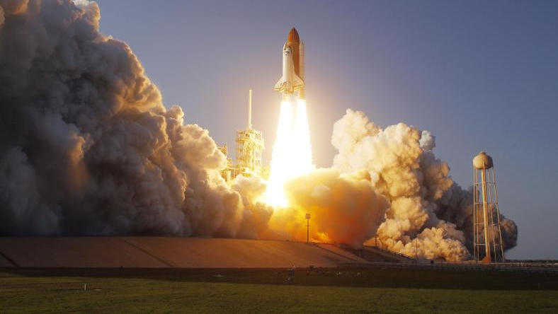
Thank you!
This Photo by Unknown author is licensed under CC BY-SA-NC.

