Slide 1
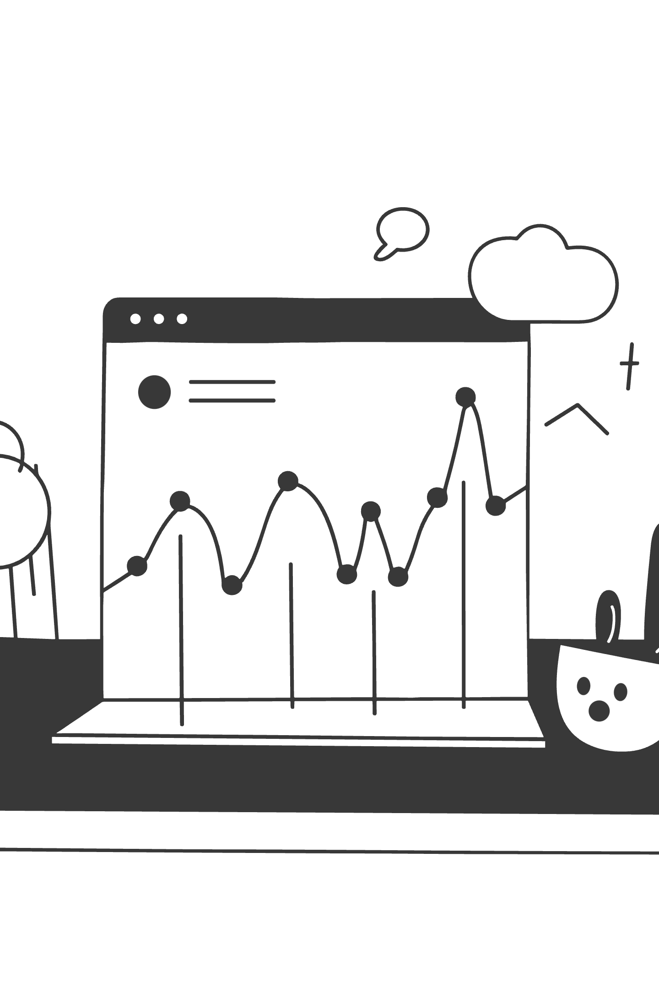
AI for Wealth Management
Day 1: From Prompts to Pipelines
Scaled Focus Inc. for Kotak Securities | January 2026
Contact: nirant@scaledfocus.com | +91 7737887058

Slide 2
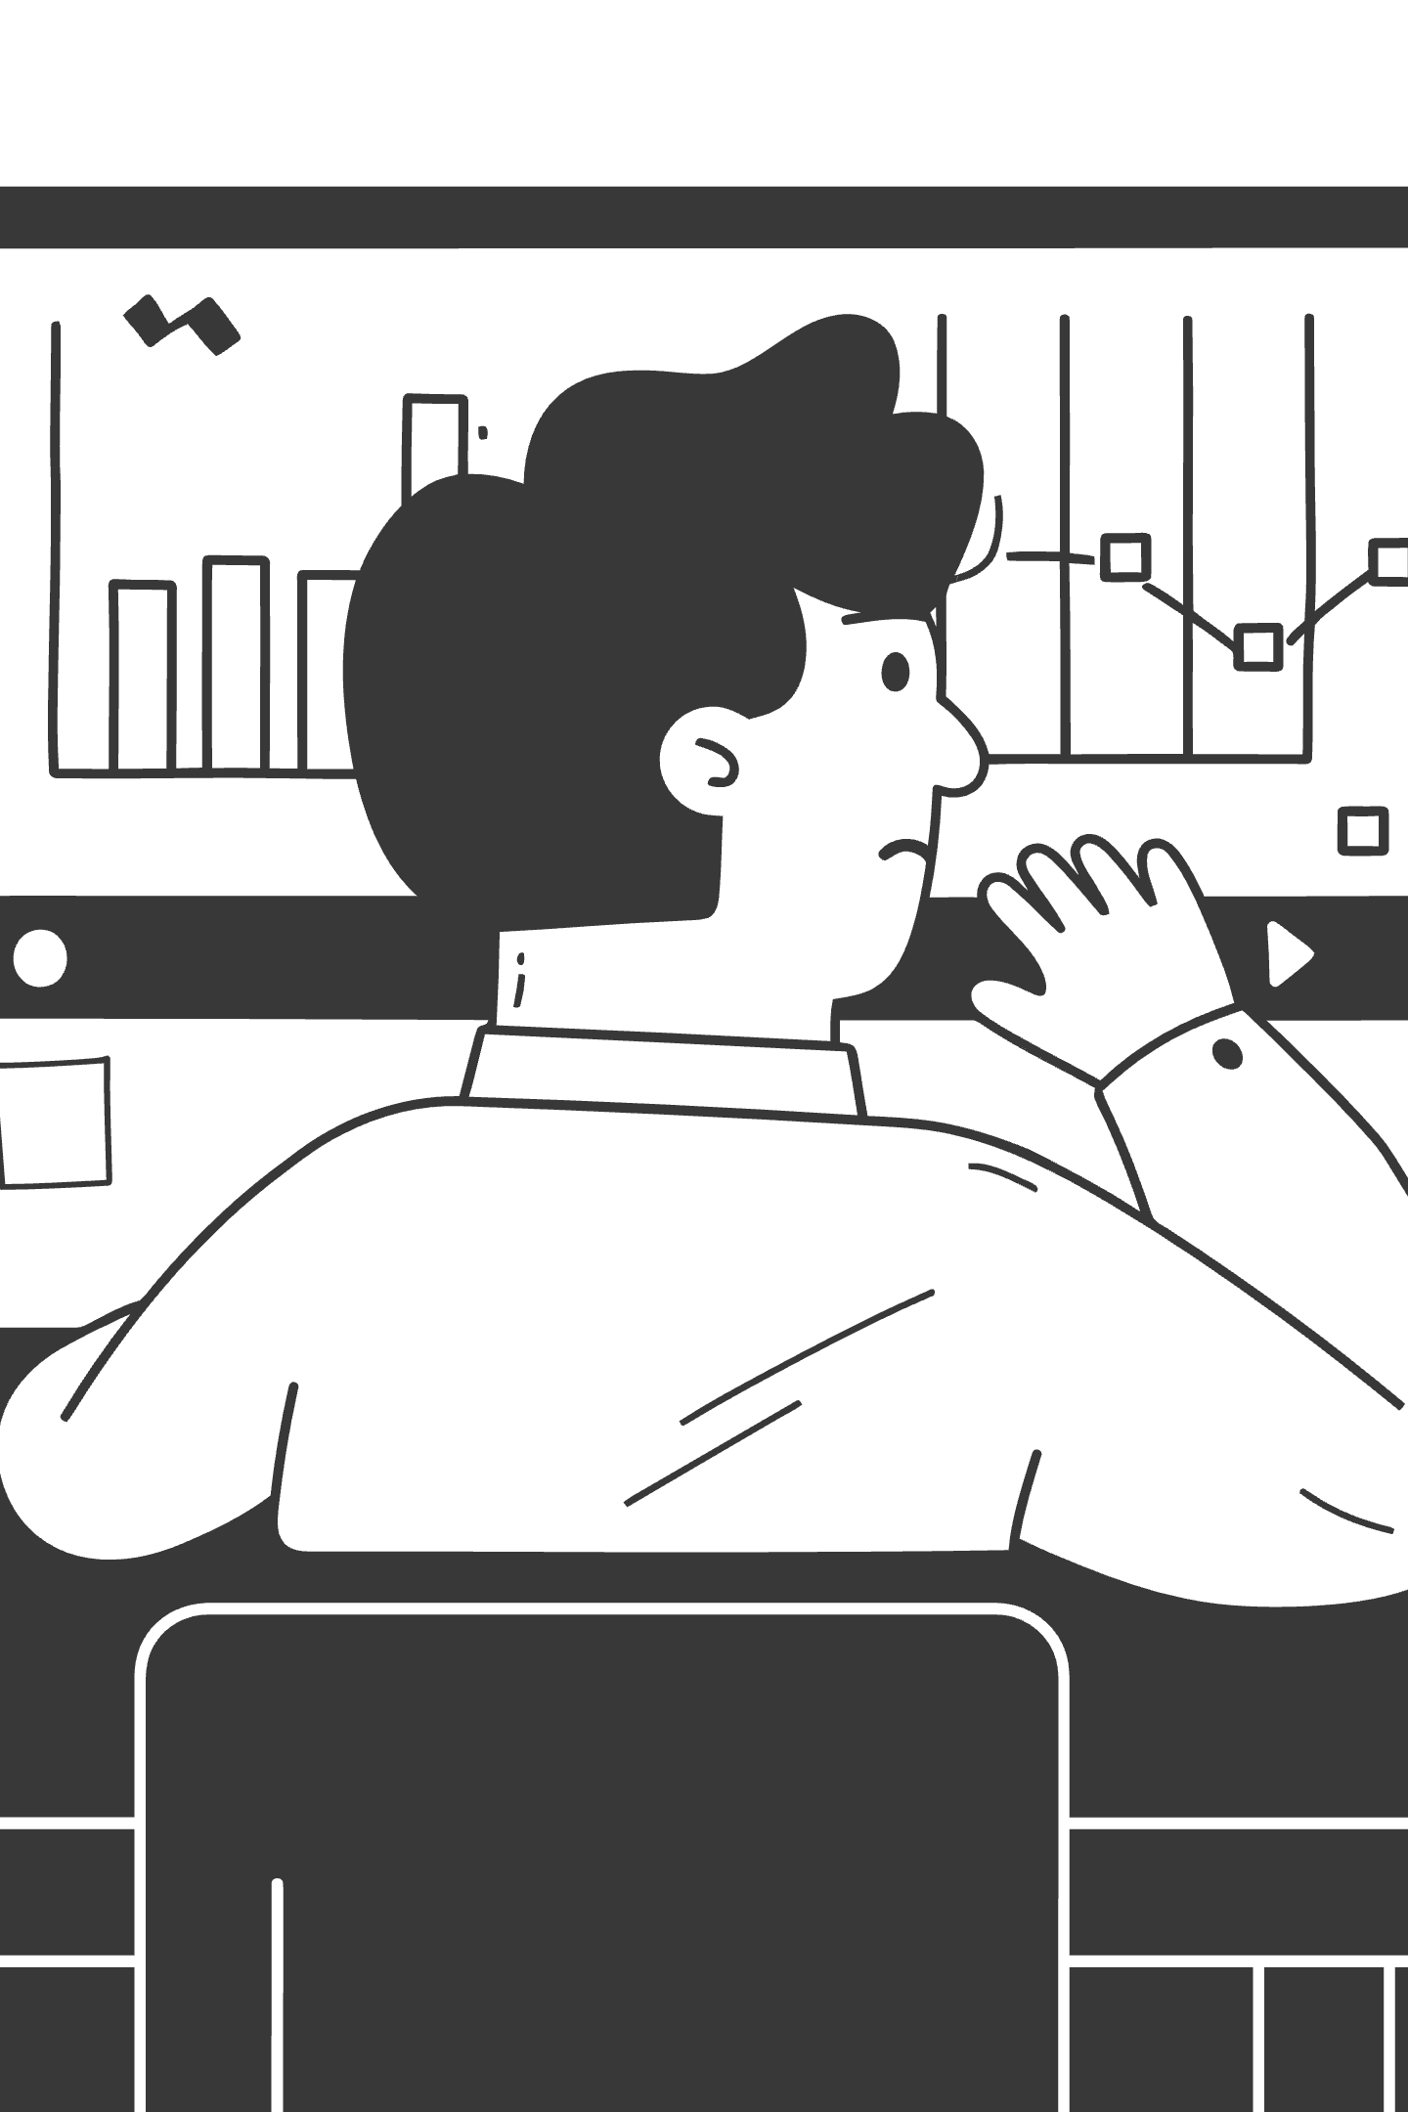
By 4pm Today
You will turn a portfolio screenshot into a client-ready email using AI. No code. No API. Just prompts.
This is about transforming how you work with data—moving from manual processes to intelligent automation that saves hours while improving accuracy.

Slide 3
Today's Learning Path
01
02
03
10:00 Start
11:30 Module 1
14:15 Module 2
You've used ChatGPT
You can architect prompts
You can chain AI steps
04
05
15:00 Module 3
16:00 Capstone
You can build reusable systems
You've built an AI analyst
Same data all day. New skills each hour. By the end, you'll have a complete system you can use immediately.

Slide 4

What You Need Today
Required
We Provide
Browser with ChatGPT or Claude
Portfolio screenshot (MProfit)
Ability to paste images
Market news screenshot
Notepad for saving prompts
All prompt templates
Azure AI Foundry available for those who prefer Microsoft stack.

Slide 5

Meet the Mehta Family Portfolio
₹41Cr
11
-0.55%
Total Portfolio
Asset Classes
Sensex Today
This screenshot will be your input all day. You'll extract data from it, analyze it, and generate client communications—all using AI.

Slide 6

MODULE 1
Advanced Prompt Architecture
Scaled Focus Inc. | nirant@scaledfocus.com | +91 7737887058
From vague requests to precise instructions

Slide 7
Why Prompts Fail
Bad Prompt
The Problem
"Look at this data and tell me what's happening."
What you get: Generic, unfocused, inconsistent output
What you need: Specific, structured, reliable output
The AI is capable. Your instructions aren't. The difference between frustration and success is how you frame the task.

Slide 8
Framework 1: RGC
Every good prompt has three parts:
Component
Question
Example
Role
Who is the AI?
"You are a senior portfolio analyst"
Goal
What should it do?
"Identify the key risk for a client meeting"
Constraints
What are the rules?
"Use plain language, limit to 3 bullets"
Memory trick: Role → Goal → Constraints = RGC

Slide 9
RGC: Before & After
Before (no RGC)
"Look at this data and tell me what's happening."
No role definition
No clear goal
No constraints
After (with RGC)
"You are a senior portfolio analyst. Analyze this portfolio and identify the key risk for a client meeting. Constraints: Plain language (no jargon), limit to 3 bullet points."
Clear role, goal, and constraints

Slide 10
Framework 2: STIC
For complex tasks, add structure:
Component
What It Does
Example
Situation
Set the context
"The market is down 2% today"
Task
Define the job
"Write a client reassurance email"
Instructions
Step-by-step guidance
"First summarize, then recommend"
Context
Provide background
"Client is conservative, 65 years old"
STIC works well for multi-step or nuanced tasks that require deeper understanding.

Slide 11
When to Use Which Framework
Situation
Use
Why
Quick analysis
RGC
Simple, fast, gets straight to the point
Client communication
STIC
Needs context, nuance, and empathy
Data extraction
RGC
Structured output, minimal ambiguity
Recommendations
STIC
Requires reasoning and personalization
Rule of thumb: Start with RGC. Add STIC elements when output isn't right.

Slide 12
Powerful Constraints
Output Format
Tone
"Respond in JSON", "Use bullet points", "Limit to 100 words"
"Use plain language", "Be reassuring", "No jargon"
Logic
Safety
"Flag anything >15% as concentration risk", "Compare to benchmark"
"Do not give specific buy/sell advice", "Include disclaimer"
Constraints are where precision happens. They turn vague requests into actionable instructions.

Slide 13
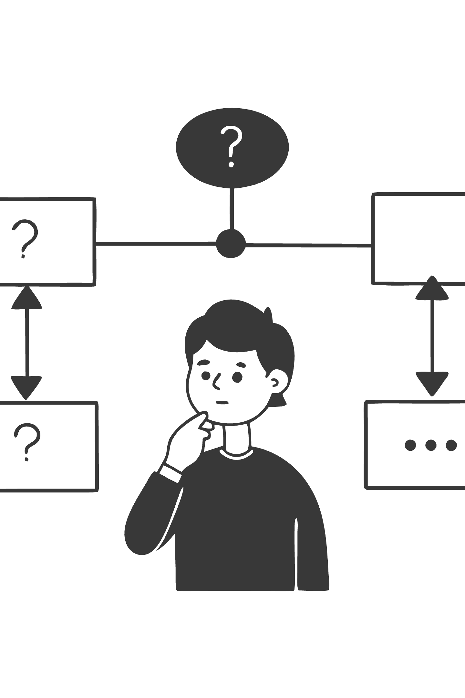
Advanced: Meta-Prompting
"First, describe your analysis approach. Then, analyze the portfolio. Finally, summarize your key finding."
Why it works: Forces structured reasoning, catches errors early, creates transparent decision-making
Pro tip: Add "Think step by step" for complex analysis

Slide 14
Prompt Anti-Patterns
Mistake
Problem
Fix
Too vague
"Analyze this"
Specify what to analyze FOR
Too long
500-word prompt
Focus on constraints, not instructions
No examples
Unclear format
Show one example of desired output
All at once
Overloaded
Break into steps
Simplicity beats complexity. Add only what changes the output.

Slide 15
Same Data, Different Output
Vague Prompt Output
"The portfolio shows various investments including stocks, mutual funds, and other assets. There appears to be some gains and losses..."
Generic, unhelpful, doesn't drive action
RGC Prompt Output
"Key Risk: Stock concentration at 27% of portfolio during a down market (-0.55% Sensex). Action: Review equity allocation given client's risk profile."
Specific, actionable, client-ready

Slide 16
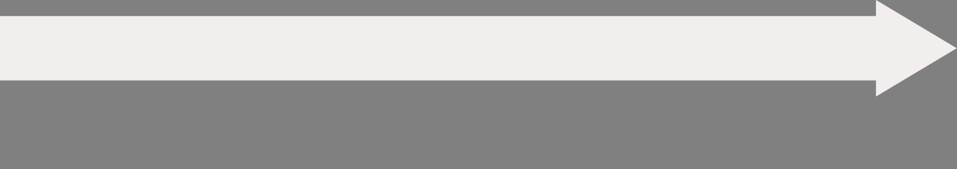

Exercise: Make the AI a Better Analyst
Add a Goal
Add a Role
Specify what it should accomplish (5 min)
Define who the AI should be (5 min)
Compare
Add Constraints
Review before/after results (5 min)
Set the rules and format (5 min)
Time: 20 minutes | Win: Same data, completely different output quality

Slide 17
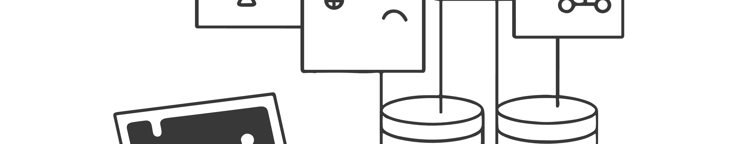
MODULE 2
Workflows & Data Extraction
Scaled Focus Inc. | nirant@scaledfocus.com | +91 7737887058
From screenshots to structured data

Slide 18
AI Can Read Screenshots
Old Way
New Way
Export to CSV
Paste screenshot
Clean data
Ask for JSON
Write parsing code
30 seconds
Handle edge cases
Hours of work
Vision models can extract structured data from images of spreadsheets, dashboards, documents—any visual data source.

Slide 19




From Pixels to Pipeline
Screenshot
JSON
Visual data (image)
Structured data
Analysis
Email
Insights extracted
Action delivered
JSON is the bridge between unstructured inputs (screenshots, PDFs, emails) and structured processing (analysis, comparison, decisions). Once you have clean JSON, everything else is easy.

Slide 20
Define What You Want
{
"client_name": "string",
"net_worth": "number",
"asset_classes": [
{
"type": "string",
"current_value": "number",
"today_gain_pct": "number"
}
],
"worst_performer_today": {
"type": "string",
"loss": "number"
}
}
Be specific. The AI follows your schema exactly. Clear structure in = clean data out.

Slide 21

The Extraction Pattern
"This is a screenshot of [WHAT IT IS]. Extract the data as JSON: {YOUR SCHEMA HERE} [PASTE SCREENSHOT]"
That's it. Schema in, data out. The simpler the pattern, the more reliably it works.
Pro tip: Start with a simple schema. Add fields as needed.

Slide 22
Workflows vs Agents
Aspect
Workflow
Agent
Control
You define each step
AI decides what to do
Predictability
High - same steps every time
Variable - may take different paths
Debugging
Easy - check each step
Hard - "why did it do that?"
Best for
Repeatable processes
Open-ended exploration
For production use cases: Start with workflows. Add agency only if needed.

Slide 23
The Workflow Pattern
Step 1: Extract
Step 2: Analyze
Step 3: Generate
Convert raw inputs into structured data
Generate insights from the data
Create actionable output
Each step is a separate prompt. Output of one feeds into the next. Why separate steps? Easier to debug, can verify intermediate results, reuse steps across workflows.

Slide 24
Chaining in Practice
01
02
03
Extract
Analyze
Generate
"Extract portfolio data as JSON [SCREENSHOT]"
"Given this portfolio: [JSON FROM STEP 1] And this news: [NEWS SCREENSHOT] What's the risk?"
"Write an email to the client based on: [ANALYSIS FROM STEP 2]"
→ JSON output
→ Client communication
→ Analysis

Slide 25
Single vs Chained Prompts
Single Prompt Problems
Chained Prompt Benefits
Extraction errors hidden
Verify extraction before analysis
Can't verify intermediate data
Catch errors early
Hard to debug
Consistent JSON structure
Inconsistent structure
Reusable components
Rule: If extraction fails, analysis is garbage. Always verify the data.

Slide 26
Combining Different Inputs
Input Type
Example
Extraction
Screenshot
Portfolio dashboard
Asset allocations
News image
BBC headline
Market context
PDF
Research report
Key findings
Text
Client notes
Preferences
The AI sees it all. You decide what to extract and how to combine the insights.

Slide 27
When Extraction Fails
Problem
Symptom
Fix
Low image quality
Missing fields
Use higher resolution
Complex layout
Wrong data
Simplify schema
Ambiguous labels
Confused mapping
Be explicit in prompt
Always have backup JSON ready for exercises. Extraction isn't 100% reliable.

Slide 28
What You're About To Do
1
Paste screenshot
2
Get clean JSON
Portfolio dashboard image goes in
All data extracted in structured format
3
Add market news
4
Get analysis
Second screenshot for context
Combined insights from both sources
No CSV export. No data cleaning. No code. Just paste → extract → analyze.

Slide 29
Exercise: Screenshot to Pipeline
Reflect
Add Market Context
Understand the pattern (5 min)
Extract Portfolio Data
Combine with news for analysis (10 min)
Get clean JSON from dashboard (10 min)
Time: 25 minutes | Win: "I just built a data pipeline with screenshots."

Slide 30
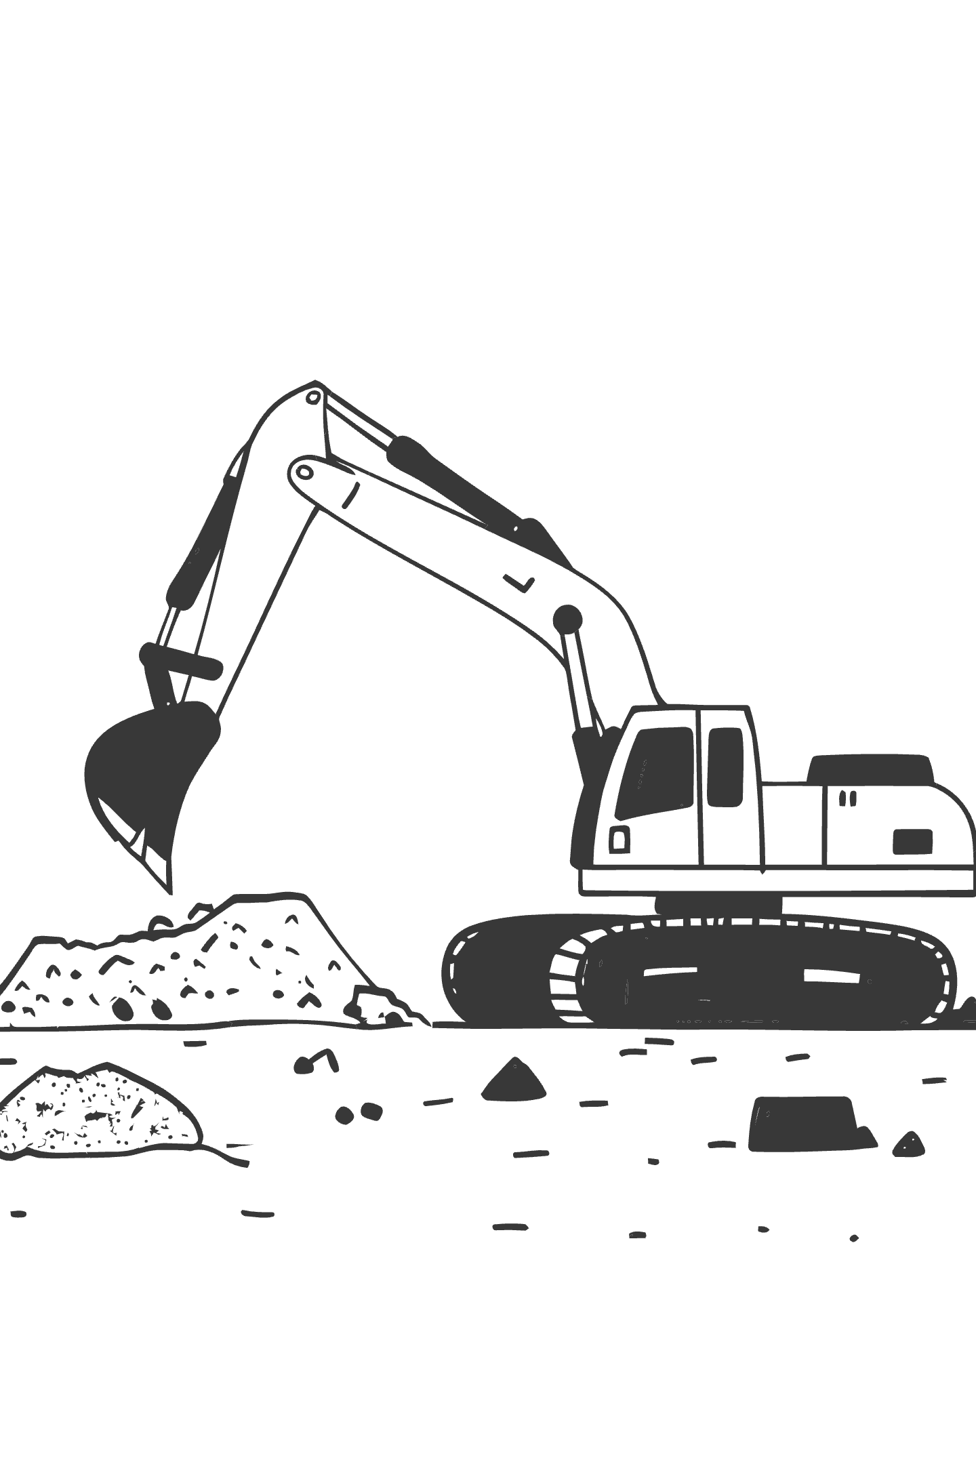
MODULE 3
Systematizing AI
Scaled Focus Inc. | nirant@scaledfocus.com | +91 7737887058
From "it worked once" to "it works every time"

Slide 31
Prompts → Templates → Systems
Level
What It Is
Reliability
Prompt
One-off instruction
Works sometimes
Template
Reusable with variables
Works consistently
System
Automated pipeline
Works at scale
Goal: Turn your working prompts into templates anyone can use. This is how expertise becomes infrastructure.

Slide 32
Identifying Variables
What CHANGES?
What STAYS THE SAME?
{{CLIENT_NAME}}
JSON schema structure
{{PORTFOLIO_IMAGE}}
Analysis questions
{{RISK_PROFILE}}
Output format
{{RM_NAME}}
Variables are placeholders for the parts that differ between runs. Everything else gets locked into the template.

Slide 33
A Complete Template
=== CLIENT PORTFOLIO ANALYZER v1.0 ===
INPUTS:
Client: {{CLIENT_NAME}}
Risk Profile: {{RISK_PROFILE}}
RM: {{RM_NAME}}
=== STEP 1: EXTRACT ===
[Fixed extraction prompt]
[INSERT {{PORTFOLIO_IMAGE}}]
=== STEP 2: ANALYZE ===
[Fixed analysis prompt]
Client risk profile: {{RISK_PROFILE}}
=== STEP 3: GENERATE ===
Write email to {{CLIENT_NAME}}...
Sign as {{RM_NAME}}

Slide 34
Templates Enable Scale
Without Templates
Rewrite prompt each time
Inconsistent quality
Knowledge in one person's head
Can't delegate
With Templates
Fill in variables
Consistent output
Documented process
Anyone can run it
Templates turn expertise into infrastructure.

Slide 35

The Automation Path
Manual
1
You paste, you run, you edit
Template
2
You fill variables, run template
Semi-auto
3
System fills variables, you review
Full auto
4
System runs, flags exceptions
Today: We're building the template layer. Tomorrow: We'll discuss productization.

Slide 36
Exercise: Make It Reusable
Identify Variables
1
What changes vs stays the same (5 min)
Build Template
2
Create reusable structure with variables (10 min)
Time: 15 minutes | Win: "I just built a system, not just a prompt."

Slide 37
What You've Built Today
Module
Skill
You Can Now...
1
RGC/STIC
Write precise, effective prompts
2
Extraction
Turn screenshots into structured data
3
Templates
Make workflows reusable at scale
Capstone: Combine all three into one end-to-end system.
15-minute break, then we put it all together.

Slide 38
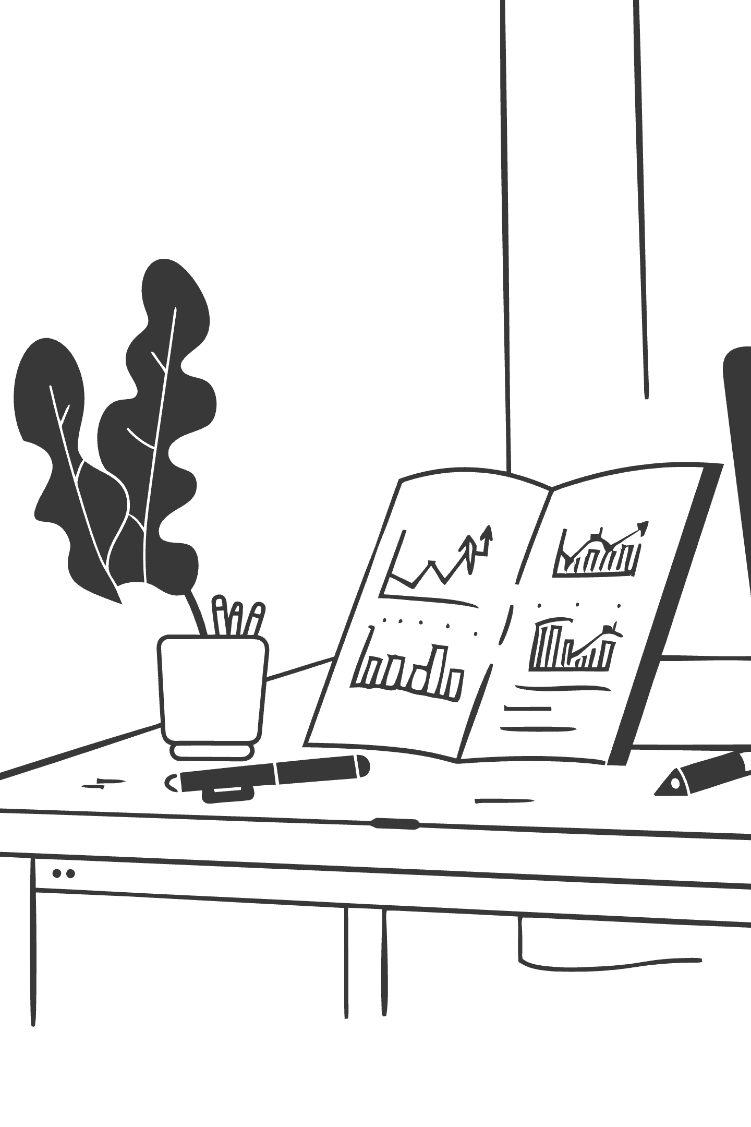
CAPSTONE
Build Your AI Analyst
Scaled Focus Inc. | nirant@scaledfocus.com | +91 7737887058
60 minutes to client-ready output

Slide 39
Your Final Challenge
Input
Output Requirements
Portfolio screenshot (Mehta Family, ₹41 crore)
Client-ready email for Mr. Rajesh Mehta
Market news (Venezuela oil headline)
Conservative investor, anxious about volatility
Reassuring tone
Clear next steps
Time: 60 minutes, 3 rounds

Slide 40
Capstone Structure
Round
Time
Goal
Win
1
15 min
Basic extraction
"It read my data!"
2
15 min
Add structure
"This is usable!"
3
15 min
Add personalization
"I could send this!"
Demo
10 min
See visual version
"Wow, what's possible"
Remember: Working > Perfect. Get something running, then improve.

Slide 41

Round 1: Basic Extraction
Paste Portfolio Screenshot
1
Use Mehta Family dashboard
Define JSON Schema
2
What fields do you need?
Extract & Verify
3
Check that data looks correct
Focus: Get clean data first. Everything else builds on this.

Slide 42
Round 2: Add Structure & Analysis
Portfolio Data
Risk Analysis
JSON from Round 1
Combine both for insights
1
2
3
4
Market Context
Draft Email
Add news screenshot
Turn analysis into communication
Focus: Chain the steps. Verify each before moving to the next.

Slide 43
Round 3: Personalization & Polish
Client Context
Tone Adjustment
Conservative, 65, anxious about volatility
Reassuring, clear, action-oriented
Next Steps
Final Review
Specific recommendations
Would you send this?
Focus: Make it client-ready. This is the output that matters.

Slide 44
Day 1 Complete
Scaled Focus Inc. for Kotak Securities
You Built
Tomorrow
Prompts that work consistently (RGC/STIC)
Product architecture
Data extraction from screenshots
Performance metrics
A reusable AI analyst template
Your Impact Memo
Save your prompts. You'll use them tomorrow.
Contact: nirant@scaledfocus.com | +91 7737887058

