Slide 1
Day 2: From Prototype to Production
AI Product Accelerator - Day 2

Slide 2
Yesterday you built it. Today you ship it.
Day 1: "Does the prompt work?"
Day 2: "Should we build this? How? When?"

Slide 3
Schedule Overview
Time
Module
Content
10:05-11:45
Module 1: Agent Design
Prioritization + Patterns + Failure Modes
1:30-2:30
Module 2: Agent Infrastructure
Skills + Build vs Buy + Observability
2:30-3:30
Module 3: Ship It
Metrics + Roadmap + Presentations

Slide 4
Module 1
Agent Design
Teaching: 25 min | Lab: 75 min

Slide 5
From Brainstorm to Backlog
You have 10 ideas from Day 1.
You can only build 1 this quarter.
How do you choose?

Slide 6
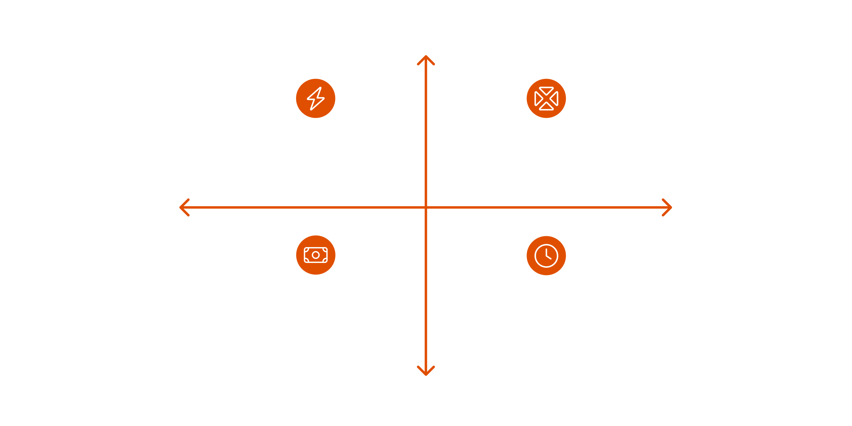

Impact/Effort Matrix
HIGH IMPACT
Quick Wins
Strategic Bets
LOW EFFORT
HIGH EFFORT
Money Pit
Fill Later
LOW IMPACT

Slide 7

Scoring Criteria
Criterion
Weight
What to Ask
Impact
1-5
How much time/money saved?
Effort
1-5
Dev weeks? Integration complexity?
Compliance Risk
H/M/L
Regulatory exposure?
Data Sensitivity
H/M/L
PII? Financial data?
Time-to-Value
Fast/Slow
When do users see benefit?
Score = Impact × (6 - Effort) × Risk Multiplier
Risk Multiplier: H=0.5, M=0.8, L=1.0

Slide 8
What is an Agent?
Agent = LLM + Tools + Memory + Control Flow
LLM
Tools
The reasoning engine
APIs, databases, functions it can call
Memory
Control Flow
Context it retains across turns
Logic that decides what happens next

Slide 9
The 4 Canonical Patterns
Router
Chain
Classify → Route to Specialist
Step 1 → Step 2 → Step 3
Orchestrator
Human-in-the-Loop
Planner + Sub-agents
Auto Easy, Escalate Hard

Slide 10

Pattern 1: Router
Classify → Route to Specialist
Agent A (Sales)
Handles sales inquiries
Router Classify
Agent C (Billing)
Agent B (Support)
Manages billing requests
Resolves technical issues
Use when: Clear categories, different expertise needed

Slide 11

Pattern 2: Chain
Step 1 → Step 2 → Step 3
Extract Data
Analyze Data
Generate Report
Use when: Sequential processing, each step builds on previous

Slide 12
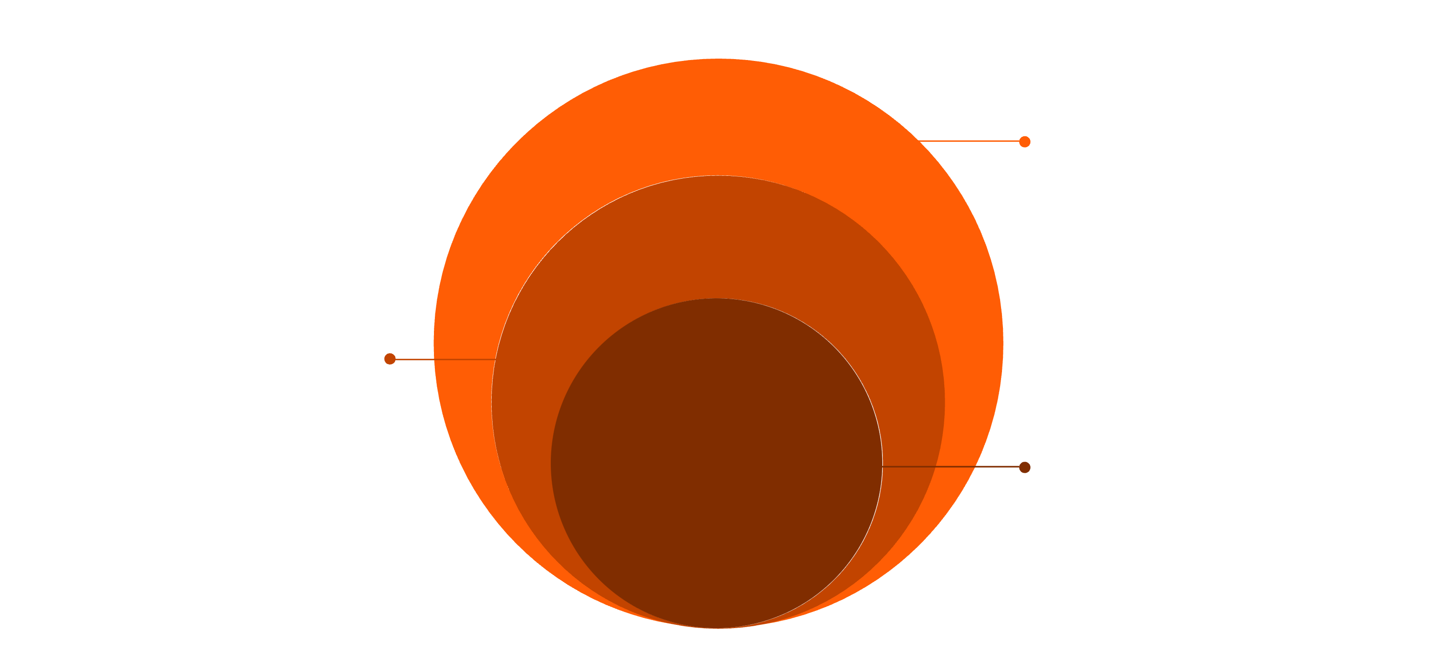
Pattern 3: Orchestrator
Planner + Sub-agents
Combine Results
Aggregate outputs and finalize solution
Worker Agents
Worker 1, Worker 2, Worker 3 execute tasks
Orchestrator
Planner coordinates tasks and strategy
Use when: Complex tasks, parallel execution possible

Slide 13
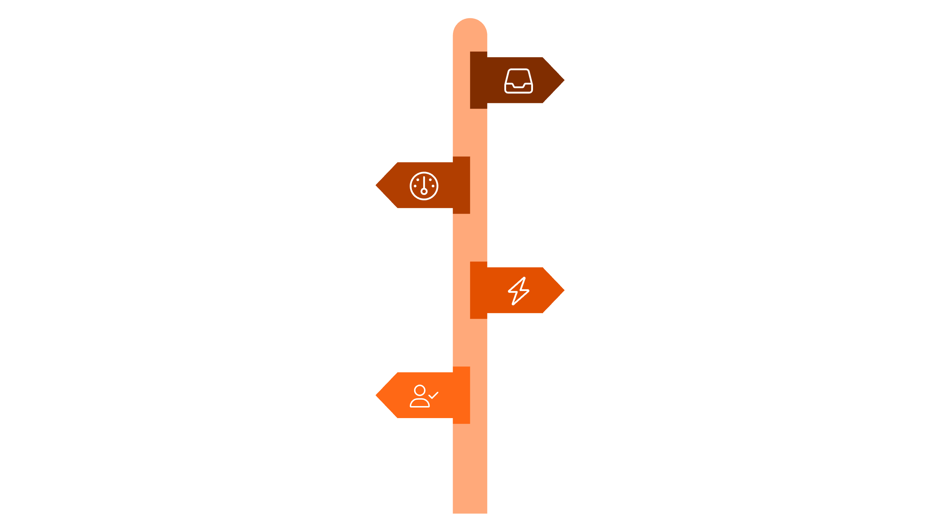
Pattern 4: Human-in-the-Loop
Auto Easy, Escalate Hard
Request
Receive user input or task request.
Confidence Check
Assess model certainty against thresholds.
High Confidence
Auto Complete the request automatically.
Low Confidence
Route to Human Review for verification.
Use when: High stakes, regulatory requirements, trust building

Slide 14
Which Pattern for Enterprise?
Usually #4
Sometimes #1
Human-in-the-Loop
Router
Regulatory compliance requires human oversight
Clear intent classification
Building trust takes time
Different workflows per category
"AI-assisted" beats "AI-replaced" for adoption
Enables incremental automation

Slide 15
State Machine Anatomy
Every agent has these components:
TRIGGER
DECISION POINTS
API call / Schedule / User action
If confidence < 80% → escalate
If amount > $10K → require approval
GUARDRAILS
HUMAN CHECKPOINTS
Block if PII detected
Final review before send
Reject if off-topic
Override capability always on

Slide 16
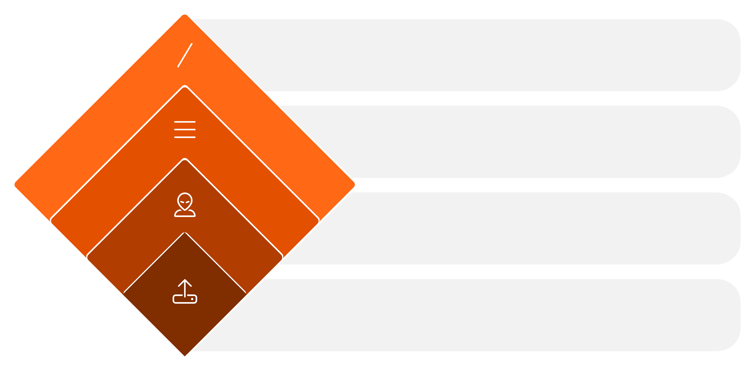
Example: Document Validation Agent
Decision Outcome
Valid → Auto Approve; Invalid → Human Review
Validate Format
Check completeness
Extract Fields
Name, ID, Date
Document Upload
Trigger: submit file

Slide 17
Pre-Mortem: Assume It Failed
Before building, imagine it's 6 months from now.
Your agent has been shut down.
What went wrong?
This mindset shift catches failures you'd otherwise miss.

Slide 18
Common Failure Mode Categories
Category
Example
Why It Happens
Hallucinated Identifiers
Wrong account number, fake ticker
LLM generates plausible-looking data
Missed Validation Flags
Compliance issue not caught
Training data didn't cover edge cases
Latency Spikes
Slow during peak hours
API rate limits, cold starts
Prompt Injection
User tricks agent into wrong action
Adversarial input not filtered

Slide 19



Lab 1: Design Your Agent
75 minutes total
Part A
Part B
Part C
Prioritize
Draw Your Agent
Failure Modes
20 min
35 min
20 min

Slide 20
Module 2
Agent Infrastructure
Teaching: 20 min | Lab: 40 min

Slide 21
What are Agent Skills?
"Folders of instructions, scripts, and resources that agents can discover and load dynamically"
— Anthropic
Think of them as playbooks for AI.

Slide 22
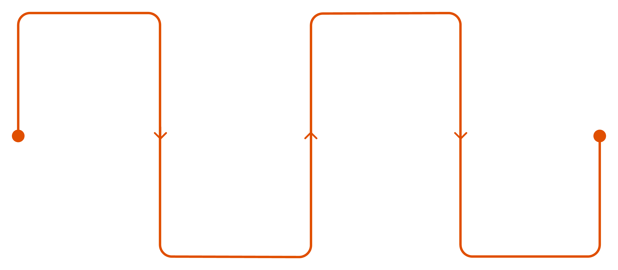
Progressive Disclosure
Agent loads only what's needed, when needed.
User asks
Load instructions
Help me with KYC
Fetch only relevant steps
Execute
Agent detects
Run with full context
Discovers KYC skill
Not loading everything upfront.

Slide 23

Skill Anatomy
my-skill/
├── SKILL.md # Required: YAML frontmatter + instructions
├── templates/ # Optional: Document templates
├── scripts/ # Optional: Automation scripts
└── examples/ # Optional: Few-shot examples
SKILL.md structure:
---
name: kyc-extraction
description: Extract and validate KYC documents
triggers: [kyc, identity verification, document check]
---
# KYC Extraction Workflow
## Step 1: Document Classification
...

Slide 24
Open Standard: agentskills.io
Works across:
Claude
GitHub Copilot
OpenAI Codex
Cursor
VS Code
Write once, use everywhere.

Slide 25

The AI Stack
DATA LAYER
1
Your proprietary data
EVAL/MONITORING
2
How you measure quality
SKILLS/WORKFLOWS
3
Your business logic
ORCHESTRATION
4
How agents coordinate
MODEL LAYER
5
The LLM itself
Rule of thumb: Own higher layers, rent lower layers.

Slide 26
The Vector DB Question
When you still need Vector DB:
When you don't:
Millions of documents
Thousands of docs (fits in tool search)
Sub-second latency requirements
Agent can query sources directly
Complex hybrid search (semantic + filters)
Skills handle retrieval logic
Modern agent SDKs (Claude Agent SDK, etc.) provide: Tool Search, Files API, Memory, MCP Tools

Slide 27
Observability: Langfuse
Open-source LLM observability
Traces
Costs
Full request/response chains
Token usage per request
Latency
Prompt versions
Response times
A/B testing prompts
Deployment options: Self-hosted (full control) | Cloud (managed)

Slide 28
Testing: Ragas Framework
Evaluate RAG pipelines
Metric
What It Measures
Faithfulness
Does answer match retrieved context? (hallucination detection)
Answer Relevancy
Does answer address the question?
Context Precision
Is retrieved context relevant?
Citation Accuracy
Are sources correctly attributed?

Slide 29
Decision Framework
Layer
Build When
Buy When
Model
Never (for most)
Always (Azure OpenAI, etc.)
Orchestration
Core differentiator
Standard patterns
Skills
Proprietary workflows
Generic tasks
Eval
Custom metrics needed
Standard benchmarks
Observability
Strict data residency
Speed to market
Hybrid: Own the workflow, rent the compute.

Slide 30
Module 3
Ship It
Teaching: 10 min | Lab: 50 min

