Slide 1
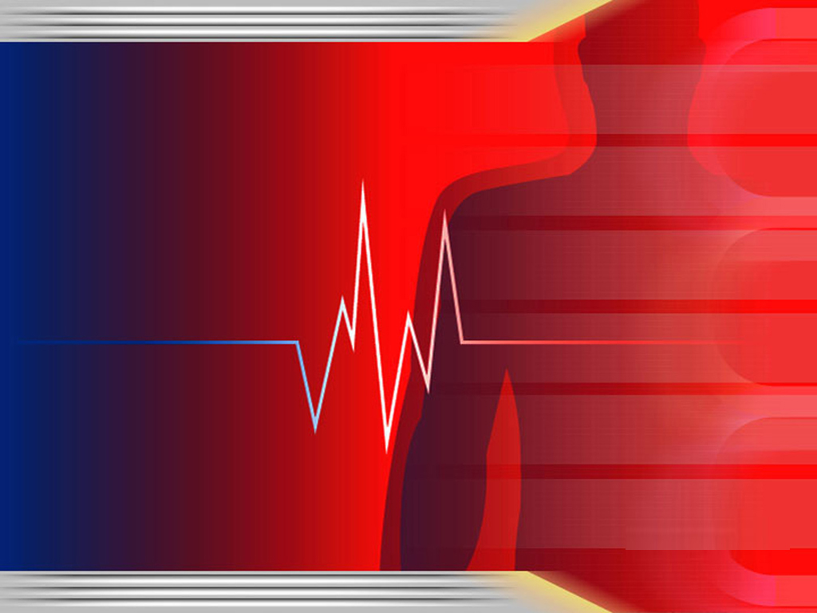
Smart Health Monitoring System
IOT Project Presentation
K.P.G.N.Buddhimali – MEC/22/B1/17
A.D.C.Jayamandira – MEC/22/B1/45

Slide 2

Introduction
Health emergencies often strike without warning.
Monitoring vital signs continuously can prevent serious conditions.
Our system offers a real-time, wearable solution.

Slide 3
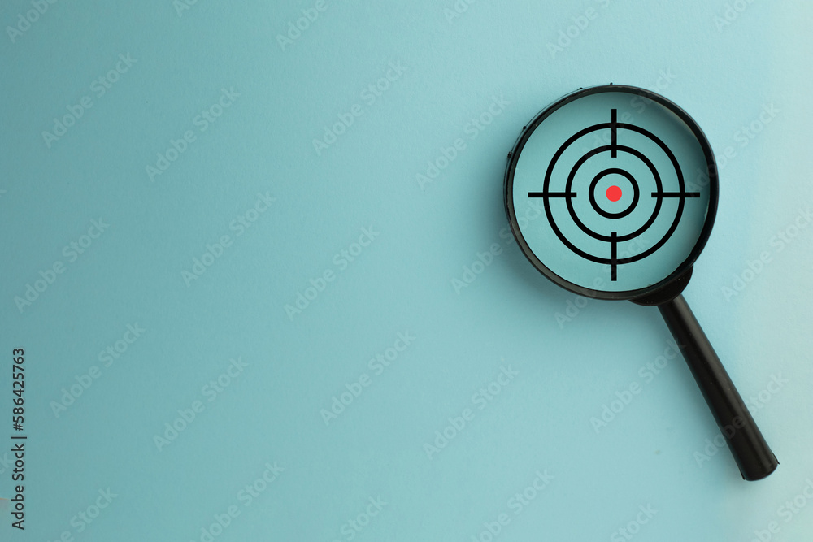
Project Objectives
Continuously monitor heart rate, SpO2, and body temperature.
Alert the user via vibration when abnormal readings are detected.
Transmit data to a web app for remote observation.
Enable custom alerts from the app to the device.

Slide 4

System Overview
- Wearable device with integrated sensors.
- ESP32 as the core controller.
- Communication via Wi-Fi (HTTP based).
- Web interface for live data visualization and remote control.

Slide 5
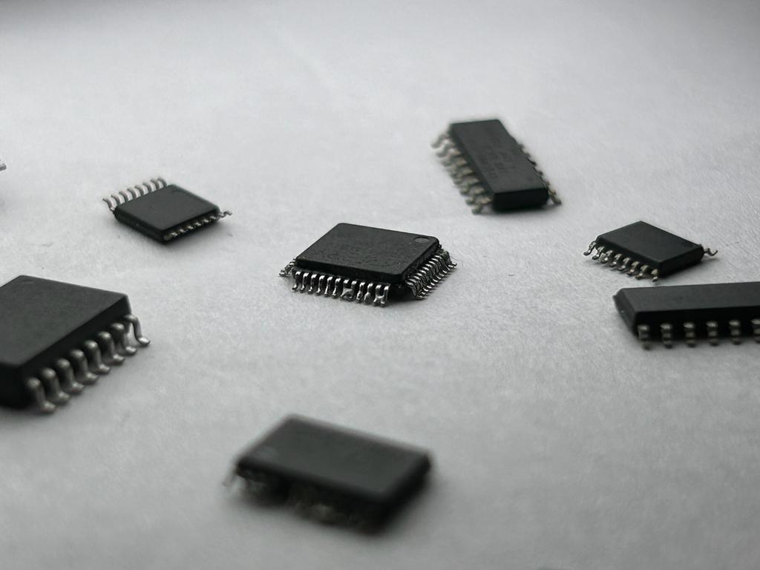
Components Used
ESP32: Wi-Fi enabled microcontroller
MAX30102: Pulse and SpO2 sensor
Analog Temp Sensor: For body temperature
Vibration Motor: Alert system
Battery Pack: Portable power
Web App: User interface and control panel

Slide 6
Web Interface Features
Real-time monitoring of heart rate, SpO2, and temperature.
Manual vibration trigger with custom patterns.
Responsive UI for mobile and desktop.

Slide 7
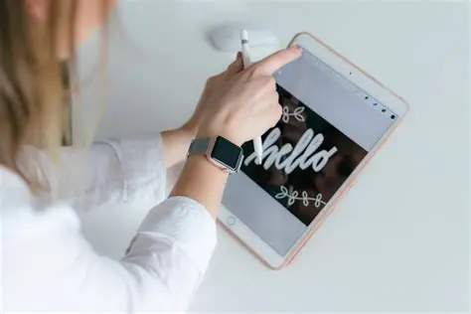
Working Principle
Sensors read vital signs every few seconds.
Data is processed and checked against thresholds.
If abnormal, device triggers vibration.
Simultaneously, data is pushed to the web app.
Web app can send vibration triggers remotely.

Slide 8

Key Advantages
Real-time local and remote monitoring
Lightweight and wearable
Offline functionality (via ESP32 AP mode)
Custom alerts from app to user
Low power, high efficiency

Slide 9

Challenges Faced
Noise in sensor readings
Accurate temperature calibration
Power management in wearable design
Smooth HTTP communication without lag

Slide 10

Future Enhancements
Add GPS for location tracking during health alerts
Include fall detection using MPU6050
Bluetooth fallback for offline data sync
Cloud storage and mobile notifications

Slide 11

Conclusion
A practical, affordable wearable solution.
Helps detect early signs of health issues.
deal for athletes, workers, and patients.
Ready for further development and real-world deployment.

Slide 12

Any Questions ?

Slide 13


