Slide 1




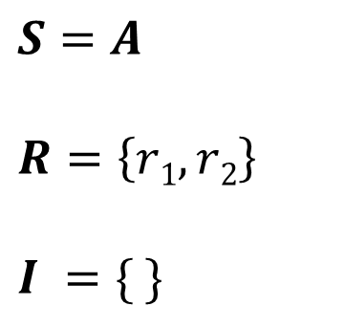
$$r1$$
$$r2$$
$$S=A$$
$$R=\left\{r1, r2\right\}$$
$$I =\{ \}$$
1 |  | 1
$$r1$$
$$r2$$
A

