Slide 1
Nykaa Fashion
Delivery – Two times a week

Slide 2
System Information:-
IP - 172.27.131.182
Username – Administrator
Password - Act*2025#@
Database Information:-
Database Name - nykaa
Collection name – date wise created like (‘products_details_04_08_2025_13_22’)
Project Path:-
Code Path - D:\dhruv\nykaa
Requirements:-
Scrape product data from inputs provided by the client.

Slide 3
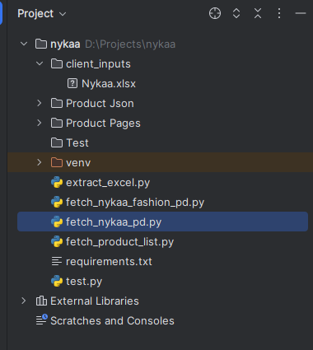
Client’s Input
Place the client input in the specified location.
Change the input file name to Nykaa

Slide 4
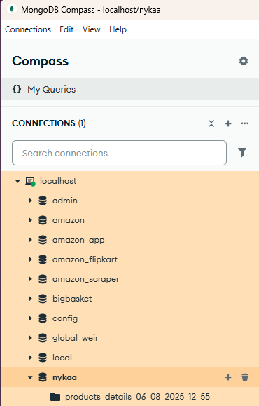
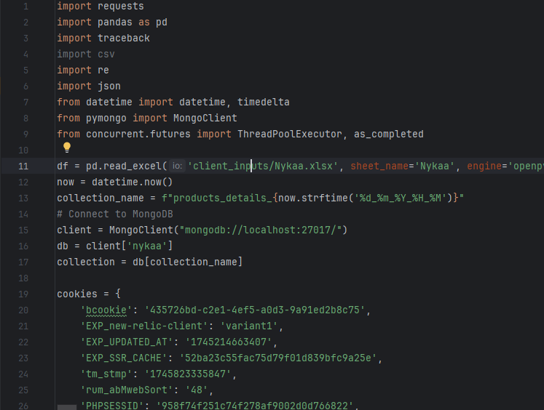
Database Information
Using MongoDB
Database
Product Data Table

Slide 5
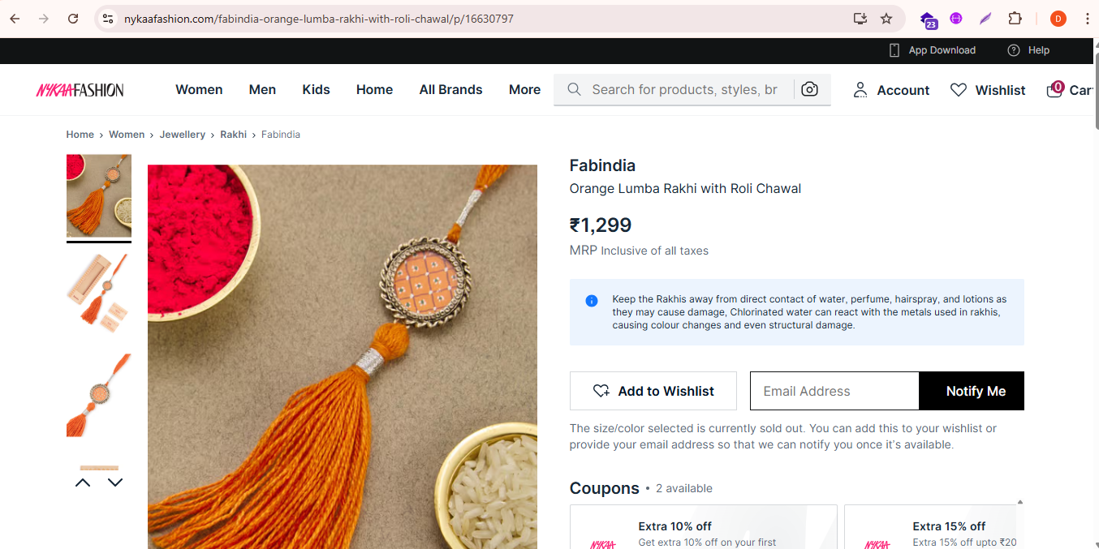
Product Details
product_url
category_hierarchy
brand
mrp

Slide 6
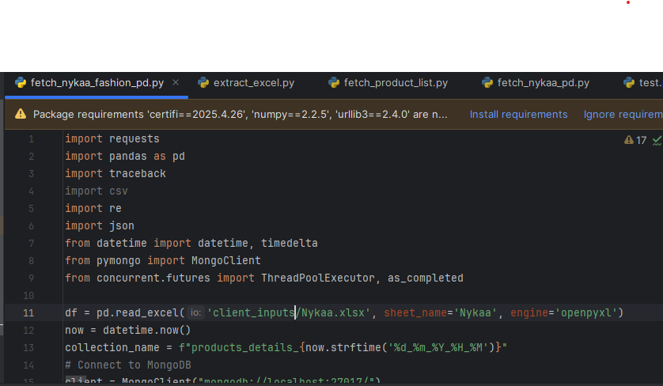
Links Extraction using below mentioned file (fetch_nykaa_fashion_pd.py) get all product ids from input file for process and after process on all product it stored in data collection which generated with today’s date and time.
Using this code product id read from client input file.
Product table date and time wise

Slide 7
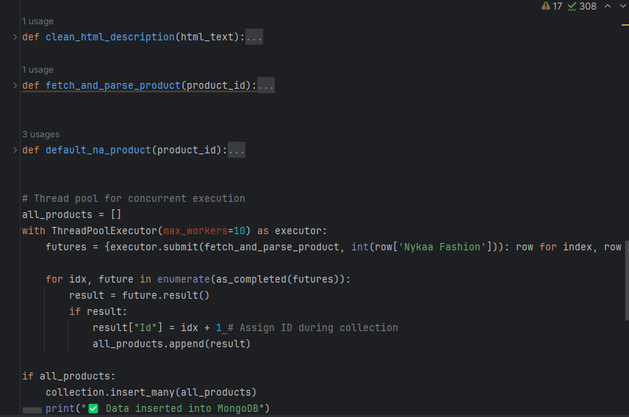
Data Extraction using below mentioned code product details fetch from response, clean fetched data, set “N/A” as default value and save into db collection
Clean fetched data
Fetch data from respons
Set default value N/A

Slide 8
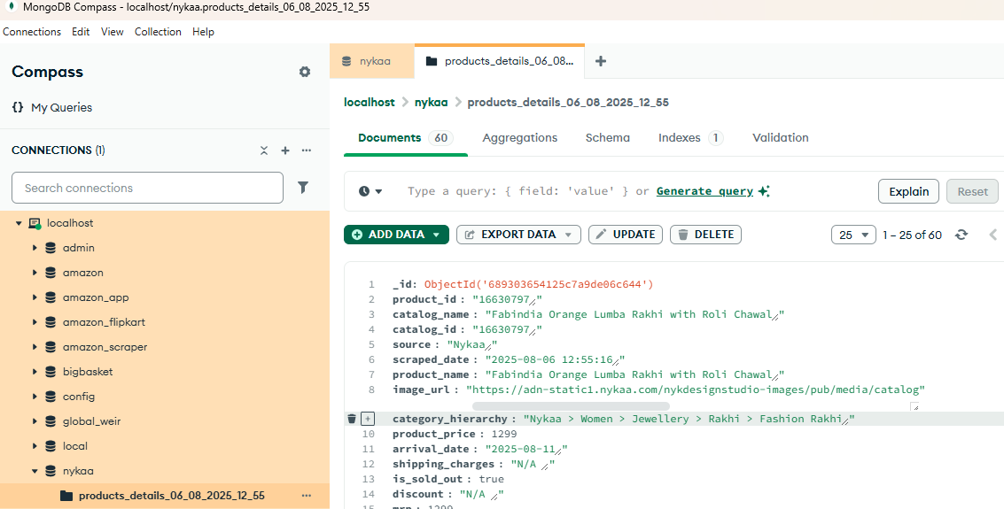
Data Store Location
Product table
Database

Slide 9
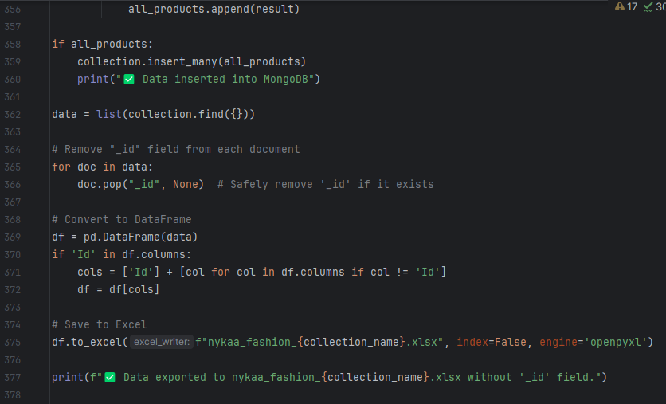
Export Data(export.py)
Using this code we can extract data from product table and save into excel

Slide 10
Thank you

