Slide 1
AJIO
Delivery – Two times a week

Slide 2
System Information:-
IP - 172.27.131.182
Username – Administrator
Password - Act*2025#@
Database Information:-
Database Name :- ajio_nua_ecom
Project Path:-
Code Path - D:\Nirav Chauhan\Code\ajio_nua_e_com
Requirements:-
Scrape product data from inputs provided by the client.

Slide 3
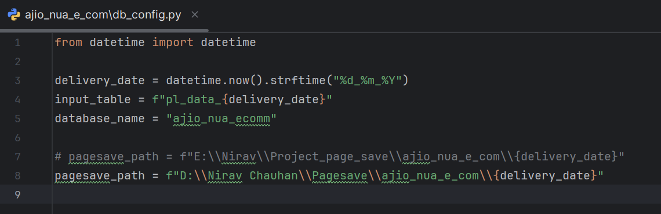
Using dbconfig to add delivery_date from delivery_date variable.
Set database name database variable
pagesave_path contains pagesave loacations

Slide 4
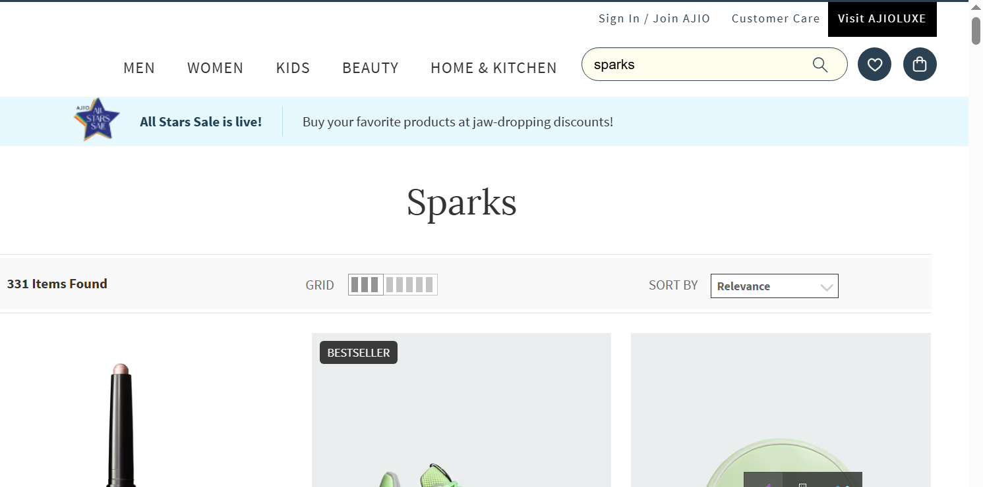
Pl_data.py
There the client is given three keywords :
1) Asian
2) sparks
3) flite

Slide 5
Pl_data.py

Slide 6
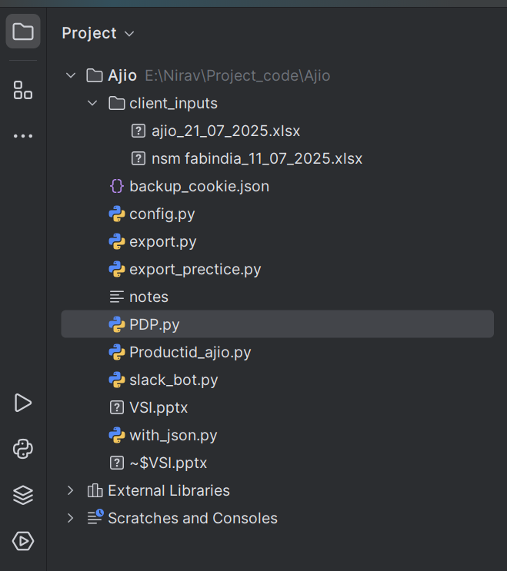
Client’s Input
Place the client input in the specified location.
Use the client inputs to extract data and insert it into the table

Slide 7
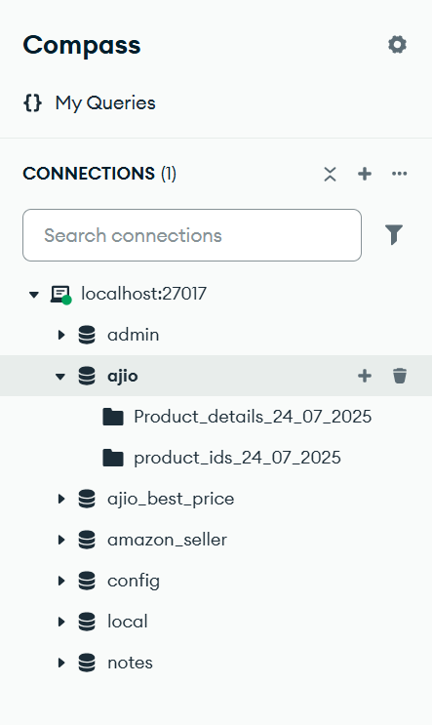
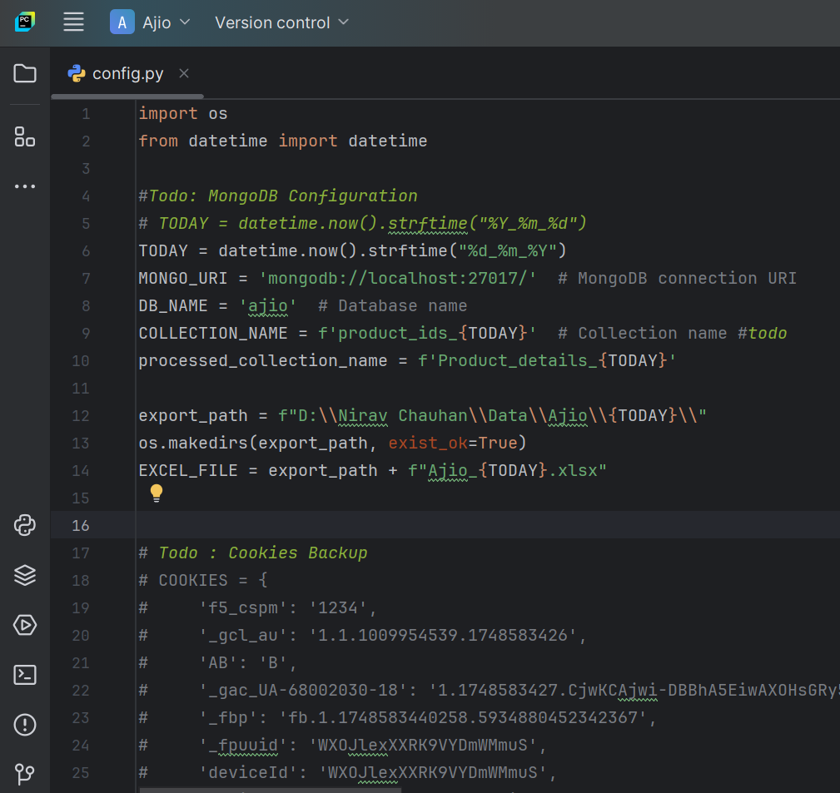
Database Information
Using MongoDB
Database
Product Data Table
Product Link Table

Slide 8
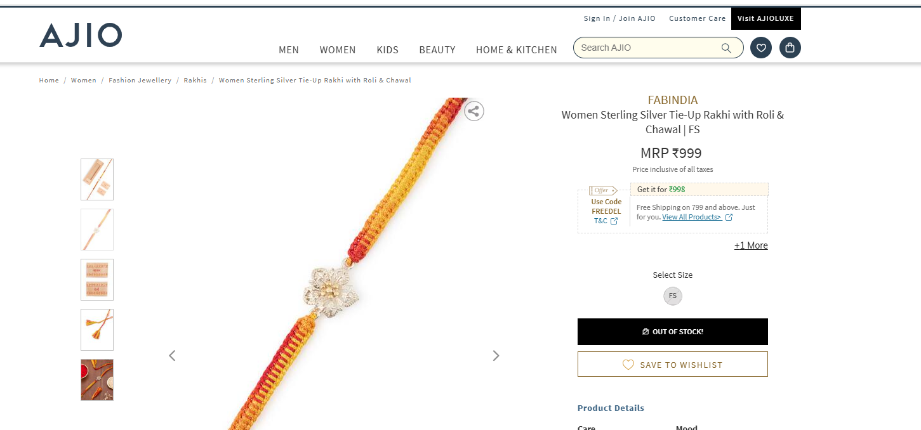
Product Details
Catalog Name
Category Hierarchy
MRP

Slide 9
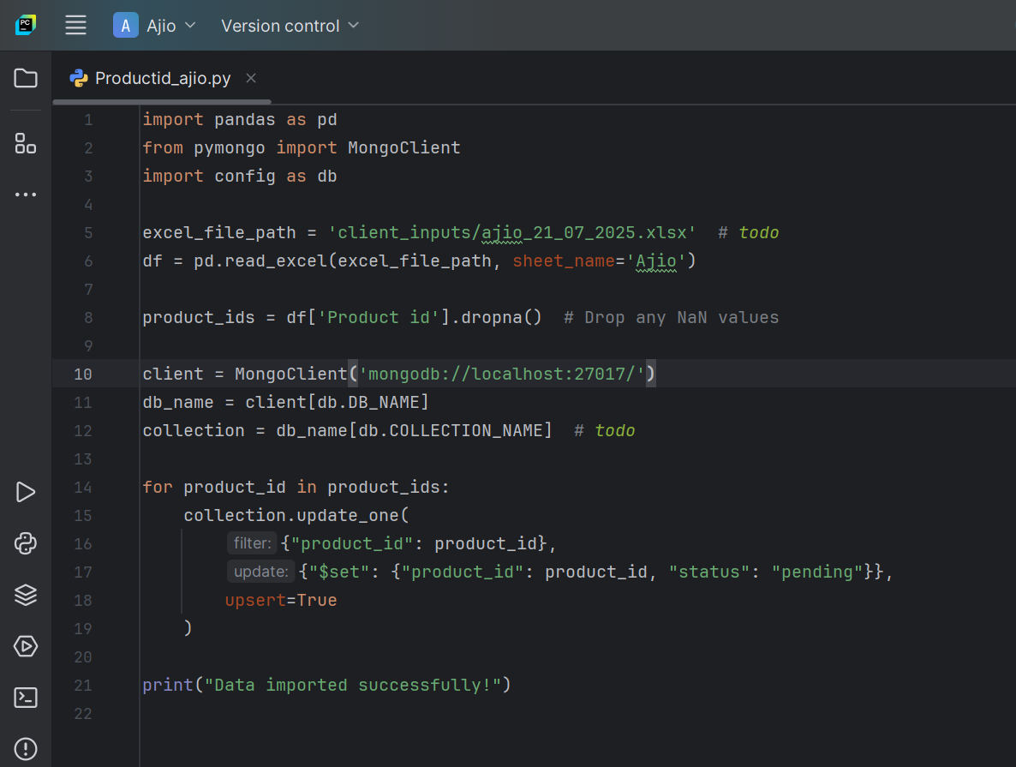
Links Extraction
To extract links, run the productid_ajio.py file. The links will be inserted into the respective prdocut_ids name table.
Using this code to store product link in this table
Product ids table

Slide 10
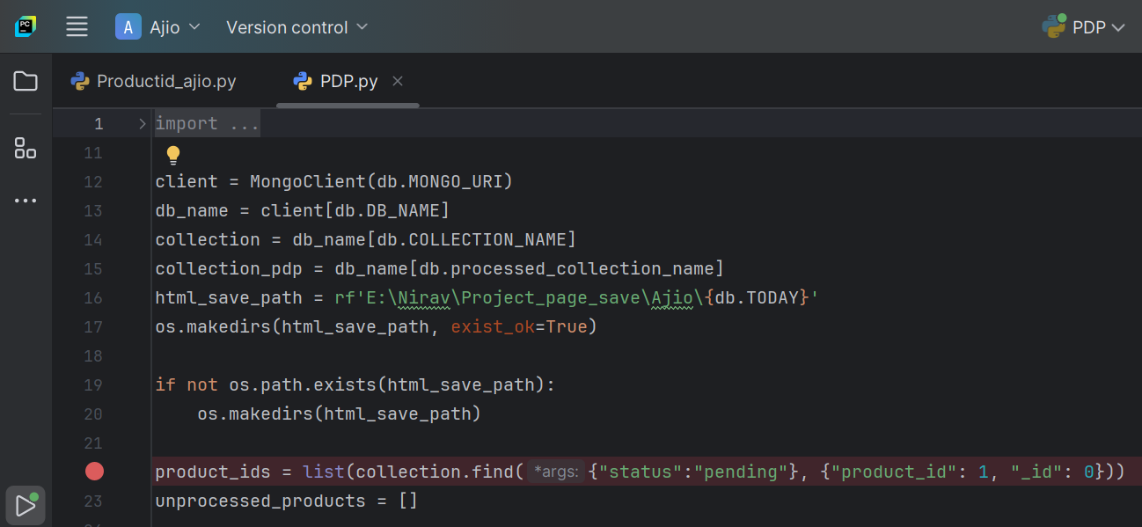
Data Extraction fetch links product_ids table and store extracted data in product_details table using PDP.py file.
Fetch url where status is pending

Slide 11
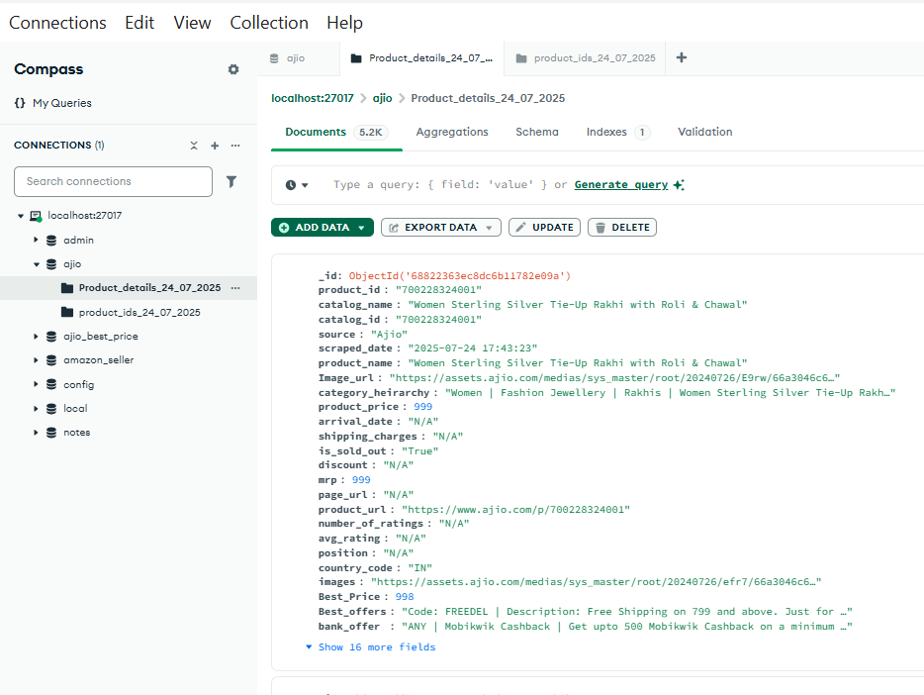
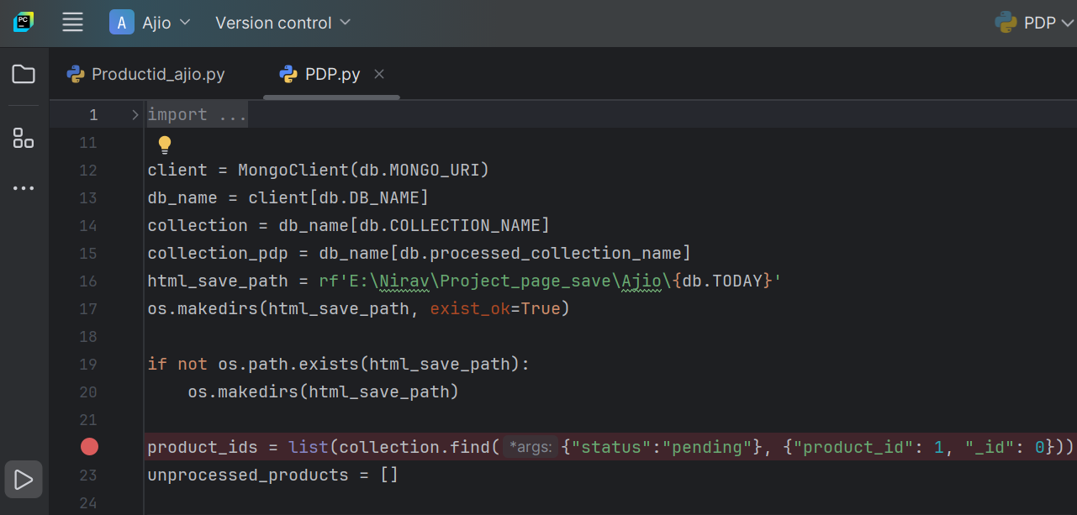
Data Store Location
Using this .py to store product detail in this location.
Data store location

Slide 12
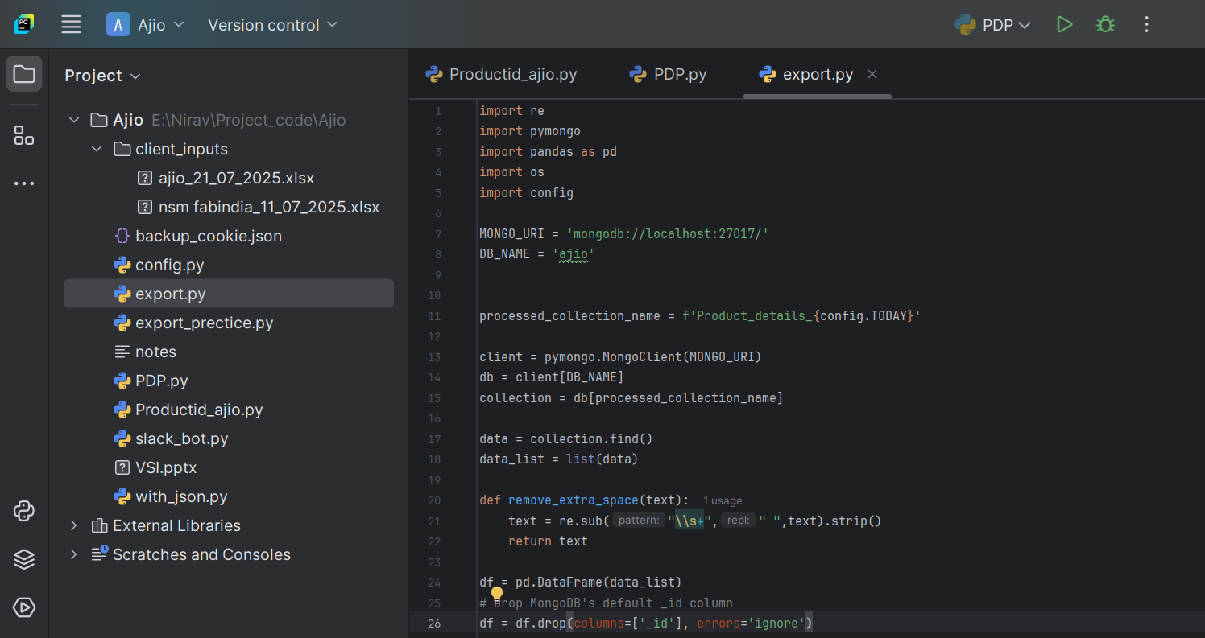
Export Data(export.py)
Using this .py file to export clean and formatted data in excel sheet

Slide 13
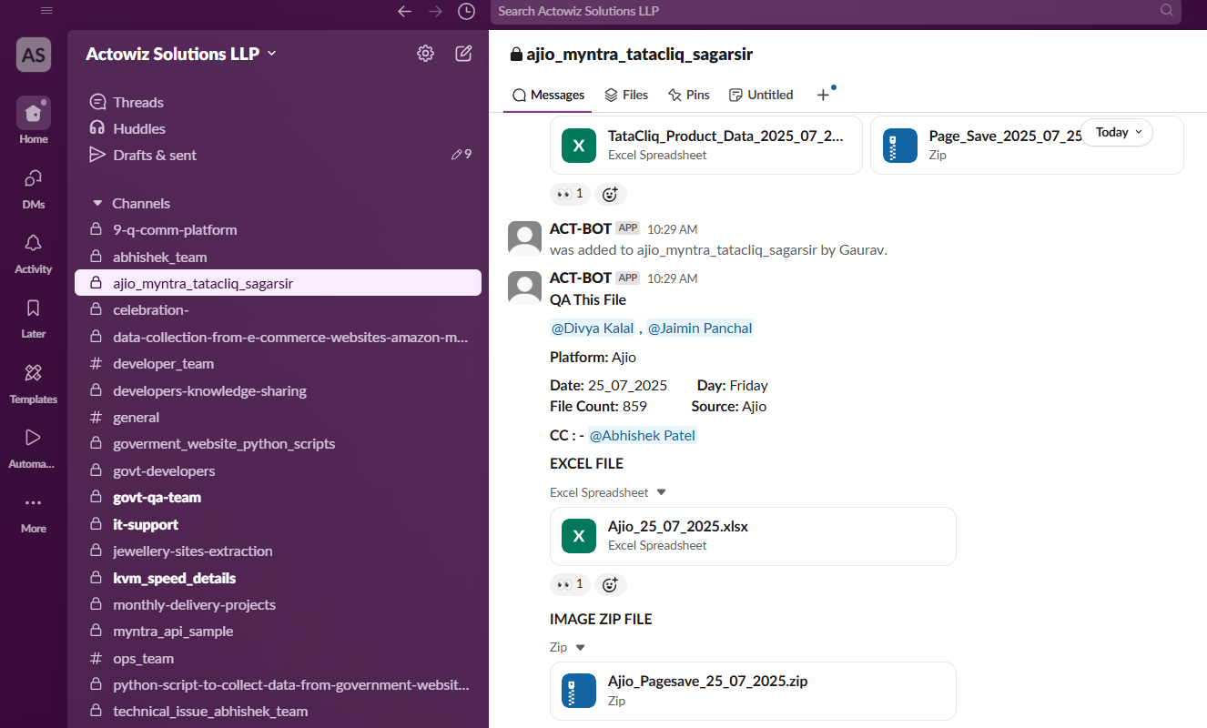
Slack BOT(slack_bot.py)
Using bot to send Ajio data file ajio_myntra_tatacliq_sagarsir
Using this bot to upload data excel file and pagesave file in this group.
Data File
Pagesave File

