Slide 2
EOS Testing Service and Quality Assurance Development
Leveraging GitLab CI and Kubernetes

Slide 3

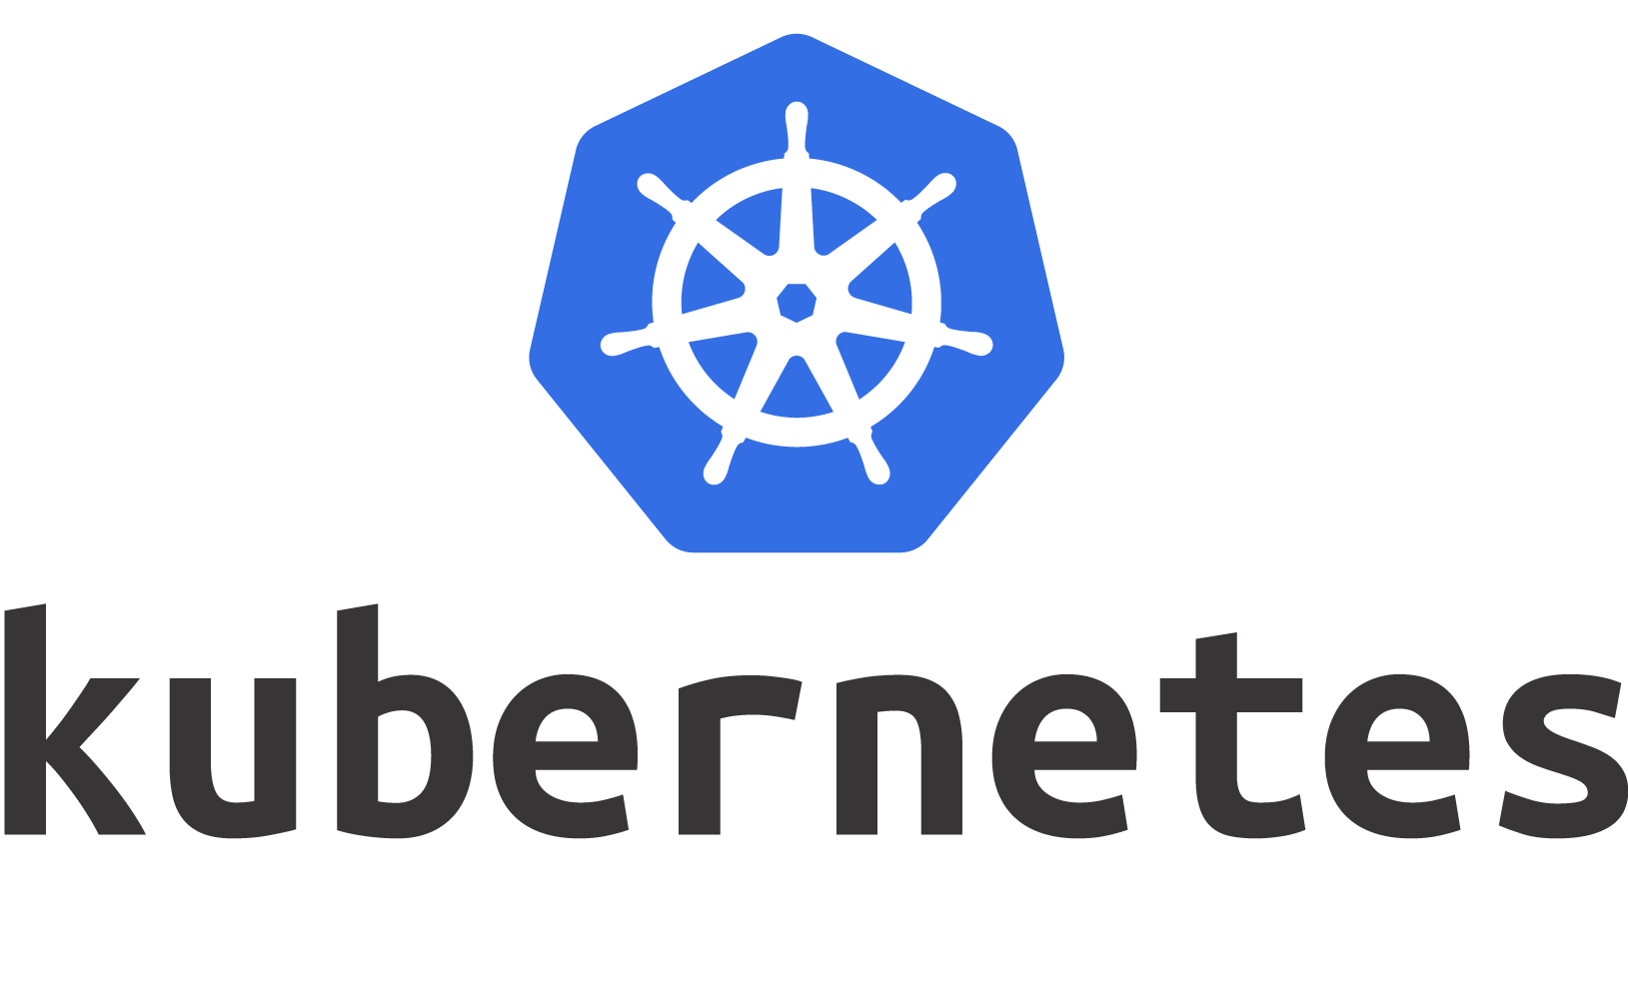
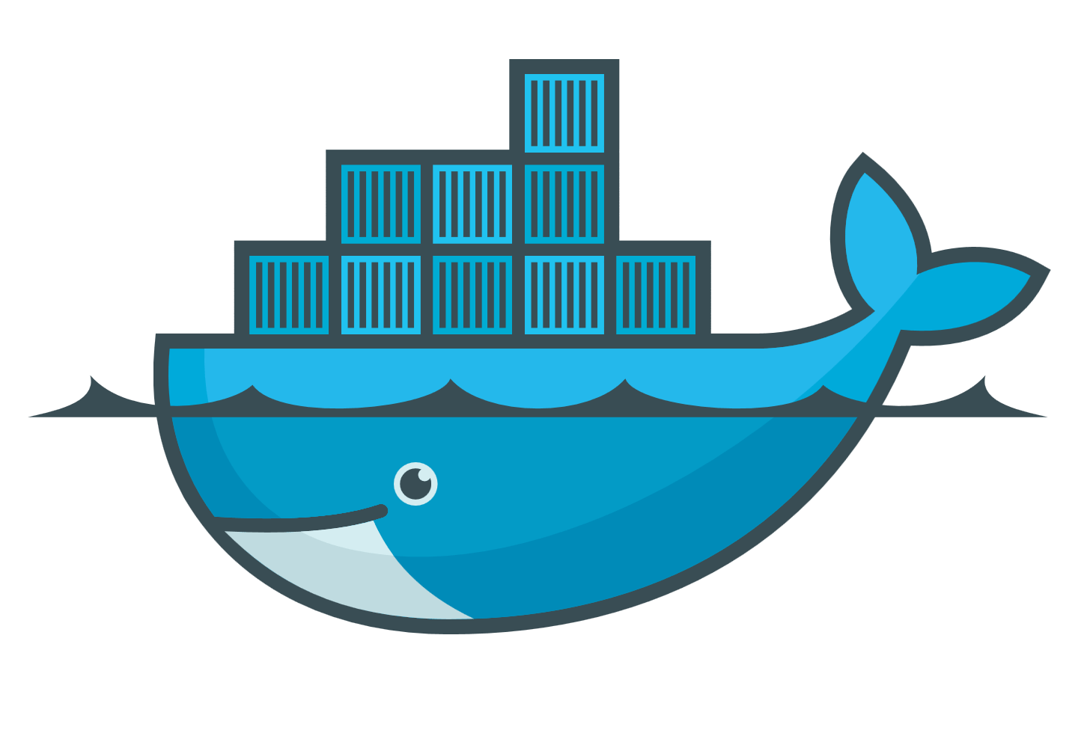
Why testing
EOS on CI - State of art
EOS on CI - Goals

Slide 4
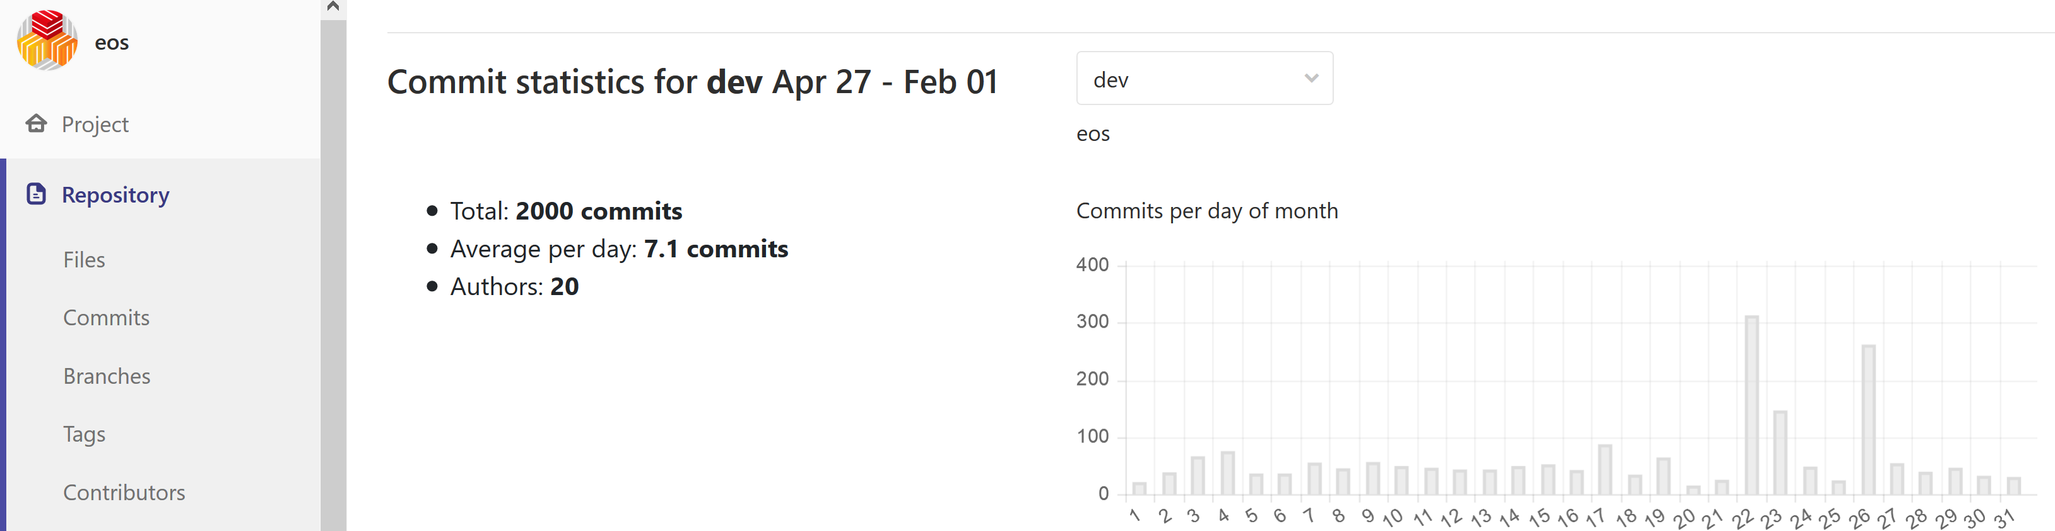
EOS Testing Service and Quality Assurance
~ 600k lines of code, 1,5k files
~ dozen of devs
100 PB of data
Physics, Home, Media …
Thousands end users / customers

Slide 5

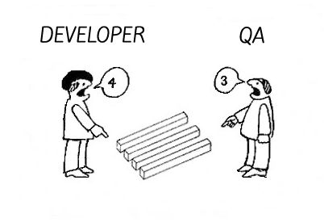
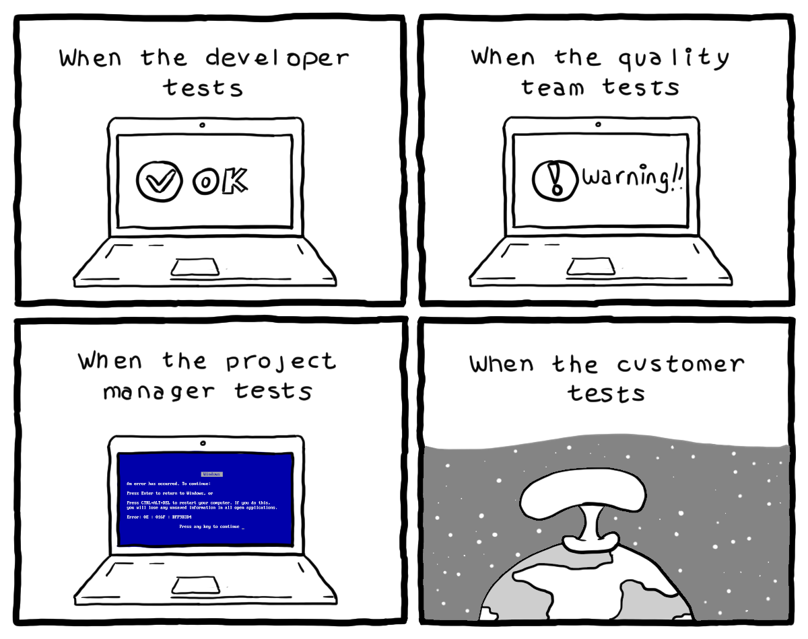
EOS Testing Service and Quality Assurance
~ 600k lines of code, 1,5k files
~ dozen of devs
100 PB of data
Physics, Home, Media …
Thousands end users / customers

Slide 6
EOS Testing Service and Quality Assurance
With such a large pool of parties involved, a testing framework is desirable mandatory, and must be:
Seamless to use
Effective
Efficient
Notes:
Seamless to use: easy deployment for admin/user/devs
Effective: as close as possible to real use cases
Efficient: reasonably consuming available computing resources

Slide 7

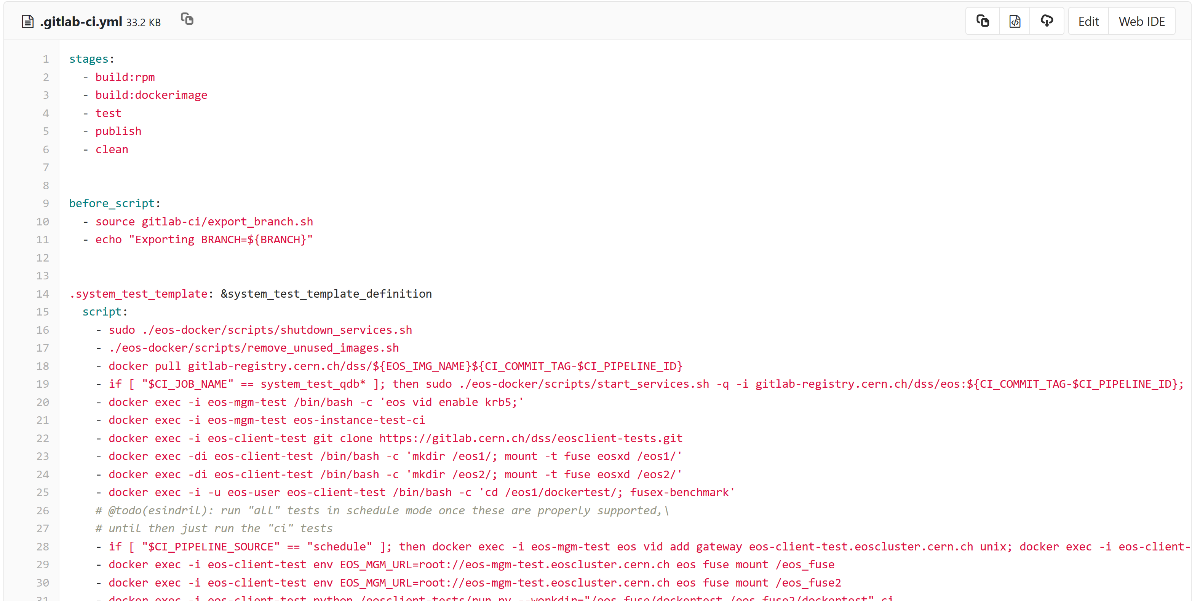
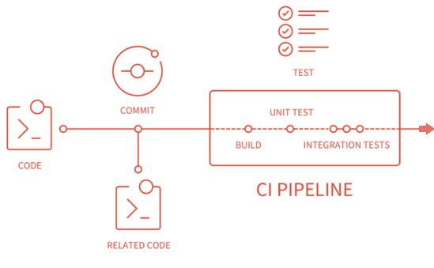
EOS on

Slide 8
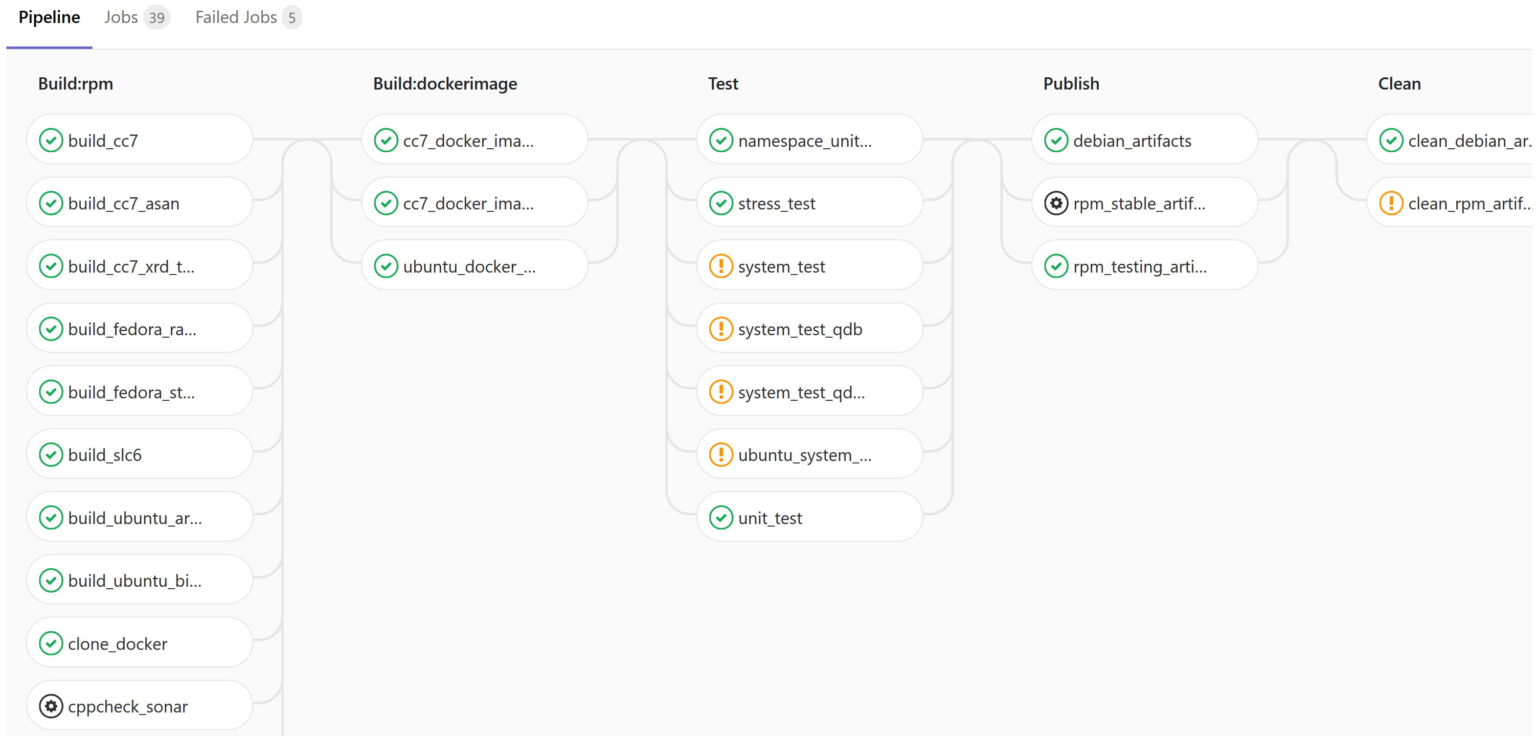
EOS on
If all stages are checked, we have (eventually) a good quality release

Slide 9
EOS on
+
Docker
Published images have all rpms, configs, environment setup needed
Faster than Puppet managed (V)Machines
Portable and self contained EOS instances, you just need an engine to run them

Slide 10
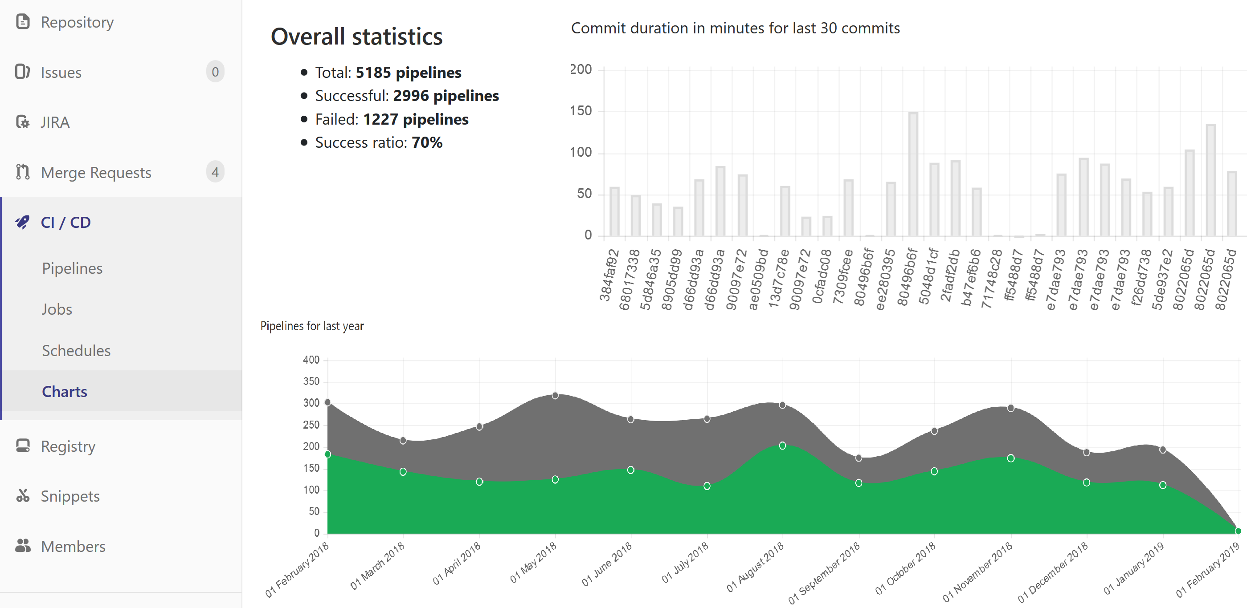

Slide 11
EOS on
If all stages are checked, we have (eventually) a good quality release

Slide 12
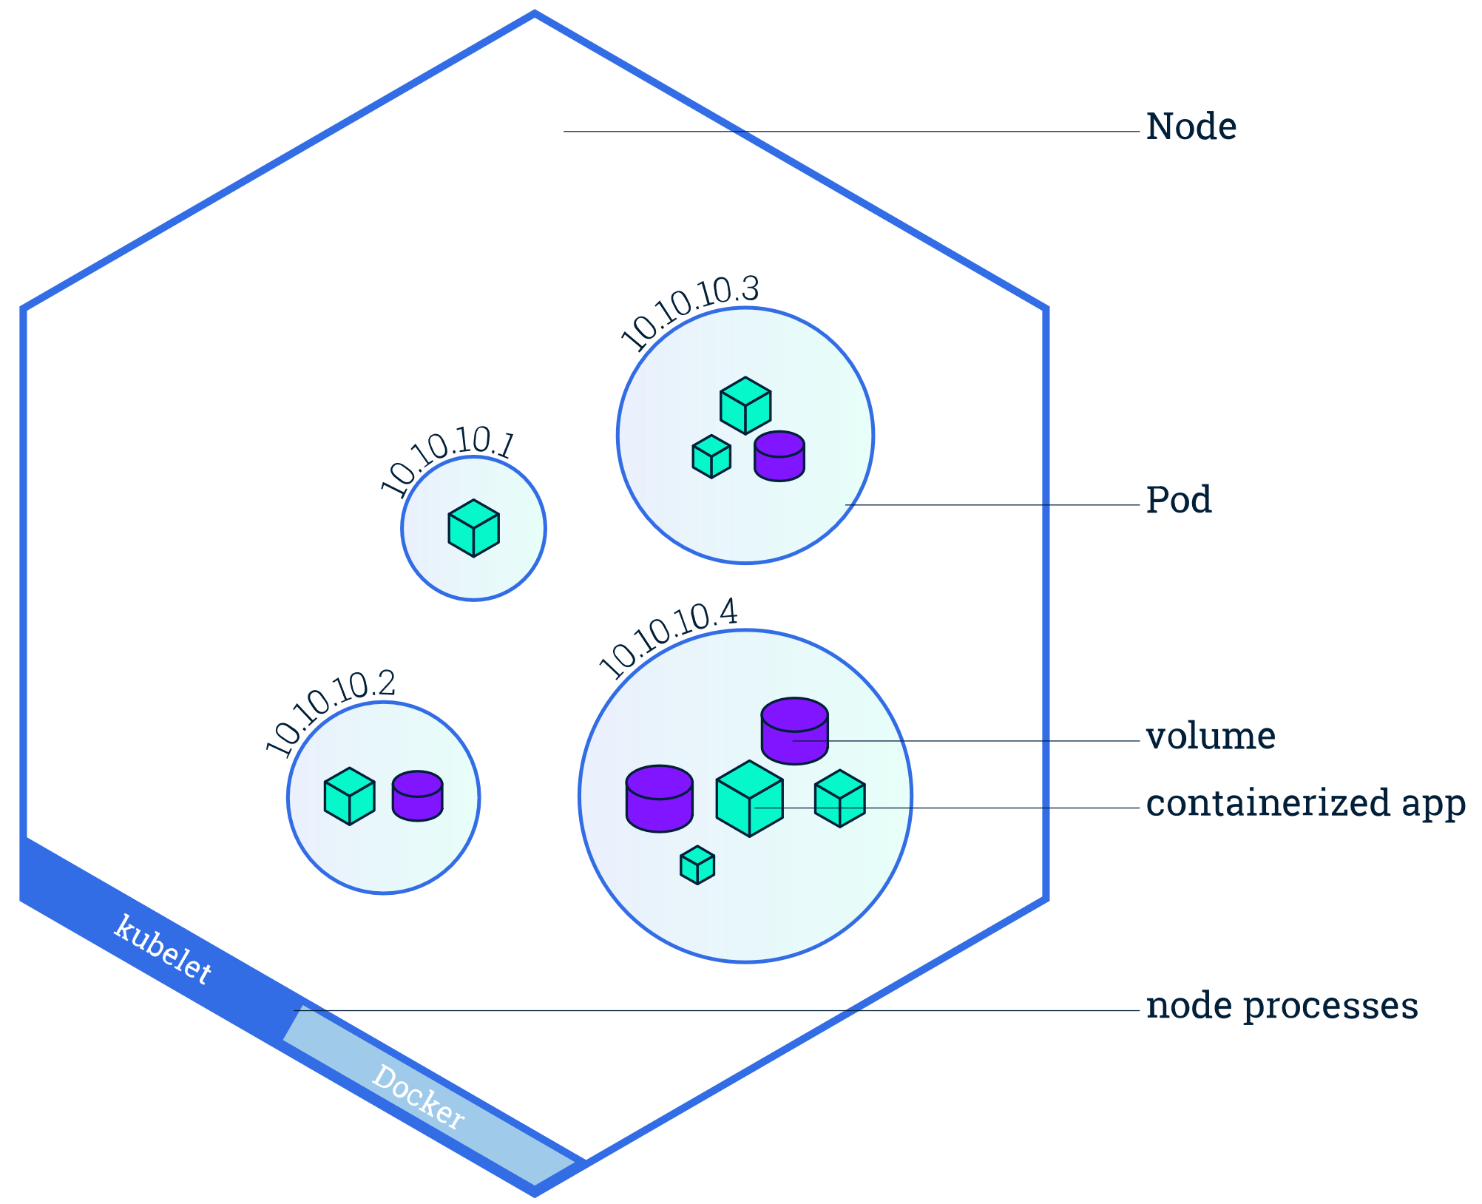
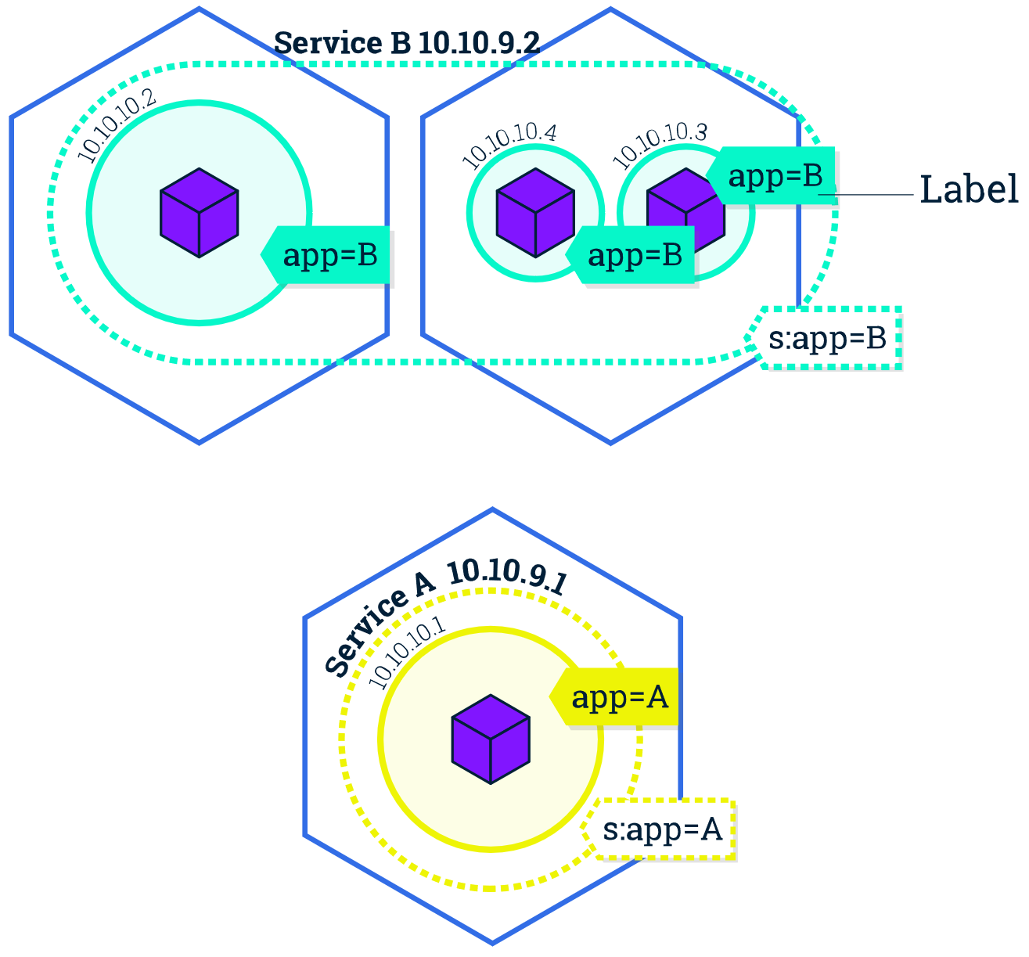
Basic Kubernetes concepts / abstractions

Slide 13
K8s Network Model

Slide 14
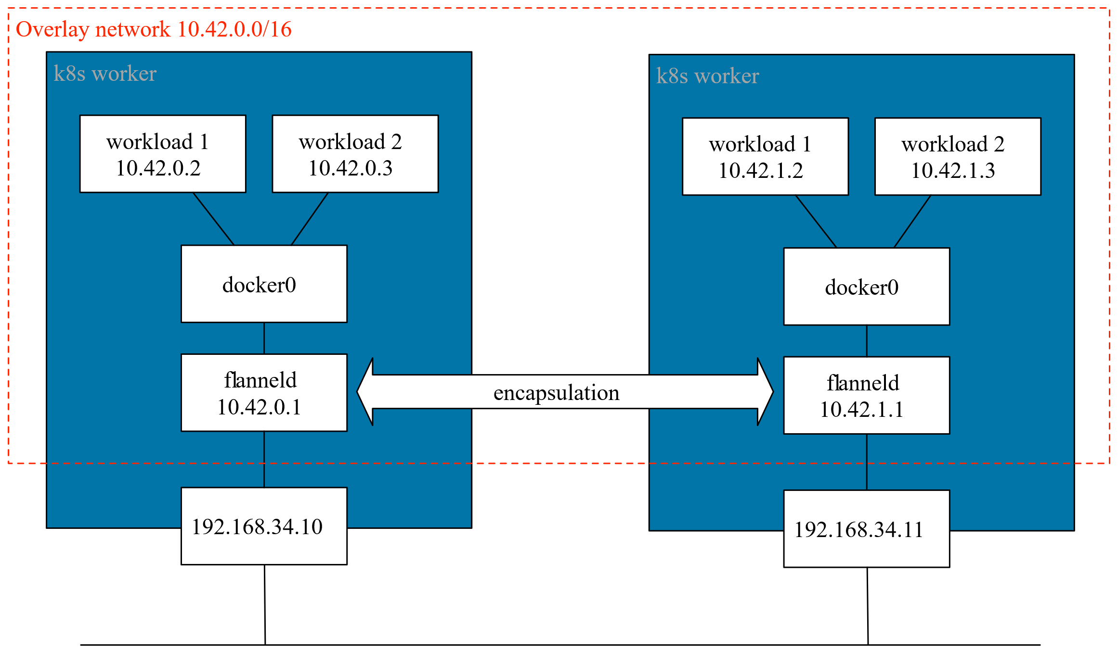
Issues

Slide 15
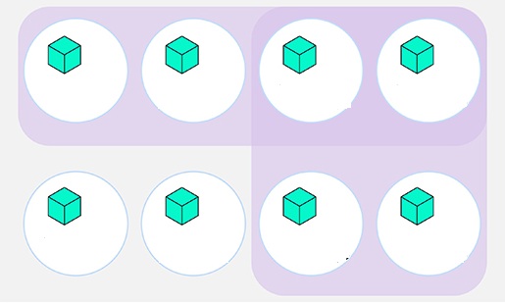
Namespaces abstraction
ns1
Cluster view
default ns
ns2
Notes:
What that allows: net isolation, parallel execution of tests, easy deployment / destroy

Slide 16



Git repository
.........
.........
Git Docker Registry
ft38
a4x9
commit
x8cc
developers
Build: rpm
Build: Docker _img
Test
Publish
Clean
GitLab Runner

Slide 17

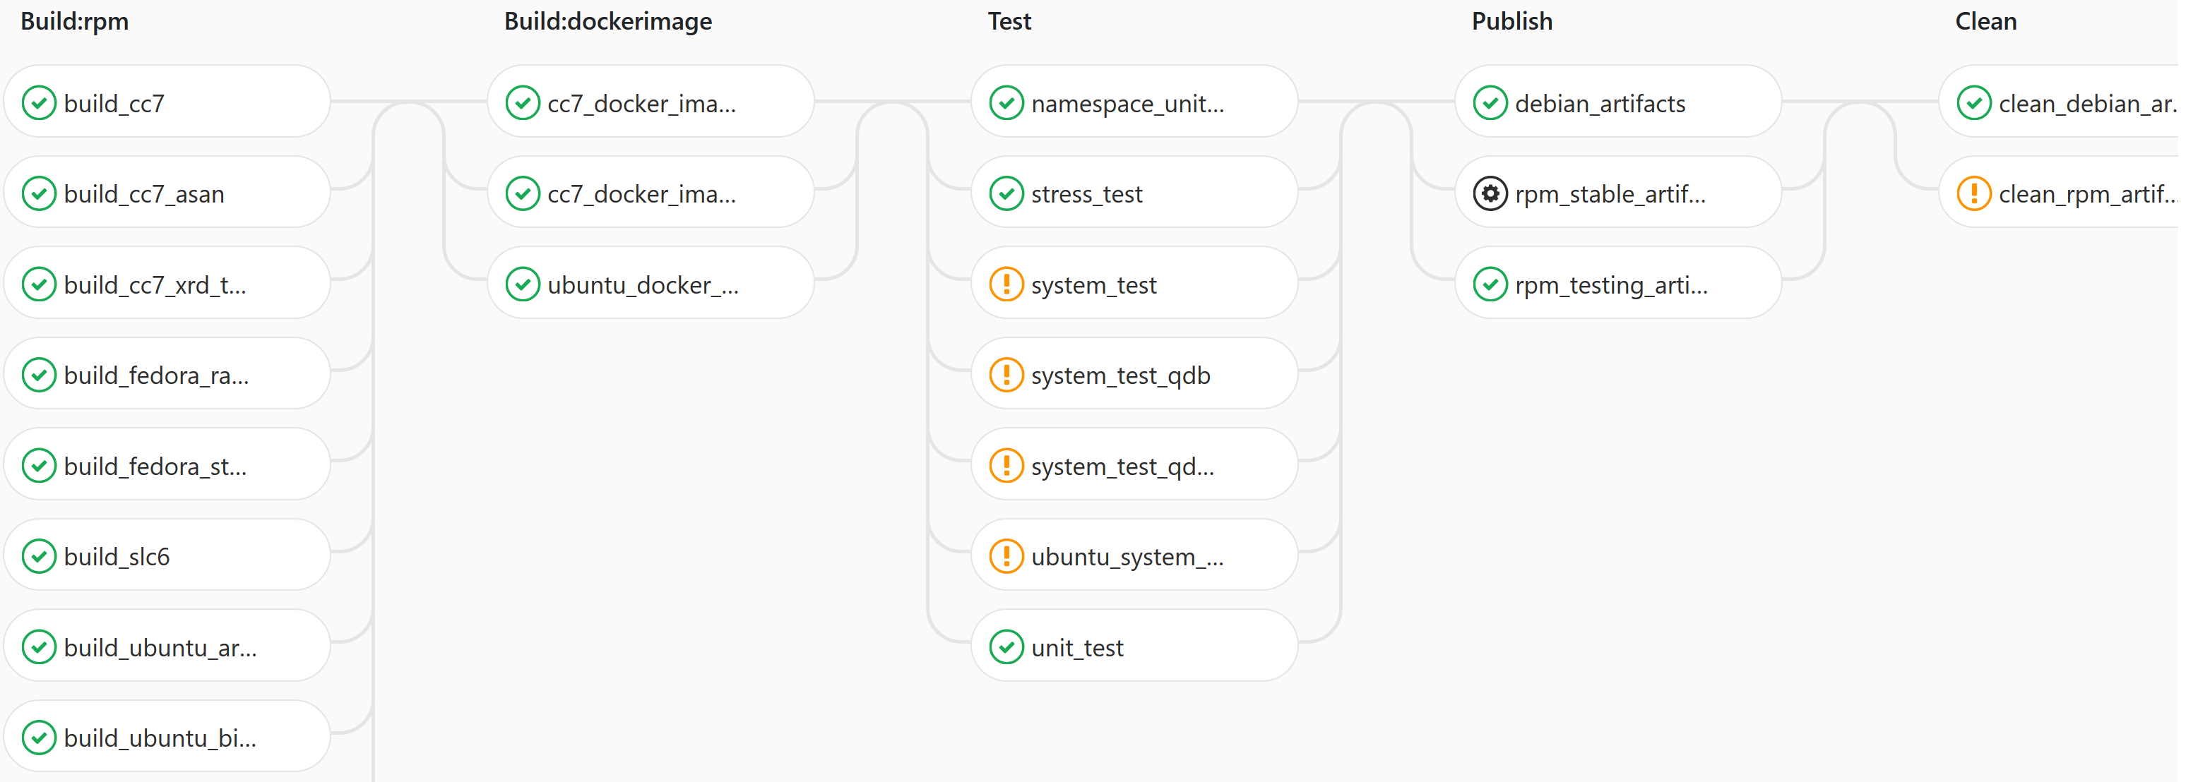
Git repository
.........
.........
Git Docker Registry
ft38
a4x9
commit
x8cc
developers
Build: rpm
Build: Docker _img
Test
Publish
Clean
GitLab Runner

Slide 18

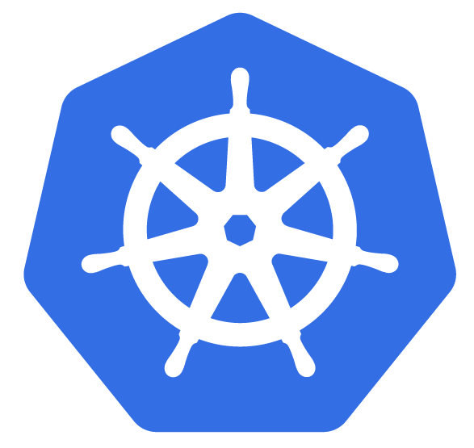
Git repository
.........
.........
Git Docker Registry
ft38
a4x9
commit
x8cc
developers
Build: rpm
Build: Docker _img
Publish
Clean
GitLab Runner
Test
Kubernetes Cluster
Notes:
Seemlessly scalable → virtually add infinite minions, check problems that happens only at large-scale
Without K8s, whole test suit takes around1 hour
Resource_after (t,s) <_ Resource_before (t,s)
“s” is cpu, ram, whatever…

Slide 19
mgm
mgm
my.namespace
mq
krb5
krb5
mgm
mgm
mq
krb5
krb5
cliX
cliX
mq
mq
cliX
cliX
my.namespace
Network
Network
my.namespace
my.namespace.3
Network
Network
mgm
mgm
qdb
qdb
mq
mgm
mq
qdb
fst3
fst3
cliY
cliY
qdb
mq
mq
fst3
fst3
cliY
fst2
fst2
cliY
fst1
fst1
fst2
fst2
fst1
fst1

Slide 20
Instantiating a test
Create a K8s Namespace
Create all K8s Services, Pods (1 or more per EOS role)
MGM, MQ, QDB, KRB5, FSTs, CLIENTs
Configure each Pod
“Patch” running containers to operate in the new network space
Run the test you like most

Slide 21
What it’s there so far
Proof of concept K8s deployment
Template for independent pod instances/svcs (mgm, mq, qdb, kdc, fsts, clients)
Scripts taking care of setup, config, and launch basic test of “health state”
Cluster can be ruled by CI Runner

Slide 22
What it’s left to be done
Proof of concept K8s deployment
Template of independent instances (mgm, mq, qdb, kdc, fsts, clients,)
Script that takes care of setup, config, and launch basic tests of “health state”
Existing tests must be plugged in
Cluster can be ruled by CI Runner, but
Runner must be properly CI-labeled to automatically launch such tests
Add/modify stages in existing pipeline
Credentials for K8s private cluster must be fetched from secure storage, now injected
More tests
(and counting … )

Slide 23
Thanks for your attention

Slide 25
BACKUP SLIDES

Slide 26
EOS Testing Service and Quality Assurance Development
Leveraging GitLab CI and Kubernetes
BACKUP SLIDES

