Slide 1

MACHINE LEARNING
School of Computing and Information Technology

Slide 2
TITLE OF THE PROJECT
WEIGHT CATEGORY PREDICTION
USING
RANDOM FOREST ALGORITHM
2

Slide 3
CONTENTS
Abstract
Introduction
Objectives
Problem Definition
System design
System Requirements
Implementation
Results
References
3

Slide 4
ABSTRACT
Weight Category (BMI) Prediction:
Random Forest + Tkinter.
Data load, preprocess, visualize.
Train model, show metrics.
User-friendly BMI input.
Visualize BMI categories.
Integrates data processing.
4

Slide 5
Introduction
Weight category(BMI) Prediction system:
Visualizes height, weight, BMI correlations.
Trains optimized model with GridSearchCV.
Predicts BMI via user-friendly GUI function.
Seamlessly integrates data processing, ML, and user interaction.
5

Slide 6
OBJECTIVE
Data Exploration: Visualize height, weight, BMI correlation.
Preprocessing: One-hot encode gender.
ML Model: Train Random Forest, optimize.
User-Friendly GUI: Tkinter for real-time BMI predictions.
Evaluation: Assess model with key metrics.
Visualization: Illustrate BMI category distributions.

Slide 7
Problem Definition:
Weight Category(BMI) Prediction System Utilizes Random Forest for accurate weight category predictions, incorporating data preprocessing, model training, optimization, and a user-friendly interface with visualizations.
7

Slide 8
System design
Scalability and Deployment:
Ensure scalability and consider deployment options
Data Handling: Load, explore, visualize with Pandas and Seaborn.
Preprocessing: Categorize BMI, one-hot encode gender, standardize.
Model Training: Split data, Random Forest, optimize with GridSearchCV.
Evaluation: Assess model using classification metrics.
Tkinter GUI: Develop user-friendly BMI prediction interface.
8

Slide 9
SYSTEM REQUIREMENTS
Hardware:
A modern multicore processor(e.g. Quad-core or higher) for faster computation.
At least 8GB of RAM, although more may be beneficial for larger datasets.
Software:
Python with popular libraries like scikit-learn,NumPy and Pandas for data manipulation and model implementation.
An integrated development environment(IDE) like Jupyter Notebook or VSCode for code development.
Random Forest Classifier:
Utilize scikit-learns implementation of the random forest classifier, which is well optimized and widely used.
Dataset:
Ensure your BMI dataset is preprocessed and cleaned, with features and labels approximately formatted for machine learning.
Storage:
Have sufficient disk space to store the dataset and any intermediate model files.

Slide 10
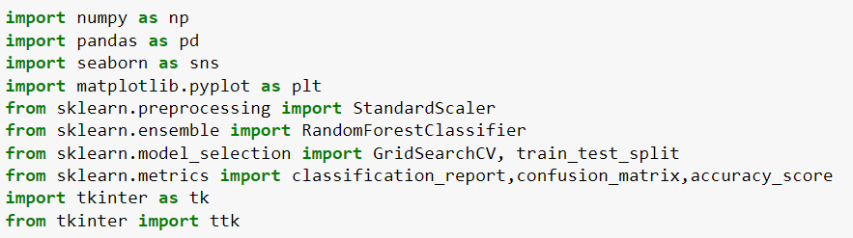
Package Installations:
Install the required packages using the following commands in your terminal or command prompt:
Compatibility:
The code should be compatible with Python 3.x versions.
10

Slide 11

IMPLEMENTATION
Data Handling: Loading the dataset.
Standardization: standardizing the data using preprocessing module in python

Slide 12
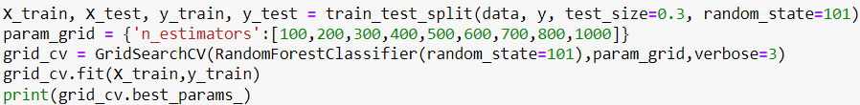
IMPLEMENTATION
Model Training: splitting the data and fitting Randomforest Classifier
Seaborn module for Implot Graph: sns method uses various attributes to give the best outcome in the form of graph.
12

Slide 13
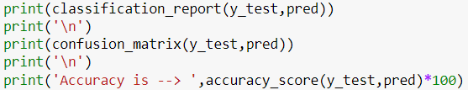
IMPLEMENTATION
Evaluation of the data: For confusion matrix and accuracy score.
13

Slide 14
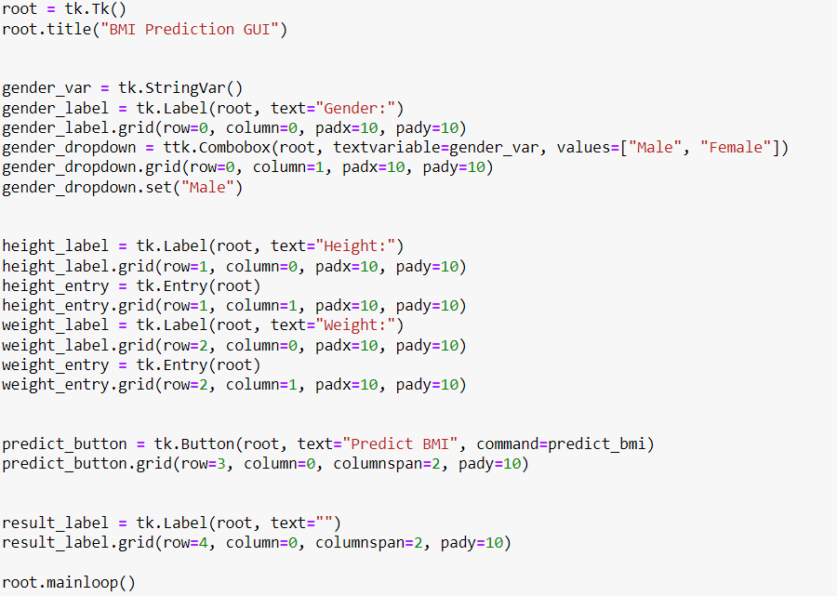
IMPLEMENTATION
GUI: using Tkinter module, created GUI for BMI
14

Slide 15
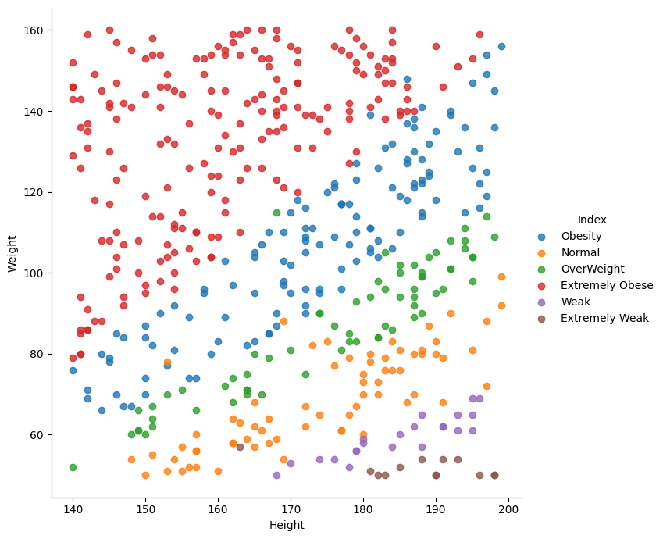
EXPECTED RESULTS
Implot Graph

Slide 16
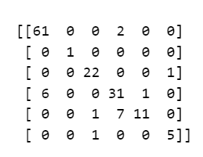

EXPECTED RESULTS
Confusion matrix:
Accuracy Score:
16

Slide 17
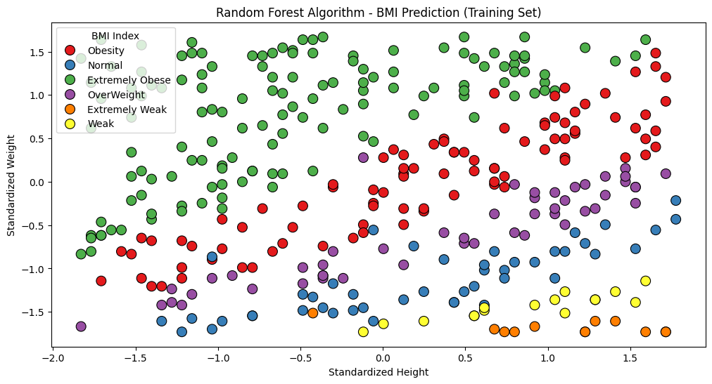
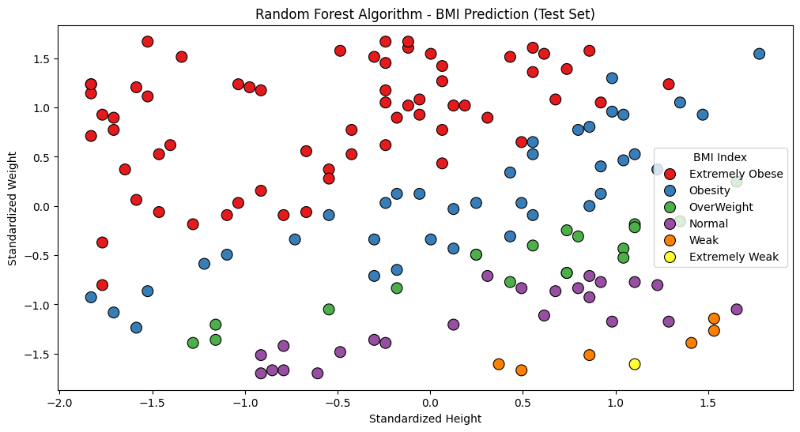
EXPECTED RESULTS
Training set
Test set
17

Slide 18
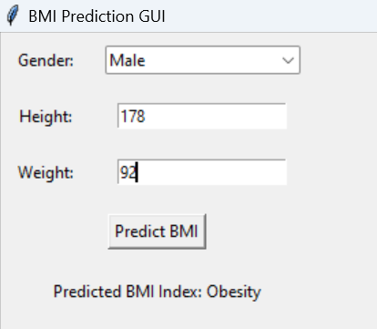
EXPECTED RESULTS
GUI MODEL
18

Slide 19
References
https://stackoverflow.com/
https://www.geeksforgeeks.org/
https://www.w3schools.com/
19

Slide 20
THANK YOU
R21EJ120
R21EJ125
R21EJ126
R21EJ127
R21EJ143

