Slide 1







HoReCa
VS
Retailer
Group 57
Classifier Using Logistic Regression
BHAVYA GUPTA -Execution Lead
NIRBHAV SINGH -Documentation Lead
HIMANSHU -Video Lead
BANOTH SUMANTH -Presentation Lead
GitHub: Project Repository
  HoReCa vs Retailer Classifier using Logistic Regression
Page 1

Slide 2





Problem and Data
Problem: Classify wholesale customers into HoReCa or Retail based on annual spending.
Dataset: UCI Wholesale Customers Dataset
  440 customer records
  6 input features
  Target: Channel (HoReCa / Retail)
  No missing values reported by UCI
Objective: Identify customer purchasing patterns using machine learning.
  Dataset size: 440 records (rows)
  Total columns: 8
  Input features: 6
  Additional columns: Channel (target) and Region
  Target classes: HoReCa (1) and Retail (2)
Features: Fresh, Milk, Grocery, Frozen, Detergents_Paper, Delicassen
Dataset Source
  HoReCa vs Retailer Classifier using Logistic Regression
Page 2

Slide 3
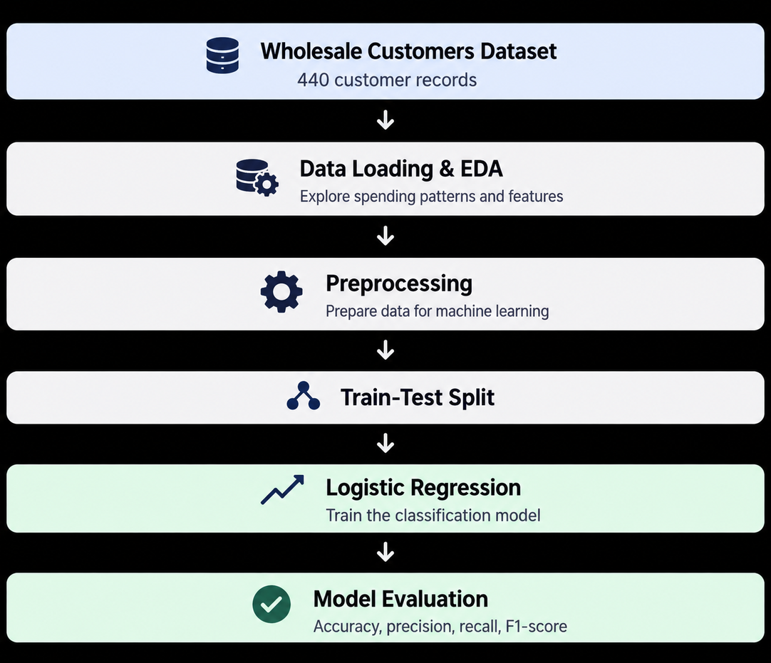


Pipeline:
Approach
Libraries:
  Python
  Pandas
  NumPy
  Scikit-learn
  Matplotlib
  Jupyter Notebook
Input: Six annual spending categories
Output: HoReCa or Retail
  HoReCa vs Retailer Classifier using Logistic Regression
Page 3

Slide 4
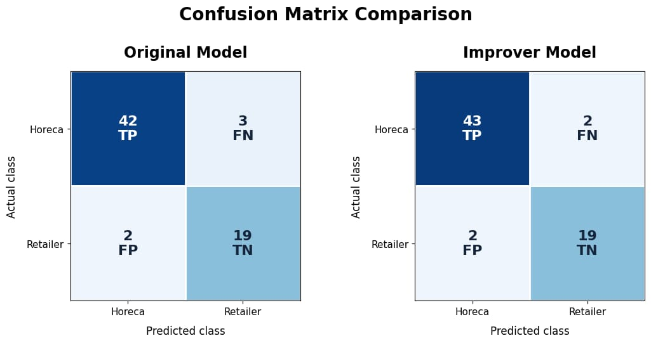

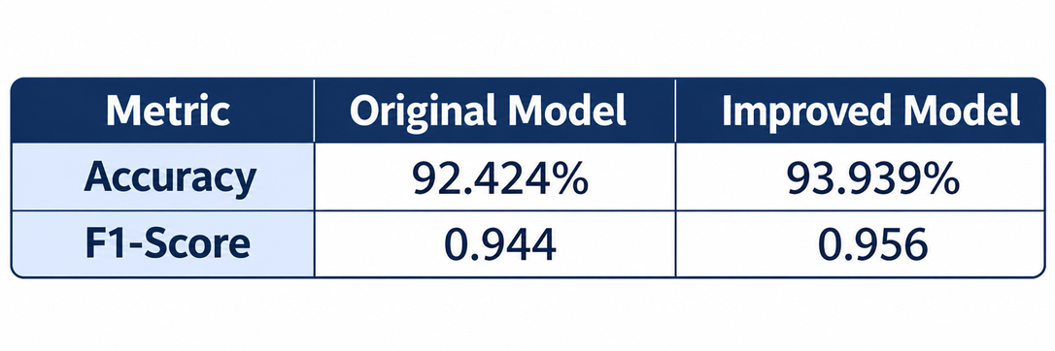
Results
Key Findings:
  Accuracy improved by 1.515 percentage points.
  Feature reduction improved model performance.
  Logistic Regression successfully classified customers.
Visuals:
  Accuracy comparison chart
  Confusion matrix screenshot
  Model prediction demo screenshot
  HoReCa vs Retailer Classifier using Logistic Regression
Page 4

Slide 5
Learnings
Contributions:
  Bhavya Gupta: Trained the second model and tested both the models
  Nirbhav Singh: Defined the dataset and project objectives
  Himanshu: Trained the base model
  Banoth Sumanth: Trained the second model and tested both the models
What Worked:
  Logistic Regression performed well.
  Feature selection improved accuracy.
  Clean data helped model development.
AI-Use Disclosure:
A.I assisted with some elements but the team verified results and wrote the submitted code independently.
Challenges:
  Highly correlated features.
  Small test sets may hide overfitting.
  HoReCa vs Retailer Classifier using Logistic Regression
Page 5

