Slide 1
BUG TRACKING SYSTEM
Group 3: BUG SMASHER
--Debarghya Mukherjee
Himanshi Lalwani
Mansi Sevgaonkar
Monali Barange
Nirbhaya Gandi
Prassanth Prasad
Ritika Srivastava
Sonali Choudhary

Slide 2
CONTENTS
INTRODUCTION
DESIGN
METHODOLOGY
DIAGRAMMATIC REPRESENTATION
IMPLEMENTATION

Slide 3

BUG TRACKING SYSTEM
REPORT
DETECT
ASSIGN

Slide 4
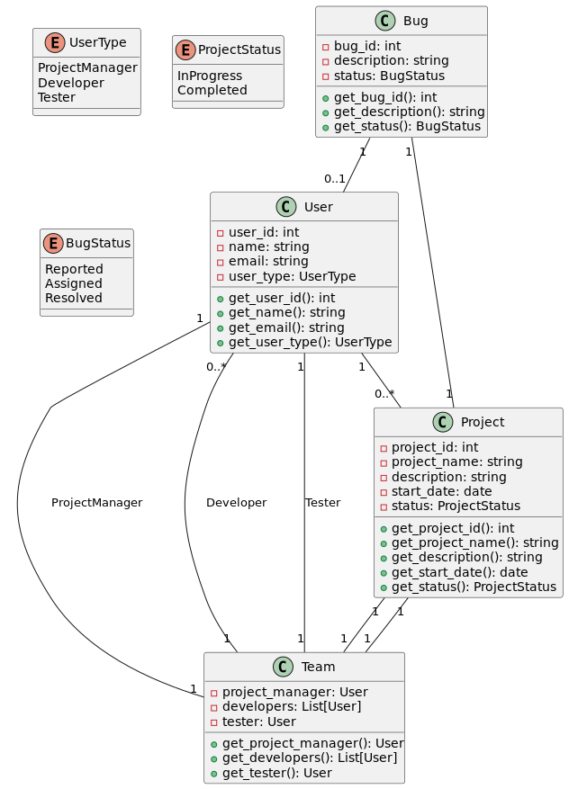
Class-Diagram

Slide 5
USERS
User Types
Project Manager
Developers
Testers
User Information
User ID
Name
Email
User Type

Slide 6
PROJECTS
Unique Project ID
Project Name
Description
Start Date
Status (In-progress or Completed)
Team Member

Slide 7
BUGS
Bugs, also known as software defects or issues, are problems or anomalies in a software application that cause it to behave unexpectedly or not as intended. They represent deviations from the expected behavior of the software.
Bug Tracking Process
Reporting,
Assignment
Implication

Slide 8
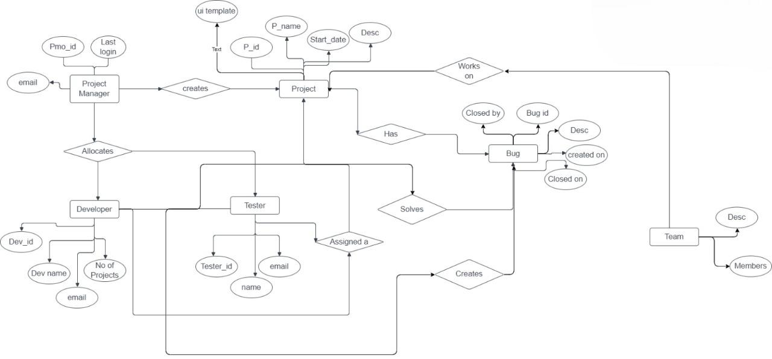
E-R DIAGRAM

Slide 9
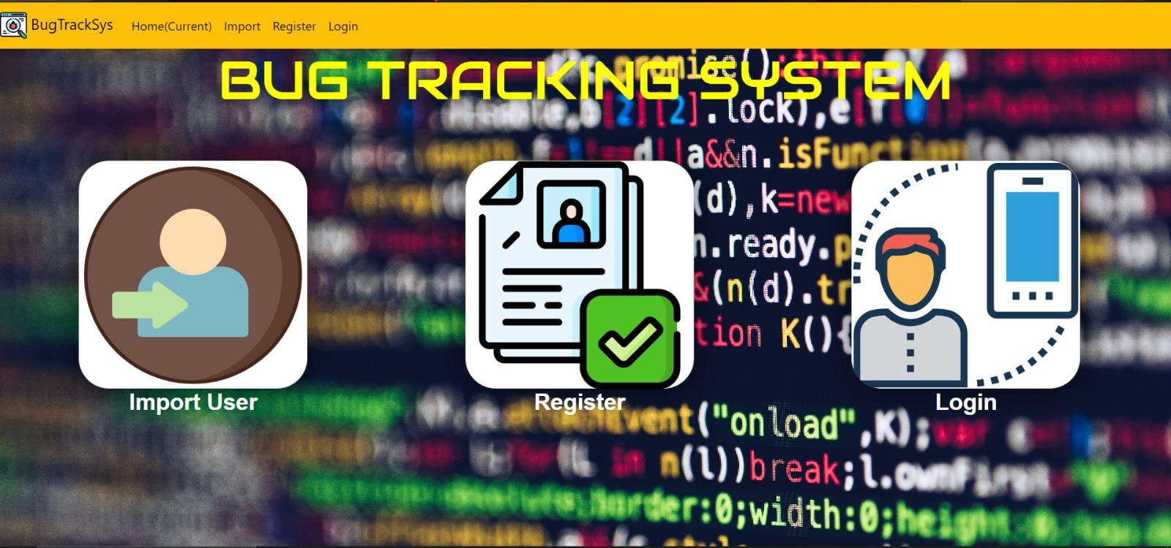
DASHBOARD

Slide 10
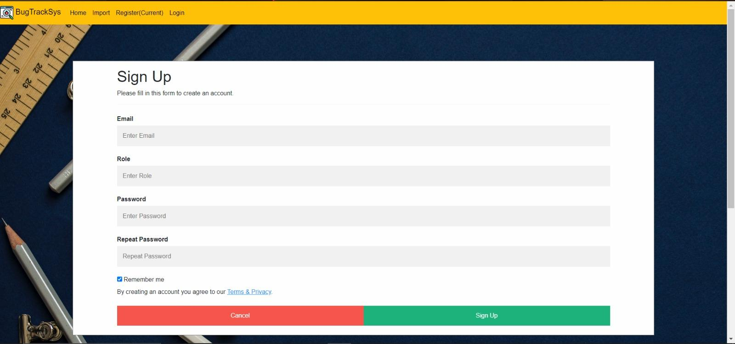
SIGN UP

Slide 11
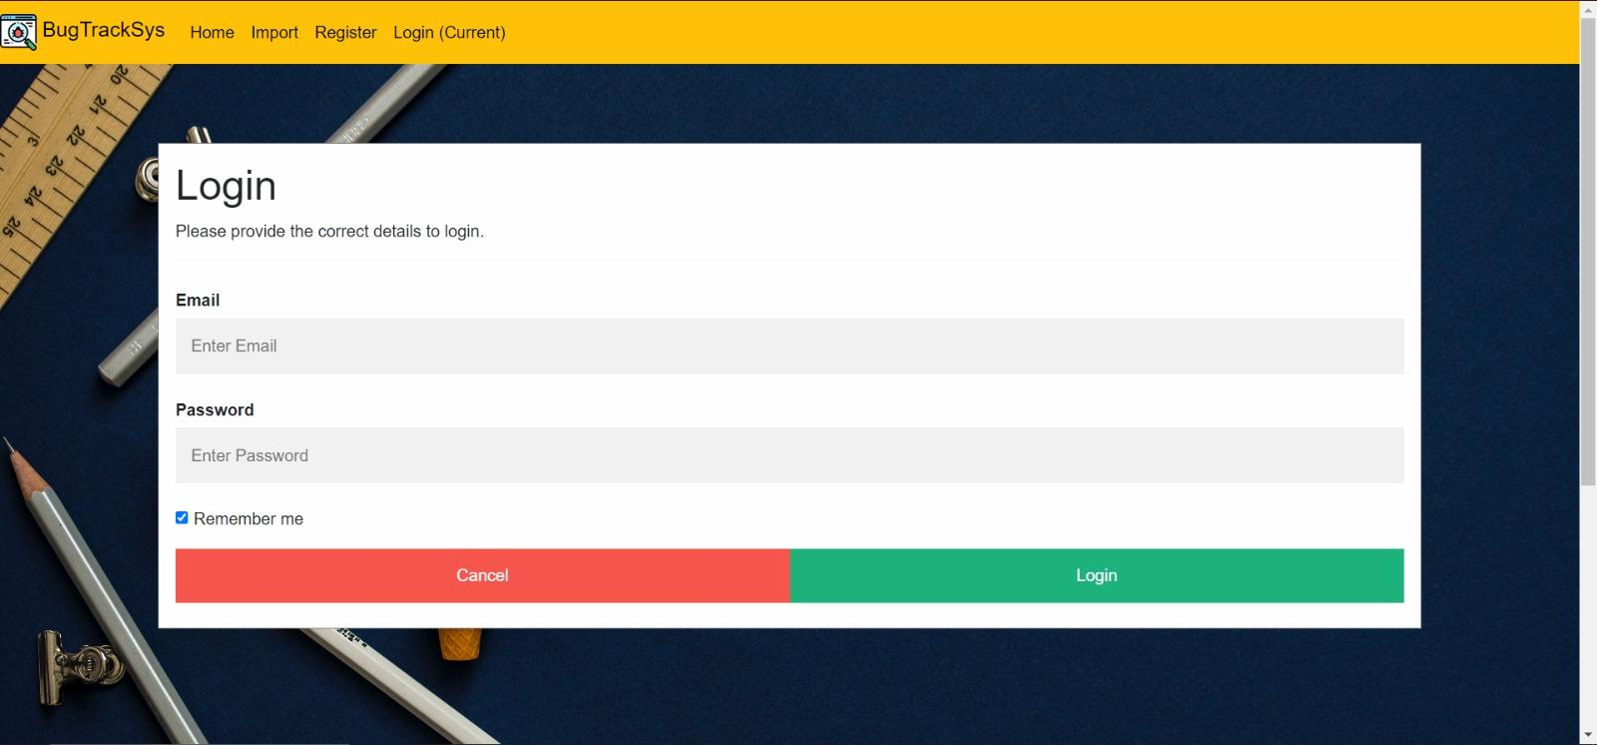
LOGIN PAGE

Slide 12
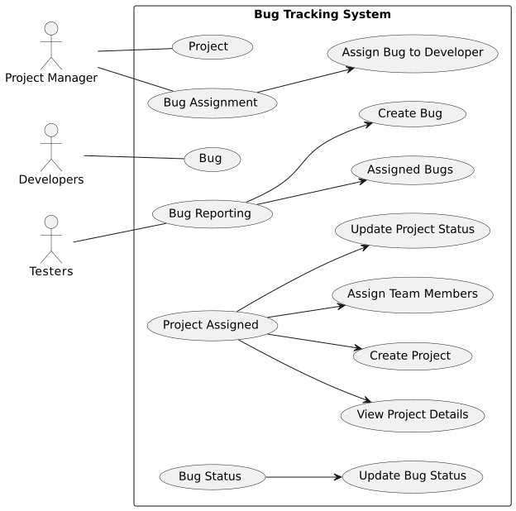

Slide 13
Thank You

