Slide 1
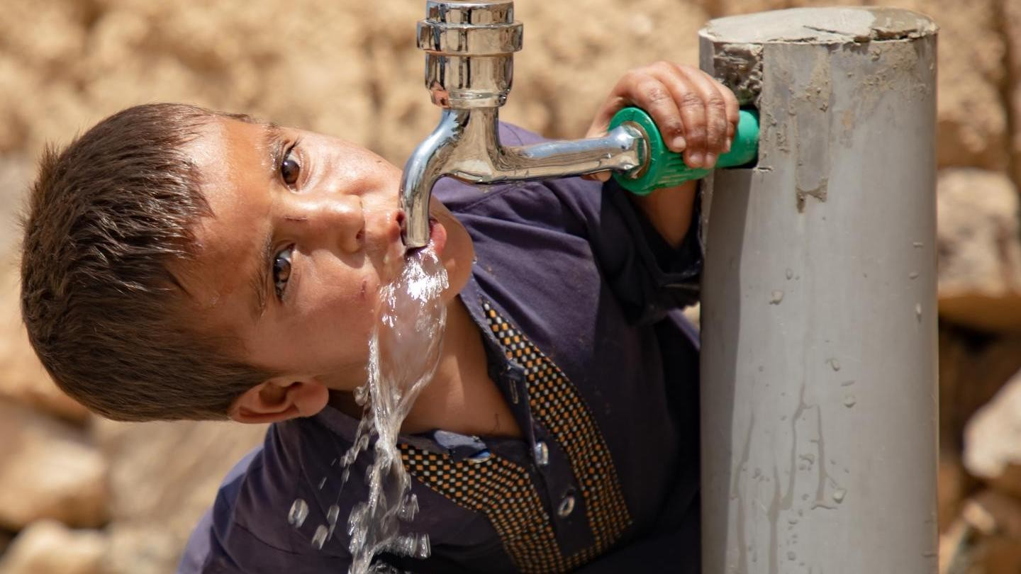

Outreach Program
Promoting Sanitation & Clean Water Awareness in Rural Communities

Slide 2


Contents
01
Program Overview
Abstract, Introduction, and Objectives of the outreach initiative
02
Activity Implementation
Planning, Execution, and Survey of outreach activities
03
Results & Reflections
Best Practices, Challenges, Outcomes, and Knowledge Gained
04
Documentation & Conclusion
Activity Documentation, Conclusion, Future Scope, and References

Slide 3
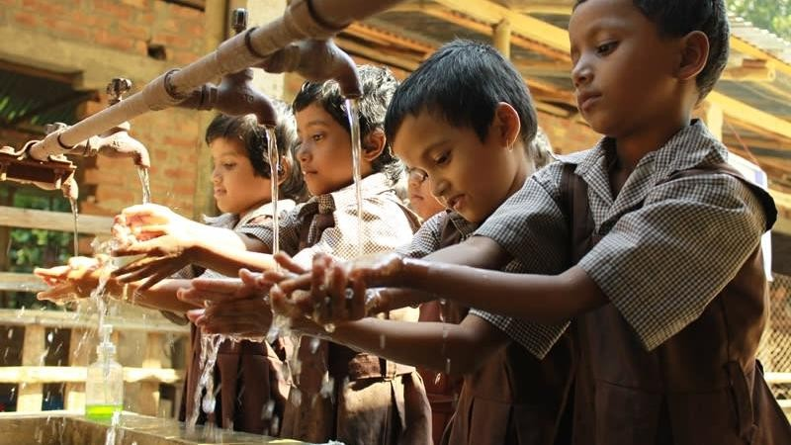

Program Overview
Understanding the purpose, goals, and scope of the outreach initiative

Slide 4
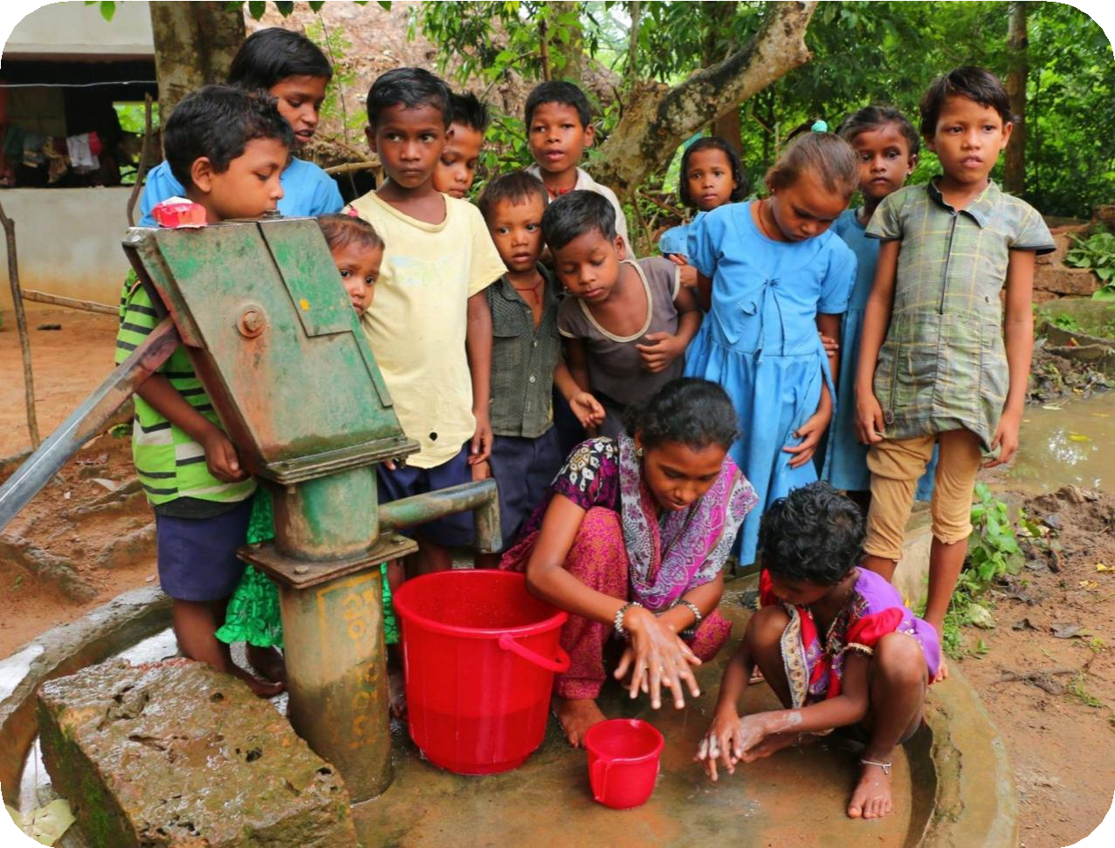
Program Overview
Activity Implementation
Results & Reflections
Documentation & Conclusion
Abstract & Introduction
Program Focus
The outreach program focused on Water, Sanitation, and Hygiene (WASH) education in underserved rural communities, aiming to raise awareness about the critical importance of clean water access, proper sanitation practices, and hygiene behaviors.
Approach
Interactive educational sessions were conducted using illustrated storyboards and participatory activities, targeting children and community members to foster behavioral change at the grassroots level.
Community Context
The program addressed community health challenges stemming from inadequate sanitation
infrastructure and limited awareness about the connection between hygiene practices and
disease prevention.
Community children participating in WASH education activities
WASH education is recognized globally as one of the most cost-effective public health interventions.
04

Slide 5
Program Overview
Activity Implementation
Results & Reflections
Documentation & Conclusion
Objectives of the Program
Raise Awareness
Health Risk Education
Educate community members on the importance of clean water, sanitation, and
hygiene practices for healthy living.
Inform communities about health risks associated with poor sanitation and
contaminated water sources.
Behavioral Change
Community Participation
Promote lasting behavioral change through interactive storytelling and visual
education materials.
Encourage active community participation in building and maintaining
sanitation facilities.
Empower Children
Document Activities
Empower children as change agents to influence household and community
hygiene practices.
Document outreach activities with geotagged photographs for accountability
and future planning.
05

Slide 6
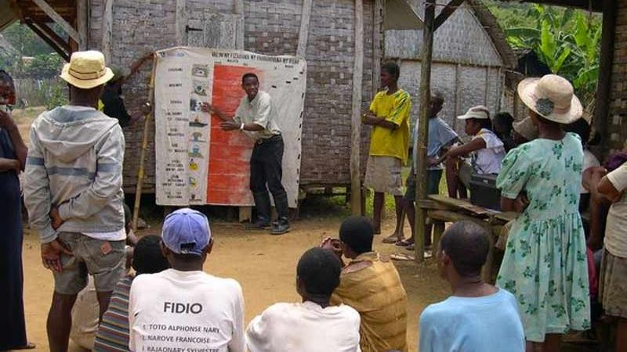
Activity Implementation
Planning, preparation, and execution of the outreach initiative

Slide 7

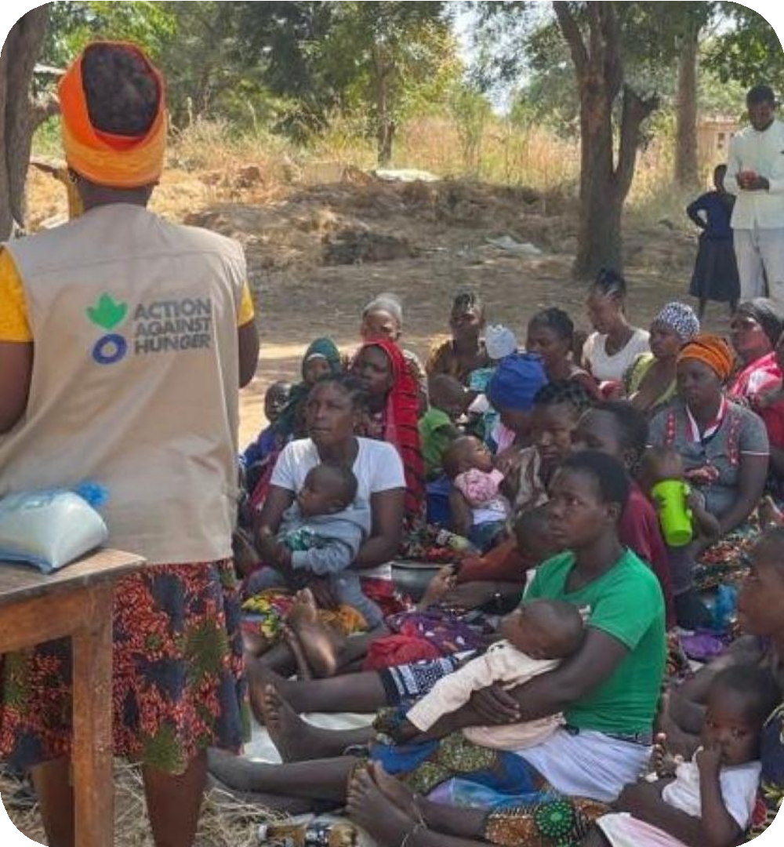
Program Overview
Activity Implementation
Results & Reflections
Documentation & Conclusion
Planning and Preparation Process
Community Needs Assessment
Identified sanitation and water-related challenges through community surveys and
local health data.
Educational Materials Development
Created illustrated storyboards: "Good Sanitation, Healthy Everyone!" and "Clean Water, Happy Life!"
Stakeholder Coordination
Coordinated with local schools, community leaders, and health workers for
program support.
Logistics Planning
Planned venue selection, session scheduling, and resource allocation for outreach activities.
Team Training
Trained team on facilitation techniques and culturally sensitive communication approaches.
07

Slide 8
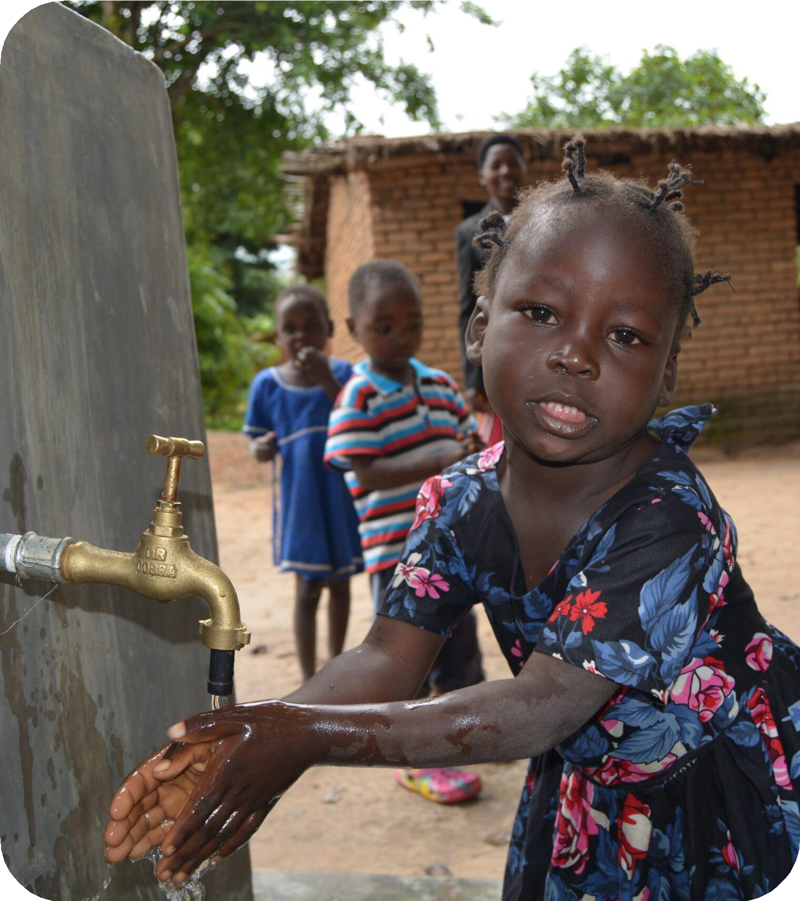
Program Overview
Activity Implementation
Results & Reflections
Documentation & Conclusion
Execution of the Outreach Activity
Interactive Storytelling
Illustrated storyboards engaged children and adults in understanding WASH concepts.
Step-by-Step Narratives
Guided participants: identify problems → understand impacts → take action → achieve
change.
Hands-On Demonstrations
Practical demos of handwashing and toilet usage for skill development.
Group Discussions & Q&A
Open discussions to address concerns and correct misconceptions.
Material Distribution
Educational materials distributed for continued learning at home.
Geotagged Documentation
Activities documented with geotagged photos for monitoring.
08

Slide 9
Program Overview
Activity Implementation
Results & Reflections
Documentation & Conclusion
Outreach Activity Survey
Survey Dimensions
Pre-Activity Survey
Assessed baseline knowledge of WASH practices among participants before the outreach sessions. Covered water source awareness, existing sanitation habits, handwashing practices, and disease prevention knowledge.
Dimension | Pre- Score | Post- Score
Water Source Awareness | 62% | 89%
Sanitation H abits | 55% | 86%
H andwashing Practices | 48% | 92%
D isease Prevention | 58% | 87%
Post-Activity Survey
Qualitative Feedback
Measured knowledge retention and attitude changes after the outreach
activities. Compared results with baseline data to quantify program effectiveness and identify areas for improvement.
Collected through participant interviews and focus group discussions to capture personal experiences, community perceptions, and suggestions for future programs.
09

Slide 10
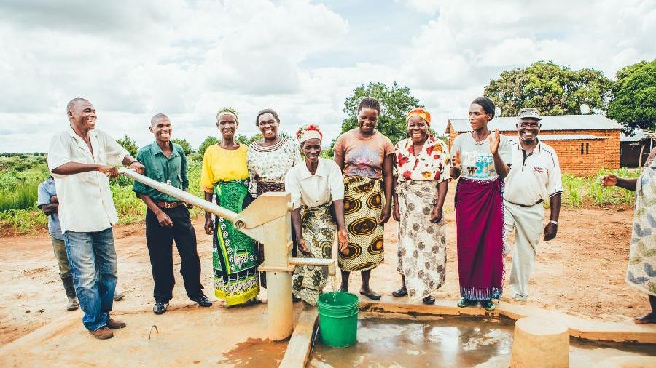
Results & Reflections
Outcomes, best practices, challenges, and key learnings from the program

Slide 11
Program Overview
Activity Implementation
Results & Reflections
Documentation & Conclusion
Best Practices
Visual Storytelling
Local Context Adaptation
Stakeholder Collaboration
Illustrated storyboards proved highly effective for engaging children and community members.
Using local language and culturally relevant scenarios increased message relatability.
Involving community leaders and teachers built trust and local ownership of the program.
Hands-On Demonstrations
Take-Home Materials
Geotagged Documentation
Practical demonstrations of handwashing and toilet use reinforced theoretical learning.
Follow-up materials enabled participants to share knowledge with family members.
Geotagged photos provided accountability and valuable data for program evaluation.
Key Insight: The combination of visual storytelling, hands-on practice, and community involvement created a multiplier effect — participants
became advocates, extending the program's reach beyond direct attendees.

Slide 12
Program Overview
Activity Implementation
Results & Reflections
Documentation & Conclusion
Challenges Faced
Limited Infrastructure
Language Barriers
Inadequate facilities in some communities made sanitation demonstrations and facility-based education difficult.
Language differences in some areas required additional local translators for effective communication.
Cultural Resistance
Sustaining Behavioral Change
Deep-rooted cultural beliefs and traditional practices initially resisted behavioral change messages.
Maintaining long-term behavioral change beyond the program period remains an ongoing challenge.
Weather & Logistics
Resource Constraints
Weather conditions and logistical constraints affected session scheduling and community attendance.
Limited resources restricted the scale and frequency of outreach sessions in target communities.

Slide 13
Program Overview
Activity Implementation
Results & Reflections
Documentation & Conclusion
Outcomes and Impact
Pre-Activity
Post-Activity
Significant improvement in WASH knowledge across all measured dimensions
100
92
90
89
86
87
80
70
62
60
55
58
Increased community awareness about the link between
sanitation, clean water, and health
50
48
40
30
20
Children demonstrated enthusiasm for adopting and promoting hygiene practices at home
10
0
Water Awareness
Sanitation Habits
Handwashing
Disease Prevention
Community members expressed willingness to participate in building sanitation facilities
Enhanced collaboration between schools, health workers, and community leaders
Foundation established for sustained community-led WASH improvement initiatives

Slide 14
Program Overview
Activity Implementation
Results & Reflections
Documentation & Conclusion
Knowledge & Understanding Gained
01
Interactive Approach
02
Participatory Learning
03
Peer Education
Storytelling and visual aids created lasting impressions compared to traditional lecture-based methods. Participants retained information better through narrative engagement.
Hands-on activities significantly increased engagement and practical skill development. Learning by doing proved more effective than passive instruction.
Children who learned became advocates, spreading awareness within families. Peer-to-peer teaching created a multiplier effect extending program reach.
04
Community-Centered Design
05
Multi-Stakeholder Collaboration
06
Documentation Value
Locally adapted content resonated more deeply than generic materials. Cultural relevance was key to message acceptance and behavioral intention.
Involving teachers, leaders, and health workers amplified program reach and credibility. Partnerships ensured sustained support beyond the outreach period.
Geotagged records provided evidence-based insights for future program iterations. Documentation enabled accountability and continuous improvement.

Slide 15
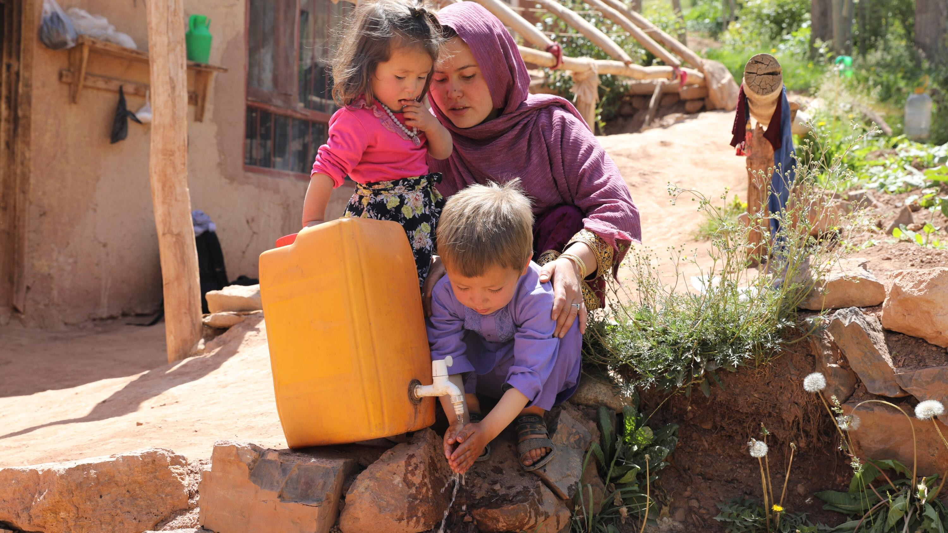
Documentation & Conclusion
Visual records, conclusions, and future directions

Slide 16
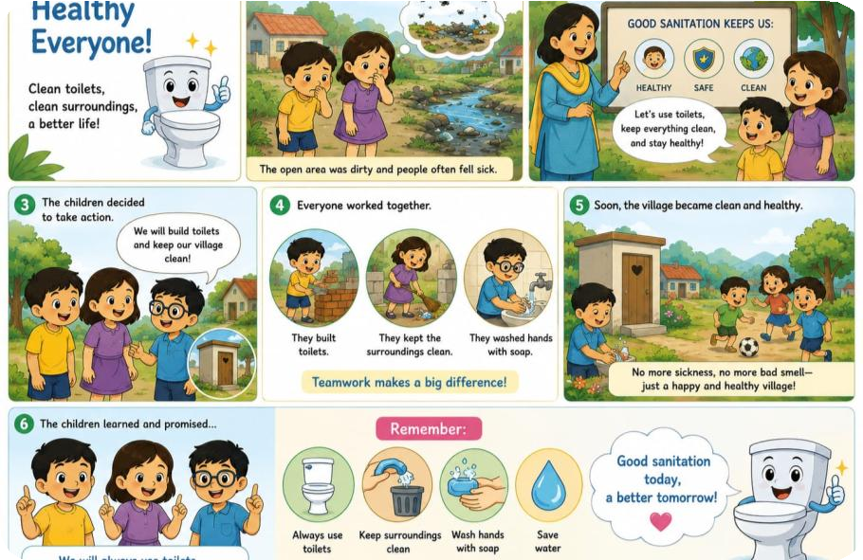
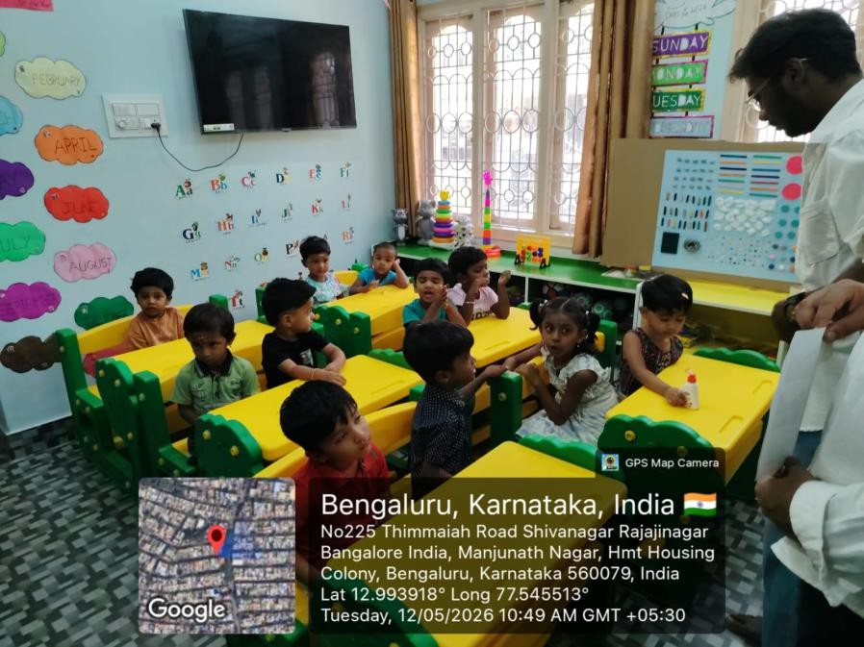
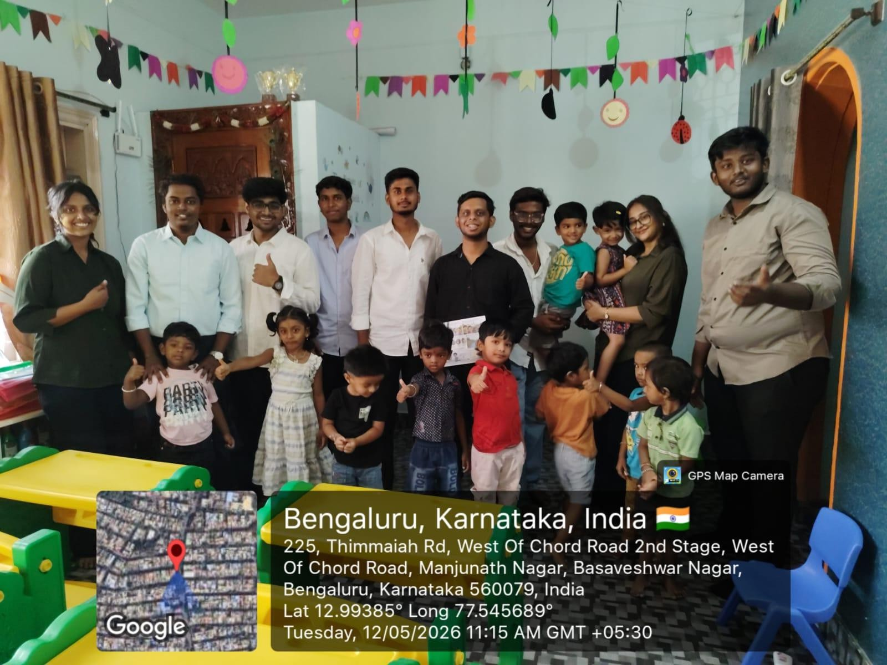
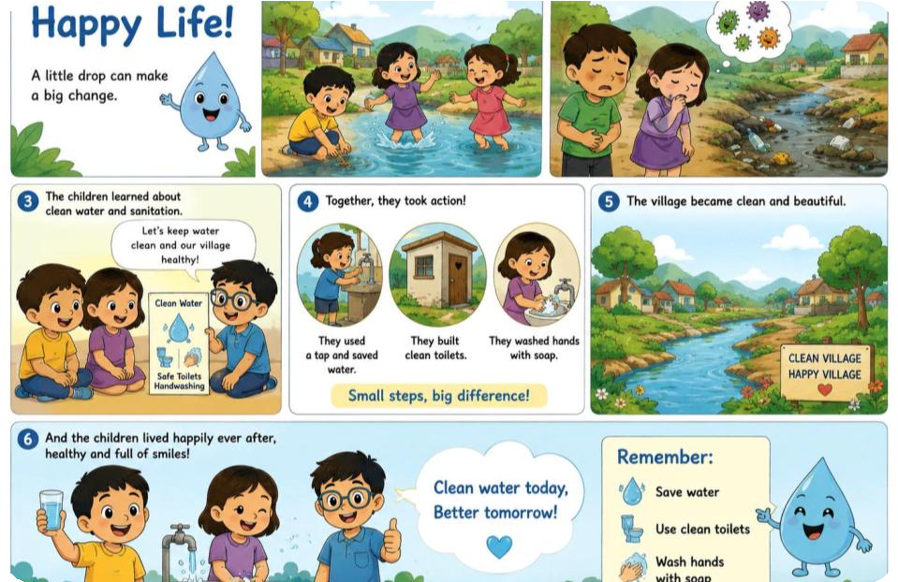
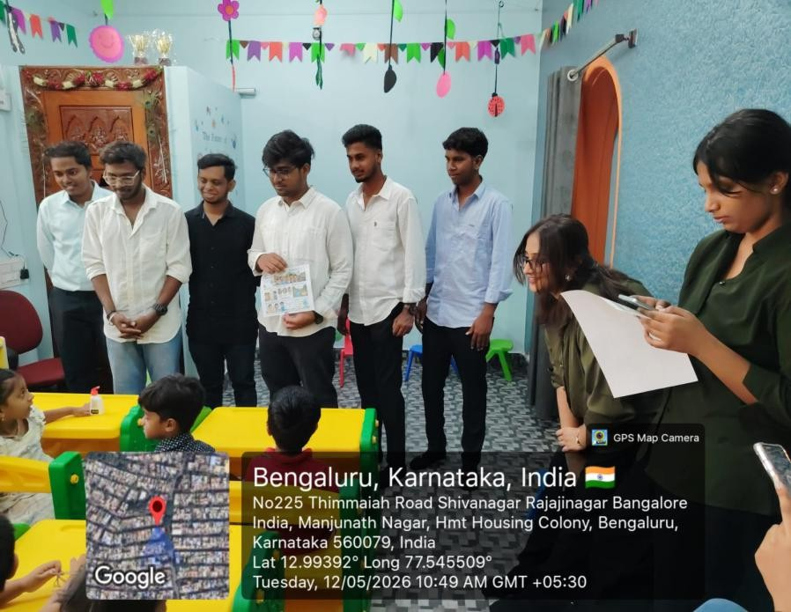
Program Overview
Activity Implementation
Results & Reflections
Documentation & Conclusion
Documentation of Activities
Good Sanitation, Healthy Everyone!
Clean Water, Happy Life!

Slide 17

Program Overview
Activity Implementation
Results & Reflections
Documentation & Conclusion
Conclusion and Future Scope
Future Scope
Conclusion
The WASH education outreach program successfully raised awareness and inspired behavioral intentions among community members. Visual storytelling and community participation emerged as key drivers of engagement.
Follow-up sessions to reinforce and sustain behavioral change over time
Scaling the model to additional communities with similar sanitation challenges
Integration with local government and NGO programs for infrastructure support
Development of digital versions of educational materials for wider reach
Establishment of community WASH committees for ongoing monitoring
88%
Average Knowledge Improvement
6
Communities Reached
2
Educational Storyboards Created
100+
Community Members Engaged

Slide 18
Program Overview
Activity Implementation
Results & Reflections
Documentation & Conclusion
References & Resources
[1]
UNICEF. (2024). Water, Sanitation and Hygiene (WASH) Program Guidelines. UNICEF WASH Section. https://www.unicef.org/water-sanitation-and-hygiene-wash
[2]
World Health Organization. (2023). Water, Sanitation and Hygiene Strategy 2023-2030. WHO Geneva. https://www.who.int/teams/environment-climate-change-and- health/water-sanitation-and-health
[3]
Ministry of Jal Shakti. (2024). Swachh Bharat Mission (Clean India Mission) — Phase II Guidelines. Government of India. https://swachhbharatmission.gov.in/
[4]
Local Health Department. (2025). Community Sanitation and Hygiene Protocols. District Health Office Publications.
[5]
International Institute for Rural Reconstruction. (2023). Community Education Best Practices Handbook. IIRR Publications.
Additional Resources
Program materials including survey instruments, storyboard templates, and facilitation guides are available for replication and adaptation in similar community outreach initiatives.

Slide 19
Thank You

