Slide 1
FIRE FIGHTING ROBOT
Guide
HORSLEY SOLOMON P
By
NIRESH KUMAR M (221709547) ARUN S (221709526) JOHN K (221709536) ANFAS P (221709563) DHUVARESH KRISHNA (221709531)

Slide 2
INTRODUCTION
Our task as Electrical Engineers was to design and build a prototype system that could automatically detect and extinguish a fire.
It is the Robot that can move through a model structure, find a lit candle and then extinguish it with help of a blowing technique.
The fire detection to be put into use is relatively free of false alarms, it is anticipated that it will not overreact in non fire stimulations.
This mission is divided into smaller tasks, and each task is implemented in the most efficient manner.
Such as self autonomous start of the robot, navigation of the robot in every room step by step finds the fire in a specific room.
Approaches the fire at a very fixed distance, extinguishes it and finally returning to the front of the house.

Slide 3
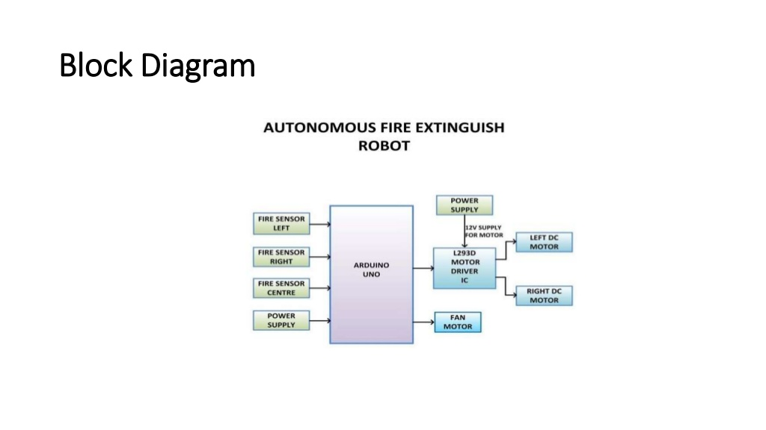
BLOCK DIAGRAM

Slide 4
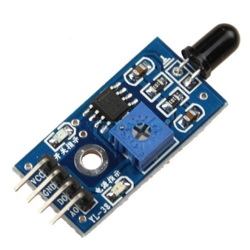
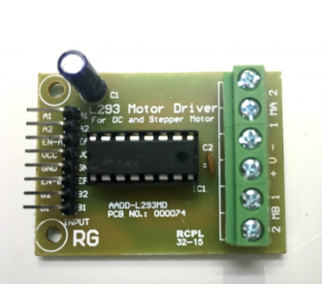
FIRE SENSOR
A flame detector is a sensor designed to detect and respond to the presence of a flame or fire allowing flame detection.
Responses to a detected flame depend on the installation and activating a fire suppression system.
L293D MOTOR DRIVER:
L293D is a dual H-bridge motor driver integrated circuit (IC).
Motor drivers act as current amplifiers since they take a low-current control signal and provide a higher-current signal. This higher current signal is used to drive the motors

Slide 5
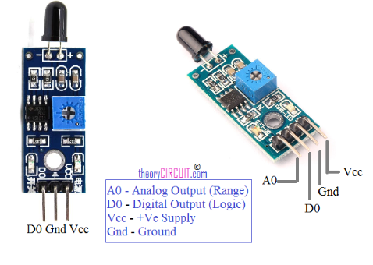

Slide 6
WATER PUMP MOTOR
Motor is a DC device that moves fluids.
DC motor converts direct current electrical power into mechanical power.
DC or direct current motor works on the principal, when a current carrying conductor is placed in a magnetic field, it experiences a torque and has a tendency to move, We are using 12V DC and the noise will be reduced.
ARDUINO UNO:
The Arduino Uno is a microcontroller board based on the ATmega328.
The arduino language is merely a C C++ function that can be called from our code.
It has 14 digital input/output pins (of which 6 can be used as PWM outputs), 6 analog inputs, a 16 MHz ceramic resonator, a USB connection, a power jack, an ICSP header, and a reset button.

Slide 7
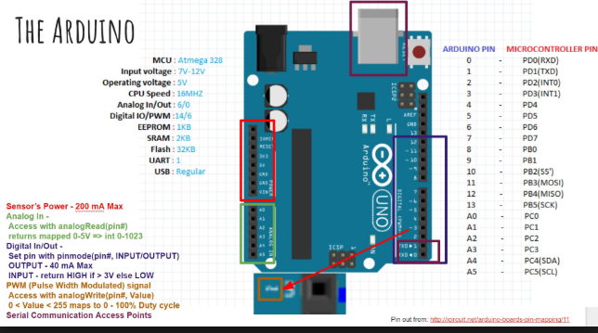

Slide 8
POWER:
VIN The input voltage to the Arduino board when it's using an external power source (as opposed to 5 volts from the regulated power source).
You can supply voltage through this pin or via power jack, access it through this pin.
5V. This pin outputs a regulated 5V from the regulator on the board.
The board can be supplied with power either from the DC power jack (7 - 12V), the USB connector (5V), or the VIN pin of the board (7-12V).
Supplying voltage via the 5V or 3.3V pins bypasses the regulator, and can damage your board.

Slide 9
WORKING OF THE PROJECT
The main brain of this project is Arduino.
When fire burns it emits small amount of infra red light,this light will be received by the IR receiver on the sensor module.
So we place three such sensors in three directions of the robot to sense on which direction the fire is burning.
We detect the direction of the fire we can use the motors to move near the fire by driving our motors through the L293D.
Using a small container we can carry water, a 5V pump is also placed in the container so that the water has to be sprayed.

Slide 10
THANK YOU

Slide 11
ADVANTAGES:
Not sensitive to Light
Wit can pass through solids to longer range
Capability of sensing accurately with increased flexibility
Not sensitive to wheather conditions.
Reduce human effort.
FUTURE SCOPE:
Remote control of robot
Camera and video transmissions can be added.
It can be enhanced by interfacing it with a wireless camera.
The practical application where robotic technology used Civil defence, Surveillance and rescue.
It will be both interesting and challenging to put all this together into a autonomous fire fighting service

