Slide 1
MySQL PROJECT
-Nirin kumar P

Slide 2

CONTENTS
SQL
SQL Servers
DBMS & RDBMS system
Databases
Data Types
Tables
Constraints
Alter and Update
General Functions
Calculate Functions

Slide 3
String Funtions
Date Functions
Logical Functions
RDBMS System
Join Queries
Case Statements
Procedures
Variables in Procedure
Triggers

Slide 4

SQL
SQL stands for Structured Query Language is a programming
Language for storing, manipulating and retrieving data in databases.
SQL was invented in the 1970s based on the relational data model.
It Was initially known as the Structured English Query Language
(SEQUEL)
SQL can do,
Execute queries against a database
Retrive data from a database
Create new databases and tables
Insert, Update and Delete records
Create stored procedures
Set permissions on tables, procedures and views

Slide 5
MySQL
MySQL is a Relational DataBase Management System (RDBMS).
MySQL is ideal for both small and large application.
MySQL is very fast, reliable, scalable and easy to use.
MySQL Users
Huge websites like Facebook, Twitter, Airbnb, Booking.com,
Uber, GitHub, YouTube, etc.
A very large number of web developers around the world.

Slide 6






Servers
Various servers available across the web. The most famous such
as Microsoft SQL, MySQL, PostgreSQL, Oracle, MongoDB,
no SQL, SQLite etc.
Servers

Slide 7
DBMS & RDBMS System
DBMS - DataBase Management System, is used to manage a
database. It uses the file system to store data. DBMS are
often used in small organisations to deal with a small
amount of data handled by a single user.
RDBMS- Relational DataBase Management System, is a type of DBMS
that is based on the relational model of data.
RDBMS are primarily designed to handle large amount of
related data that can be handled by multiple users.

Slide 8
Difference between DBMS & RDBMS
DBMS | RDBMS
Data is stored as file There is no relationship between data in DBMS DBMS deals with small quantity of data DBMS supports single user at a time E.g: File system, XML | Data is stored as tables Data is present in multiple tables which can be related to each other RDBMS deals with large quantity of data RDBMS supports multiple users at a time E.g: Oracle, SQL server

Slide 9
Databases
Database are used to store data such as tables, values,
Procedures, etc. We can manipulate the data from database.
To create database
QUERY: Create database Employment_process;
To Use database
QUERY: Use Employment_process;
To View database
QUERY: Show databases;
To Drop database
QUERY: Drop database Employment_process;

Slide 10
Data Types
Each column in a database table is required to have a name
and a data type. In MySQL there are three main data types: string,
numeric and date and time.
String - It can contain letters, numbers and special characters.
Types- Char, Varchar, Binary, Text, etc.
Numeric - It contains only Numeric values.
Types- Bit, Int, Bigint, Float, Double, etc.
Date and Time - It contains date, time and combination of date and time.
Types- Date, Datetime, Time, Timestamp, etc.

Slide 11
Tables
Tables are used to store data in the database. We can insert,
Update and delete the data from the table.
To create Table
QUERY: Create table Employee_details(Employee_ID int, Employee_Name
varchar(100), Designation_ID int, Dept_No int, Date_Of_Join date,
primary key(Employee_ID));
To view Table
QUERY: Show tables;
To drop Table
QUERY: Drop table Employee_details;

Slide 12
To Insert Values
QUERY:
insert into Employee_details values
(17001, 'Geetha', 3001, 50, '2022-05-10'),
(17002, 'Guru', 3002, 50, '2022-05-12'),
(17003, 'Gokul', 3003, 50, '2022-05-15'),
(17004, 'Mani', 3004, 60, '2022-05-20'),
(17005, 'Moorthy', 3005, 50, '2022-05-23'),
(17006, 'Amutha', 3006, 50, '2022-06-05'),
(17007, 'Jaga', 3003, 70, '2022-06-06'),
(17008, 'Pavithra', 3007, 60, '2022-06-07'),
(17009, 'Arthi', 3005, 50, '2022-06-08'),
(17010, 'Kabilan', 3006, 70, '2022-06-09'),
(17011, 'Manasi', 3001, 70, '2022-06-10'),
(17012, 'Suja', 3002, 50, '2022-06-11'),

Slide 13
(17013, 'Arun', 3003, 60, '2022-06-12'),
(17014, 'Deepa', 3004, 60, '2022-06-13'),
(17015, 'Sindhu', 3005, 80, '2022-06-14'),
(17016, 'Madhavi', 3002, 50, '2022-06-15'),
(17017, 'Swetha', 3002, 70, '2022-06-16'),
(17018, 'Selvi', 3002, 70, '2022-06-17'),
(17019, 'Pooja', 3002, 70, '2022-06-18'),
(17020, 'Lakshmi', 3002, 70, '2022-06-19'),
(17021, 'Veeramani', 3002, 80, '2022-06-20'),
(17022, 'Pandian', 3002, 80, '2022-06-21'),
(17023, 'Veera', 3002, 80, '2022-06-22'),
(17024, 'Devi', 3005, 70, '2022-06-23'),
(17025, 'Devan', 3006, 60, '2022-06-24'),
(17026, 'Keerthi', 3001, 60, '2022-06-25'),
(17027, 'Venkatesh', 3003, 80, '2022-06-26');

Slide 14
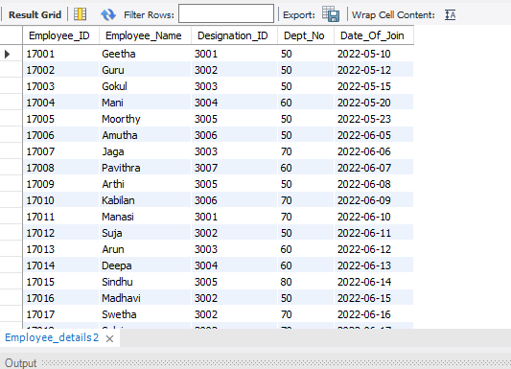

Slide 15
Constraints
SQL constraints are used to specify rules for data in a table.
There different types of constraints such as,
Not Null
Auto Increment
Default
Primary Key
Foreign Key

Slide 16
Not Null
It ensures that a column cannot have a NULL value.
Query
Create table Employee_details(Employee_ID int Not Null,
Employee_Name varchar(40), Designation_ID int, Dept_No int,
Date_Of_Join date, primary key(Employee_ID));

Slide 17
Auto Increment
It will do increment in the values automatically such as SI.No.
Query
Create table Employee_details(SI.No int auto_increment,
Employee_ID int, Employee_Name varchar(40),
Designation_ID int, Dept_No int, Date_Of_Join date,
primary key(Employee_ID));

Slide 18
DEFAULT
It Sets a default value for a column if no value is specified
Query
Create table Employee_details(SI.No int, Employee_ID int, Employee_Name varchar(40), Designation_ID int, Dept_No int, Date_Of_Join date, Branch varchar(30) Default ‘Chennai’,
primary key(Employee_ID));

Slide 19
Primary Key
A combination of a Not Null and Unique. Uniquely identifies each row in a table
Query
Create table Employee_details(SI.No int, Employee_ID int, Employee_Name varchar(40), Designation_ID int, Dept_No int, Date_Of_Join date, Branch varchar(30) Default ‘Chennai’,
primary key(Employee_ID));

Slide 20
Foreign Key
A Foreign Key is a field in one table, that refers to the
Primary Key in another table.
Query
Create table Employee_details(SI.No int, Employee_ID int, Employee_Name varchar(40), Designation_ID int, Dept_No int, Date_Of_Join date, Branch varchar(30) Default ‘Chennai’,
primary key(Employee_ID), Foreign Key(Dept_no) references
Dept_details(Dept_no));

Slide 21
Alter and Update
ALTER
The Alter Table statement is used to add, delete or
Modify columns in an existing table
Single Add
Multiple Add
Rename
Modify
Drop Column
Add Primary Key
Drop Primary Key

Slide 22
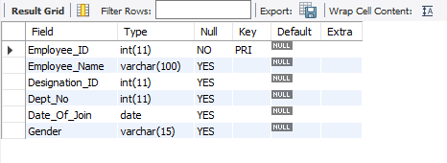
Single Add
We can add a column in the created table by using alter.
Query
Alter table employee_details add Gender varchar(15);

Slide 23
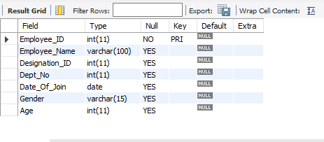
Multiple Add
We can add multiple column in the created table by using alter at the same time.
Query
Alter table employee_details add Gender varchar(15),
add Age int;

Slide 24
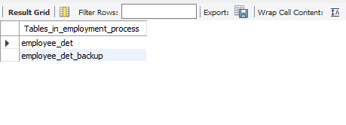
Rename
We can Rename to the table using Alter.
Query
Alter table employee_details Rename to employee_det;

Slide 25
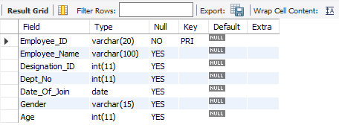
Modify
We can Modify the created table by using alter.
Query
Alter table employee_details Modify Employee_ID varchar(20);

Slide 26
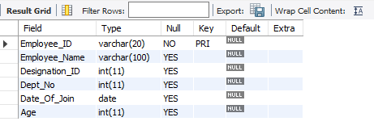
Drop Column
We can Drop a column from the created table by using alter.
Query
Alter table employee_details Drop Gender;

Slide 27
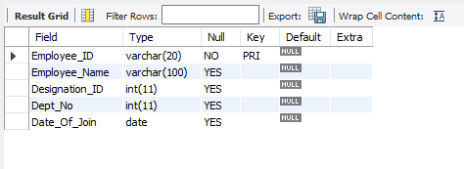
Add Primary Key
We can Add Primary Key in the created table by using alter.
Query
Alter table employee_details Add Primary key(Employee_ID);

Slide 28
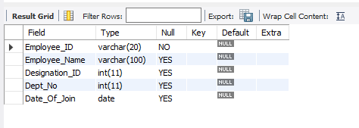
Drop Primary Key
We can Drop Primary Key from the created table by using alter.
Query
Alter table employee_details Drop primary key;

Slide 29
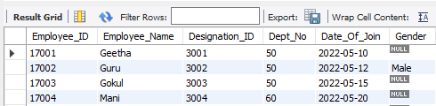
UPDATE
We can Update the table data by using Update keyword
Query
Update employee_details set gender='Male' where employee_id=17002;

Slide 30
General Functions
Where
OR
AND
IN
NOT IN
“>” (Greater than)
“<“ (Lesser than)
“>=“ (Greater than or equal to)
“<=“ (Lesser than or equal to)
“<>” (Not equal to)
“!” (Not)
COUNT
DISTINCT
COUNT WITH DISTINCT
ORDER BY ASC
ORDER BY DESC
GROUP BY
LIMIT
DESC LIMIT
LIKE (_%)
NOT LIKE
BETWEEN

Slide 31
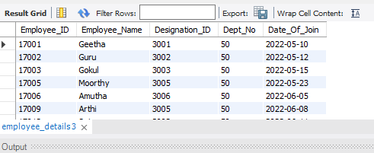
WHERE
The Where clause is used to filter records. It is used
To extract only those records that fulfill a specified condition.
Query
Select * from employee_details where Dept_no=50;

Slide 32
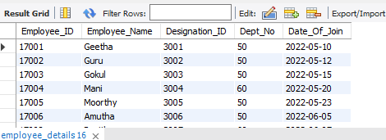
OR
The OR operator are used to filter records based on more than
One condition and it displays a record if any of the conditions is TRUE.
Query
select * from employee_details where dept_no=50 or dept_no=60;

Slide 33
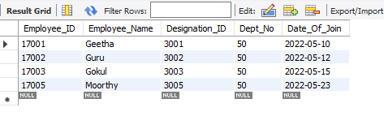
AND
The OR operator are used to filter records based on more than
One condition and it displays a record if all the conditions are TRUE.
Query
select * from employee_details where dept_no=50 and
date_of_join<'2022-06-01';

Slide 34
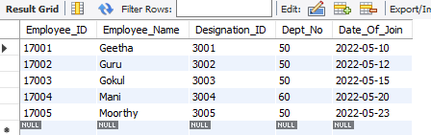
WHERE, AND and OR
Combination of Where, AND and OR at the same time.
Query
Select * from employee_details where
(dept_no=50 or dept_no=60) and Employee_id<=17005;

Slide 35
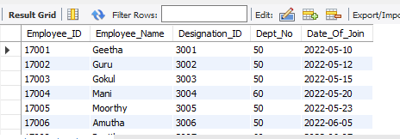
IN
The IN operator allows to specify multiple values in a WHERE
Clause. It is a shorthand for multiple OR conditions.
Query
Select * from employee_details where dept_no in (50, 60);

Slide 36
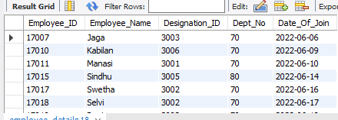
NOT IN
The NOT IN provides the output as Contradiction of IN.
Query
Select * from employee_details where dept_no not in (50, 60);

Slide 37
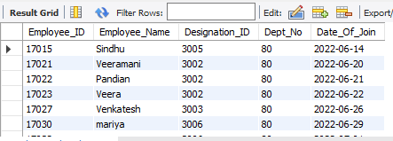
“>” - Greater than
The “>” Greater than operator displays the output which
Satisfies strictly greater than the specified condition
Query
Select * from employee_details where dept_no>70;

Slide 38
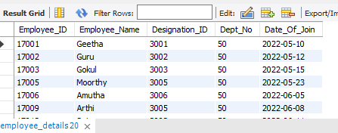
“<” - Lesser than
The “<” Lesser than operator displays the output which
Satisfies strictly lesser than the specified condition
Query
Select * from employee_details where dept_no<60;

Slide 39
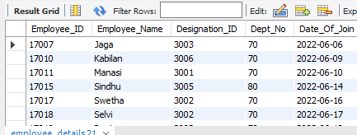
“>=” - Greater than or equal to
The “>=” Greater than or equal operator displays the output
which Satisfies greater than or equal to the specified condition
Query
Select * from employee_details where dept_no>=70;

Slide 40
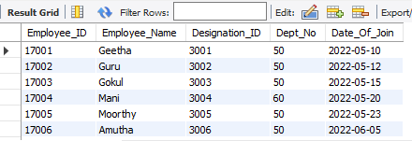
“<=” - Lesser than or equal to
The “<=” Lesser than or equal operator displays the output
which Satisfies lesser than or equal to the specified condition
Query
Select * from employee_details where dept_no<=60;

Slide 41
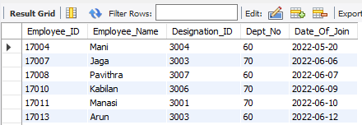
“<>” and “!”
“<>”- It represents Not equal to the Specified condition.
“!” – It represents Not equal to when combine with “=”
Query
Select * from employee_details where dept_no <>50;
Select * from employee_details where dept_no !=50;

Slide 42
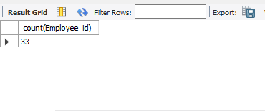
COUNT
The COUNT function returns the number of rows that matches
a specified criterion.
Query
Select count(Employee_id) from employee_details;

Slide 43
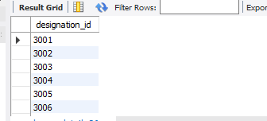
DISTINCT
The DISTINCT function returns the unique rows that satisfies
the specified condition.
Query
Select distinct designation_id from employee_details;

Slide 44
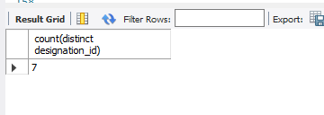
Count with Distinct
The combination of DISTINCT and COUNT function returns the number of unique rows that satisfies the specified condition.
Query
Select count(distinct designation_id) from employee_details;

Slide 45
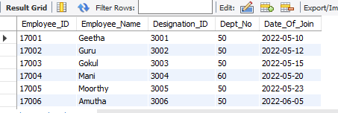
Order by Asc
The ORDER BY ASC display the output in the ascending order
of satisfying the specified condition.
Query
Select * from Employee_details order by employee_id asc;

Slide 46
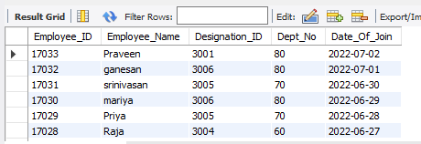
Order by Desc
The ORDER BY DESC display the output in the descending order
of satisfying the specified condition.
Query
Select * from Employee_details order by employee_id desc;

Slide 47
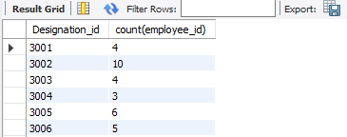
GROUP BY
The GROUP BY statement groups rows that have the same
values into summary rows
Query
select Designation_id, count(employee_id) from employee_details
Group by designation_id;

Slide 48
LIKE
The LIKE operator is used in where clause to search for a
Specified pattern in a column.
There are two wildcards often used in conjunction with the
LIKE operator:
“%” - The percentage sign represents zero, one or multiple
characters
“_” - The underscore sign represents one, single character
The percent sign and the underscore can also be used in
combination.

Slide 49
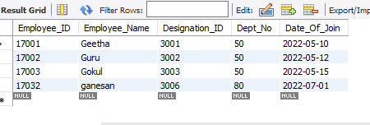
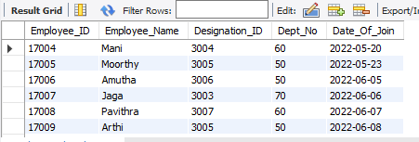
Query
Select * from employee_details where employee_name like 'G%';
NOT LIKE
Select * from employee_details where employee_name not like 'G%';
Query

Slide 50
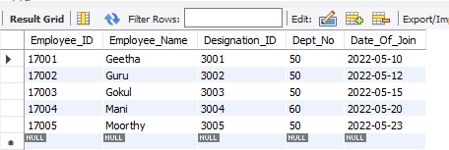
BETWEEN
The BETWEEN operator selects values within a given range.
The values can be numbers, text, or dates. It includes the begin and
end values.
Query
Select * from employee_details where date_of_join
between '2022-05-01' and '2022-05-31';

Slide 51
Calculate Functions
The Calculate Functions are Mathematical operations such as:
SUM
AVERAGE
COUNT
MIN
MAX

Slide 52
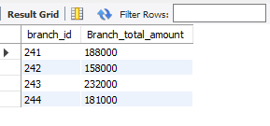
SUM
The SUM function returns the total sum of numeric values
under specified condition.
Query
Select Branch_id, sum(amount) as Branch_total_amount from
salary_details group by Branch_id;

Slide 53
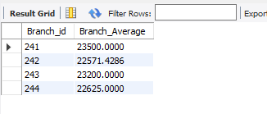
AVERAGE
The AVERAGE function returns the average of numeric values under specified condition
Query
Select Branch_id, avg(amount) as Branch_Average from
salary_details group by Branch_id;

Slide 54
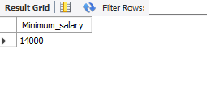
MIN
The MIN function returns the Minimum of numeric values under
the specified condition.
Query
Select min(amount) as Minimum_salary from salary_details;

Slide 55
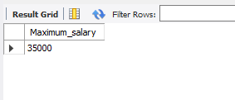
MAX
The MAX function returns the Maximum of numeric values under
the specified condition.
Query
Select max(amount) as Maximum_salary from salary_details;

Slide 56
STRING Functions
The STRING functions are used to perform various actions
deals with Strings. Let us see some of string functions that are
used most:
Lcase
Ucase
Left
Right
Concat
Trim
Mid
Char_length
Length

Slide 57
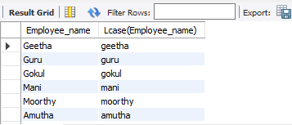
LCASE
The LCASE function is used to make all the characters
into Lowercase
Query
Select Employee_name, Lcase(Employee_name)
from Employee_details;

Slide 58
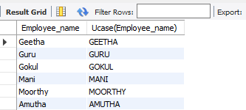
UCASE
The UCASE function is used to make all the characters
into Uppercase
Query
Select Employee_name, Ucase(Employee_name)
from Employee_details;

Slide 59
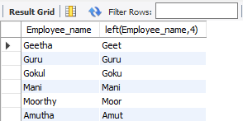
LEFT
The LEFT function is used to get the selected length of string
From the left
Query
Select Employee_name, left(Employee_name,4)
from Employee_details;

Slide 60
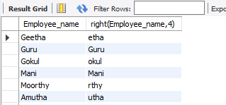
RIGHT
The RIGHT function is used to get the selected length of string
From the right
Query
Select Employee_name, right(Employee_name,4)
from Employee_details;

Slide 61
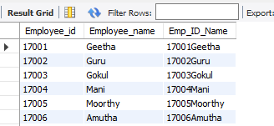
CONCAT
The CONCAT function is used to concatenate more than one
column into single column.
Query
select Employee_id, Employee_name,
concat(Employee_id, employee_name) as Emp_ID_Name
from Employee_details;

Slide 62
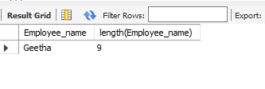
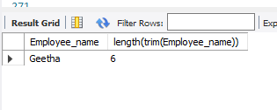
TRIM
The TRIM function is used to remove the Extra spaces.
Select Employee_name, length(trim(Employee_name))
from Employee_details where Employee_id=17001;
Query
Before Trim
After Trim

Slide 63
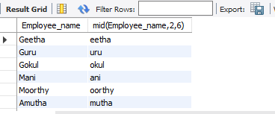
MID
The MID function is used to get a piece of string by mentioning
the begining and ending.
Query
Select Employee_name, mid(Employee_name,2,6)
from Employee_details;

Slide 64
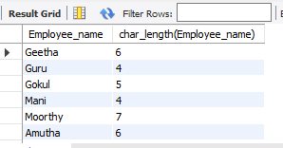
Length an Char_Length
Both LENGTH and CHAR_LENGTH function is used to find
the length of a String.
Select Employee_name, length(Employee_name)
from employee_details;
Query
Select Employee_name, char_length(Employee_name)
from Employee_details;

Slide 65
Date Function
Day
Month
Year
Now
Date Add
Datediff
Timestamp Diff
Date Format

Slide 66
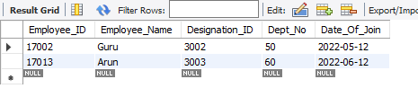
Day
The DAY keyword is used to filter only on date
Query
Select * from Employee_details where Day(Date_of_join)=12;

Slide 67
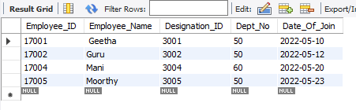
Month
The MONTH keyword is used to filter only on Month.
Query
Select * from Employee_details where Month(Date_of_join)=05;

Slide 68
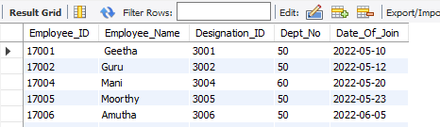
Year
The YEAR keyword is used to filter only on Year.
Query
Select * from Employee_details where Year(Date_of_join)=2022;

Slide 69
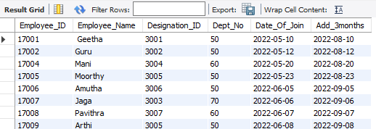
Date Add
The DATE_ADD keyword is used to add the specified days,
Months or years.
Select *, date_add(Date_of_join, interval 3 month) as
Add_3months from Employee_details;
Query

Slide 70
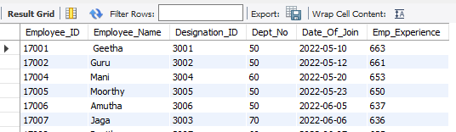
Datediff
The DATEDIFF keyword is used to find the difference of
two dates.
Query
Select *, datediff(Curdate(),Date_of_join) as
Emp_Experience from Employee_details;

Slide 71
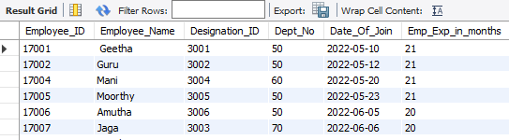
Timestampdiff
The TIMESTAMPDIFF keyword is used to find the difference
of two dates in the reuied terms such as days, months or years.
Select *, timestampdiff(month,Date_of_join,Curdate())
as Emp_Exp_in_months from Employee_details;
Query

Slide 72
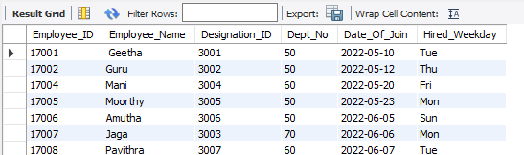
Date Format
The DATE_FORMAT keyword is used to convert the date to the
required format such as weekdays('%a'), months('%a'), etc.
Select *, date_format(Date_of_join, '%a') as
Hired_Weekday from Employee_details;
Query

Slide 73
Logical Funtions
IF statement
IF with AND
IF with OR
Nested IF
IF Statement
The IF keyword returns a value if a condition is TRUE, or
another value if the condition is FALSE.

Slide 74
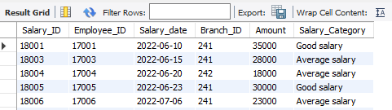
Query
Select *, if(amount>=30000, 'Good salary', 'Average salary')
as Salary_Category from Salary_details;

Slide 75

IF with AND
Query
Select *, if((month(salary_date)<07) and amount>=30000,
'Experienced with Good salary', 'Fresher with Average salary')
as EMP_Description from salary_details;

Slide 76

IF with OR
Query
Select *, if((amount<25000) or (amount=25000), 'Average salary',
'Good salary') as Salary_Category from Salary_details;

Slide 77

Nestef IF
Query
Select *, if(amount>=30000, 'High salary', if(amount>=25000,
'Good salary', if(amount>=20000, 'Average salary', 'Low salary')))
as Salary_category from Salary_details;

Slide 78
RDBMS
A Relational database defines database relationships in the
form of tables. The tables are related to each other – based on data
common to each
We can connect two or more tables using Foreign Key which
is the common field to each other. Foreign Key of one table is the Primary Key of another table.

Slide 79
Query for Connecting tables
Table 1
Create table Employee_details(Employee_ID int, Employee_Name
varchar(100), Designation_ID int, Dept_No int, Date_Of_Join date,
primary key(Employee_ID));
Table 2
Create table Salary_details(Salary_ID int, Employee_ID int,
Salary_date date, Branch_ID int, Amount int, primary key(Salary_ID),
foreign key(Employee_ID) References Employee_details(Employee_ID));

Slide 80
Join Queries
The JOIN clause is used to combine rows from two or more
Tables, based on a related column between them.
Types of JOIN
INNER Join
LEFT Join
RIGHT Join
FULL OUTER Join(UNION)
CROSS Join

Slide 81

INNER JOIN
The INNER JOIN keyword selects records that have matching
values in both tables.

Slide 82

Query
Select * from Employee_details inner join Salary_details on
Employee_details.Employee_id = Salary_details.Employee_id;

Slide 83

LEFT JOIN
The LEFT JOIN keyword returns all record from the left table
(table 1) and the matching records (if any) from the right table.

Slide 84

Query
Select * from Employee_details Left join Salary_details on
Employee_details.Employee_id = Salary_details.Employee_id;

Slide 85

RIGHT JOIN
The RIGHT JOIN keyword returns all the records from the right
table (table2) and the matching records (if any) from the left table (table1)

Slide 86

Query
Select * from Employee_details right join Salary_details on
Employee_details.Employee_id = Salary_Details.Employee_id;

Slide 87

FULL OUTER JOIN (UNION)
The UNION operator is used to combine the result set of two
Or more SELECT statements.
Every SELECT statement within UNION must have the same
number of columns
The columns must also have similar data types
The columns in every SELECT statement must also be in the
same order

Slide 88

Query
Select * from Employee_details Left join Salary_details on
Employee_details.Employee_id = Salary_Details.Employee_id
Union
Select * from Employee_details Right join Salary_details on Employee_details.Employee_id = Salary_details.Employee_id;

Slide 89

CROSS JOIN
The CROSS JOIN keyword returns all the records from both
The tables (table1 and table2).

Slide 90

Query
Select * from Employee_details Cross join Salary_details;

Slide 91
Case Statement
The CASE statement goes through conditions and returns a value
When the first condition met(like an If-then-else statement).
Once a Condition is true, it will stop reading and return the result.
If no conditions are true, it returns the value in ELSE clause.
If there is no ELSE part and no condition are true, it returns NULL.

Slide 92

Query
Select *, Case
when Designation_id=3001 then 'Manager'
when Designation_id=3003 then 'Senior Manager'
when Designation_id=3004 then 'HR'
when Designation_id=3005 then 'General Manager'
when Designation_id=3006 then 'Team Lead'
when Designation_id=3007 then 'Senior HR'
Else 'Junior Associate'
End as Job_Role
from Employee_details;

Slide 93
Procedures
A stored Procedure is a prepared SQL code that we can save,
So the code can be reused over and over again
So if we have an SQL query that we write over and over again,
Save it as a stored Procedure and then just call it to execute it
We can store more than one output in a single stored Procedure
and executed all the output simultaneously by calling the
stored Procedure.

Slide 94
To Create Procedures
Query
delimiter //
create procedure Stored_data()
Begin
Select * from Employee_details where Dept_no=80;
Select * from Salary_details where Amount >=30000;
Select * from Salary_details where Branch_id=242;
end //
delimiter ;

Slide 95



To Execute Procedure
Query
Call Stored_data;
Output 1
Output 2
Output 3

Slide 96

VARIABLES
Variables are created in Procedure to store a value which
may be output of specified condition inside the Procedure.
Query
delimiter //
create procedure store_variable()
Begin
declare DesignID_Count int;
select count(distinct Designation_id) into DesignID_Count
from Employee_details;
select DesignID_Count;
end //
delimiter ;
Call Store_variable;

Slide 97
TRIGGER
A database TRIGGER is a stored program which is automatically
Fixed or executed when some events occurs.
Types of Trigger
Row Level Trigger
Statement Level Trigger
Trigger Timings
Before Insert
Before Update
Before Delete
After Insert
After Update
After Delete

Slide 98
Row Level Trigger
An event is triggered at Row level for each row Update,
Insert or Delete
Query
delimiter //
Create trigger check_age before insert on Employee_info for
each row
Begin
If new.age<=0 then set new.age=0;
End if;
End //
delimiter ;

Slide 99

Inserting values
Insert into Employee_info values
(17001, 'Geetha', 3001, 50, '2022-05-10', 24),
(17002, 'Guru', 3002, 50, '2022-05-12', -31),
(17003, 'Gokul', 3003, 50, '2022-05-15', 0),
(17004, 'Mani', 3004, 60, '2022-05-20', -28),
(17005, 'Moorthy', 3005, 50, '2022-05-23', 30),
(17006, 'Amutha', 3006, 50, '2022-06-05', 22);

Slide 100
Statement Level Trigger
An event is Triggered at table level for each execution of
SQL statement.
Query
Delimiter //
Create trigger Employee_det_Backup after insert on
Employee_details for each row
Begin
Insert into Employee_Backup(Employee_ID, Employee_Name,
Designation_ID,Dept_No, Date_Of_Join) values
(new.Employee_ID, new.Employee_Name,new.Designation_ID,
new.Dept_No, new.Date_Of_Join);
End //
delimiter ;

Slide 101


Slide 102
THANK YOU

