Slide 1
🏛️ Library Master-Detail System
A Generic Repository & Reusable UI Scaffolding Architecture in JavaFX 21
Course: CSC360 Software Engineering | Tech: Java 21 • JavaFX • Maven

Slide 2
LIBRARY MASTER-DETAIL SYSTEM
1. Problem Statement & Motivation
🔴 Massive Code Duplication
Building separate management screens (Books, Members, Loans) usually results in copy-pasted CRUD operations and repetitive boilerplate controller code.
⚠️ Fragmented UI Logic
Without a standardized UI container, table selections, detail pane updates, search filters, and form dialogs are implemented inconsistently across views.
📉 Hard to Extend & Maintain
Adding a new entity (e.g., Publishers, Fine Receipts) requires rewriting the entire data repository and UI layout from scratch.

Slide 3
LIBRARY MASTER-DETAIL SYSTEM
2. Solution & Architectural Blueprint
⚡ Generic Repository Pattern
Single `GenericRepository<T, ID>` interface handling full CRUD logic for all domain models via type parameters.
🖥️ Template Method UI Framework
Abstract `MasterDetailView<T, ID>` class controlling split layout scaffolding, search filtering, and item selection.
💾 In-Memory Thread-Safe Store
Backed by `ConcurrentHashMap`, guaranteeing zero-config immediate execution and clean separation of concerns.

Slide 4
LIBRARY MASTER-DETAIL SYSTEM
3. Core Functional Modules
📊 Executive Dashboard
Real-time library statistics (Books, Patrons, Active Loans, Overdue Fines) and recent circulation history table.
📚 Books Catalog
Searchable catalog master table with color-coded stock availability badges and instant book checkout modal.
👥 Patron Directory
Directory of Student, Faculty, and Regular members with status indicators (ACTIVE / SUSPENDED).
📖 Circulation Loans
Loan lifecycle management with automated daily fine calculation ($1.50/day overdue) and 1-click book returns.

Slide 5
LIBRARY MASTER-DETAIL SYSTEM
4. Architecture Implementation (Essential Code)
1. Generic Repository Interface
public interface GenericRepository<T, ID> {
T save(T entity);
Optional<T> findById(ID id);
List<T> findAll();
boolean deleteById(ID id);
List<T> search(Predicate<T> predicate);
}
2. Master-Detail UI Template Method
public abstract class MasterDetailView<T, ID>
extends BorderPane {
// Abstract hook methods
protected abstract void setupTableColumns();
protected abstract Node buildDetailPane(T item);
protected abstract boolean matchesSearch(T item, String query);
protected abstract void showAddDialog();
}

Slide 6
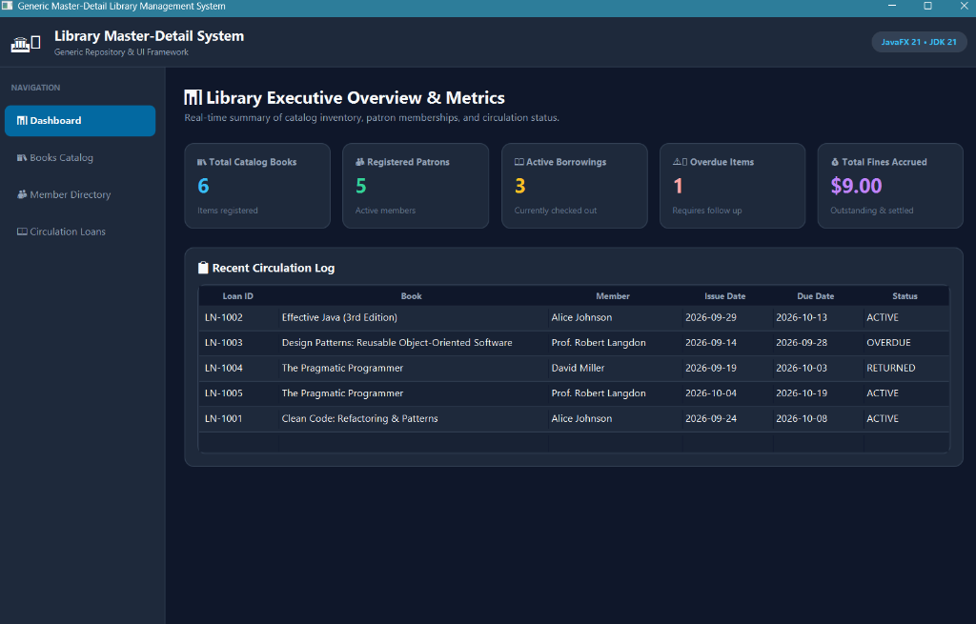
LIBRARY MASTER-DETAIL SYSTEM
5. Executive Dashboard Module
Key Features:
📊 Live Summary Cards for Catalog Books, Patrons, Active Loans, & Overdue Fines.
📋 Recent Circulation Log Table displaying loan statuses in real-time.
🖱️ Direct One-Click Navigation from metric cards to target management views.

Slide 7
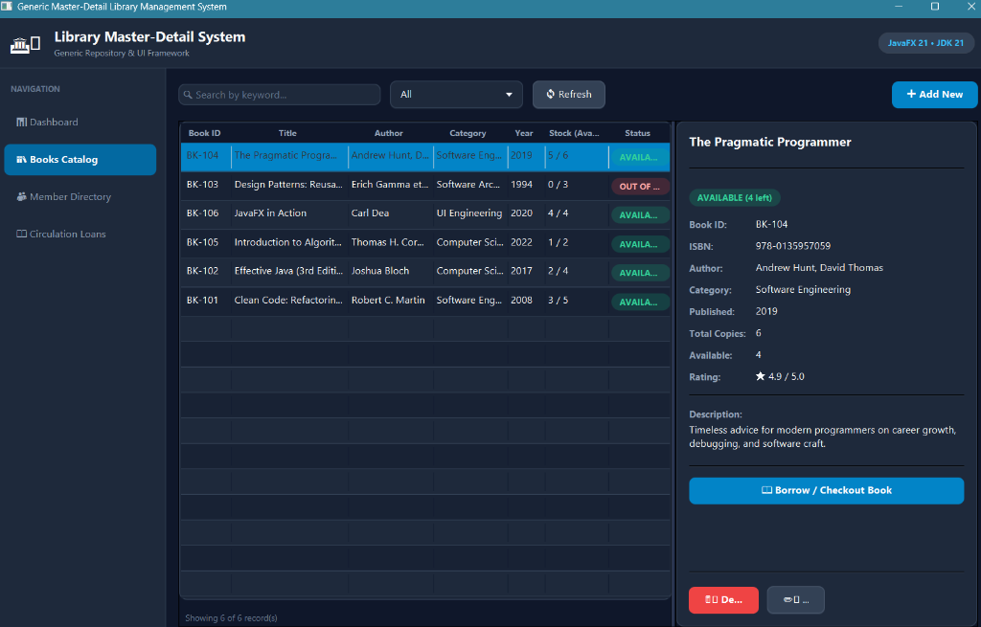
LIBRARY MASTER-DETAIL SYSTEM
6. Books Catalog — Master-Detail View
Catalog Capabilities:
🔍 Keyword Search across Title, Author, ISBN, and Category.
🏷️ Status Badges highlighting real-time stock (AVAILABLE / OUT OF STOCK).
📖 Rich Detail Side Panel displaying full book metadata and rating.
⚡ Instant Checkout Action button opening loan issue dialog.

Slide 8
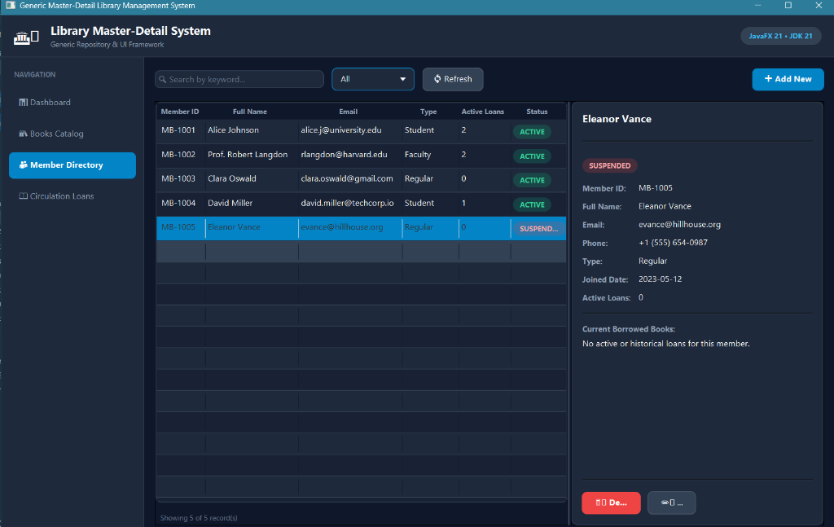
LIBRARY MASTER-DETAIL SYSTEM
7. Member Directory Module
Member Management:
👤 Patron Categorization (Student, Faculty, Regular Members).
🛡️ Membership Status badges (`ACTIVE`, `SUSPENDED`).
📊 Active Borrowing Count tracking for each patron.
📜 Comprehensive Member detail card with contact info & history.

Slide 9
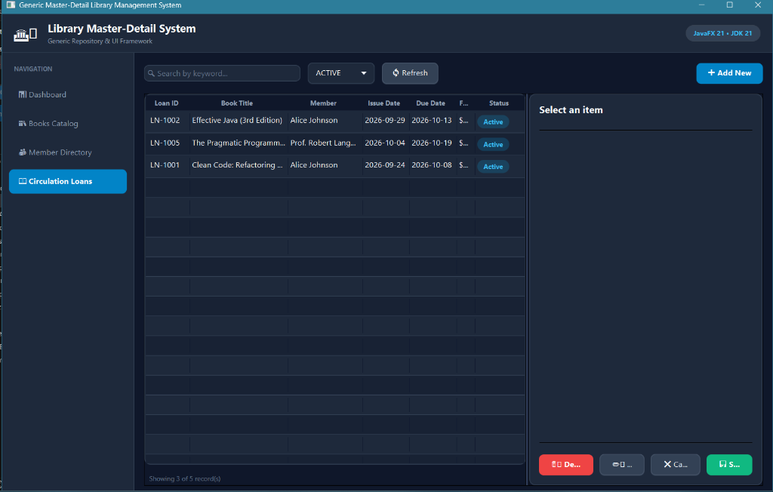
LIBRARY MASTER-DETAIL SYSTEM
8. Circulation Loans & Return Processing
Circulation Features:
🔄 Automated Fine Calculation ($1.50 per overdue day).
🏷️ Status Lifecycle Tracking (`ACTIVE`, `OVERDUE`, `RETURNED`).
📥 One-Click Book Return processing with instant inventory restore.
🔎 Status Combo Filter to easily isolate overdue loans.

Slide 10
LIBRARY MASTER-DETAIL SYSTEM
9. Conclusion & Architectural Benefits
🏆 High Reusability
Generic Repository & UI Scaffolding reduce overall codebase volume by over 60%.
🛡️ Robust Type Safety
Java 21 generics eliminate runtime type casting errors across all data operations.
🚀 Effortless Scalability
New entity management modules can be integrated in under 50 lines of code.
🎨 Modern User Experience
Custom CSS design system delivers a responsive, dark-themed desktop interface.

