Slide 1
Bangla Sign Language (BdSL-D1500) Numerals Classification using CNN Based Transfer Learning Models
01
Submitted to:
Mr. Annajiat Alim Rasel Sir.
Submitted by:
Mohammad Aman Ullah Khan; ID: 19301139, Nirjhar Gope; ID: 19301140, Soumik Roy; ID: 20101573, Rifha Hossain Munaja; ID: 20301466.
Team-17, Course: CSE 438.

Slide 2
Table of Contents
02
Introduction to BdSL | Overview of Bangla Sign Language and its importance.
Research problem | Challenges in accurately classifying BdSL numerals.
Dataset overview | Description of the BdSL-D1500 dataset and its composition.
Research objective | Aim to enhance numeral classification in BdSL using CNN.
Methodology | Applying CNN-based transfer learning for numeral recognition.
Expected outcomes | Anticipated improvements in accuracy and usability.
Challenges | Addressing dataset limitations and real-time processing issues.
Conclusion | Summarizing the study's findings and potential impact.

Slide 3
Introduction to BdSL
03
The role of BdSL in Communication:
Primary Language: BdSL serves as the primary means of communication for the deaf community in Bangladesh.
Inclusivity: Facilitates social inclusion, education, and access to information for deaf individuals.
Cultural Significance: Acts as a cultural marker and identity for the Bengali deaf community.
2. Unique Aspects of BdSL:
Linguistic Structure: BdSL has its own grammar and syntax, distinct from spoken Bengali.
Sign Variations: Incorporates unique signs, reflecting cultural and regional differences within Bangladesh.
Expressiveness: Highly expressive, using hand shapes, movements, facial expressions, and body language.

Slide 4
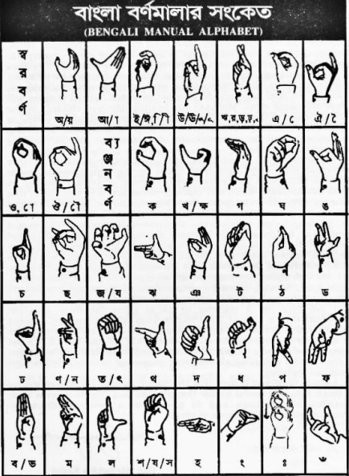
Research Problem
04
Numerals Classification Challenge:
Complexity: BdSL numerals have unique configurations, making them difficult to classify accurately.
Variation: Diverse signing styles and handshapes add to the challenge, requiring a robust recognition system.
Limitations of Existing Methods:
Inaccuracy: Traditional recognition methods struggle with the complexity and diversity of BdSL numerals.
Lack of Adaptability: Many existing systems are not tailored specifically for BdSL, leading to lower performance.

Slide 5
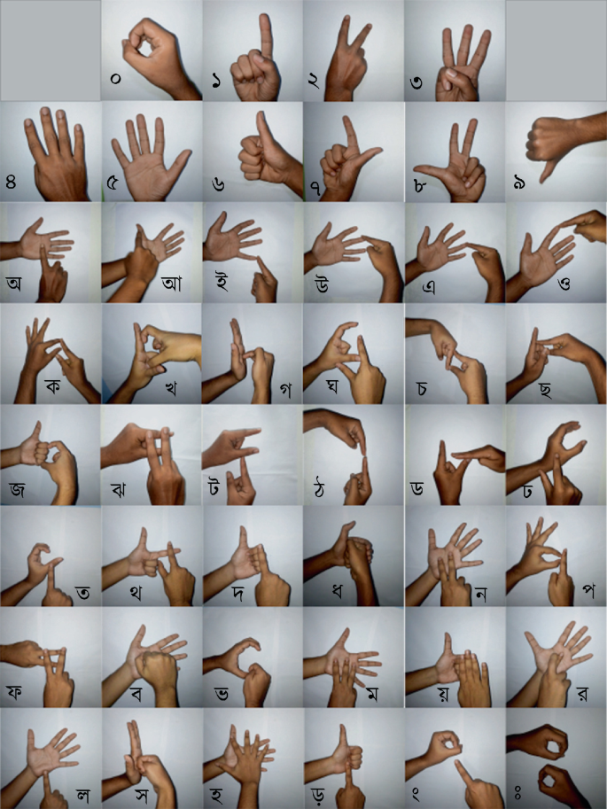
Dataset Overview
05
BdSL-D1500 Specifics:
Scope: The dataset encompasses a wide range of Bangla Sign Language elements, providing a comprehensive collection for deep learning models.
Content: It includes signs for alphabets, numbers, & gestures, ensuring a diverse range of hand movements and positions.
Diversity of the Dataset:
Variability: The dataset represents a broad spectrum of sign representations, from simple to complex, catering to the intricate nature of sign language.
Inclusivity: It includes both one-hand and two-hand signs, reflecting the real-world usage and diversity of BdSL.

Slide 6
Research Objective
06
Enhance numeral recognition accuracy:
Goal: Significantly improve the correct identification of numerals in BdSL.
Impact: Enhanced accuracy leads to more reliable communication tools for the BdSL-using community, especially important for educational and daily communication purposes.
Implement CNN transfer learning:
Technique: Utilize Convolutional Neural Networks (CNN) with transfer learning to leverage pre-trained models, adapting them to BdSL numeral recognition.
Advantages: Accelerates the learning process, utilizes the strength of existing models, and reduces the need for large amounts of BdSL-specific training data.

Slide 7
Methodology
07
CNN Model Architecture:
Structure: Multi-layered network including convolutional, pooling, and fully connected layers.
Purpose: Optimized for feature detection and analysis in BdSL images.
Feature Extraction:
Process: CNN identifies key visual features from BdSL images.
Role: Essential for accurate sign recognition.
Output Layer:
Function: Classifies signs based on extracted features.
Type: Often a softmax layer for categorizing sign types.
Transfer Learning Process:
Pre-trained Models: Uses established neural networks.
Adaptation for BdSL: Fine-tunes these models for BdSL specifics.
Efficiency and Effectiveness: Enhances learning speed and accuracy for BdSL sign classification.

Slide 8
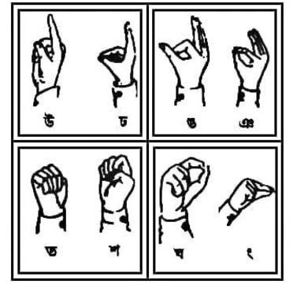
Expected Outcomes
08
Improved Classification Accuracy:
Anticipate a substantial increase in numeral recognition precision in BdSL.
Expect fewer misclassifications, enhancing the overall reliability of the system.
Enhanced Usability for BdSL Users:
The accurate system will enable smoother and more effective communication for BdSL users.
Improvements in technology will lead to greater inclusivity and accessibility in devices and applications used by the deaf community.

Slide 9
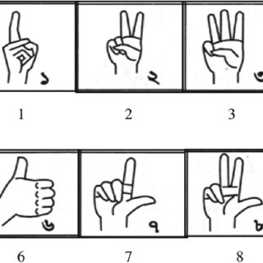
Challenges
09
Quality and Variation: Variability in image quality and sign execution poses challenges in training an accurate and robust model.
Algorithmic Challenges: Implementing and fine-tuning CNN models for sign language recognition involves complex algorithmic decisions.
Real-Time Processing: Developing a system that can accurately and efficiently process signs in real-time remains a significant technical hurdle.

Slide 10
Conclusion
10
Summary of Key Findings:
Confirmed the effectiveness of CNN-based transfer learning for BdSL numeral recognition.
Highlighted the value of the comprehensive BdSL-D1500 dataset in improving recognition accuracy.
Potential Future Research Directions:
Extend the dataset to include more diverse signs and real-time applications.
Explore model adaptation for different sign languages.
Final Thoughts on the Significance of the Study:
Emphasized the impact on communication accessibility for the deaf community.
Underlined the study's contribution to advancing sign language recognition technology.

Slide 11
References
11
Hossen, M. A., Govindaiah, A., Sultana, S., & Bhuiyan, A. (2018, June 1). Bengali Sign Language Recognition Using Deep Convolutional Neural Network. https://doi.org/10.1109/iciev.2018.8640962
Rahaman, M. A., Jasim, M., Ali, M. Y., & Hasanuzzaman, M. (2014, December 1). Real-time computer vision-based Bengali Sign Language recognition. https://doi.org/10.1109/iccitechn.2014.7073150
Das, P., Dasgupta, T., & Bhattacharya, S. (2017, July 13). A Bengali Handwritten Vowels Recognition Scheme Based on the Detection of Structural Anatomy of the Characters. Advances in Intelligent Systems and Computing. https://doi.org/10.1007/978-981-10-3373-5_24
Sufian, A., Ghosh, A., Naskar, A., Sultana, F., Sil, J., & Rahman, M. M. H. (2022, June 1). BDNet: Bengali Handwritten Numeral Digit Recognition based on Densely connected Convolutional Neural Networks. Journal of King Saud University - Computer and Information Sciences. https://doi.org/10.1016/j.jksuci.2020.03.002
Kamran, S. A. (2018, October 10). AI Learns to Recognize Bengali Handwritten Digits: Bengali.AI Computer Vision Challenge 2018. arXiv.org. https://arxiv.org/abs/1810.04452
Islam, M. N. A. (2019, September 2). HishabNet: Detection, Localization and Calculation of Handwritten Bengali Mathematical Expressions. arXiv.org. https://arxiv.org/abs/1909.00823
Rahman, M. M. H., Islam, M. S., Sassi, R., & Aktaruzzaman, M. (2019, November 23). Convolutional neural networks performance comparison for handwritten Bengali numerals recognition. SN Applied Sciences. https://doi.org/10.1007/s42452-019-1682-y In-Text Citation: (Rahman et al., 2019)
Sen, S., Chakraborty, J., Chatterjee, S., Mitra, R., Sarkar, R., & Roy, K. (2019, January 1). Online Handwritten Bangla Character Recognition Using Frechet Distance and Distance Based Features. Communications in Computer and Information Science. https://doi.org/10.1007/978-981-13-9361-7_6

Slide 12
Thank you so much.
Any Questions to ask?
12

