Slide 1


RIMBERIO.CO
MACHINE TRANSLATION SYSTEM USING DEEP LEARNING FOR ENGLISH TO URDU
SUBMITTED BY:NIRJHAR GOPE ID:19301140
SUBMITTED TO:ANNAJIAT ALIM RASEL

Slide 2
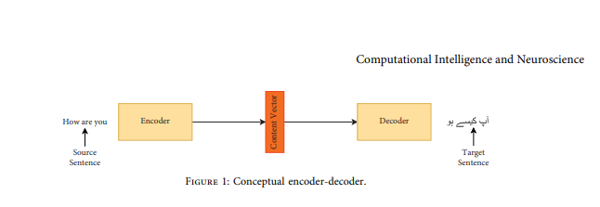
RESEARCH BACKGROUND
FOCUS ON THE DEVELOPMENT OF A NEURAL NETWORK-BASED DEEP LEARNING TECHNIQUE FOR ENGLISH TO URDU LANGUAGES.
OVERVIEW OF MACHINE TRANSLATION AND ITS EVOLUTION

Slide 3
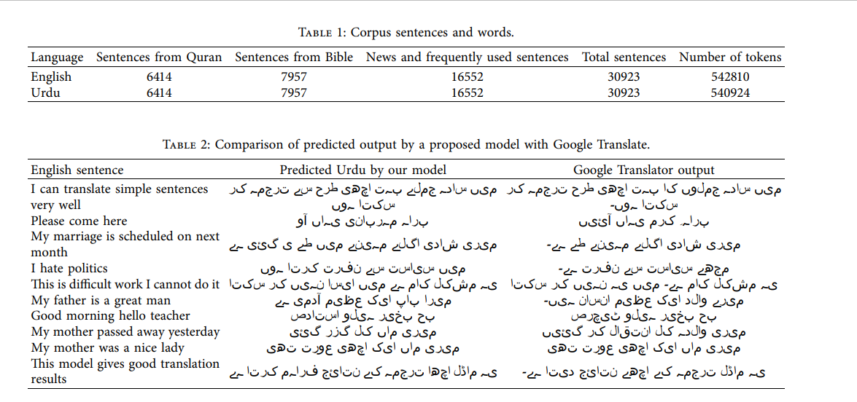
DATA COLLECTION AND STUDY AREA SLIDE:
DESCRIPTION OF THE PARALLEL CORPUS USED FOR THE STUDY.
DETAILS ON THE SIZE AND CONTENT OF THE CORPUS, INCLUDING ENGLISH-URDU PARALLEL CORPUS NEWS AND DAY-TO-DAY SENTENCES.

Slide 4
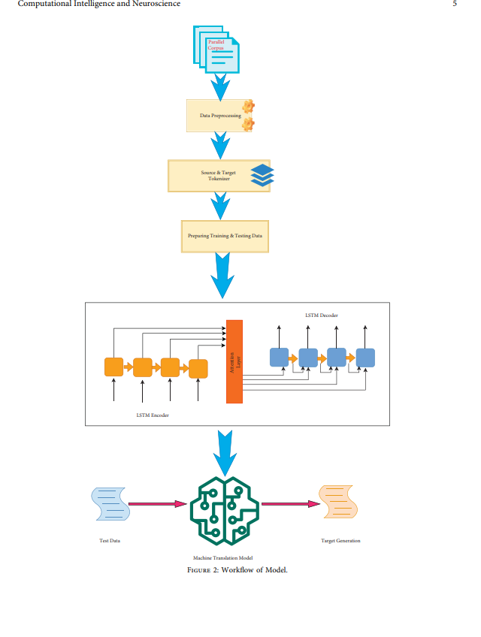

Slide 5
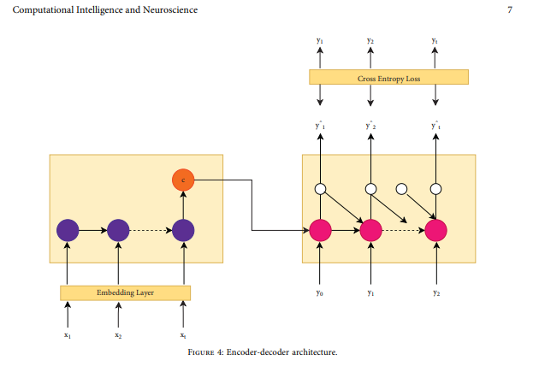
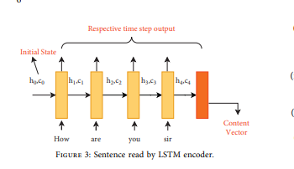
ALGORITHMS AND MODEL SLIDE
INTRODUCTION TO THE LSTM ENCODER AND DECODER ARCHITECTURE WITH AN ATTENTION MECHANISM.
EXPLANATION OF THE MODEL'S WORKFLOW, INCLUDING PREPROCESSING, WORD EMBEDDING, ENCODING, AND DECODING.

Slide 6
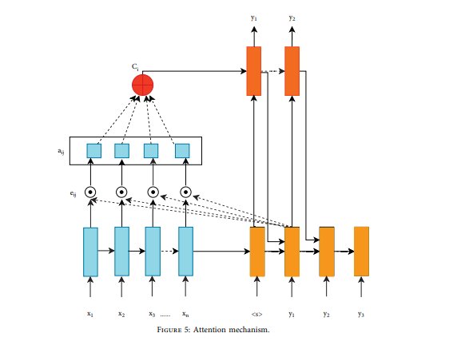

Slide 7
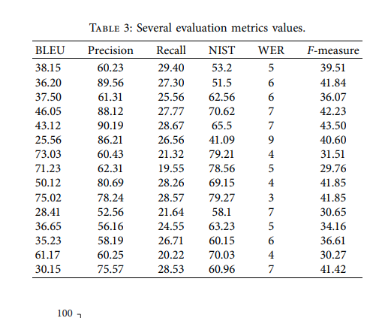
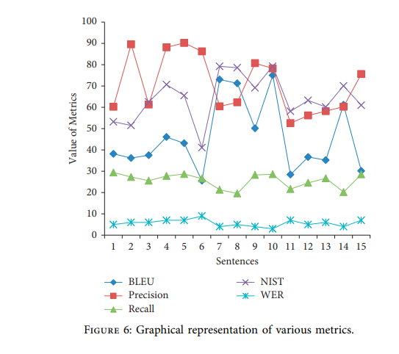
RESULT AND MODEL SELECTION
SUMMARY OF THE MODEL'S PERFORMANCE, INCLUDING THE AVERAGE BLEU SCORE
COMPARISON OF THE MODEL OUTPUT WITH GOOGLE TRANSLATOR.

Slide 8
BROADER IMPLICATIONS & FUTURE WORKACKNOWLEDGEMENTS
IMPLICATIONS OF THE RESEARCH FOR MACHINE TRANSLATION, PARTICULARLY FOR THE ENGLISH-URDU LANGUAGE PAIR
FUTURE GOALS, INCLUDING EXPANDING THE CORPUS SIZE AND INTEGRATING A SPEECH RECOGNITION MODULE.
.
FUTURE GOALS, INCLUDING EXPANDING THE CORPUS SIZE AND INTEGRATING A SPEECH RECOGNITION MODULE.

Slide 9
THANK YOU

