Slide 1

Predicting Heavy Rain Damage using
Big Data and Machine Learning
Submitted by: Nirjhar Gope
ID: 19301140; Course: Cse438.
Submitted to: Annajiat Alim Rasel

Slide 2
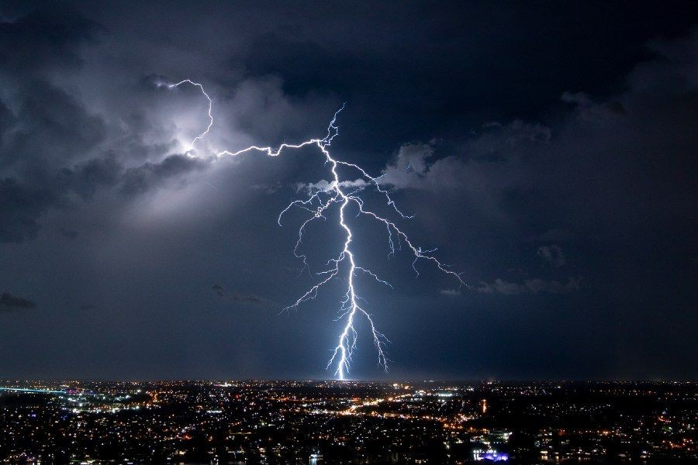
Research Background
Objective: Predict heavy rain damage.
Heavy rain damages disrupt local economies and ecosystems.
Traditional prediction models are
limited in scope and accuracy.
Need for a more precise, data-driven approach.
Aim: Maximize prediction performance.

Slide 3

Data collection & Study Area
Data Sources: Annual Natural Disaster Report, Korea Meteorological Administration.
Data span: 22 years from 1994 to 2015.
Focused on Seoul Capital Area. Reliable data prioritized over sheer volume.

Slide 4
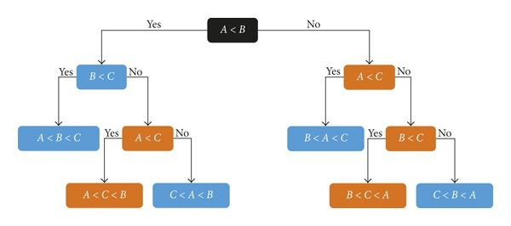
Algorithms & Models
Algorithm 1: Predicts using same-day data. High AUC values.
Algorithm 2: Uses past weather data. More practical application.
Models: Decision tree, bagging, random forest, boosting.
Importance of optimal tuning parameters.

Slide 5
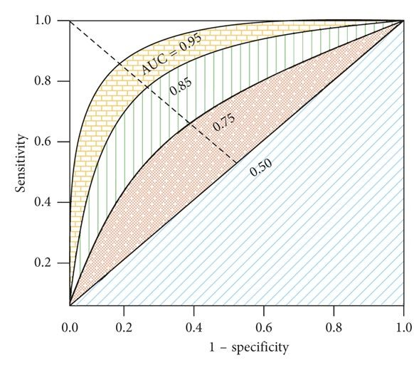
Results & Model Selection
AUC values provide predictive accuracy.
Boosting model (Algorithm 2) with past 1-4 days data: Highest AUC value of 95.867%.
Selected due to superior real-world applicability.
Algorithm 1 shows high AUC but lacks practicality.
Boosting model (Algorithm 2) presents the best balance of accuracy and utility.

Slide 6
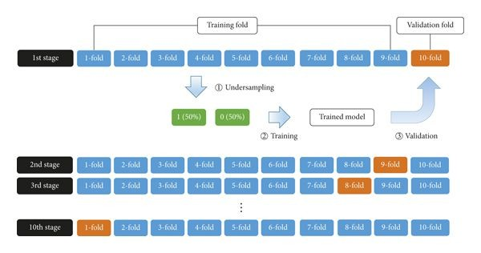
Model Validation & Variability
AUC values provide predictive accuracy.
Boosting model (Algorithm 2) with past 1-4 days data: Highest AUC value of 95.867%.
Selected due to superior real-world applicability.
Boosting model (Algorithm 2) presents the best balance of accuracy and utility.
●

Slide 7
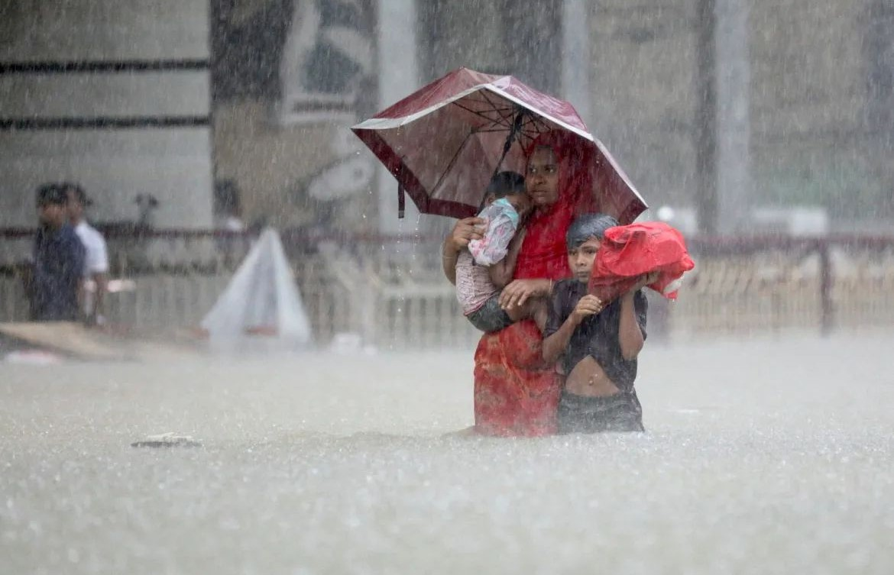
Broader implications & Future work
Study serves as a foundational framework for heavy rain damage prediction.
More exhaustive data can enhance prediction accuracy.
Potential inclusion of socio-economic and environmental data.
Paves way for holistic disaster prediction models.

Slide 8
Acknowledgements, Data & Integrity
Research supported by Inha University.
Three stages: Data collection, Model integration, & Prediction.
Data transparency: Available on request.
No conﬂicts of interest, ensuring unbiased outcomes.

Slide 9
Thank you so much!

