Slide 1
Java
What is java Programming?
Java is an Object-Oriented programming language developed by James Gosling in the early 1990s.
First Version of Java(JDK 1.0).It was introduced on 23rd Jan 1996 by MicroSystem.
Syntax of Java:
Class class_name
{
Public static void main(String[ ] args)
{
System.out.println(“*”);
}
}
Save:->class_name.java
Compilation:->Javac class_name.java
Execution:->Javac class_name

Slide 2
Java features
Object Oriented:In Java, everything is an Object.
Platform Independent: Java Programs are compiled into byte code. bytecode is platform independent.
Simple Language:Java is designed to be easy to learn.
Secure:Authentication techniques are based on public-key encryption
Portable:Being architecture-neutral and having no implementation dependent aspects of the specification makes Java portable
Compiled & Interpreted: No compiler.
High Performance:With the use of Just-In-Time compilers, Java enables high performance.
Robust:Java makes an effort to eliminate error prone situations on compile time error checking and runtime checking.
Distributed : Java is designed for the distributed environment of the internet.
Multi-threaded:With Java's multithreaded feature it is possible to write programs that can perform many tasks simultaneously.

Slide 3
Object − Objects have states and behaviors. Example: A dog has states - color, name, breed as well as behavior such as wagging their tail, barking, eating. An object is an instance of a class.
Class − A class can be defined as a template/blueprint that describes the behavior/state that the object of its type supports.
Methods − A method is basically a behavior. A class can contain many methods. It is in methods where the logics are written, data is manipulated and all the actions are executed.
Instance Variables − Each object has its unique set of instance variables. An object's state is created by the values assigned to these instance variables
Notes:
Case Sensitivity − Java is case sensitive, which means identifier Hello and hello would have different meaning in Java.
Class Names − For all class names the first letter should be in Upper Case. If several words are used to form a name of the class, each inner word's first letter should be in Upper Case.
Example: class MyFirstJavaClass
Method Names − All method names should start with a Lower Case letter. If several words are used to form the name of the method, then each inner word's first letter should be in Upper Case.
Example: public void myMethodName()
Program File Name − Name of the program file should exactly match the class name.

Slide 4
Oops Concepts
Polymorphism
Inheritance
Encapsulation
Abstraction
Classes
Objects
Access Modifiers
Private
Protected
Public
Default

Slide 5
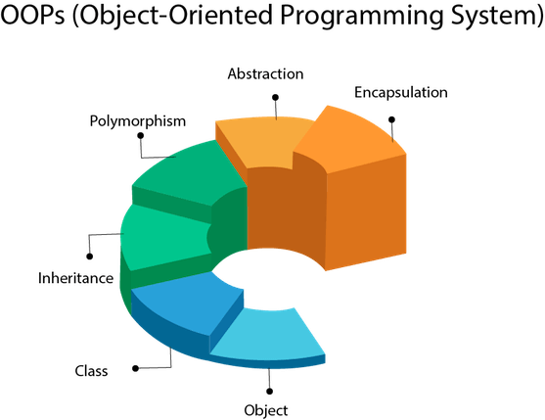

Slide 6
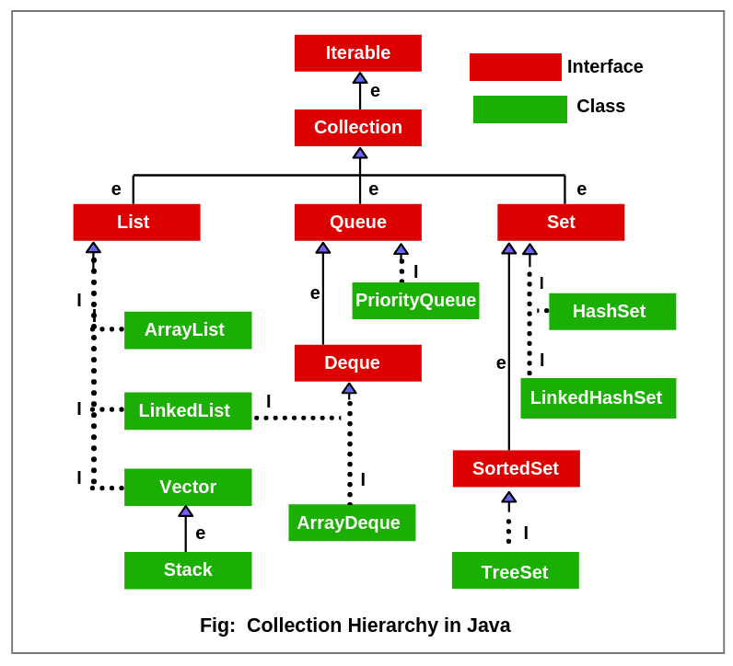
Collection

Slide 7
