Slide 1

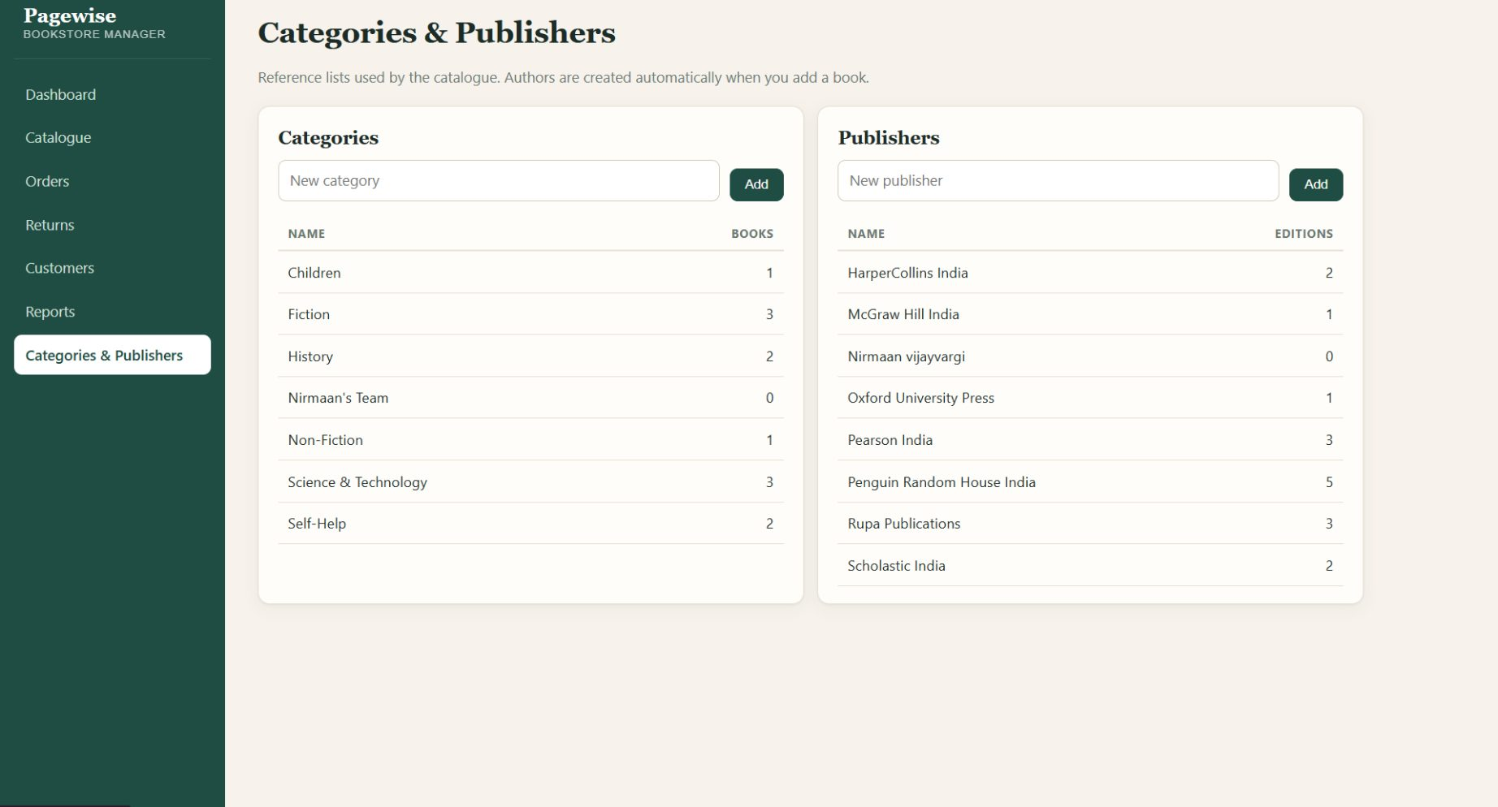


WOXSEN UNIVERSITY · SCHOOL OF TECHNOLOGY
Bookstore Inventory &
Online Sales
Management System
Database Management System project
Nirmaan Vijay Vargi
B.Tech AIML · Semester 3 · 25WU0102187
Faculty: Dr. C Nagaraju · 13 October 2026

Slide 2
SYSTEM OVERVIEW
A connected record of every store operation
Flask workflows use a relational database to coordinate catalogue, customers,
orders, fulfillment and reporting.
PRESENTATION
APPLICATION
DATA
HTML / CSS
→
Python / Flask
→
MySQL / MariaDB
Dashboard, catalogue, customers,
orders, returns
Routes, validation, SQL
operations and page rendering
Relations, constraints, triggers
and reporting views
Catalogue → stock → order → payment / shipment → return → reports

Slide 3


CORE MODELLING CHOICE
One work can have many sellable editions
BOOKS · THE WORK
1 → N
EDITIONS · THE STOCK ITEM
Title + category
ISBN + format
A single literary work, linked to one or
more authors.
BOOKS →
EDITIONS
Publisher, year, price, stock quantity and
reorder level.
BOOK_AUTHORS resolves the many-to-many author
relationship.
ORDER_ITEMS.unit_price preserves the price charged
at sale time.

Slide 4
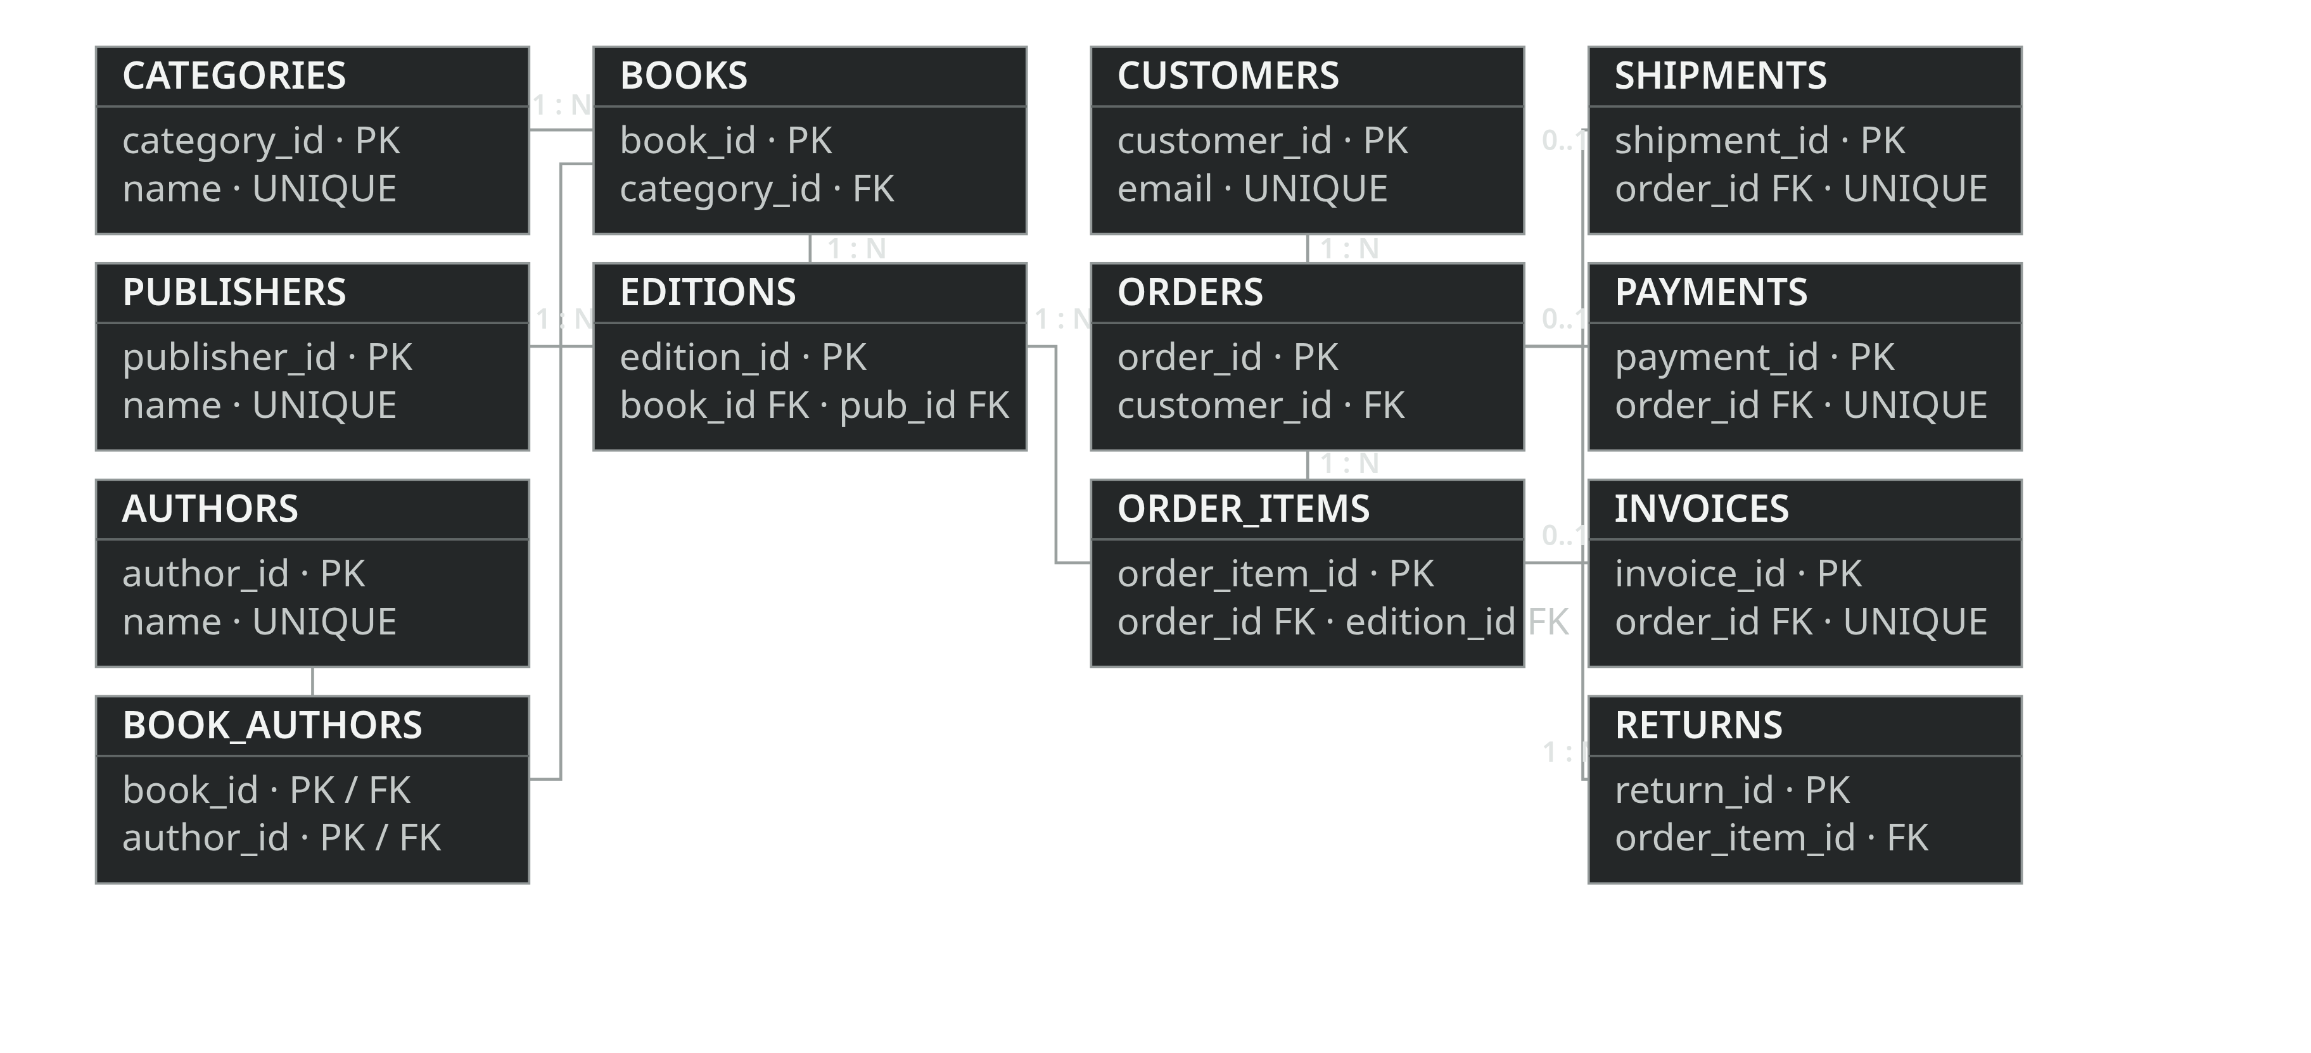
LOGICAL DATA MODEL
Entity relationship model
BOOK_AUTHORS resolves the Books ↔ Authors M:N relationship · PK = primary key · FK = foreign key

Slide 5

RELATIONAL SCHEMA · 1 OF 2
Catalogue schema
Descriptive records stay separate from editions that carry inventory.
REFERENCE DATA
WORKS AND EDITIONS
CATEGORIES
BOOKS
category_id PK · name UNIQUE NOT NULL
book_id PK · title · category_id FK
PUBLISHERS
BOOK_AUTHORS
publisher_id PK · name UNIQUE NOT NULL · email
book_id + author_id composite PK; both FKs
AUTHORS
EDITIONS
author_id PK · name UNIQUE NOT NULL
edition_id PK · book_id FK · publisher_id FK · ISBN UNIQUE
Edition attributes: format · edition_no · pub_year · price ·
stock_qty · reorder_level
Primary and foreign keys preserve the links between the catalog tables.

Slide 6



RELATIONAL SCHEMA · 2 OF 2
Transaction schema
Order headers, line items and lifecycle records use separate relations.
CUSTOMERS
SHIPMENTS
customer_id PK · name · email UNIQUE · phone · address ·
created_at
shipment_id PK · order_id FK UNIQUE · carrier · tracking_no ·
shipped_date · delivered_date
ORDERS
PAYMENTS
order_id PK · customer_id FK · order_date · status
payment_id PK · order_id FK UNIQUE · amount · method · status ·
paid_at
ORDER_ITEMS
order_item_id PK · order_id FK · edition_id FK · quantity ·
unit_price · UNIQUE(order_id, edition_id)
INVOICES
invoice_id PK · order_id FK UNIQUE · invoice_no UNIQUE ·
issued_at
RETURNS
return_id PK · order_item_id FK · quantity · reason · return_date ·
refund_amount
One order line keeps its sale-time price.
Current edition pricing can change without rewriting the
transaction.

Slide 7


DATABASE BEHAVIOR
Integrity rules and reporting
FOUR TRIGGERS
SIX REPORTING VIEWS
Stock check → stock deduction
v_order_summary
v_stock_report
Rejects physical order quantities above stock; deducts
accepted units.
Items, units, order total
OUT / LOW / OK status
v_category_sales
v_author_sales
Return rules → restocking
Units and revenue
Units and revenue
Delivered only · 30-day window · no digital items · caps
quantity and refund.
v_popular_books
v_customer_history
Ranked by units / revenue
Orders, spend, latest order

Slide 8
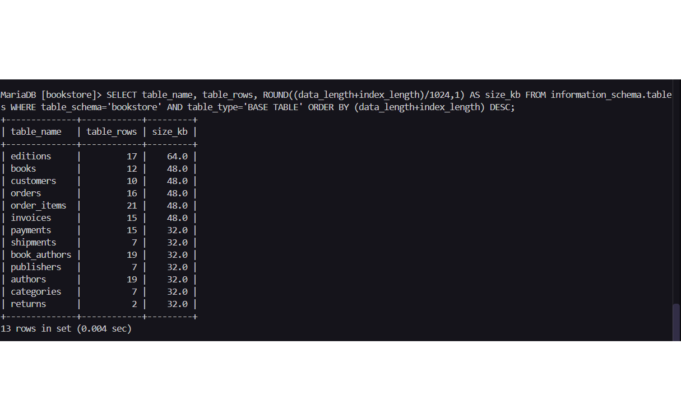

VERIFICATION SNAPSHOT · REPORT SCREENSHOTS
Sample database evidence
13
10
base tables
customer rows
17
17
edition rows
order rows
Additional screenshots show 8 publishers, 19 authors and
7 categories. Counts describe the report’s sample
database at capture time.
Information-schema output captured in the report

Slide 9
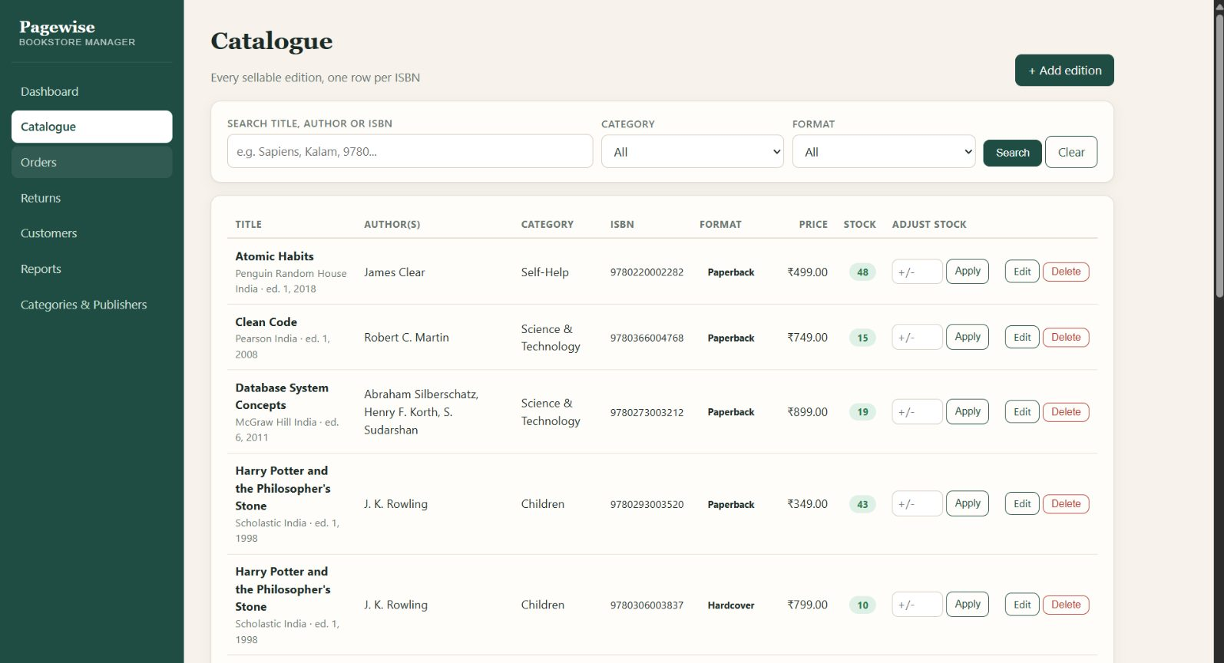
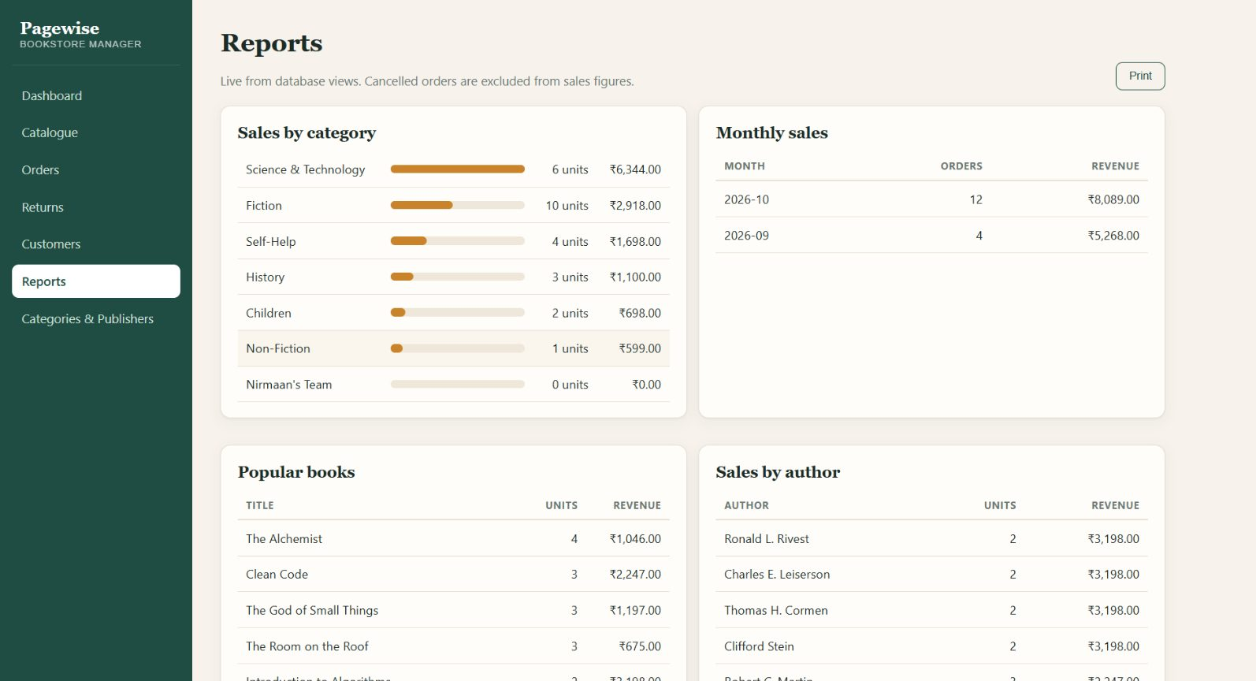
INTERFACE EVIDENCE · FROM THE REPORT
Application screens
Catalogue · editions, price and stock
Reports · category and monthly sales

Slide 10

CONCLUSION
A relational foundation for
bookstore operations
The model connects catalogue and inventory records to customer orders, returns
and reusable reporting.
Access control
Test coverage
Operations
Add authentication and role-based
permissions.
Exercise stock, returns, refunds and
transaction failures.
Add backups and prepare secure
deployment settings.
Academic local demonstration · not yet hardened for real customer or payment data

