Slide 1
Team-01
Canvas & Chapter
AOOP-Review 2

Slide 2
Agenda
1
2
3
4
5
6
7
Introduction to the Project
Survey findings
Technology Stack
Design and Architecture (MVC)
Features and Functionality
Development Workflow
Role and Contribution of each member

Slide 3
Introduction
Canvas & Chapter is an online eCommerce platform designed to sell books based on categories and art supplies. The platform aims to provide a seamless shopping experience for book lovers and artists by offering a curated selection of products with an intuitive user interface.

Slide 4
Survey of Existing Websites
Survey-01 (Books & Art Supplies Section)
Website: Amazon Books & Art Supplies
Key Features:
Extensive collection of books across multiple genres.
Wide range of art supplies, including premium brands.
Potential Disadvantages / Areas for Improvement:
Overwhelming options, lack of a niche-specific focus for art enthusiasts, no community groups, no art galleries.

Slide 5
Survey of Existing Websites
Survey-02 Flipkart (Books & Stationery Section)
Website: Flipkart Books & Stationery
Key Features:
Dedicated stationery section with art supplies.
Seller marketplace model allowing third-party vendors.
Potential Disadvantages / Areas for Improvement:
Limited personalized recommendations, inconsistent product availability, no community groups, no art galleries.

Slide 6
Survey of Existing Websites
Survey-03 Crossword
Website: Crossword.com
Key Features:
Premium bookstore with curated collections
loyalty programs
Potential Disadvantages: Limited art supplies section, No inspiration art work curation, no chat groups.

Slide 7
Features and Functionality
Secure User Authentication – Allows users to register, log in, and manage profiles.
Shopping Cart – Users can add/remove items and save products for later.
Integrated Payment Gateway – Secure online transactions through Razorpay/Stripe.
Admin Dashboard – Manages product listings, order processing, and user analytics.
Art Gallery – Users can upload, share, and explore artworks with material details.
Community Forum – Allows users to connect, discuss, and share creative ideas based on interests.

Slide 8
Technology Stack
Frontend: HTML, CSS, JavaScript
Backend: Java Spring
Database: MongoDB

Slide 9
Model-View-Controller (MVC) Architecture
Model:
Handles data storage and interactions with MongoDB.
View:
Manages user interfaces and page rendering using Java Servlets.
Controller:
Processes requests, applies business logic, and returns responses.

Slide 10
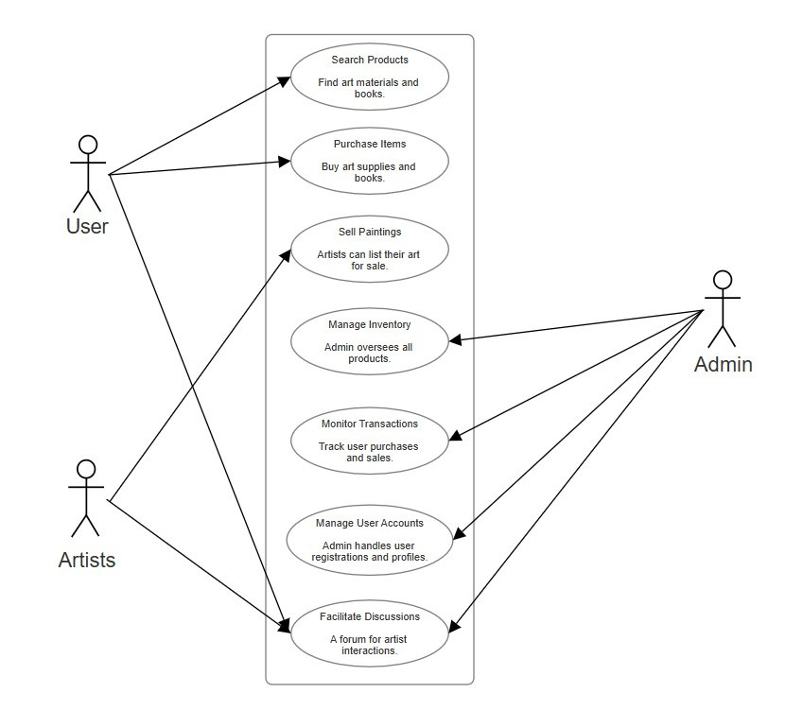
Design and Architecture

Slide 11
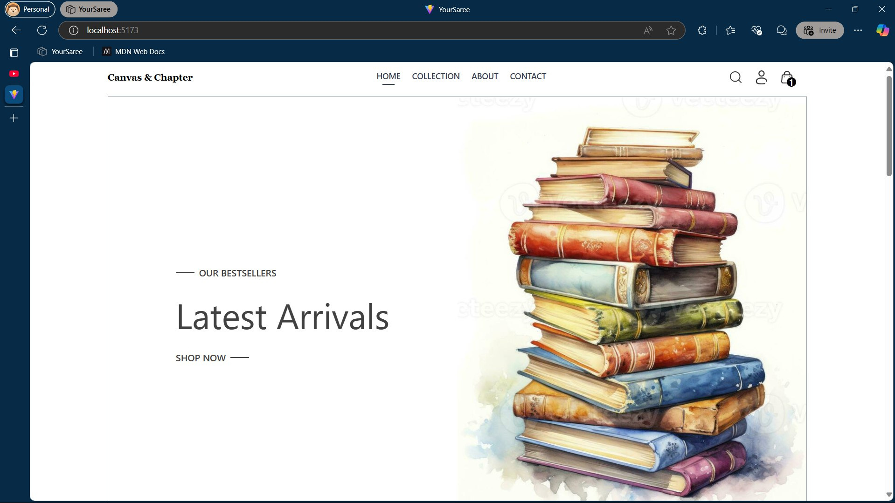

Slide 12
DEVELOPMENT WORKFLOW WITH TIMELINE OF EACH STAGE
Planning & Research (Weeks 1-2):
Competitor Analysis
Feature Finalization
Wireframing & UI/UX Design
Development Phase 1 (Weeks 3-4):
Frontend Design (HTML, CSS, JavaScript, Bootstrap)
Backend Setup (Spring, MongoDB)
Development Phase 2 (Weeks 5-6):
API Integration (Payment gateway, Authentication)
Feature Implementation (Gallery, Chat groups)
Maintenance & Updates (Week 10+):
User Feedback Integration
Security Patches and New Features
Deployment (Week 9):
Hosting on AWS/Heroku
Final Testing and Launch
Testing & Debugging (Weeks 7-8):
Unit Testing
Bug Fixing & Performance Optimization

Slide 13
Role and contribution of the team members
1
2
3
4
Nirmal - 2310030112: Team lead, UML designer
Sanvika - 2310030143: Front end developer
Sai Pranitha - 2310030113: Backend developer
Ashmit - 2310030019: Tester, Database Administrator

Slide 14


Slide 15
Development workflow
1. Setup Development Environment
•Install Eclipse IDE for Java EE development.
•Install MongoDB and set up a local database.
•Add MongoDB Java Driver to the project (via Maven or manual .jar files).
2. Project Structure in Eclipse
•WebContent: Store HTML, CSS, and JSP/Servlets.
•src: Store Java classes (e.g., servlets, data models).
•lib: Store external libraries like MongoDB Java Driver.

Slide 16
Development workflow
3. MongoDB Integration
•Create a utility class for database connection.
•java
•CopyEdit
•MongoDatabasegetDatabase() { return new MongoClient("localhost", 27017).getDatabase("CanvasDB");}
•Use MongoDB to store and retrieve website data .
4. Create Java Servlets
•Handle client requests (GET/POST) and interact with MongoDB.
•Example: Fetch patient data:
•java
•CopyEdit
•MongoCollection<Document> collection = database.getCollection("chapter");
•Document user = collection.find().first();

Slide 17
Development workflow
5. HTML & CSS for Frontend
•HTML for the user interface.
•CSS for styling.
•html
•CopyEdit
•<h1>Welcome to Canvas And Chapter</h1><p>Click below to view details:</p><a href="cc">View content</a>
•CSS for page styling:
•css
•CopyEdit
•body { font-family: Arial, sans-serif; background-color: #f4f4f4; }
•h1 { color: #333; }
6. Deploy and Test
•Run the project on Apache Tomcat.
•Test data retrieval from MongoDB and ensure proper front-end display.

